Slide 1
Office of Real Estate Services
Lauraine Rizer, Officer
Enterprise Architecture
Rob Byrd, Chief Enterprise Architect
Real Estate Inventory System (REIS)
Presentation to the Audit and Finance Committee
October 23, 2013
Developed Jointly by:
Notes:
Speaker Notes

Slide 2
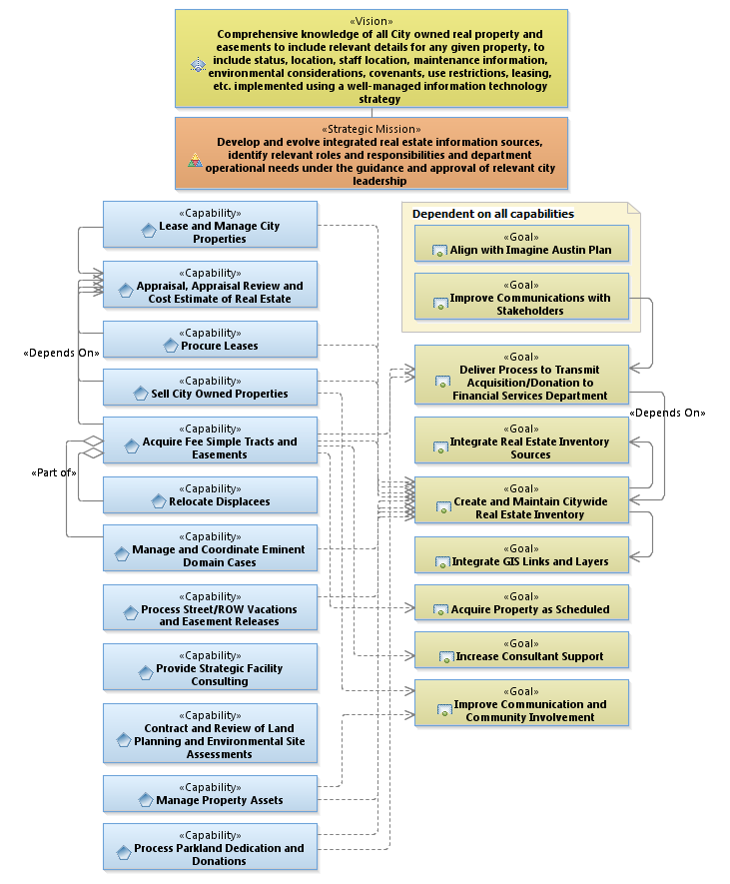
Business Plan
Benefits Maximum Capability
Notes:
Speaker Notes

Slide 3
Business Plan
Benefits Maximum Capability

Slide 4
Real Estate Inventory System (REIS)
Purpose
Lease and Manage City Properties
Procure Leases
Sell City Owned Properties
Acquire Fee Simple Tracts and Easements
Manage and Coordinate Eminent Domain Cases
Process Street/Right of Way Vacations and Easement Releases
Manage Property Assets
Process Parkland Dedication and Donations
And, other department purposes…

Slide 5
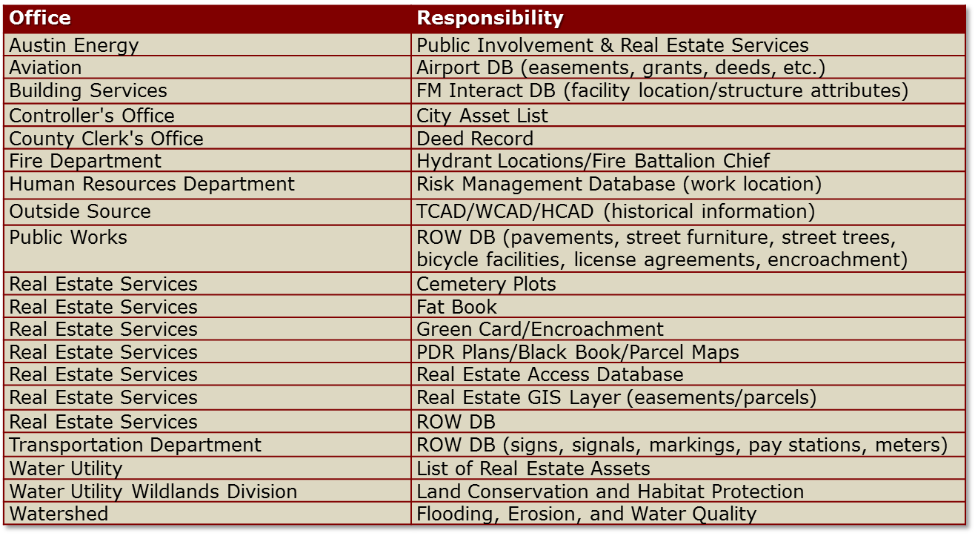
Additional Real Estate Sources and Responsibilities

Slide 6
Problem Statement
City departments maintain real estate information differently because the purpose varies significantly between them. As a result, each department developed their own real estate database to suit their individual business needs
Real estate information differences between the data sources (concordance) does not provide the necessary business intelligence to effectively manage City-owned real estate
Notes:
Speaker Notes

Slide 7
REIS Development Principles
Develop REIS to conform to City business needs
Understand and communicate the business purpose and value by creating a REIS Enterprise Architecture
Use REIS Enterprise Architecture to develop a statement of work to elicit qualified vendor
Notes:
Develop REIS to conform to City business needs
City-owned real estate information is used by various department roles throughout the City with differing purposes.
Perform operational analysis to ensure REIS provides the relevant data attributes to enable various department purpose and value
Understand the business purpose and value by creating a REIS Enterprise Architecture (EA)
Includes logical data model (LDM) and use case specifications for important business processes
Use REIS EA to develop a statement of work to elicit qualified vendor
EA establishes clearly defined outcome focused objectives
Vendor performance measured by EA
EA provides operational foundation for testing
Speaker Notes

Slide 8
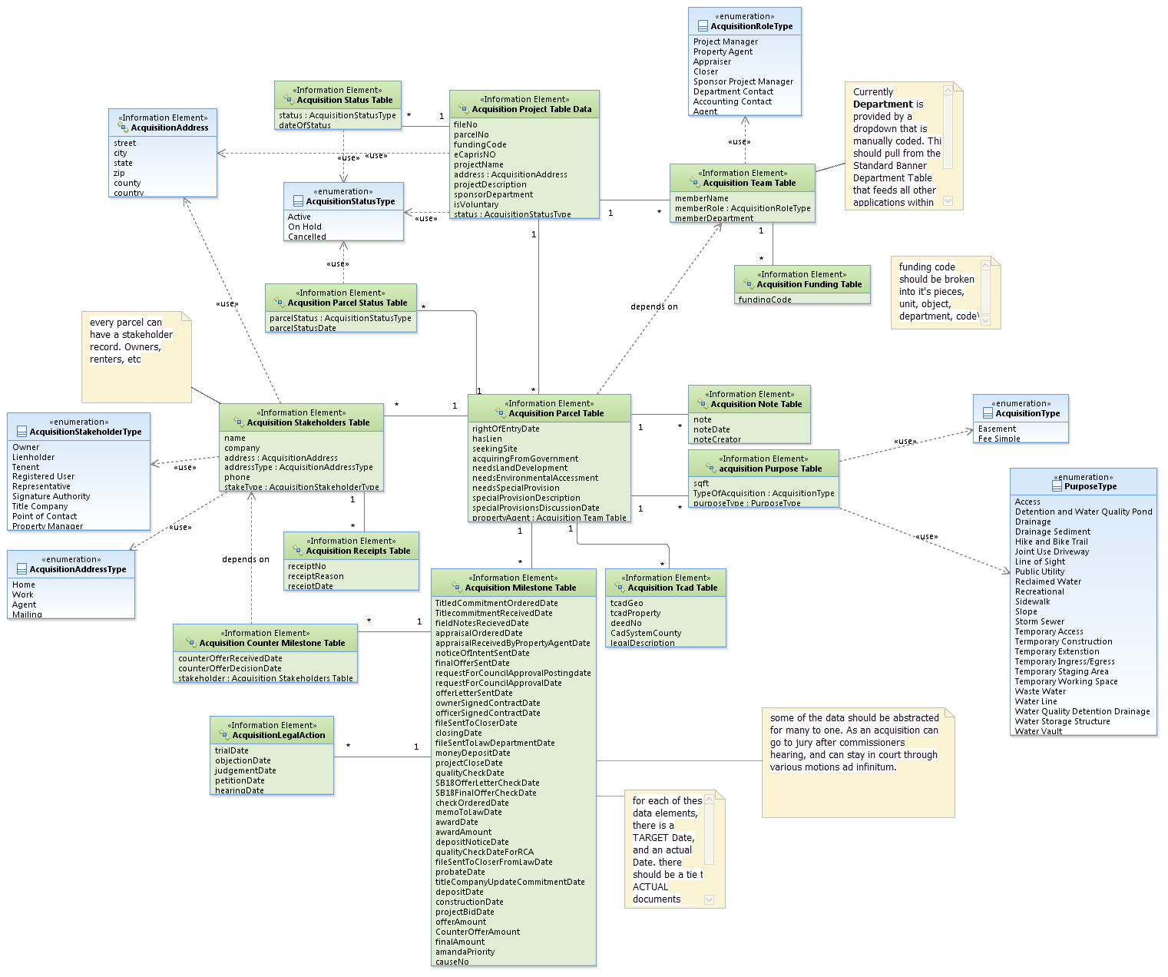
EA Logical Data Model
Enhance to accommodate single member District
Notes:
Speaker Notes

Slide 9
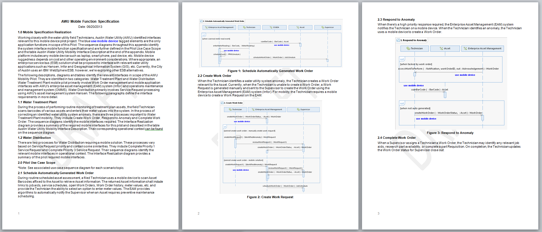
Include EA in Statement of Work
“This is the best written SOW that we have ever seen.” Esri
Provides means to determine level of effort and clearly communicate scope
Reduces contractor risk resulting in reduced cost
Yields additional cost savings because contractor did not perform the business analysis
Needs identified by user community – increasing buy in
Notes:
Speaker Notes

Slide 10
Evaluate Real Estate Information
Ownership Policy and Procedures
Establish Office of Real Estate Services as the central source for real estate information
Determine REIS access controls
  Assists in policy implementation
  Procedures route requests to authorized personal
Establish Service Level Agreement for REIS
  Measures of performance
  Service maintenance
  Information protection and disaster recovery
Notes:
Speaker Notes

Slide 11
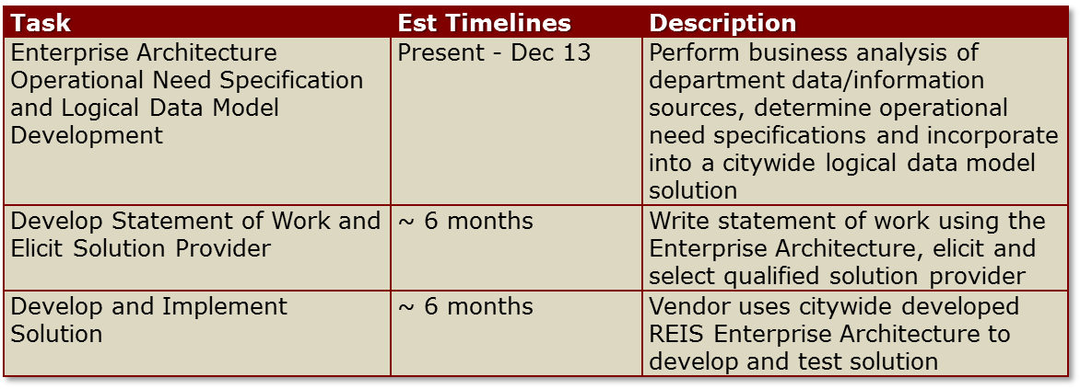
Cost and Schedule
Cost
  Setup cost estimate ~$250K* (not in budget)
  Annual cost ~$20K* / year
  * Cost estimate based on vendor developed database application
  – further review required for alternative solutions such as outsourced COTS solution
Schedule
Note: Timelines are estimated and may change as REIS requirements mature
Notes:
Speaker Notes

Slide 12
Questions?

