Slide 1
Office of Real Estate Services Lauraine Rizer, Officer Enterprise Architecture Rob Byrd, Chief Enterprise Architect
Real Estate Inventory System (REIS) Presentation to the Audit and Finance Committee October 23, 2013
Developed Jointly by:

Slide 2
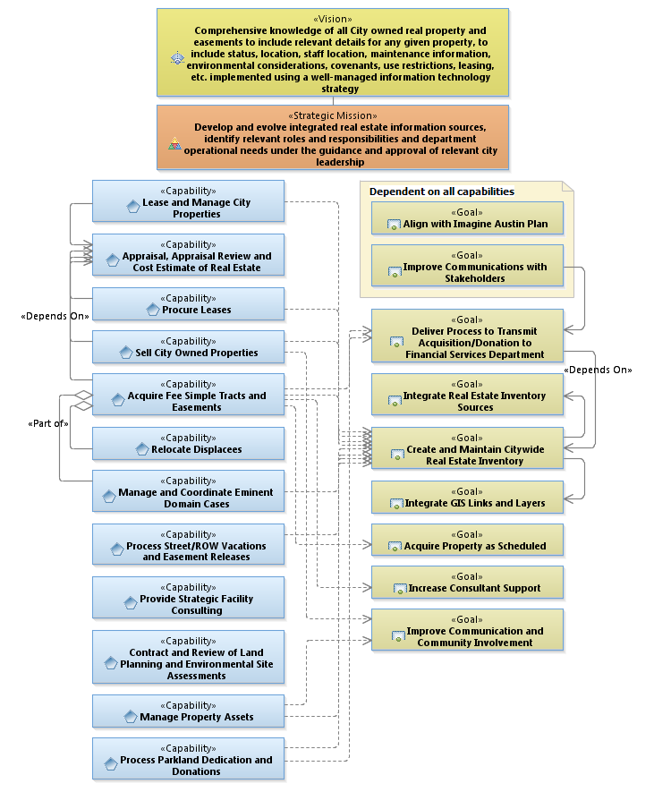
Business Plan
Benefits Maximum Capability

Slide 3
Business Plan
Benefits Maximum Capability

Slide 4
Real Estate Inventory System (REIS) Purpose
Lease and Manage City Properties
Procure Leases
Sell City Owned Properties
Acquire Fee Simple Tracts and Easements
Manage and Coordinate Eminent Domain Cases
Process Street/Right of Way Vacations and Easement Releases
Manage Property Assets
Process Parkland Dedication and Donations
And, other department purposes…

Slide 5
Additional Real Estate Sources and Responsibilities
Office | Responsibility
Austin Energy | Public Involvement & Real Estate Services
Aviation | Airport DB (easements, grants, deeds, etc.)
Building Services | FM Interact DB (facility location/structure attributes)
Controller's Office | City Asset List
County Clerk's Office | Deed Record
Fire Department | Hydrant Locations/Fire Battalion Chief
Human Resources Department | Risk Management Database (work location)
Outside Source | TCAD/WCAD/HCAD (historical information)
Public Works | ROW DB (pavements, street furniture, street trees, bicycle facilities, license agreements, encroachment)
Real Estate Services | Cemetery Plots
Real Estate Services | Fat Book
Real Estate Services | Green Card/Encroachment
Real Estate Services | PDR Plans/Black Book/Parcel Maps
Real Estate Services | Real Estate Access Database
Real Estate Services | Real Estate GIS Layer (easements/parcels)
Real Estate Services | ROW DB
Transportation Department | ROW DB (signs, signals, markings, pay stations, meters)
Water Utility | List of Real Estate Assets
Water Utility Wildlands Division | Land Conservation and Habitat Protection
Watershed | Flooding, Erosion, and Water Quality

Slide 6
Problem Statement
City departments maintain real estate information differently because the purpose varies significantly between them. As a result, each department developed their own real estate database to suit their individual business needs
Real estate information differences between the data sources (concordance) does not provide the necessary business intelligence to effectively manage City-owned real estate

Slide 7
REIS Development Principles
Develop REIS to conform to City business needs
Understand and communicate the business purpose and value by creating a REIS Enterprise Architecture
Use REIS Enterprise Architecture to develop a statement of work to elicit qualified vendor
Notes:
Develop REIS to conform to City business needs
City-owned real estate information is used by various department roles throughout the City with differing purposes.
Perform operational analysis to ensure REIS provides the relevant data attributes to enable various department purpose and value
Understand the business purpose and value by creating a REIS Enterprise Architecture (EA)
Includes logical data model (LDM) and use case specifications for important business processes
Use REIS EA to develop a statement of work to elicit qualified vendor
EA establishes clearly defined outcome focused objectives
Vendor performance measured by EA
EA provides operational foundation for testing

Slide 8
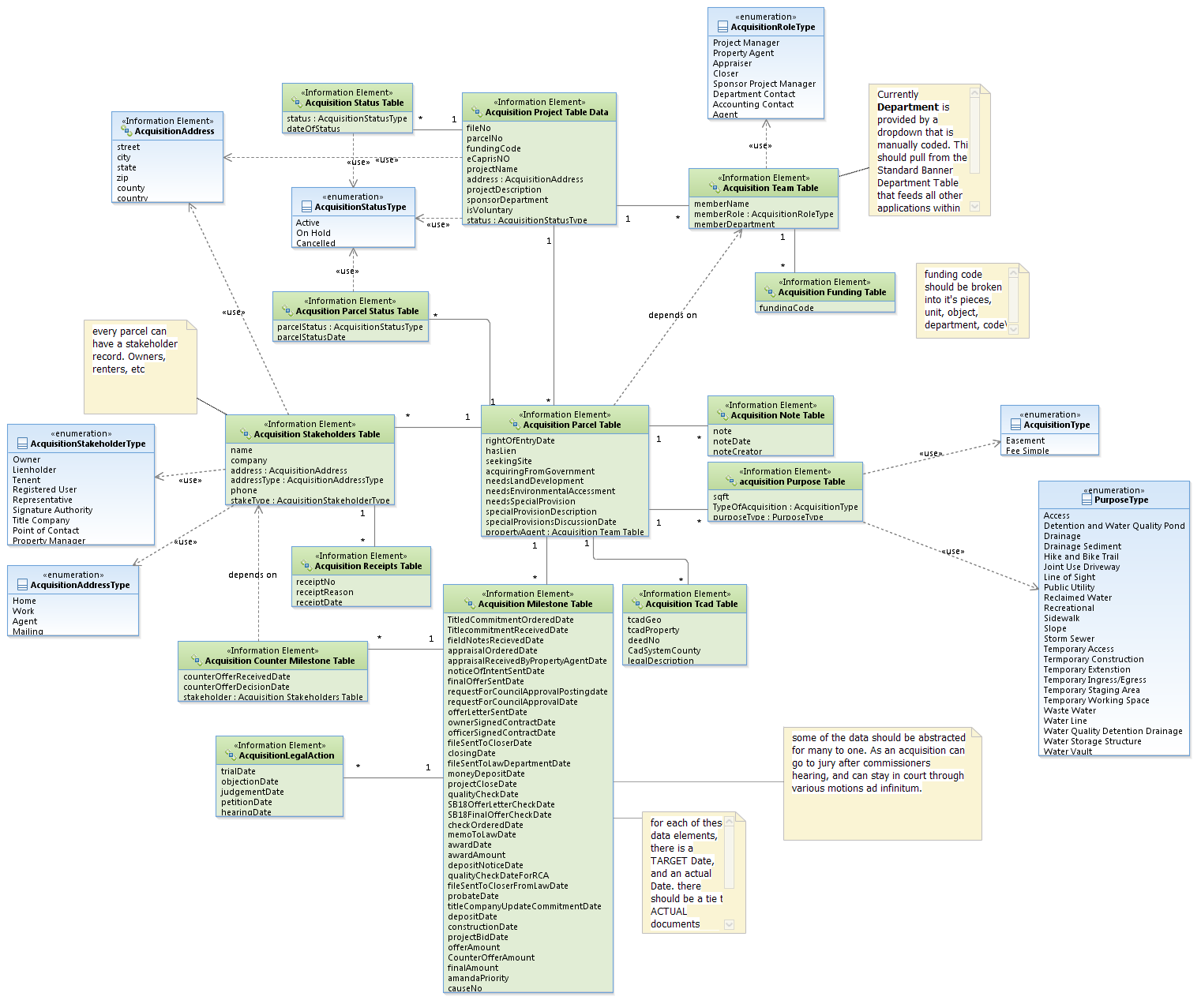
EA Logical Data Model
Enhance to accommodate single member District

Slide 9
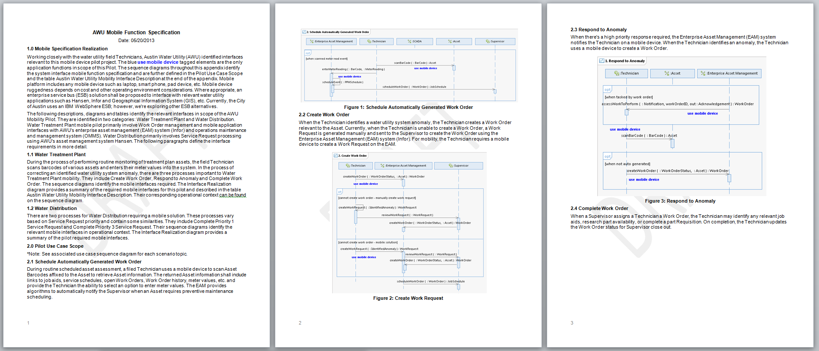
Include EA in Statement of Work
“This is the best written SOW that we have ever seen.” Esri
Provides means to determine level of effort and clearly communicate scope
Reduces contractor risk resulting in reduced cost
Yields additional cost savings because contractor did not perform the business analysis
Needs identified by user community – increasing buy in

Slide 10
Evaluate Real Estate Information Ownership Policy and Procedures
Establish Office of Real Estate Services as the central source for real estate information
Determine REIS access controls
Assists in policy implementation
Procedures route requests to authorized personal
Establish Service Level Agreement for REIS
Measures of performance
Service maintenance
Information protection and disaster recovery

Slide 11
Cost and Schedule
Cost
Setup cost estimate ~$250K* (not in budget)
Annual cost ~$20K* / year
* Cost estimate based on vendor developed database application – further review required for alternative solutions such as outsourced COTS solution
Schedule
Task | Est Timelines | Description
Enterprise Architecture Operational Need Specification and Logical Data Model Development | Present - Dec 13 | Perform business analysis of department data/information sources, determine operational need specifications and incorporate into a citywide logical data model solution
Develop Statement of Work and Elicit Solution Provider | ~ 6 months | Write statement of work using the Enterprise Architecture, elicit and select qualified solution provider
Develop and Implement Solution | ~ 6 months | Vendor uses citywide developed REIS Enterprise Architecture to develop and test solution
Note: Timelines are estimated and may change as REIS requirements mature

Slide 12
Questions?

