Slide 1
Introduction to Enterprise Architecture
Rob Byrd rob.byrd@austintexas.gov

Slide 2
Enterprise Architecture
The process of translating business vision and strategy into effective enterprise change by creating, communicating and improving the key requirements, principles and models that describe the enterprise's future state and enable its evolution over time
A process to deliver critical mass of understanding to the enterprise!
Critical Mass of Understanding…

Slide 3
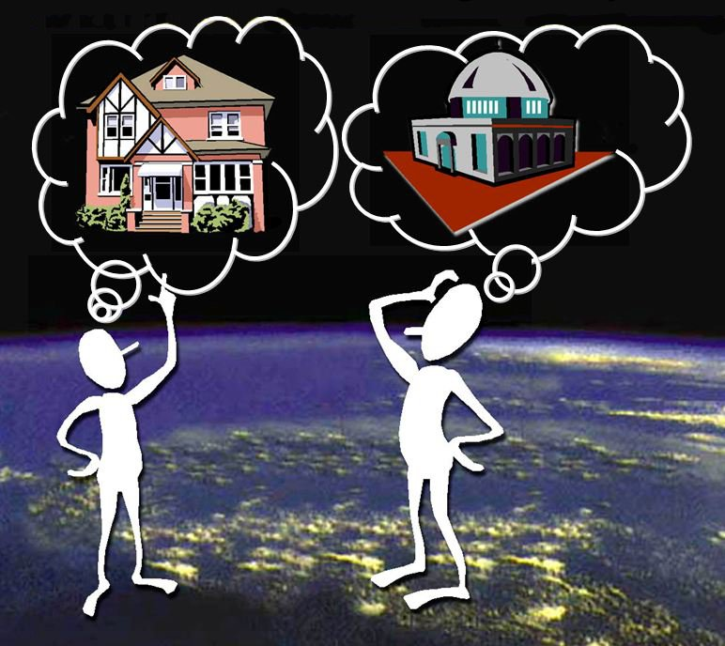
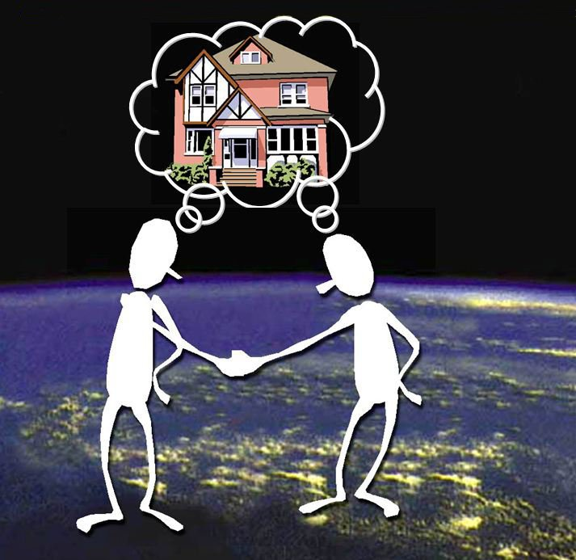
Critical Mass of Understanding
No Blueprint = Disjointed Understanding
Blueprint = Mutual Understanding
critical understanding
momentum = mass x velocity
in a given direction

Slide 4
Comparative Investment
$ 0
$ xxx,xxx
Major Construction Project Cost
Architecture Expenditure
8 – 15% of Total Cost
Major IT Project Cost
IT Architecture Expenditure
< 0.25 % of Total Cost

Slide 5
Important EA Terms
Vision: Outlines what the organization wants to be, or how it wants the world in which it operates to be (an "idealized" view of the world). It is a long-term view and concentrates on a description of the future state. It can be emotive and is a source of inspiration.
Mission: Defines the fundamental purpose of an organization or an enterprise, succinctly describing why it exists and what it does to achieve its vision. A high-level action or process description of an organization, spells out its overall goal, provides a path, and guides decision-making. A formal short written statement of an organization's value proposition.

Slide 6
Important EA Terms
Capability: People, processes and systems delivering value for a specific purpose. The quality of being capable; to have the capacity or ability to do something, achieve specific effects or declared goals and objectives
Goal: A desired result a person or a system envisions, plans and commits to achieve. A desired end-point in some sort of assumed development. Many people endeavor to reach goals within a finite time by setting deadlines (a milestone). Goals amplify and quantify the organization’s Vision
Objective: Quantifies a Goal – a performance measure of behavior

Slide 7
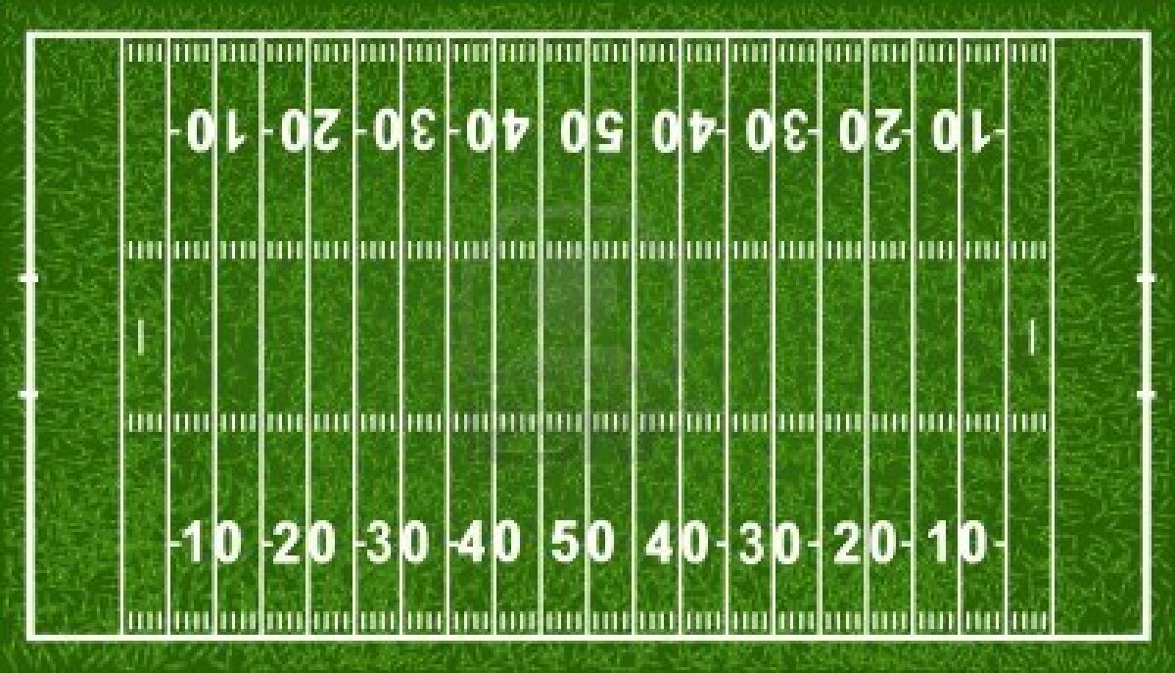
Trick to Remember Difference Between Goal and Objective
Think of a football field…
Goal
Touchdown!
Objective
10 yards every three plays
Goals identify end state
Objectives measure behavior

Slide 8

Dealing With Complexity
<<vision>>
Best Managed City
<<capability>>
Manage Infrastructure
<<capability>>
Clean Water
<<capability>>
Equal Opportunities
<<capability>>
Healthy Economy
<<capability>>
Safe Public
<<capability>>
Healthy Community
<<capability>>
Reliable Energy
<<capability>>
Mobile Community
Establish Goals
<<goal>>
Conserve Water Resources
<<goal>>
Integrate Case and Asset Management
<<goal>>
Sustain Environment
<<goal>>
Optimize Operations
<<goal>>
Increase Revenue
<<goal>>
Respond to Customer Needs
<<goal>>
Define Mobile User Processes

Slide 9
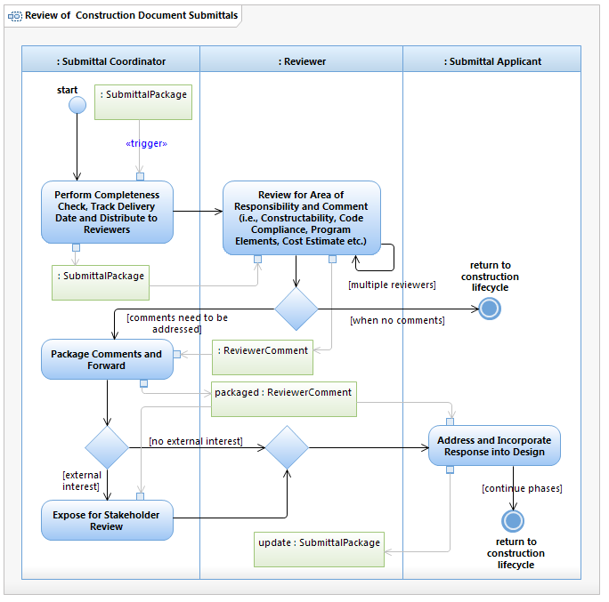
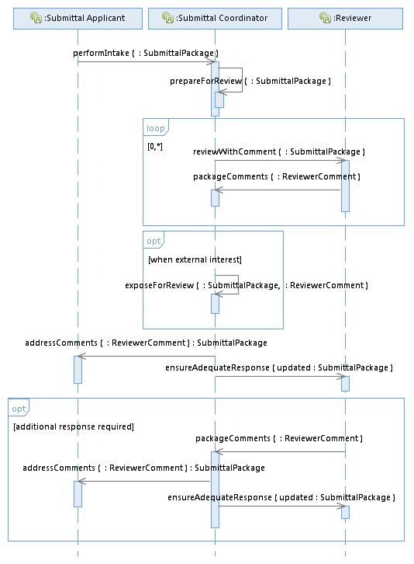

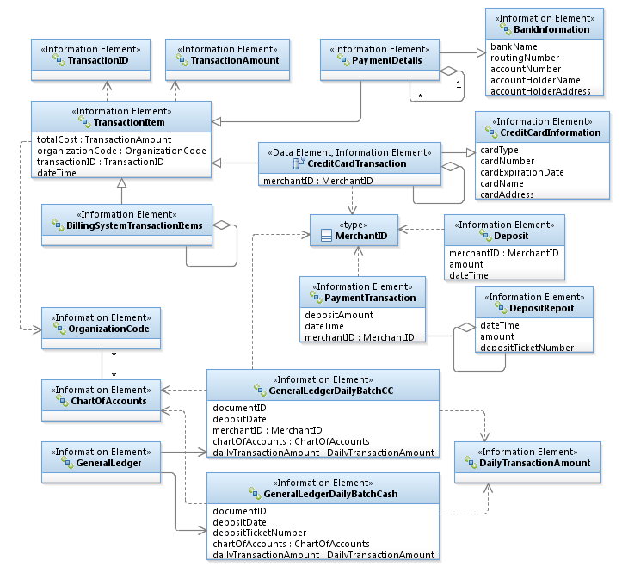
Dealing With Complexity
Process
Stakeholder developed!
Sample use case model

Slide 10
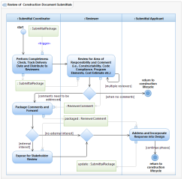
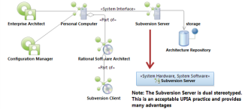
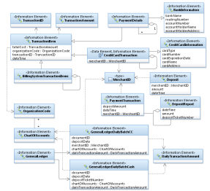
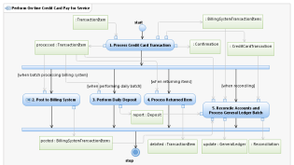
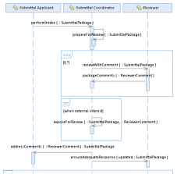
Dealing With Complexity
<<vision>>
Best Managed City
<<capability>>
Manage Infrastructure
<<capability>>
Clean Water
<<capability>>
Equal Opportunities
<<capability>>
Healthy Economy
Identify Common Capabilities
<<capability>>
Safe Public
<<capability>>
Healthy Community
<<capability>>
Reliable Energy
<<capability>>
Mobile Community
Identify Common Process
Goals Amplify Vision!
Identify Common Infrastructure
Top Down – Bottom Up
Identify Common Data
<<goal>>
Conserve Water Resources
<<goal>>
Integrate Case and Asset Management
<<goal>>
Sustain Environment
<<goal>>
Optimize Operations
Identify Common Goals
<<goal>>
Increase Revenue
<<goal>>
Respond to Customer Needs
<<goal>>
Define Mobile User Processes

Slide 11
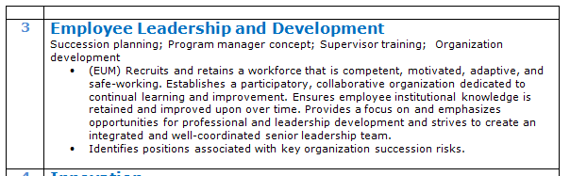

Connecting Business Needs to IT Solutions
The Architect’s Viewpoint
Recruit and maintain a competent, motivated, adaptive, and safe workforce. Establish participatory, collaborative organization dedicated to learning and process improvement. Ensure institutionalization of retained knowledge. Emphasis professional and leadership development and integrate a well-coordinated leadership team.

Slide 12
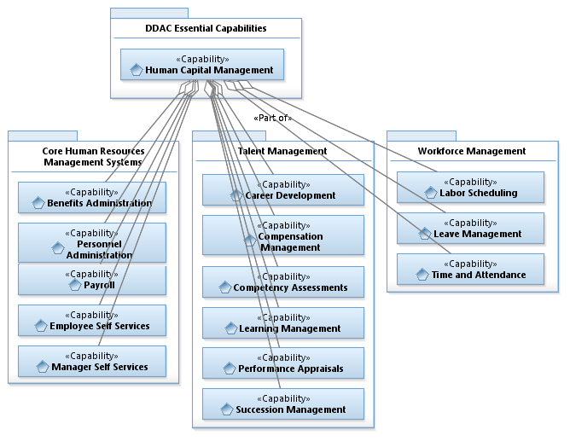
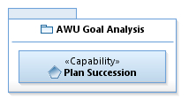
Connecting Business Needs to IT Solutions continued…
Reusable Opportunity!
<<Depends on>>

Slide 13

Connecting Business Needs to IT Solutions
The Architect’s Viewpoint
Employ innovative operational technology to support timely improvements.

Slide 14
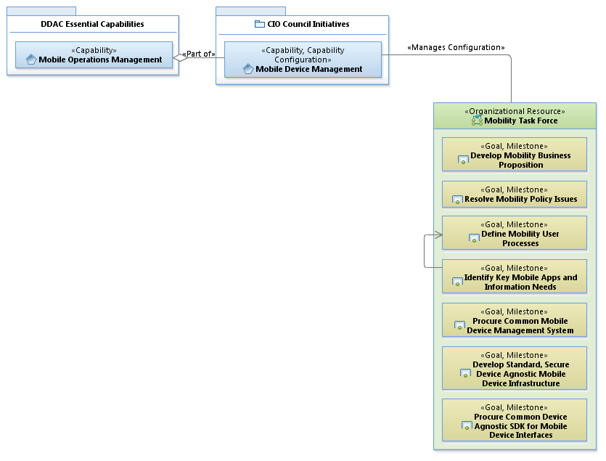
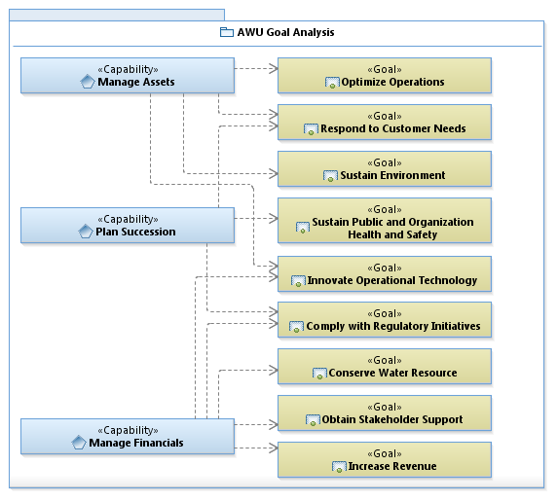
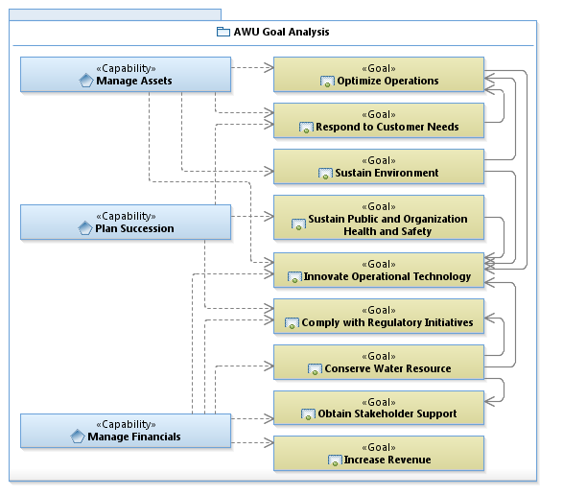
Connecting Business Needs to IT Solutions continued…

Slide 15
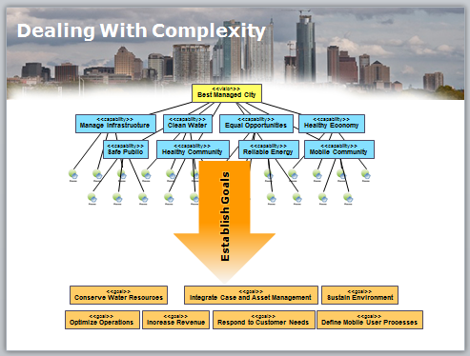
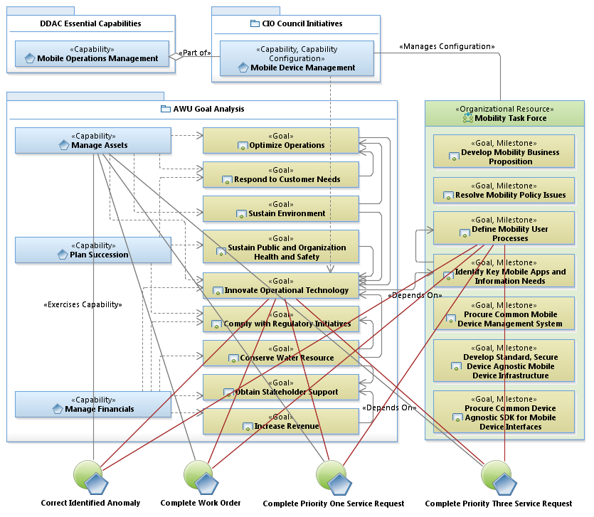
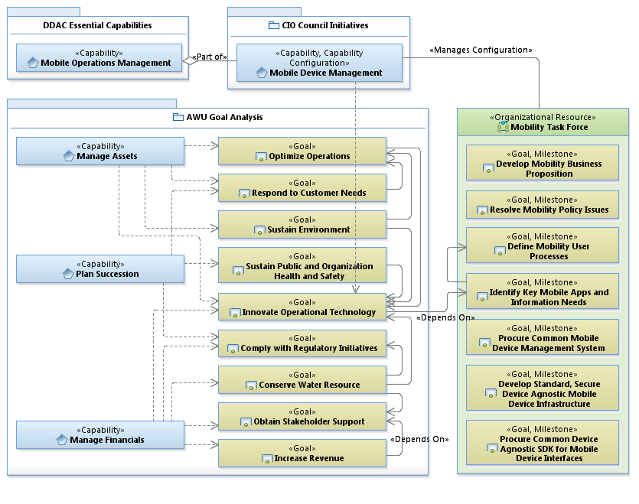
Improving Capability Using EA
Expanded Viewpoint

Slide 16
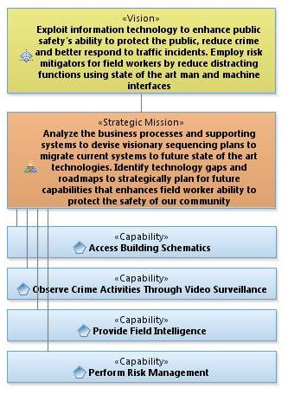
Vision, Mission and Strategy

Slide 17
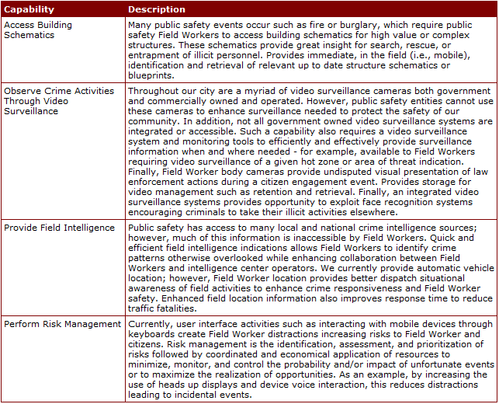
Capability Description

Slide 18
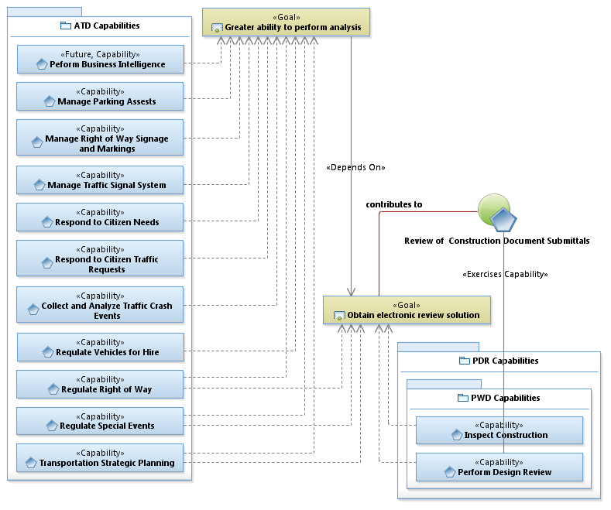
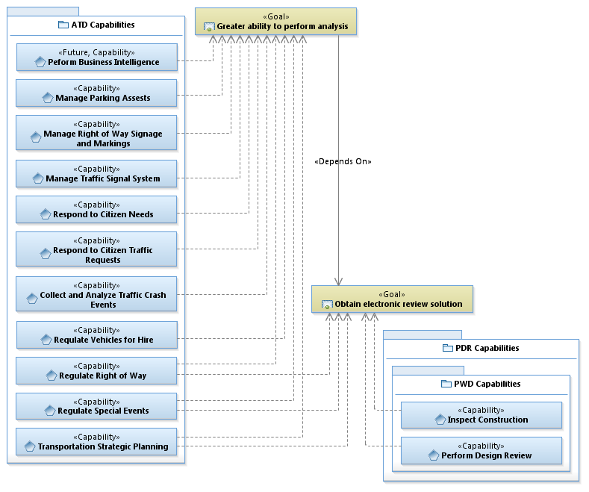
Identifying Common Process
Dependency due to the need for meta-data necessary for analysis
Use Case

Slide 19
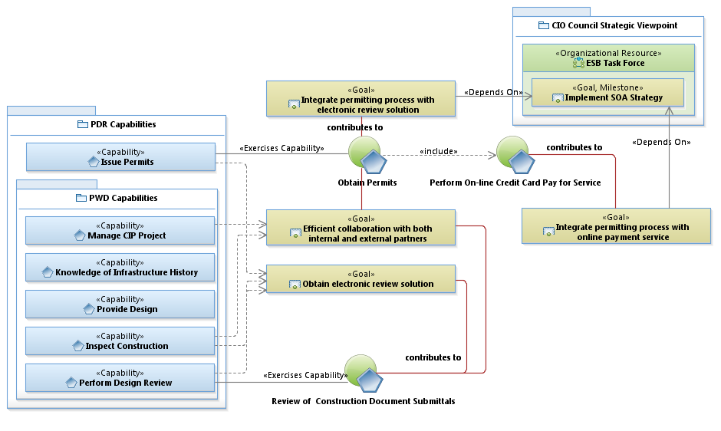
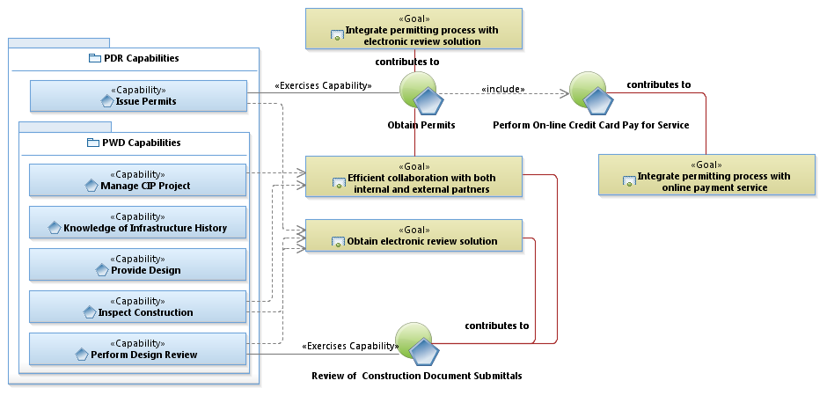
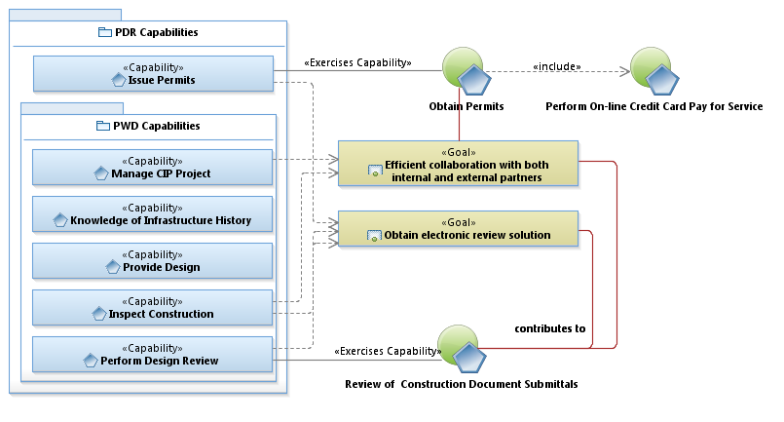
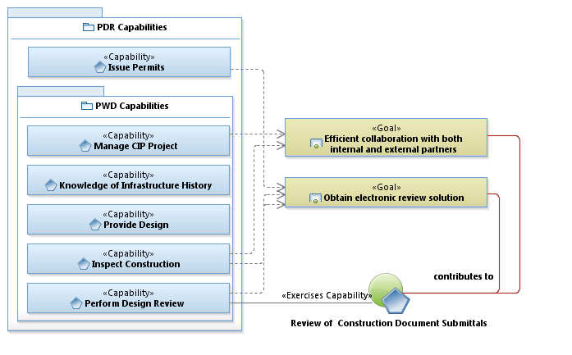
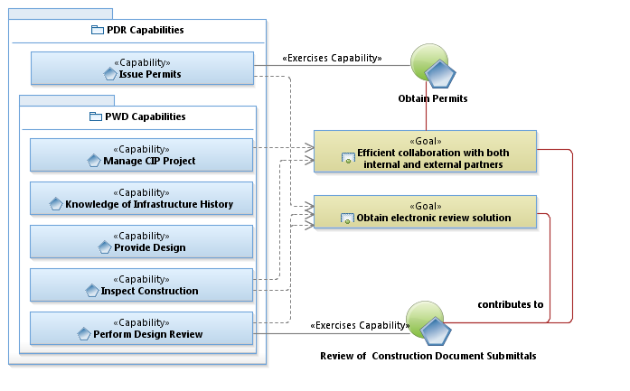
Developing IT Strategy

Slide 20
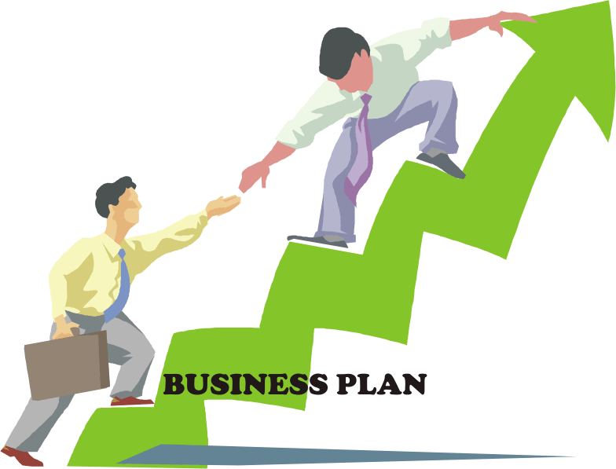
The Value of Enterprise Architecture
Ensures business outcomes drive IT solutions
Helps identify important goals and their dependency
Increases team communication and understanding
Reduces implementation risk
Visit http://austinea.org to download presentations

