Slide 1
ESB Task Force
Rob Byrd
rob.byrd@austintexas.gov

Slide 2
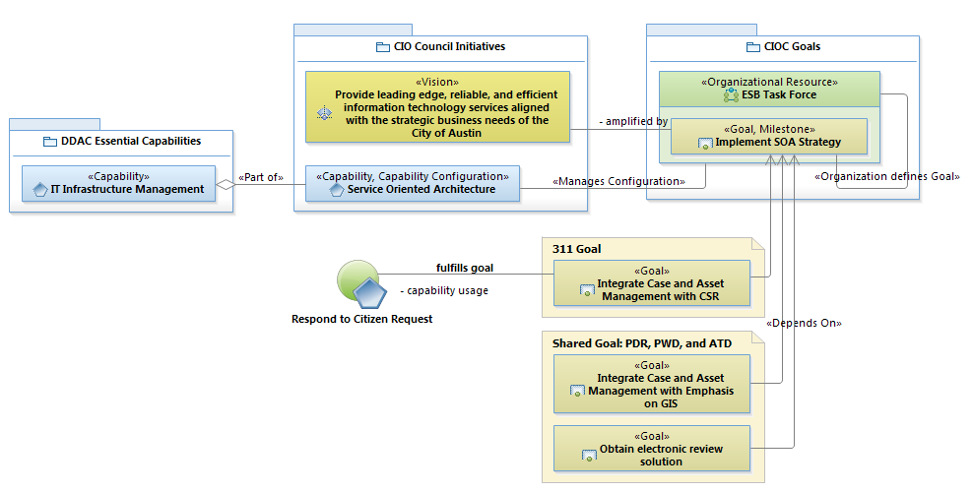
ESB Task Force Requirements Overview

Slide 3
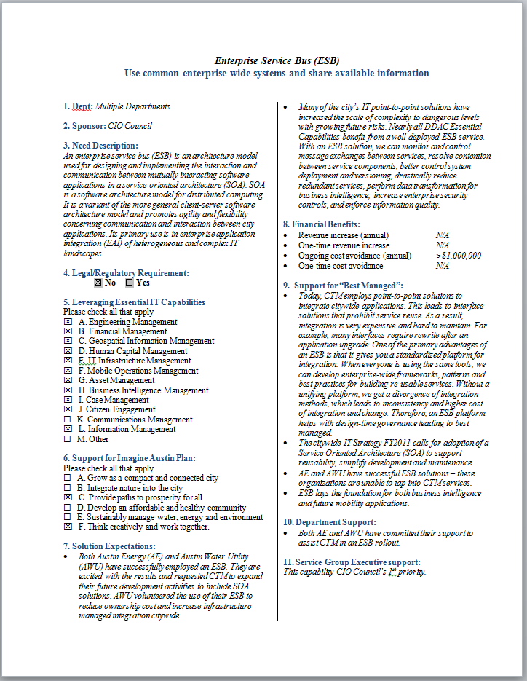
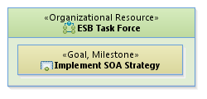
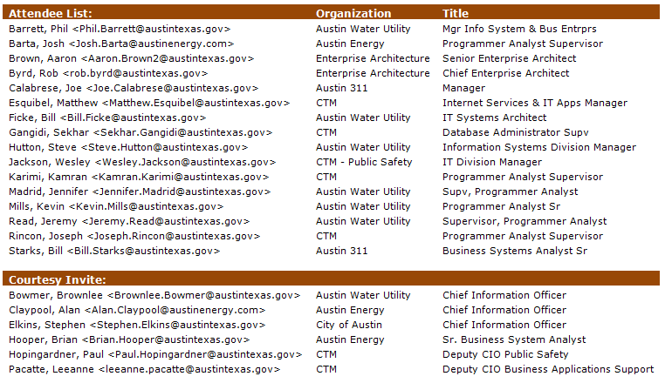
Governance
Business Need Statement
establishes
consists of

Slide 4
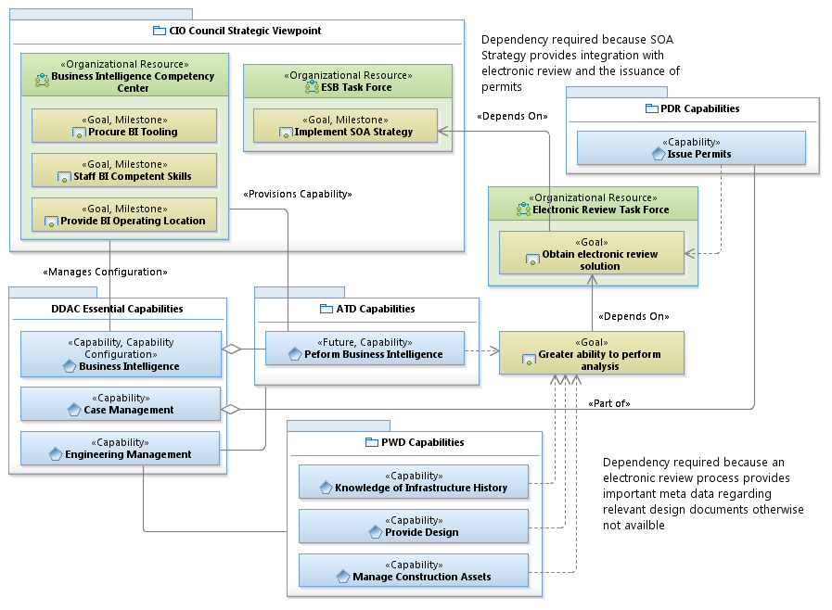
Additional Capability Benefits

Slide 5
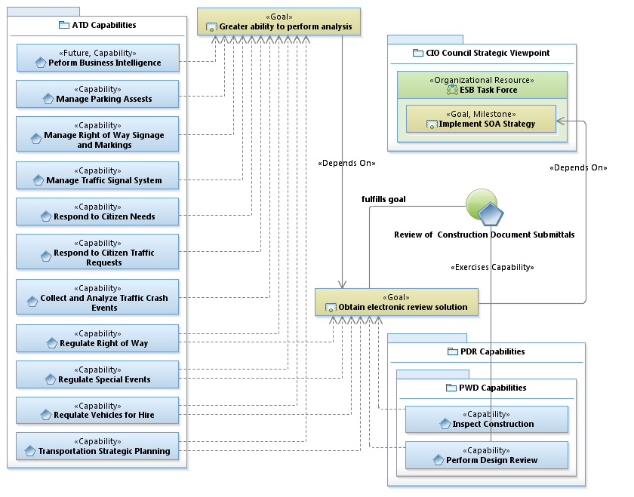
Additional Capability Benefits

Slide 6
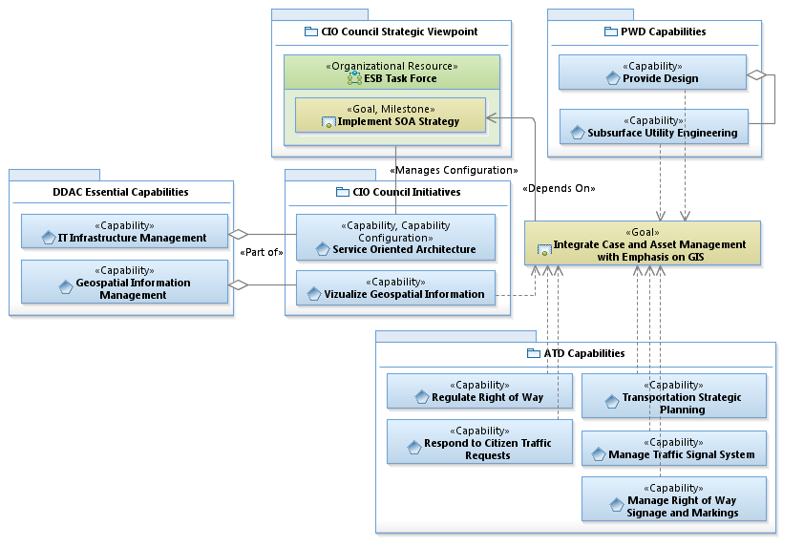
Additional Capability Benefits

