Slide 1

IT Principles
Implement IT strategic plan with focus on common and shared services Use enterprise-wide systems - share information systems Share highly specialized IT resources Retire legacy assets based on pre-identified technology lifecycles Reuse existing capabilities before we buy; buy before we build Purchase with full and open competition Build an agile organization that responds quickly and cost-effectively Build appropriate redundancy and business continuity into critical systems Secure systems to prevent unauthorized access Employ Enterprise Architecture principles
Build IT Infrastructure of a Top 10 City
Foster One City IT
All Things Online

Slide 2
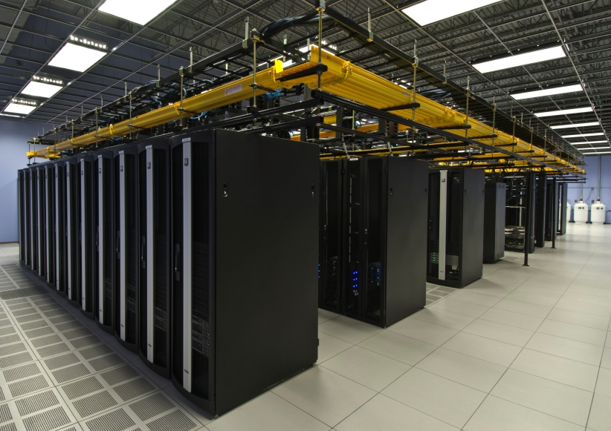
Build IT Infrastructure of a Top 10 City
Deliver required services at an affordable price Become full-fledged IT service-oriented provider Develop innovative technologies providing systems of record Create policies, standards and practices to sustain our technology in a secure infrastructure
Current:
Flood zone prone data center
Lack of redundant services
Expensive, none shared resources
Non service-oriented

Slide 3
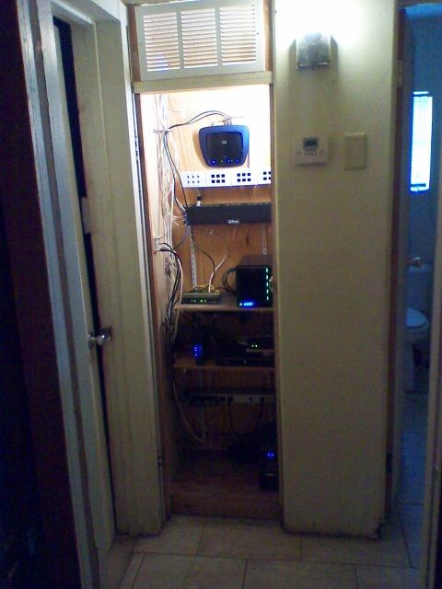
Foster One City IT
Organize to function as one technology provider Empower to lead and direct technology tasks Deploy capable staff in the most effective way Centralize when it makes sense, decentralize when needed
Current:
17 Data Centers – most housed in unprotected, small closets
35 instances of email servers of various configurations
6 Active Directory domains
A plethora of home-built, non supported business applications
Lack of cross-department integration

Slide 4
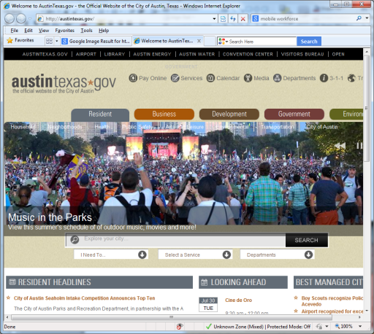

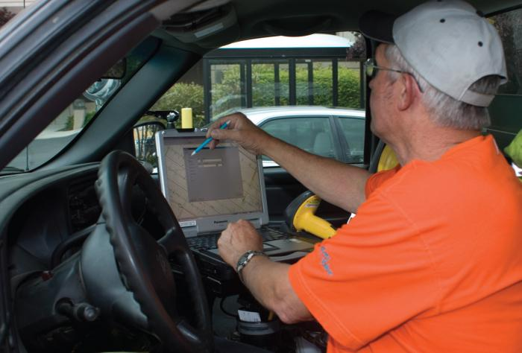
All Things Online
Empower citizens to engage with community and government Support city staff working online from anywhere Provide open access to data and information – digital inclusion Exploit opportunities to conduct business online
Current:
Limited, unreliable solutions
Department specific implementations lack economy of scale
Citizens must visit departments to conduct business

Slide 5
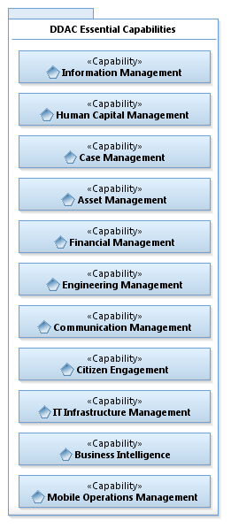
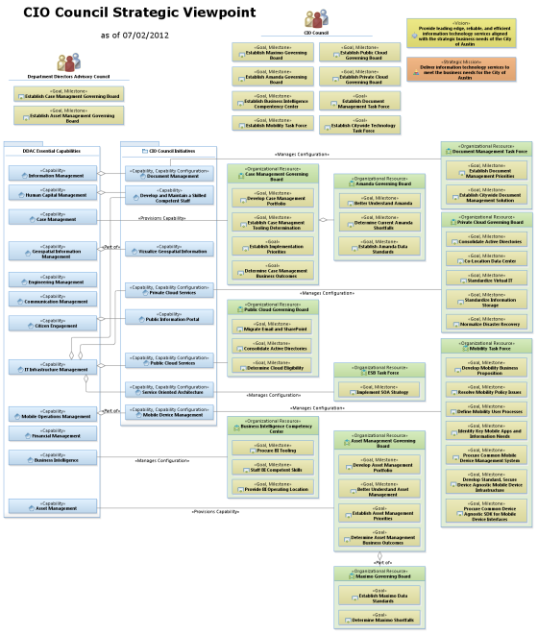


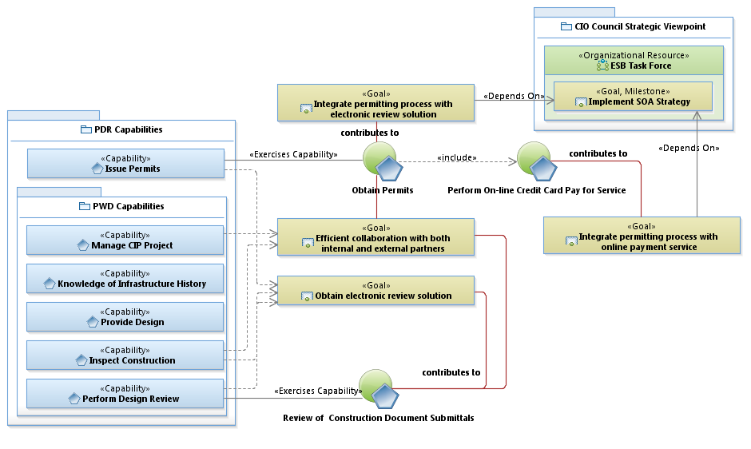
IT Vision
Business Priorities
Build Infrastructure of a Top 10 City
Foster One City IT
DDAC Essential Capabilities
Information Management
Human Capital Management
Case Management
Asset Management
Financial Management
Engineering Management
Communication Management
Citizen Engagement
It Infrastructure Management
Business Intelligence
Mobile Operations Management
IT Principles
Develop agile organization
Employ shared services
Exploit enterprise-wide systems
Reuse existing, useful capabilities
Retire legacy assets
Implement business continuity
Secure systems
Employ Enterprise Architecture
All Things Online
Transform
Closet IT to Center of Excellence
guided by
IT Initiatives
Upgrade AMANDA
Exercise Business Intelligence/Extract, Transform & Load (ETL) Tooling
Expand DMAV/DVV Storage Expansion/Refresh & Expand CTECC & Public Safety Storage
Employ Enterprise Service Bus (ESB)
Provide Citywide Email Archiving
Develop Contract Management System
Normalize EDIMS
Replace SDPP Application with AMANDA for WPD
Provide Federated Authentication
Perform Human Resources System Assessment
Update IT Staff Titles and Roles
Deploy MAXIMO Citywide
Provide Online Review of Building Plan Submittals
Upgrade COATN, Redundant Internet Access
implement by
results in
IT Outcomes
Service-oriented provider
Established systems of record
Policies, standards & practices
Empowered leadership & citizens
Capable and competent staff
Work anywhere online
Open access to information
Conduct business online
Cross-department integration
Imagine Austin
E A20 - Improve government efficiency through technology (software and hardware) investments and by developing and retaining information technology staff

Slide 6
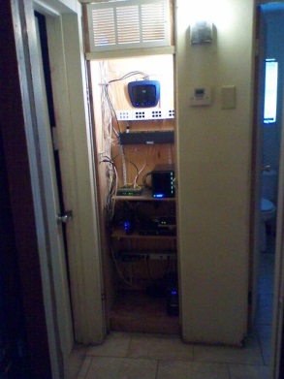



COA IT Strategy
Vision | Big City IT One City IT All Things Online
Vision | Big City IT One City IT All Things Online | Imagine Austin E A20 - Improve government efficiency through technology (software and hardware) investments and by developing and retaining information technology staff
Principles | Develop agile organization Employ shared services Exploit enterprise-wide systems Reuse existing, useful capabilities | Retire legacy assets Implement business continuity Secure systems Employ Enterprise Architecture
DDAC Essential Capabilities | IT Initiatives
Information Management Human Capital Management Case Management Asset Management Financial Management Engineering Management Communication Management Citizen Engagement It Infrastructure Management Business Intelligence Mobile Operations Management | Upgrade AMANDA Exercise Business Intelligence/Extract, Transform & Load (ETL) Tooling Expand DMAV/DVV Storage Expansion/Refresh & Expand CTECC & Public Safety Storage Employ Enterprise Service Bus (ESB) Provide Citywide Email Archiving Develop Contract Management System Normalize EDIMS Replace SDPP Application with AMANDA for WPD Provide Federated Authentication Perform Human Resources System Assessment Update IT Staff Titles and Roles Deploy MAXIMO Citywide Provide Online Review of Building Plan Submittals Upgrade COATN, Redundant Internet Access Establish Shared Data Center Provide Mobile Device Management
DDAC Essential Capabilities | IT Initiatives
Information Management Human Capital Management Case Management Asset Management Financial Management Engineering Management Communication Management Citizen Engagement It Infrastructure Management Business Intelligence Mobile Operations Management | Upgrade AMANDA Exercise Business Intelligence/Extract, Transform & Load (ETL) Tooling Expand DMAV/DVV Storage Expansion/Refresh & Expand CTECC & Public Safety Storage Employ Enterprise Service Bus (ESB) Provide Citywide Email Archiving Develop Contract Management System Normalize EDIMS Replace SDPP Application with AMANDA for WPD Provide Federated Authentication Perform Human Resources System Assessment Update IT Staff Titles and Roles Deploy MAXIMO Citywide Provide Online Review of Building Plan Submittals Upgrade COATN, Redundant Internet Access Establish Shared Data Center Provide Mobile Device Management
Current State | IT Initiatives
Flood zone prone data center 17 data centers – most housed in unprotected, small closets Lack of redundant services Expensive, none shared resources Non service- oriented infrastructure 35 instances of email servers of various configurations 6 Active Directory domains Plethora of home-built, non supported business applications Lack of cross-department integration Limited, unreliable mobile solutions Department implementations lack economy of scale Citizens must visit departments to conduct business Aging staff with non-competitive incentive to attract new talent | Upgrade AMANDA Exercise Business Intelligence/Extract, Transform & Load (ETL) Tooling Expand DMAV/DVV Storage Expansion/Refresh & Expand CTECC & Public Safety Storage Employ Enterprise Service Bus (ESB) Provide Citywide Email Archiving Develop Contract Management System Normalize EDIMS Replace SDPP Application with AMANDA for WPD Provide Federated Authentication Perform Human Resources System Assessment Update IT Staff Titles and Roles Deploy MAXIMO Citywide Provide Online Review of Building Plan Submittals Upgrade COATN, Redundant Internet Access Establish Shared Data Center Provide Mobile Device Management
Current State | IT Initiatives | Future State
Flood zone prone data center 17 data centers – most housed in unprotected, small closets Lack of redundant services Expensive, none shared resources Non service- oriented infrastructure 35 instances of email servers of various configurations 6 Active Directory domains Plethora of home-built, non supported business applications Lack of cross-department integration Limited, unreliable mobile solutions Department implementations lack economy of scale Citizens must visit departments to conduct business Aging staff with non-competitive incentive to attract new talent | Upgrade AMANDA Exercise Business Intelligence/Extract, Transform & Load (ETL) Tooling Expand DMAV/DVV Storage Expansion/Refresh & Expand CTECC & Public Safety Storage Employ Enterprise Service Bus (ESB) Provide Citywide Email Archiving Develop Contract Management System Normalize EDIMS Replace SDPP Application with AMANDA for WPD Provide Federated Authentication Perform Human Resources System Assessment Update IT Staff Titles and Roles Deploy MAXIMO Citywide Provide Online Review of Building Plan Submittals Upgrade COATN, Redundant Internet Access Establish Shared Data Center Provide Mobile Device Management | Empowered leadership & citizens Service-oriented provider Capable and competent staff Established systems of record Cross-department integration Policies, standards & practices Conduct business online Work anywhere online Open access to information

Slide 7
IT Strategy
Vision | Big City IT One City IT All Things Online
DDAC Essential Capabilities | IT Initiatives
Information Management Human Capital Management Case Management Asset Management Financial Management Engineering Management Communication Management Citizen Engagement It Infrastructure Management Business Intelligence Mobile Operations Management | Upgrade AMANDA Exercise Business Intelligence/Extract, Transform & Load (ETL) Tooling Expand DMAV/DVV Storage Expansion/Refresh & Expand CTECC & Public Safety Storage Employ Enterprise Service Bus (ESB) Provide Citywide Email Archiving Develop Contract Management System Normalize EDIMS Replace SDPP Application with AMANDA for WPD Provide Federated Authentication Perform Human Resources System Assessment Update IT Staff Titles and Roles Deploy MAXIMO Citywide Provide Online Review of Building Plan Submittals Upgrade COATN, Redundant Internet Access Establish Shared Data Center Provide Mobile Device Management

Slide 8
IT Strategy
Vision | Big City IT One City IT All Things Online
Current State | IT Initiatives
Flood zone prone data center 17 data centers – most housed in unprotected, small closets Lack of redundant services Expensive, none shared resources Non service- oriented infrastructure 35 instances of email servers of various configurations 6 Active Directory domains Plethora of home-built, non supported business applications Lack of cross-department integration Limited, unreliable mobile solutions Department implementations lack economy of scale Citizens must visit departments to conduct business Aging staff with non-competitive incentive to attract new talent | Upgrade AMANDA Exercise Business Intelligence/Extract, Transform & Load (ETL) Tooling Expand DMAV/DVV Storage Expansion/Refresh & Expand CTECC & Public Safety Storage Employ Enterprise Service Bus (ESB) Provide Citywide Email Archiving Develop Contract Management System Normalize EDIMS Replace SDPP Application with AMANDA for WPD Provide Federated Authentication Perform Human Resources System Assessment Update IT Staff Titles and Roles Deploy MAXIMO Citywide Provide Online Review of Building Plan Submittals Upgrade COATN, Redundant Internet Access Establish Shared Data Center Provide Mobile Device Management

Slide 9
IT Strategy
Vision | Big City IT One City IT All Things Online | Imagine Austin E A20 - Improve government efficiency through technology (software and hardware) investments and by developing and retaining information technology staff
Principles | Develop agile organization Employ shared services Exploit enterprise-wide systems Reuse existing, useful capabilities | Retire legacy assets Implement business continuity Secure systems Employ Enterprise Architecture
Current State | IT Initiatives
Flood zone prone data center 17 data centers – most housed in unprotected, small closets Lack of redundant services Expensive, none shared resources Non service- oriented infrastructure 35 instances of email servers of various configurations 6 Active Directory domains Plethora of home-built, non supported business applications Lack of cross-department integration Limited, unreliable mobile solutions Department implementations lack economy of scale Citizens must visit departments to conduct business Aging staff with non-competitive incentive to attract new talent | Upgrade AMANDA Exercise Business Intelligence/Extract, Transform & Load (ETL) Tooling Expand DMAV/DVV Storage Expansion/Refresh & Expand CTECC & Public Safety Storage Employ Enterprise Service Bus (ESB) Provide Citywide Email Archiving Develop Contract Management System Normalize EDIMS Replace SDPP Application with AMANDA for WPD Provide Federated Authentication Perform Human Resources System Assessment Update IT Staff Titles and Roles Deploy MAXIMO Citywide Provide Online Review of Building Plan Submittals Upgrade COATN, Redundant Internet Access Establish Shared Data Center Provide Mobile Device Management

Slide 10
IT Strategy
Vision | Big City IT One City IT All Things Online | Imagine Austin E A20 - Improve government efficiency through technology (software and hardware) investments and by developing and retaining information technology staff
Principles | Develop agile organization Employ shared services Exploit enterprise-wide systems Reuse existing, useful capabilities | Retire legacy assets Implement business continuity Secure systems Employ Enterprise Architecture
Current State | IT Initiatives | Future State
Flood zone prone data center 17 data centers – most housed in unprotected, small closets Lack of redundant services Expensive, none shared resources Non service- oriented infrastructure 35 instances of email servers of various configurations 6 Active Directory domains Plethora of home-built, non supported business applications Lack of cross-department integration Limited, unreliable mobile solutions Department implementations lack economy of scale Citizens must visit departments to conduct business Aging staff with non-competitive incentive to attract new talent | Upgrade AMANDA Exercise Business Intelligence/Extract, Transform & Load (ETL) Tooling Expand DMAV/DVV Storage Expansion/Refresh & Expand CTECC & Public Safety Storage Employ Enterprise Service Bus (ESB) Provide Citywide Email Archiving Develop Contract Management System Normalize EDIMS Replace SDPP Application with AMANDA for WPD Provide Federated Authentication Perform Human Resources System Assessment Update IT Staff Titles and Roles Deploy MAXIMO Citywide Provide Online Review of Building Plan Submittals Upgrade COATN, Redundant Internet Access Establish Shared Data Center Provide Mobile Device Management | Empowered leadership & citizens Service-oriented provider Capable and competent staff Established systems of record Cross-department integration Policies, standards & practices Conduct business online Work anywhere online Open access to information

