Slide 1
Introduction to the Unified Model Language (UML)
Rob Byrd
rob.byrd@austintexas.gov

Slide 2
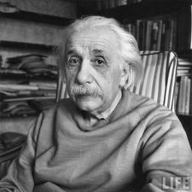
Curriculum Outline
Model Language Background
Terms and Definitions
Use Case Development Process and Tooling
We cannot solve our problems with the same thinking we used when we created them.
- Albert Einstein

Slide 3
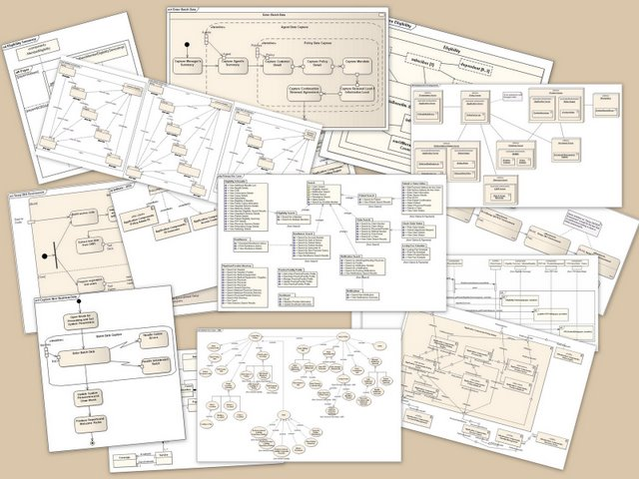
UML Background
A standardized general-purpose modeling language in the field of object-oriented software engineering
Standard managed and created by the Object Management Group. First added to the list of OMG adopted technologies in 1997 and has since become the industry standard for modeling software-intensive systems
Combines best practices from: Grady Booch, Dr. James Rumbaugh, and Dr. Ivar Jacobson – Referred as the Three Amigos

Slide 4

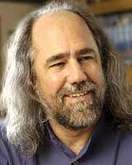
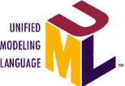
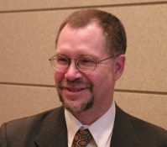
The Three Amigos…
Dr. Ivar Jacobson
Swedish computer scientist
Grady Booch
American software engineer
Former Chief Scientist of Rational Software
Currently IBM and IEEE Fellow
Dr. James Rumbaugh
American computer scientist

Slide 5
UML Enhancements - Unified Profile for DoDAF/MODAF (UPDM)
The UPDM initiative began in ~2005 and adopted by the OMG in 2007
IBM commercialized UPDM for civilian use with Rational Software Architect using an Extension for Integrated Architecture called UML Profile-Based Integrated Architecture (UPIA)
Supports XMI-based file exchange between tools and repositories
XMI (UML over XML)– Extensible Markup Interchange
UPIA extends UML to include strategic, organization, and system viewpoints beyond software intensive engineering
DoDAF - Department of Defense Architecture Framework
MODAF – Ministry of Defence Architecture Framework

Slide 6
Enterprise Architecture Method is an Abstracted use of UML
Traditional Design UML
The creation of a view that suppresses unnecessary details to focus on a specific set of details of interest
An abstraction defines a boundary relative to the perspective of the viewer
Enterprise UML

Slide 7
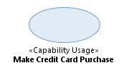
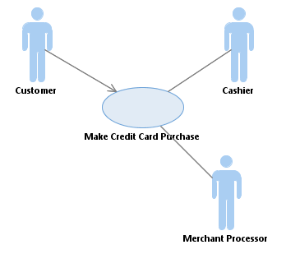
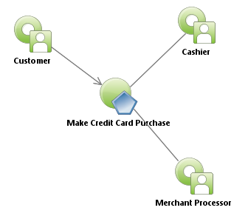

Why UPIA?
Traditional UML Use Case
UML/UPIA Use Case
Standardized Stereotypes for better Business Intelligence reporting
Indicates relationship to operational node
No capability viewpoint
Indicates relationship to capability
Reference Wikipedia Use Case Description

Slide 8



UPIA Normalizes Defined Parts
Classes = Types of Things
Traditional UML
UML with UPIA
Stereotyped
class
Visually rendered based on stereotype
UML with UPIA
Standardized relationship stereotype
Attributes and operations turned off

Slide 9
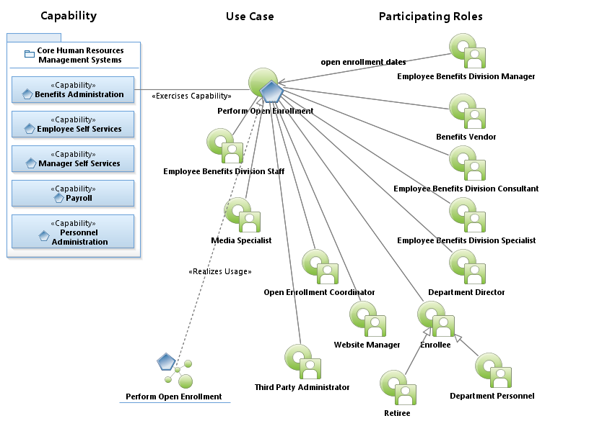
Use Case Used for Concept Development
Trace to capability
(part of strategic viewpoint)
Scope: Prepares and executes a five-week enrollment period that allows employees and retirees to make benefit changes without a qualifying event. This would include adding and dropping dependents to coverage, changing or adding medical, dental, vision, life, disability, and legal coverage.
Defines scope
Identifies participating roles
Ensures “results of value” ROV

Slide 10
UML Capitalizes on Human Collaboration Factors – i.e., Teams Working Together
EA should be included early!
Builds collective knowledge – individually, we’re smart – together, we’re genius
Teams should be limited to 5 - 9 people. If larger, this significantly reduces effective team knowledge
The Use Case Model establishes the audience/stakeholder on the boundary of the problem and the scope of discussion
During model development, the end state is clear preventing wondering concepts outside the discussion boundary - leads to quicker results
Provides tool for Critical Mass of Understanding!

Slide 11
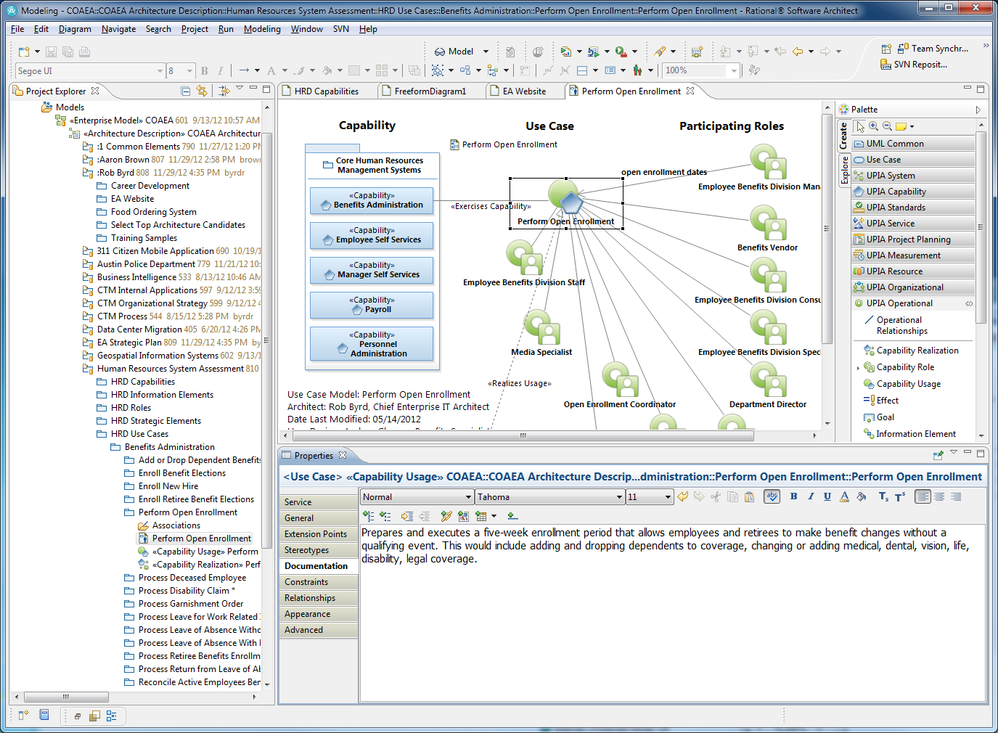
Rational Software Architect Tool
UPIA Drawers
Design Space
Project Explorer
Element Properties

Slide 12
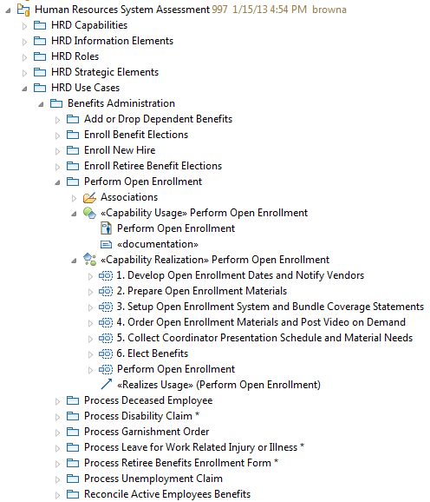

Model Structure
Project Explorer
Solely for storing parts
Design captured by diagrams
Caution: Do not design in structure!
Diagram
<<Realizes Usage>>

Slide 13
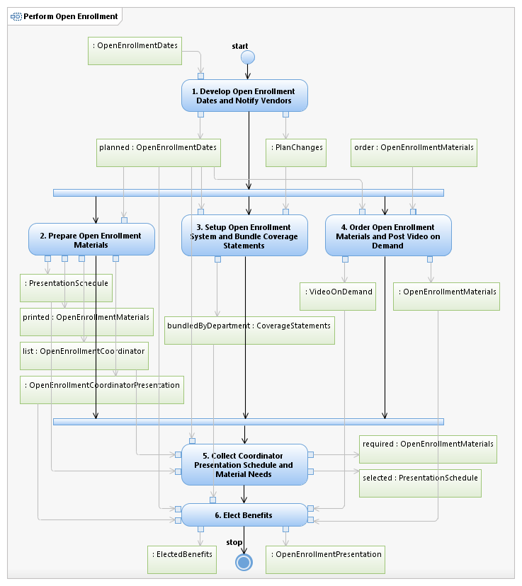
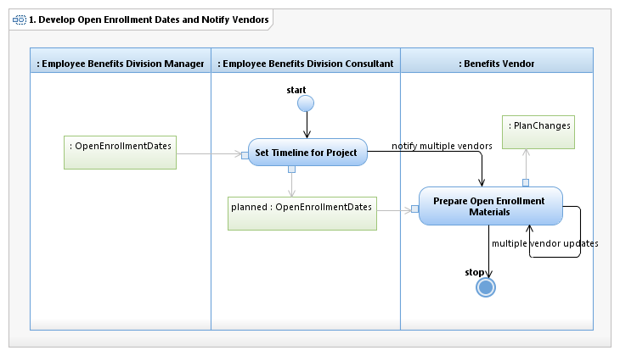
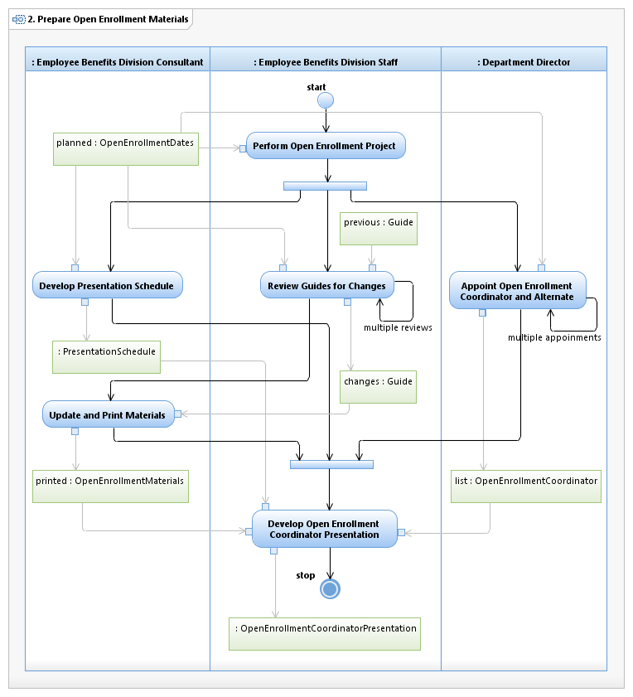
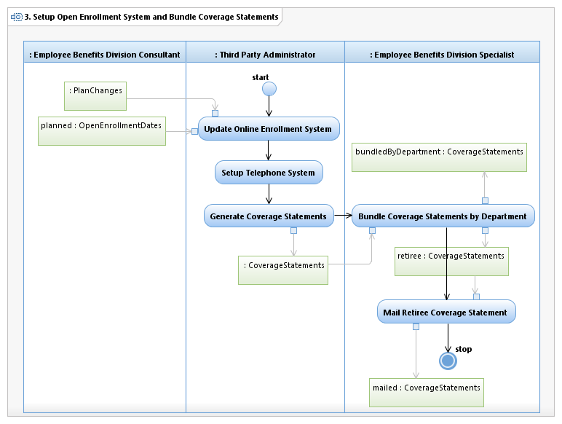
Realization Documents the Process
Realization
(employs value chain concepts)

Slide 14
Value Chain
A chain of activities and their objects that an organization performs in order to deliver something valuable (product or service)
A powerful analysis tool for strategic planning and business process reengineering
UML Use Cases typically produce value in the form of information elements (objects) – use cases are sometimes referred to as business components
Indifferent to the systems, tools or processes used, UML use cases always produce the same value (or outcome)

Slide 15

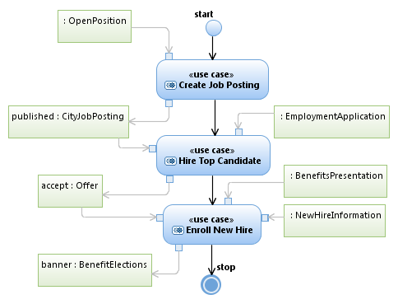
Business Component Value Chain
Use Case (business component
sometimes referred as service)
Triggering and producing object

Slide 16
Interaction Overview – Activity Model
Activity
Process Flow
(flow of control)
The value chain
Forks / Joins
(synchronizes activities)
Objects
(information elements)

Slide 17
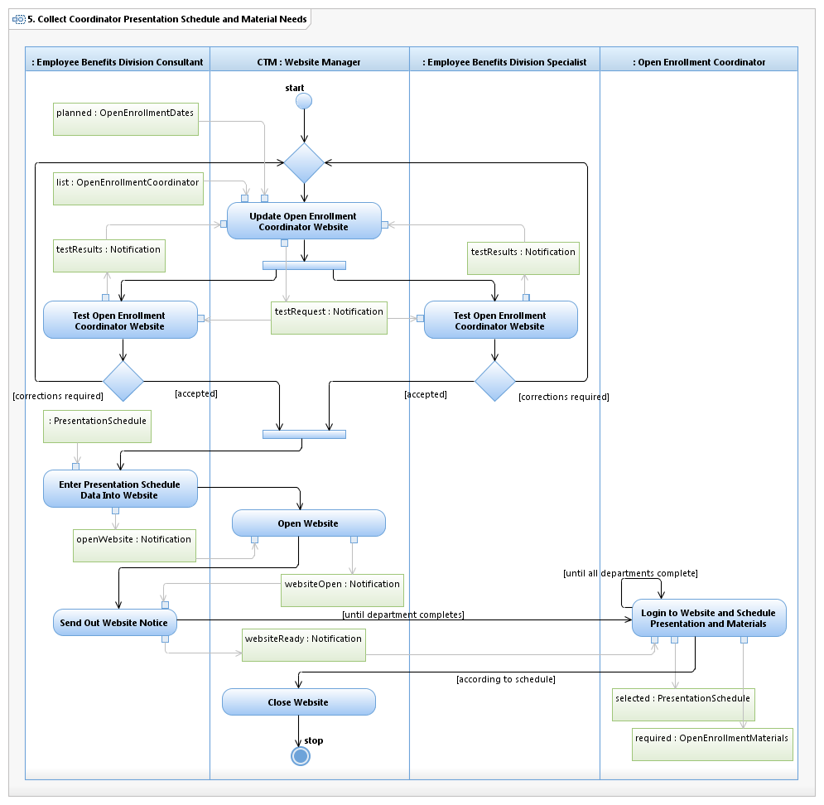

Swim-lane Activity Model
Merge Point
Decision Point

Slide 18
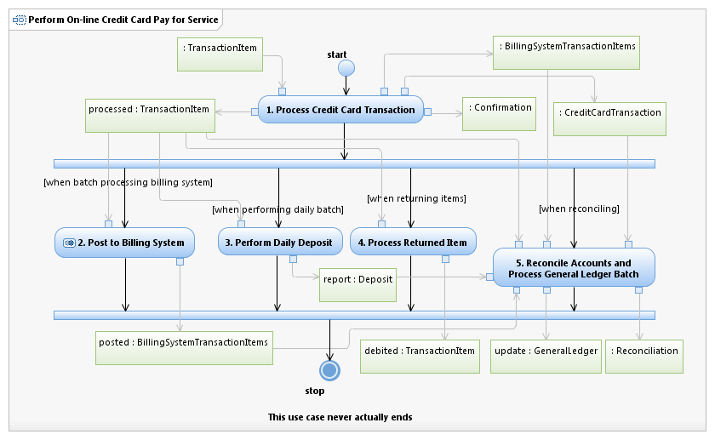
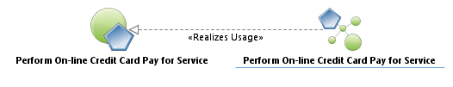
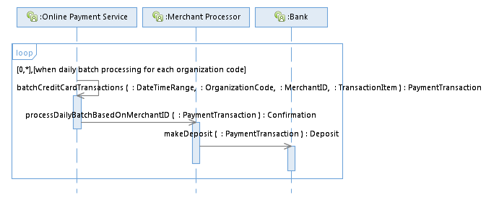
Sequence Diagram
Interaction Overview
Object
Combined fragment
Lifeline
Message
Focus of control
Signature

Slide 19
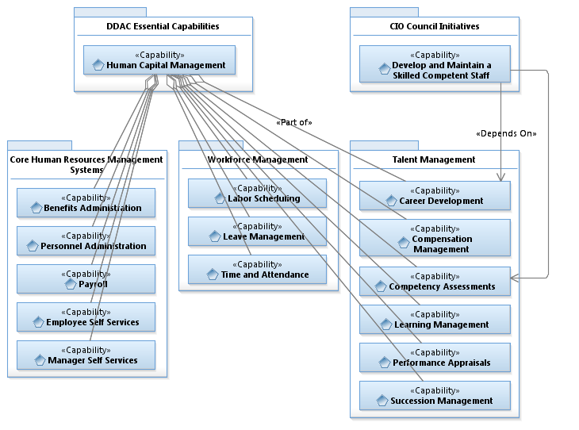
Class Relationships

Slide 20
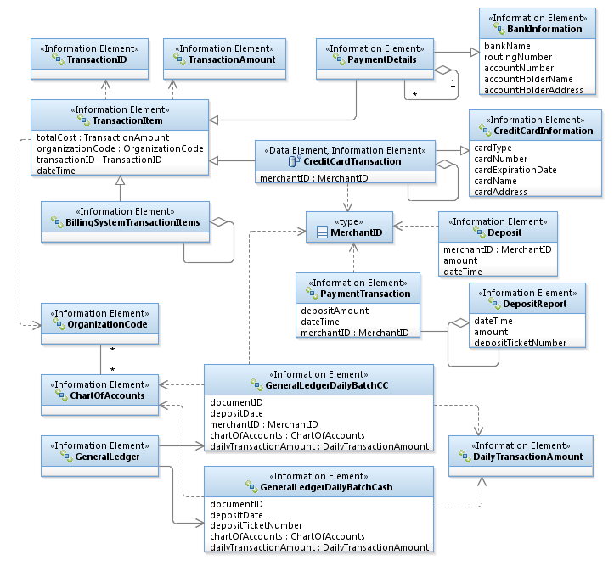
Logical Data Model
The UML expert can read this diagram like a book – associations define the relationships between the information elements
The enterprise architect makes the associations based on the use case model
Any qualified IT developer knows how to read these diagrams – hence the UML bridges the gap between the user and the developer because the user identified them in the use case

Slide 21
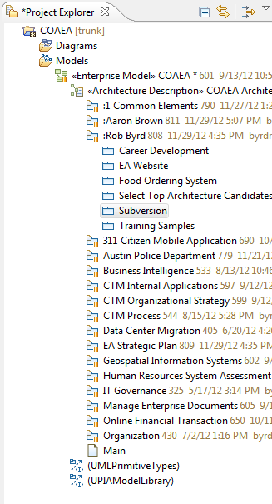
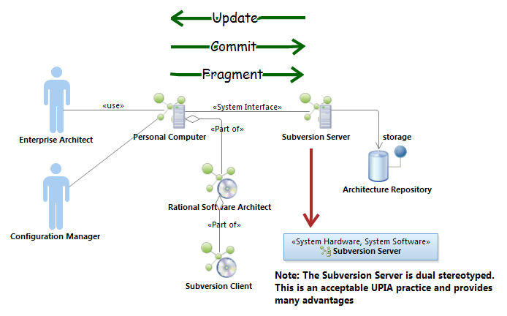
Configuration Management
UML System Context Diagram
Orange button indicates package under Subversion control

Slide 22
Summary
UML is an open standard general purpose language for object-oriented analysis and design created by the Three Amigos
UPIA extends the UML to standardize classes and their associations – it normalizes defined parts
The use case is the primary instrument for collaboration, concept development, business process analysis and value chain understanding – the use case always results in the same value
Logical data models define the data requirements use by the use case
Configuration management allows teams to work collaboratively in “one” model

