Slide 1
Enterprise Architecture Rob Byrd, Chief Enterprise Architect
Strategic Planning Using Enterprise Architecture December 03, 2013
Presented by:

Slide 2
Problem Statement
Identify and establish important business capabilities to aid in defining important IT improvements and project priorities
Ensure business capabilities are outcome focused and consistently defined at the same level of abstraction
Clearly identify important business patterns (i.e., similar outcomes) to optimize reuse opportunities
There is no silver bullet…

Slide 3
Industry Role of EA?
Enterprise architects work with stakeholders, both leadership and subject matter experts, to build a holistic view of the organization's strategy, processes, information, and information technology assets. The role of the enterprise architect is to take this knowledge and ensure that the business and IT are in alignment. The enterprise architect links the business mission, strategy, and processes of an organization to its IT strategy, and documents this using multiple architectural models or views that show how the current and future needs of an organization will be met in an efficient, sustainable, agile, and adaptable manner.
~source Wikipedia
Responsible to align IT services with the business needs of the city
Business need: Information technology solutions to assist in delivering important business outcomes
EA is more a business entity than an IT service provider – places business need in context of the required user experience without dictating the final solution

Slide 4

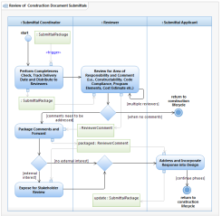
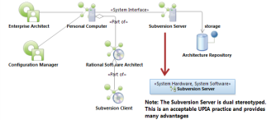
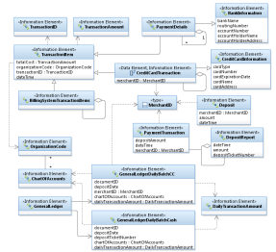
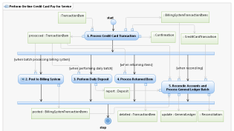
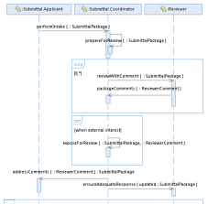
Dealing With Complexity
<<vision>>
Best Managed City
<<capability>>
Manage Infrastructure
<<capability>>
Clean Water
<<capability>>
Equal Opportunities
<<capability>>
Healthy Economy
Identify Common Capabilities
<<capability>>
Safe Public
<<capability>>
Healthy Community
<<capability>>
Reliable Energy
<<capability>>
Mobile Community
Identify Common Process
Goals Amplify Vision!
Identify Common Infrastructure
Top Down – Bottom Up
Identify Common Data
<<goal>>
Conserve Water Resources
<<goal>>
Integrate Case and Asset Management
<<goal>>
Sustain Environment
<<goal>>
Optimize Operations
Identify Common Goals
<<goal>>
Increase Revenue
<<goal>>
Respond to Customer Needs
<<goal>>
Define Mobile User Processes

Slide 5
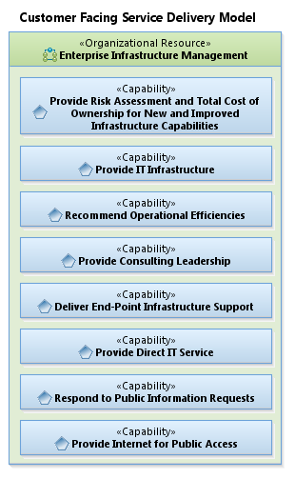
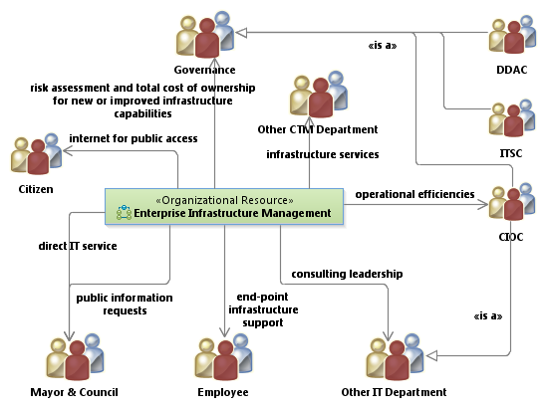
Customer Facing Delivery Model

Slide 6
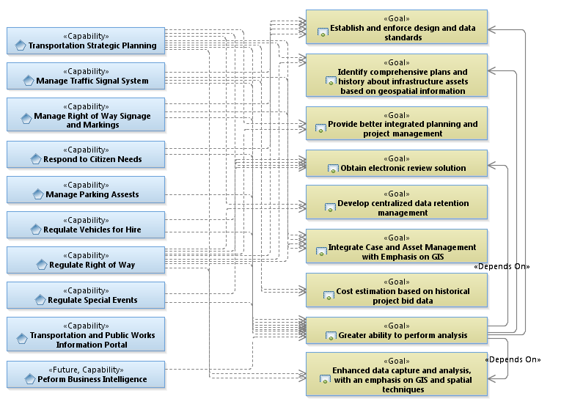
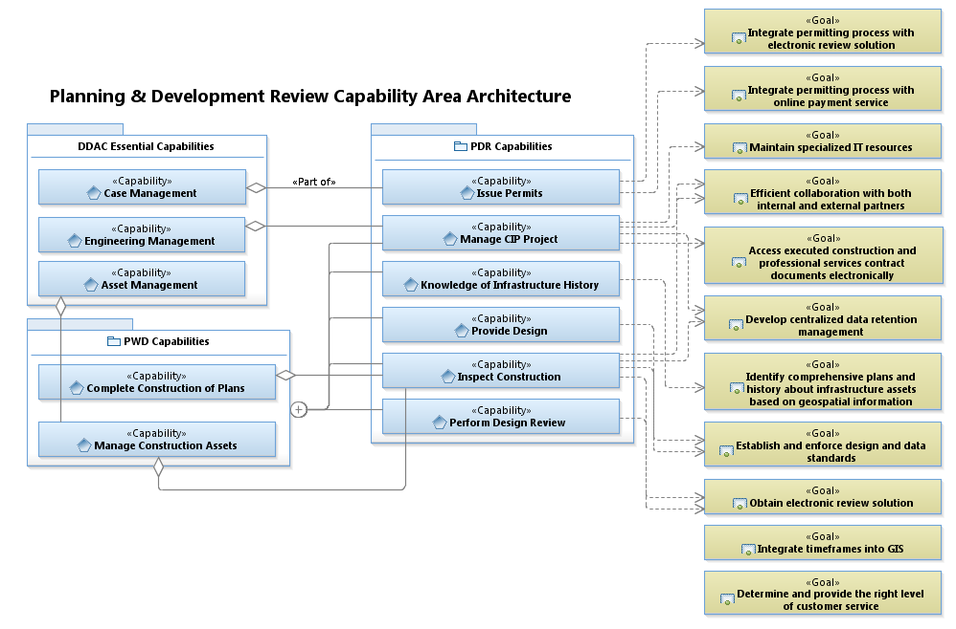
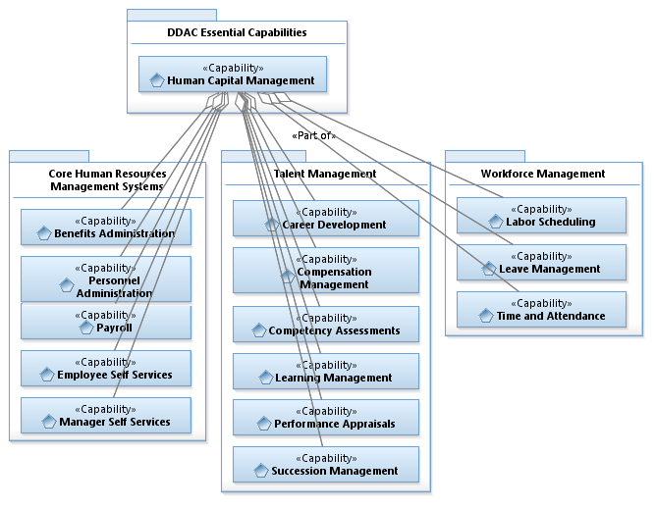
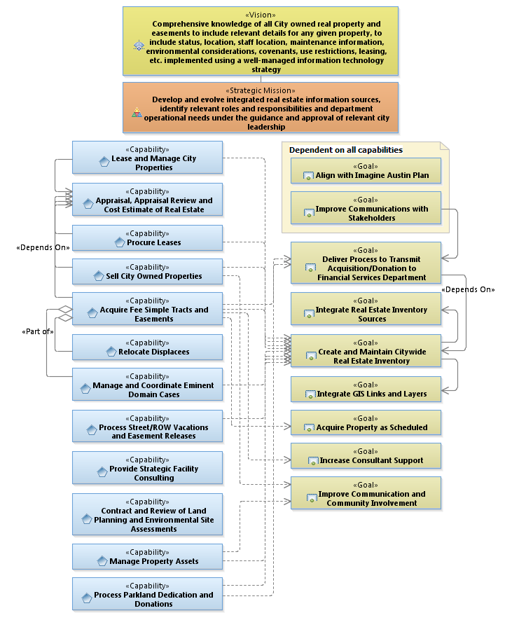
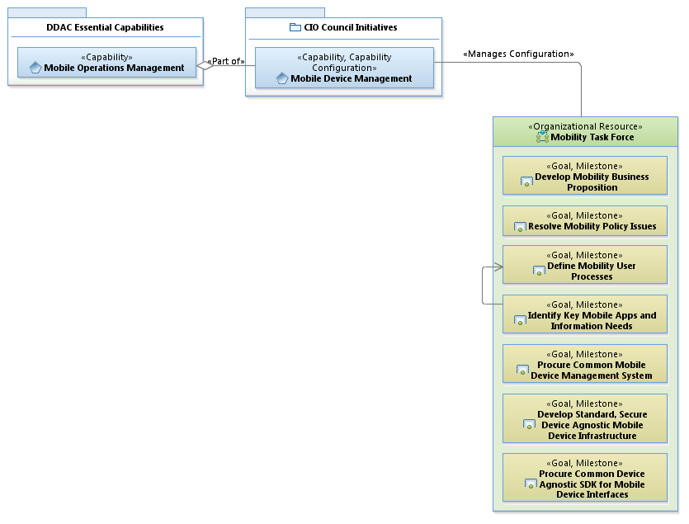
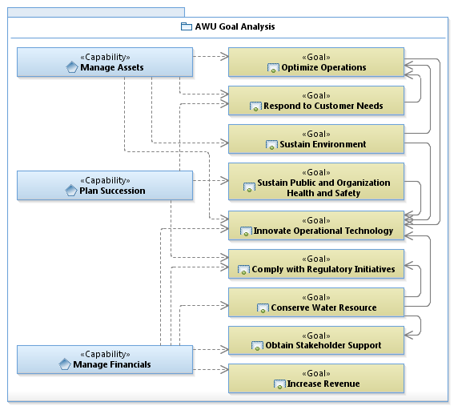
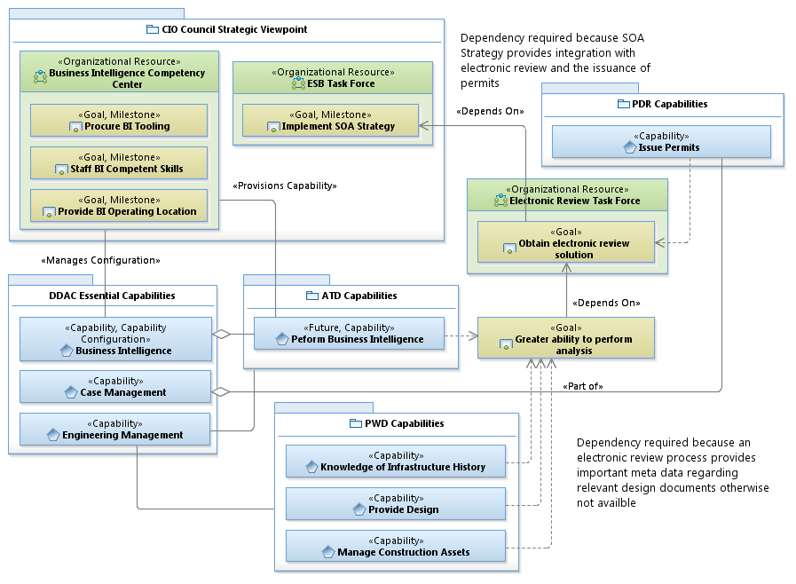
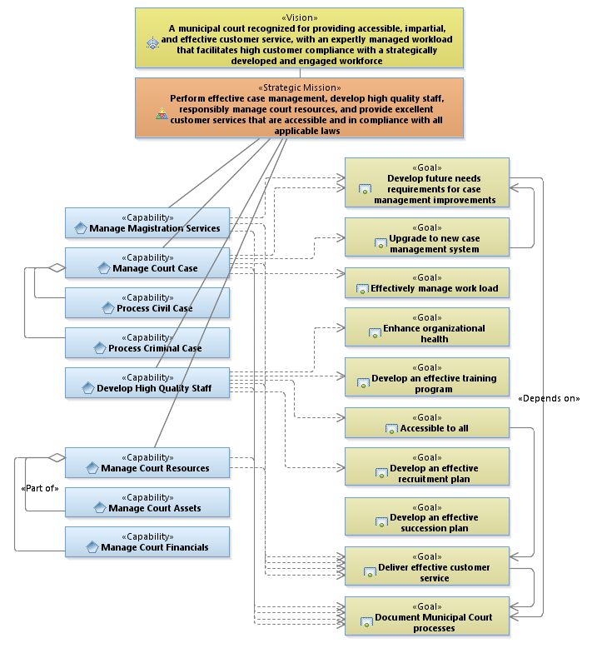
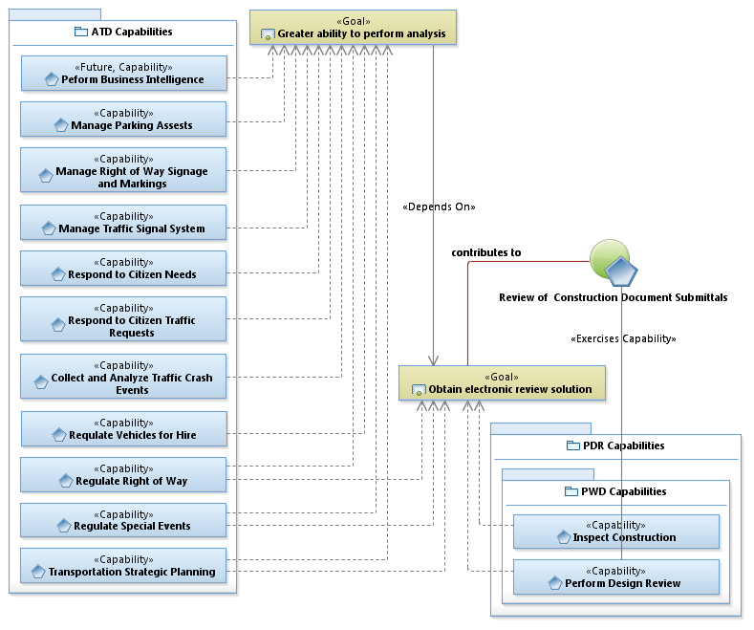
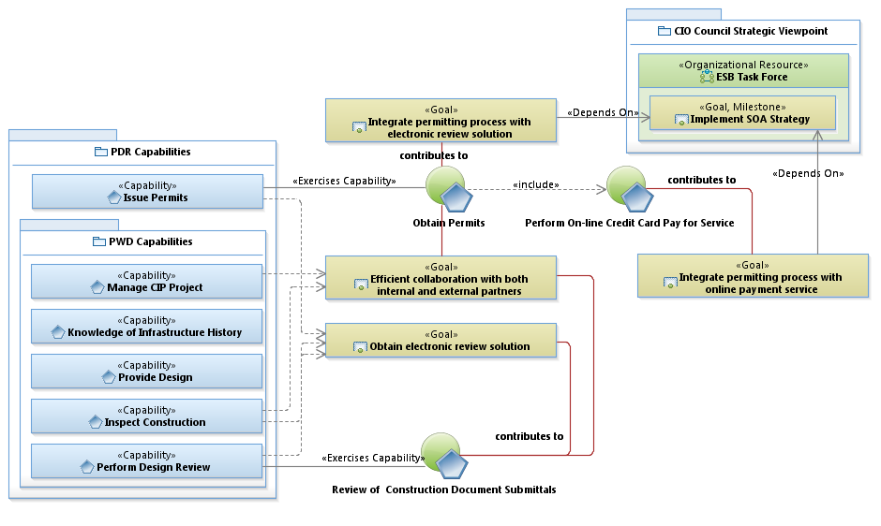
Existing Strategic Viewpoints (Capabilities and Goals)

Slide 7
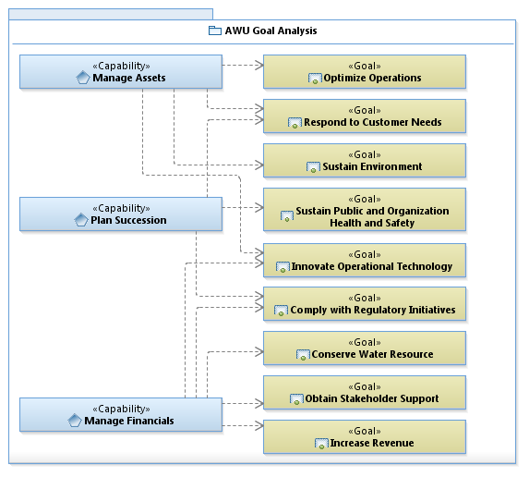
Connecting Business Needs to IT Solutions continued…

Slide 8
IT Strategic Analysis

Slide 9
Planning and Development Review (PDR)
Residential Review Architecture

Slide 10
Integrate Real Estate Sources

Slide 11
Municipal Court

Slide 12
Goal Dependency

Slide 13
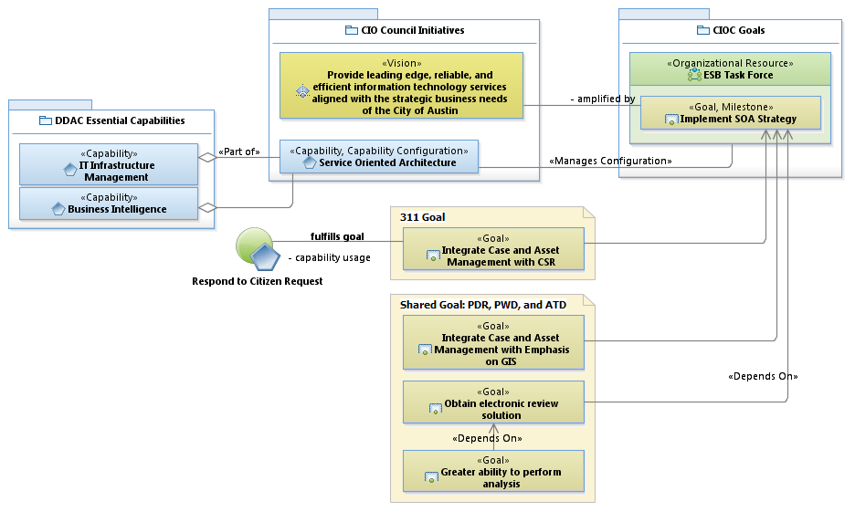
Strategic Viewpoint

Slide 14
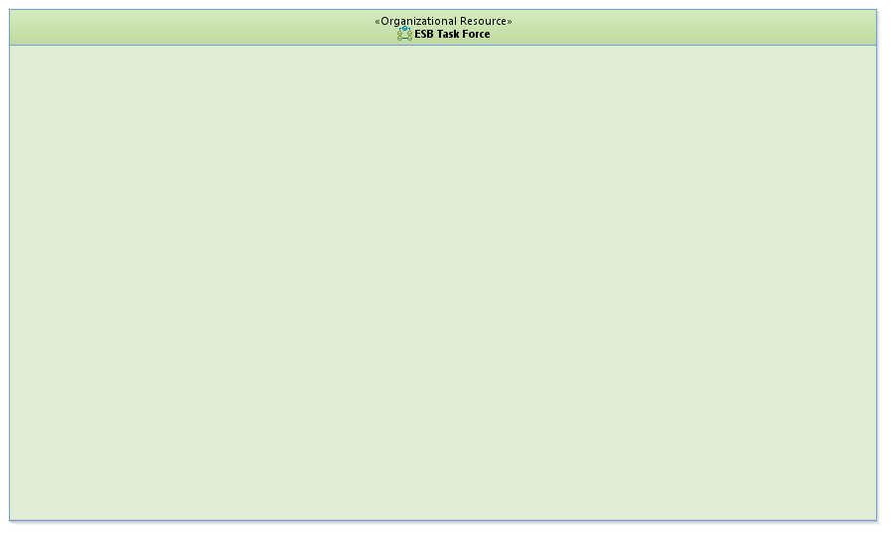

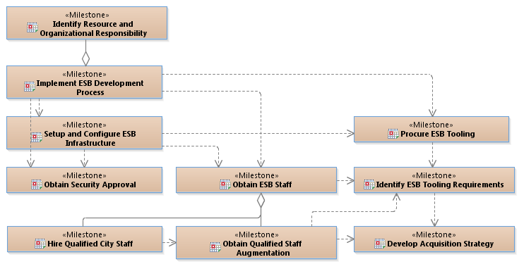
Sequencing Plans Development (transition from current to future state)
Sequencing Plan = Action Plan

Slide 15
Notional Waterfall Project Schedule Based on Sequencing Plan
Time
start
stop
Develop Acquisition Strategy
Identify ESB Tooling Requirements
Procure ESB Tooling
Obtain Qualified Staff Augmentation
Hire Qualified Staff
Implement ESB Development Process
Identify Resource and Organizational Responsibility
depends on acquisition strategy
Setup and Configure ESB Infrastructure
Obtain Security Approval
Based on Sequencing Plan Milestones

Slide 16
Customer Facing Delivery Model

Slide 17
Customer Service Description
Customer Service | Description
Provide Risk Assessment and Total Cost of Ownership for New and Improved Infrastructure Capabilities | Provide city governance entities such as CIO Council (CIOC), Department Directors Advisory Council (DDAC), and IT Steering Committee (ITSC) budgeting, total cost of ownership, cost value, risk mitigation, and other programmatic elements relevant to new and improved infrastructure capabilities.
Provide Infrastructure Services | Provide platform and infrastructure as a service, authentication (such as Federated authentication infrastructure), IT security, integrated system architecture, voice over Internet Protocol (VIOP), analog voice services, business continuity, email, badging, fax services, configuration management, open source tooling, IT hardware, data center operations (storage, servers, and virtualization), and networking.
Recommend Operational Efficiencies | Recommend infrastructure operational efficiencies to include Citywide standardization, economies of scale, and best practice guidance.
Provide Consulting Leadership | Provide consulting services to establish process with other departments, scheduling, asset management, vendor coordination, PC imaging, PC refresh, standardization, budgeting (costing), financial allocation, life cycle management, security governance model, Citywide IT infrastructure, contract coordination, etc.
Deliver End-Point Infrastructure Support | Assists city employees with IT infrastructure support needs to include desktop anomalies. This service is typically triggered through the service desk.
Provide Direct IT Service | Mayor and Council represent important leadership roles here at the City and require special attention as they respond to citizen needs. Therefore, special care is provided to ensure that IT services are meeting their needs.
Respond to Public Information Requests | Through the policy of open government, Mayor and Council sometimes are requested to deliver public information to its citizens. This service provides policies and procedures to gather the requested information and deliver it Mayor and Council per their request.
Provide Internet for Public Access | Provides Internet services throughout our City (mostly in City owned property) such as COA Mesh and Internet access points at City Hall where the public may freely access the Internet.

Slide 18
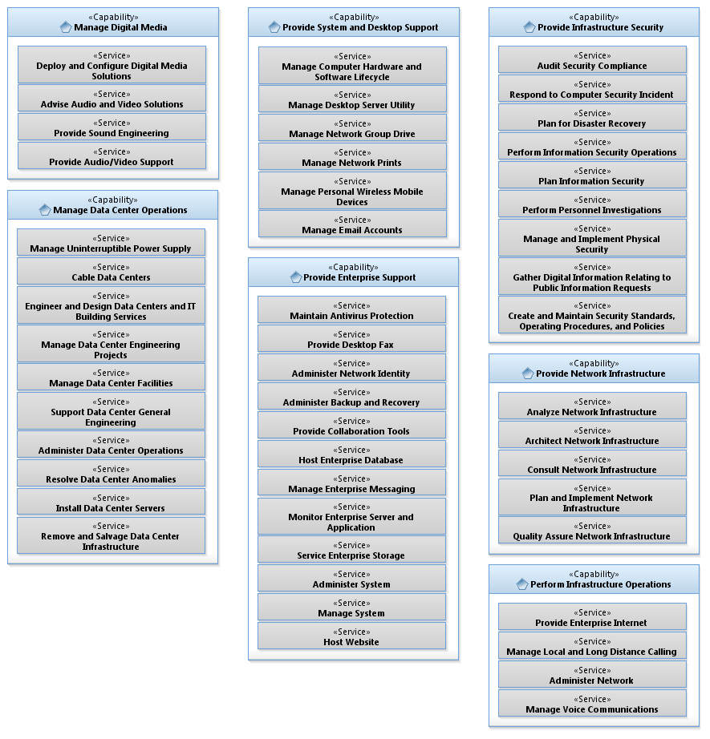
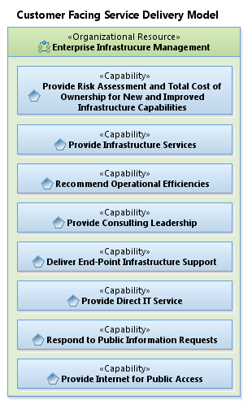

Improve Service Delivery Model
Service Catalog Rewritten to
Emphasize Outcome
Establish
Improvement Goals
Measurable Objectives
Develop Sequencing Plan
Look for concentrations and patterns
- Model becomes discussion point

Slide 19
EA Requires Leadership Support and Understanding…
EA process is industry best practice
There’s still much work to do…
Continue black-box approach for DDAC selected business units
Identify important business patterns (i.e., shared capabilities/goals)
Incorporate EA into the DDAC planning and decision-making process

