Slide 1
Enterprise Architecture
– A Citywide Strategy
Aligning Information Technology Services to the Business Needs of the City…
Rob Byrd Chief Enterprise Architect

Slide 2
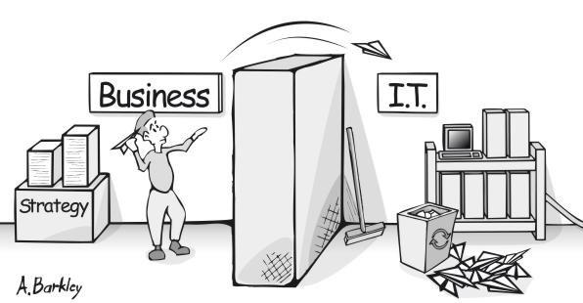
The Business Struggle

Slide 3
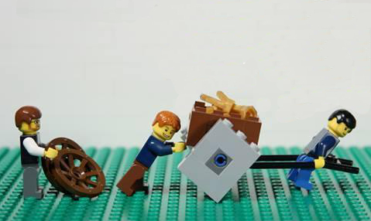
The Enterprise Architecture Struggle
I’m here to help you with your architecture
No thanks!
We’re too busy…

Slide 4
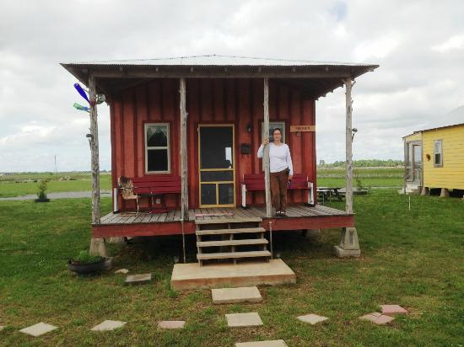
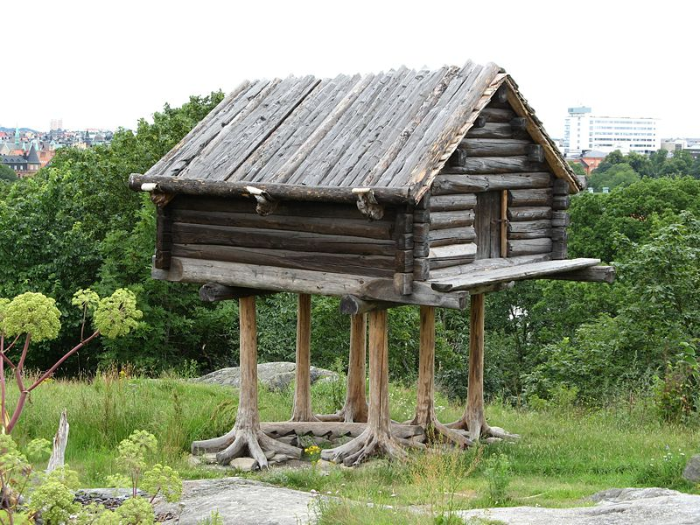
Importance of Enterprise Design
What the business user wanted…
What the business user got…

Slide 5
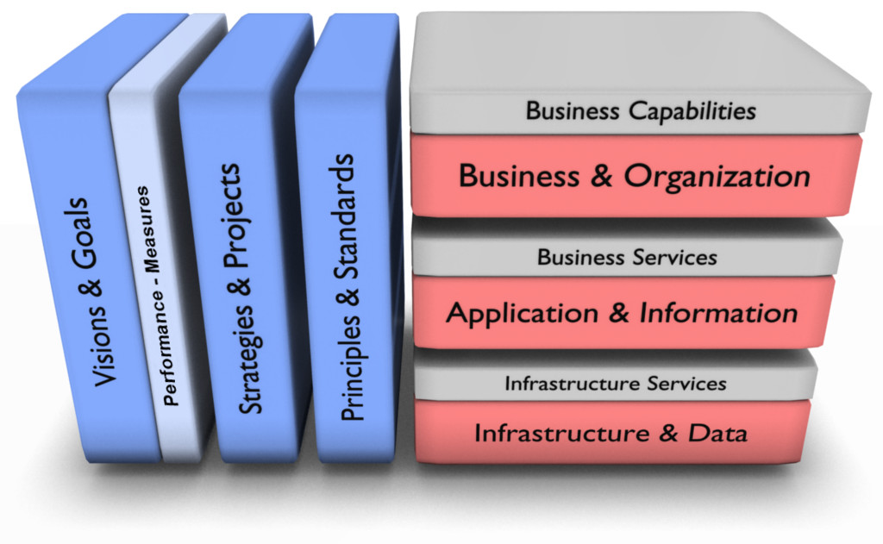
Align IT Services to Business Capabilities

Slide 6

Business Plan Alignment
Enterprise Architecture
Department
Business Architecture
Enterprise Context
Business Plan
Enterprise Processes
Information
Technology
Solution Architecture
Enterprise Services
Implementation Components
Business Plan

Slide 7
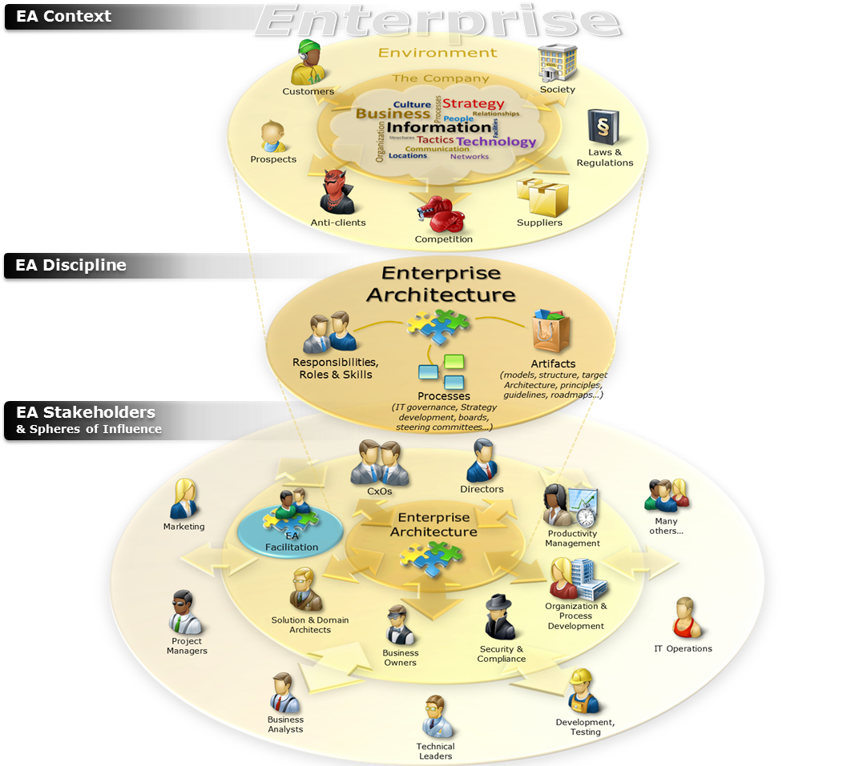

Slide 10
Enterprise Architecture Establishes Order

Slide 11

Managing Complexity
<<vision>>
Best Managed City
<<capability>>
Manage Infrastructure
<<capability>>
Clean Water
<<capability>>
Equal Opportunities
<<capability>>
Healthy Economy
<<capability>>
Safe Public
<<capability>>
Healthy Community
<<capability>>
Reliable Energy
<<capability>>
Mobile Community
Establish Goals
<<goal>>
Conserve Water Resources
<<goal>>
Integrate Case and Asset Management
<<goal>>
Sustain Environment
<<goal>>
Optimize Operations
<<goal>>
Increase Revenue
<<goal>>
Respond to Customer Needs
<<goal>>
Define Mobile User Processes

Slide 12
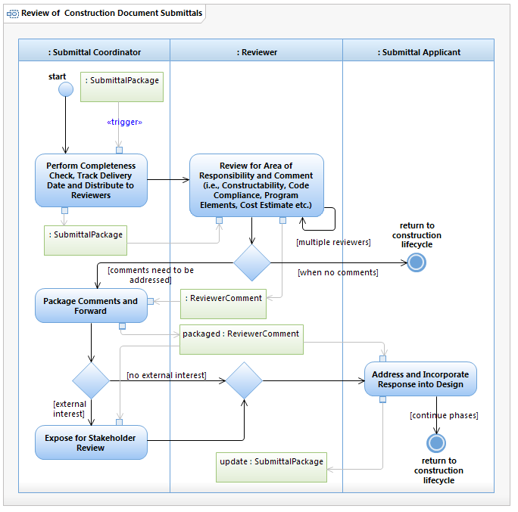
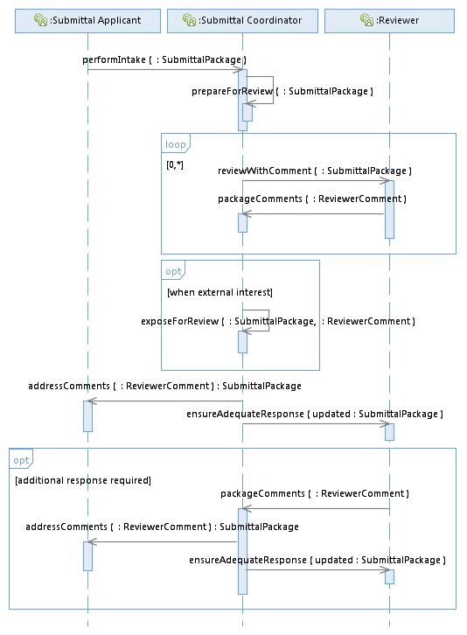

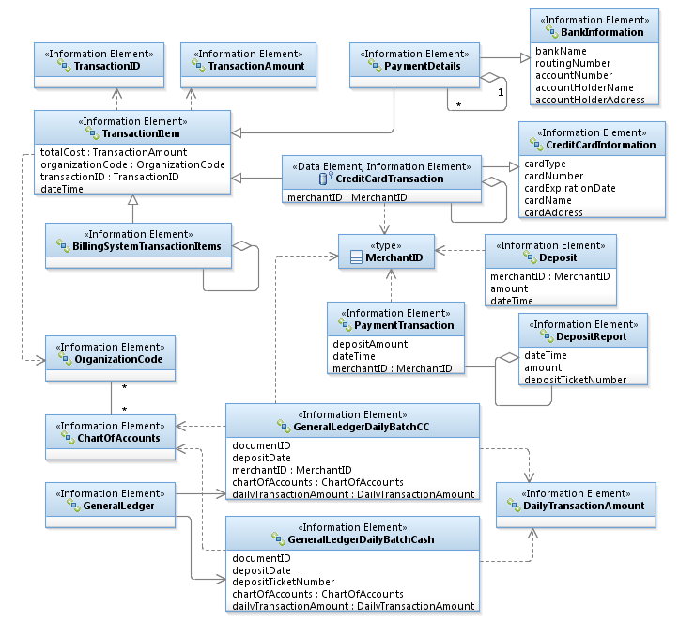
Managing Complexity
Process
Integration
Information
Business developed!

Slide 13
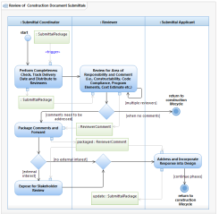
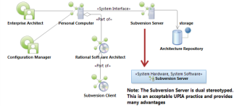
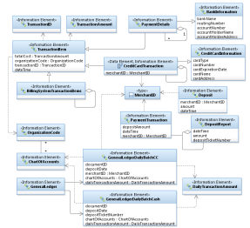
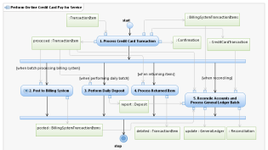
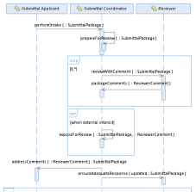
Identifying Common Opportunities
<<vision>>
Best Managed City
<<capability>>
Manage Infrastructure
<<capability>>
Clean Water
<<capability>>
Equal Opportunities
<<capability>>
Healthy Economy
Identify Common Capabilities
<<capability>>
Safe Public
<<capability>>
Healthy Community
<<capability>>
Reliable Energy
<<capability>>
Mobile Community
Identify Common Process
Goals Amplify Vision!
Identify Common Infrastructure
Identify Common Data
<<goal>>
Conserve Water Resources
<<goal>>
Integrate Case and Asset Management
<<goal>>
Sustain Environment
<<goal>>
Optimize Operations
Identify Common Goals
<<goal>>
Increase Revenue
<<goal>>
Respond to Customer Needs
<<goal>>
Define Mobile User Processes

Slide 14
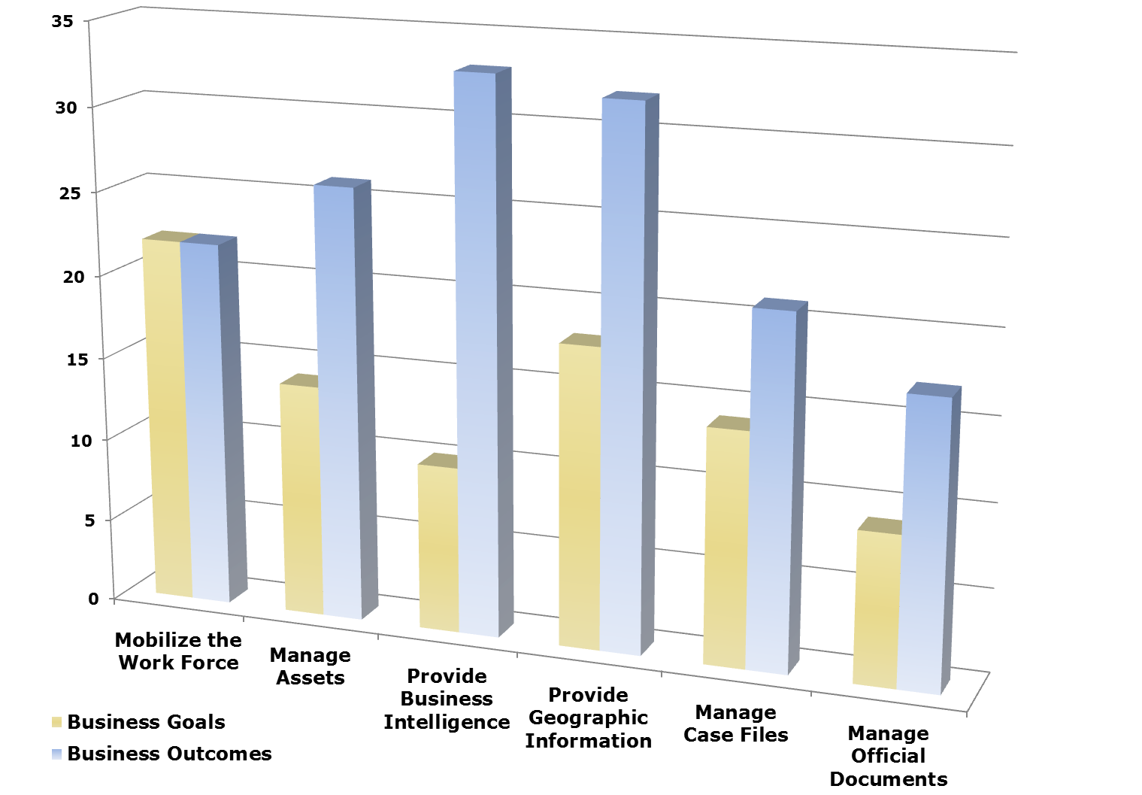
Architecture Investment Analysis
Outcomes
Goals

Slide 15
Success Stories…
Successful enterprise service bus (ESB) rollout…
Best RFP we’ve ever seen - excellent specifications!
Integrated electronic planning review with permitting
Who was the consulting firm you hired to write the RFP?
Developed employee safety business application in just 48 hours – included mobile component
Business-driven data model - “This is a highly valuable tool,” James Snow, PWD Assistant Director
Identified common business application service needs
Documented over 100 HR Processes!
And many, many more...

Slide 16
Way Ahead
Train department Enterprise Architects…
Train once a week for 3 hours ~ 1 year or more to certification
Three certified – two departments 311 and Convention Center
Others currently in training…
Need more full-time EA staff
Business need outpacing capacity to deliver…
Get the word out!
2015
2016
Develop EA staff
Architect business planning and governance
Put EA in full action…

Slide 17
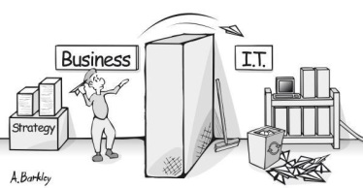
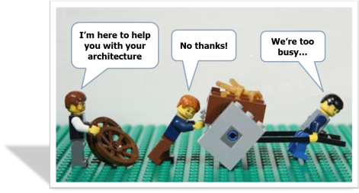

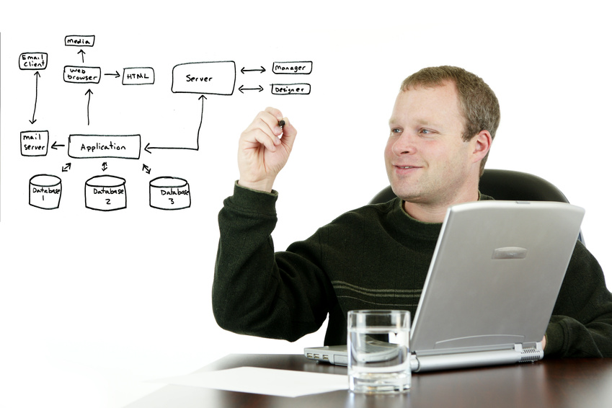
Let’s Connect IT to Business Need
Please champion Enterprise Architecture!

