Slide 1
Rob Byrd Chief Enterprise Architect
Environmental Health Services Business Process Improvement
Aligning Information Technology Services to the Business Needs of the City…

Slide 2
Purpose
Develop and evolve an integrated Health and Human Services (HHS) system by developing a comprehensive enterprise architecture (EA) to communicate functional needs for future proposals or internal development activities
Elicit business needs from relevant stakeholders to describe the future state of the HHS system
Use the EA to identify potential early fixes to business process using the existing system and to manage progress of the future state HHS system

Slide 3
Vision/Mission
Vision - Provide an advanced Health and Human Services system delivering paperless records management, effectively managed workflow, Web services for customer self-service and workforce mobility, data portal to disseminate information to the public, and an effective and comprehensive financial and resource management capability
Mission - Provide environmental health services for the health and safety of the community

Slide 4
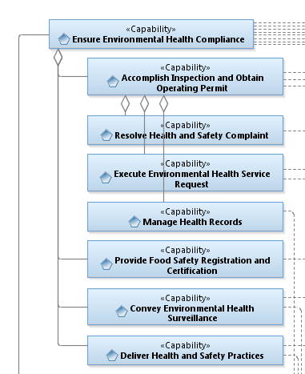
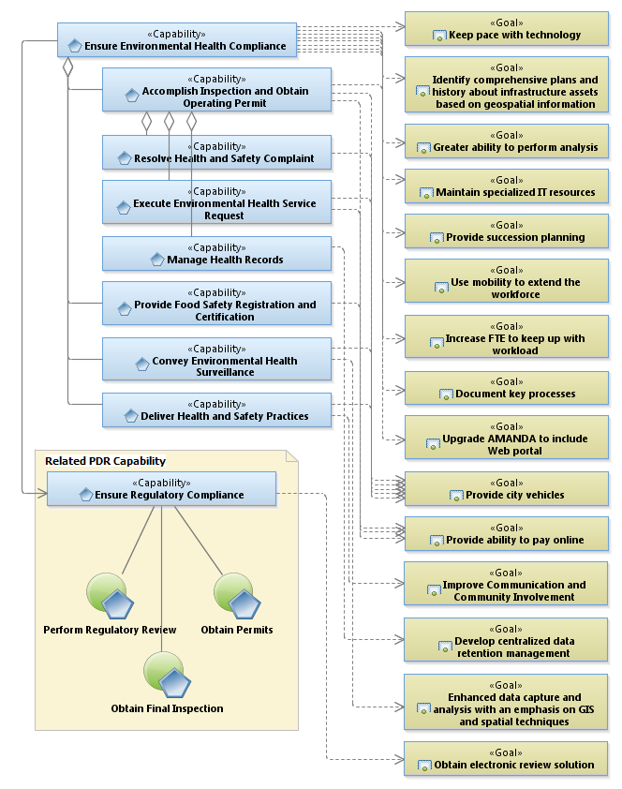
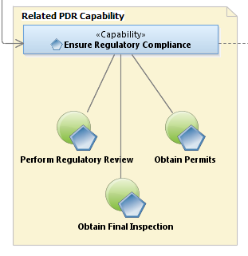
Capability Area Architecture

Slide 5
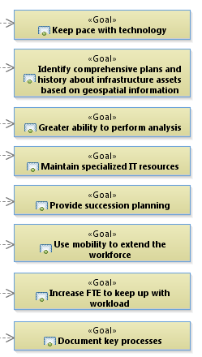
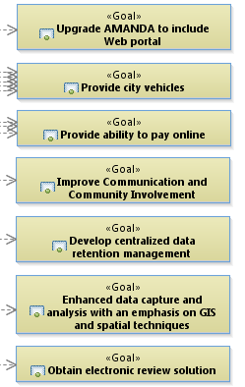
Capability Area Architecture

Slide 6
Processes Analyzed
Inform Public on Pest Management
Perform Facility Health Review
Perform Recreational Water Sampling
Quantify Mosquito Population
Report Legal Compliance

Slide 7
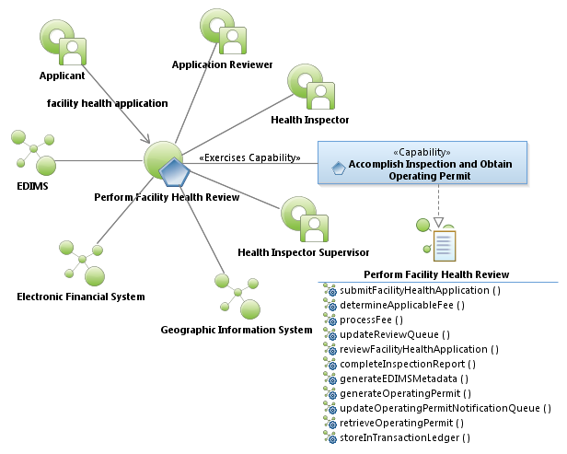
Perform Facility Health Review

Slide 8
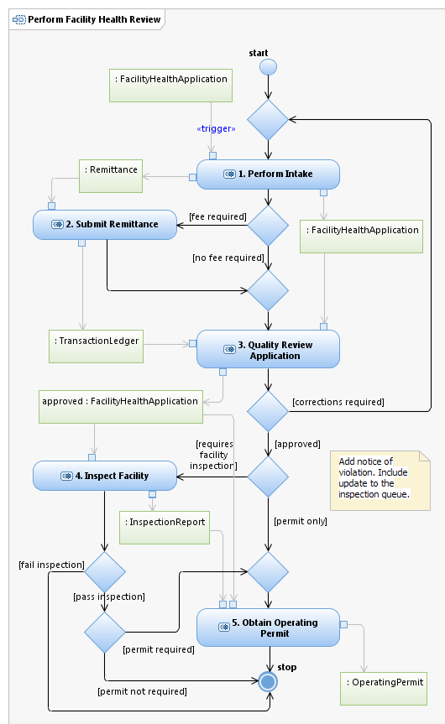


Slide 9
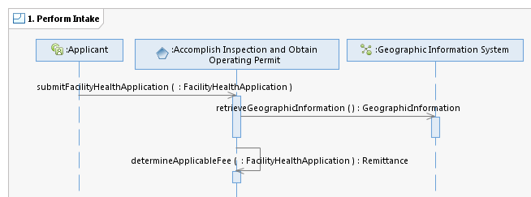

Perform Intake
Through a Web portal, the system guides the Applicant to the proper application(s) to request a facility health review. This may include a request for Operating Permit when successfully obtained a Certificate of Occupancy for new facilities or remodels, a re-occurring request for an Operating Permit, a facility heath inspection for Change of Ownership, a facility health inspection for general facility assessment, custodial care inspection, or health facility related complaint. The system provides form(s) for Health Inspection Application, Operating Permit Application or both when needed, custodial care inspection, a health related complaint requiring a Health Inspector assessment and Food Handler Employee List. When supporting documentation is required such as Certificate of Occupancy or Change of Ownership, the system provides a method for the Applicant to upload the documentation included with the Facility Review Application. If the Applicant obtained a Certificate to Occupancy through the Planning and Development Review (PDR) use case Obtain Final Inspection, the Applicant enters the PDR reference code instead. The system provides the Applicant the ability to expedite inspections and permits. By doing so, the requested Facility Health Application is given higher priority in the selected queue - i.e., Review Queue and/or Inspection Queue. For Food Handler Employee List, the system correlates / adjudicates known food handlers already existing in the system through the food handler registration process.
For certain intake items, the system uses city available Geographic Information System to retrieve and populate Project Information. Can be used to explore and/or research the Geographical Information System.
The system determines the required fee based on fee tables or similar means of fee calculation. The fee table or related lookup must be modifiable by approved city staff. The fee table takes into consideration certain attribute values of the Inspection Application such as recent issuance of Certificate of Occupancy, requests for inspection only application or Change of Ownership requiring an inspection. The system checks the Operating Permit application to determine if there's a change in ownership and the system requires an inspection and notifies applicant of the additional inspection application and fees. Fees may include such items as late fees, compliance verification, fess for previously approved but incomplete submission (such as non-compliance of food handlers), expedite inspections and permits, custodial care inspection etc.

Slide 10
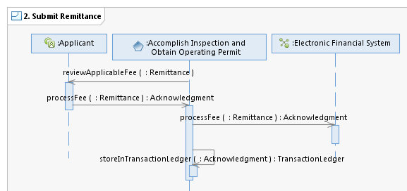

Submit Remittance
The Applicant is presented with a summary representing the required fee and terms and conditions associated with payment.
The Applicant uses the system to process online financial transactions with the city's approved financial service provider.
When an Acknowledgment is received from the Electronic Financial System (i.e., the city's approved online financial service provider), the system updates the Transaction Ledger for future reconciliation or to determine financial obligation of Applicant based on previous Facility Health Application submissions.

Slide 11
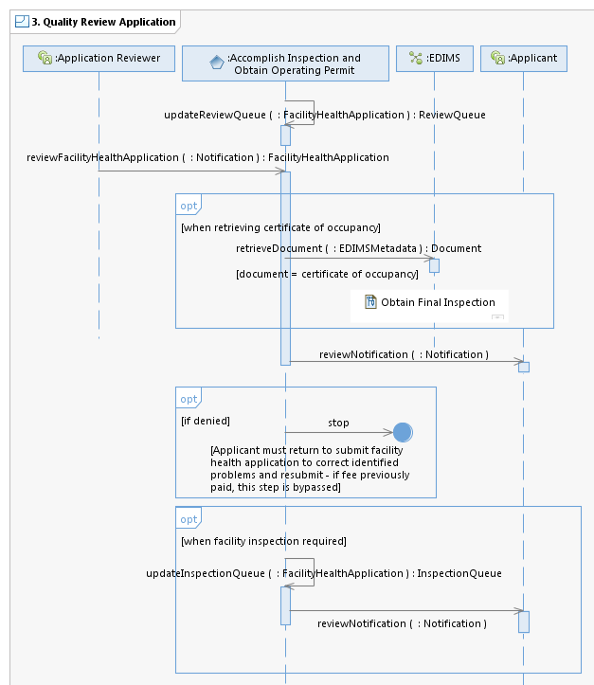

Quality Review Application
Once Acknowledgment is received from the Electronic Financial System (if fee is required), the Facility Health Application is added to the Review Queue in date/time order for a quality review by Application Reviewer. Expedited Facility Health Applications are given priority in the Review Queue.
The Application Reviewer selects items in the Quality Review Queue based on the date/time order and reviews the Inspection Application for completeness and accuracy. Once selected for review, the system removes the selected quality item from the queue to prevent multiple reviews from the same item by other Application Reviewers. The Applicant Reviewer can make minor corrections as need for proper processing. The Application Reviewer reviews the Inspection Request Application and determines the condition of the Inspection Application as either approved or denied. If denied, the Application Reviewer indicates the reason for denial and provides relevant information for the Applicant to correct and resubmit. On resubmission, the system bypasses fees already paid. The system provides a template of modifiable, predefined responses selectable by the Application Reviewer. Each template is customizable based on the profile of the Application Reviewer. The template is used for routine and common errors made by Applicant submissions. If a cross reference code was provided for Certificate of Occupancy, the system automatically retrieves the certificate from EDIMS for Application Reviewer verification. The system allows conditional approval when Food Handler Employee List is incomplete, requiring resubmission by the Applicant; however, the Operating Permit may still be issued. The conditional approval is tracked by the system to ensure follow up completion by Applicant.
The system generates the necessary enterprise document imaging and management system (EDIMS) meta-data needed for Document retrieval and retrieves the associated Document.
Once the Facility Health Application is approved and a facility inspection is requested or required, the system adds certain application attributes needed by the Health Inspector to the Inspection Queue. Inspection Queue items are stored in date/time order to ensure fair inspection order and expedited inspection requests are given priority in the Inspection Queue. The system automatically updates the Inspection Queue by assigning Inspectors based on area of responsibility or jurisdiction - this is determined by the Geographic Information retrieved during Facility Health Application submission. The Inspection Queue includes inspection items relevant to Health Inspector identified on the by PDR use case Obtain Final Inspection for new facility or remodeled facility. The Inspection Queue manages re-occurring inspection needs such as initial 30 day inspection for new or remodeled facilities and other routine re-occurring inspections requiring Health Inspector.

Slide 12
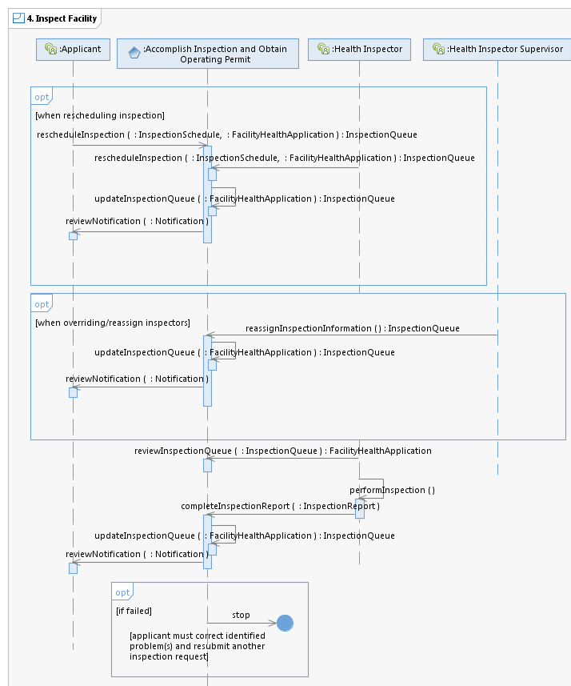

Inspect Facility
The Applicant use the Web portal to view their scheduled inspection and reschedule the inspection if required. The system provides a selectable calendar of available inspection opportunities. This can also be used by the Inspectors to reschedule inspections when verbal communications occurs between the Applicant and the Inspector. The Notification message provides a link to the rescheduling Web portal for Applicant access when required. The Web portal provides guidance and constraints on any rescheduling limitations.
The system provides an electronic means of communicating with the Applicant throughout the Facility Health Application process. The means of communications - i.e., text message, email, etc. is established on the Facility Health Application. During the initial application process, the text message or email is validated with the system to ensure established and valid source. The Applicant receives a Notification on the status of their Facility Health Application as approved or denied with reason for denial and action required to resubmit. This message also provides indication of Health Inspector assigned, their contact information and the initially planned inspection time and date to include continual updates as the Inspection Queue items are completed, feedback on inspection results and link to Operating Permit if applicable. The system identifies renewal dates/time indications and automatically notifies the Applicant to resubmit to renew Operating Permit when time period nears expiration.
The system provides a Health Inspector Supervisor the ability to modify the Inspection Queue to include Health Inspector assignment, priority order, and inspection timing. The Health Inspector Supervisor may also perform a quality review of Inspection Requests. The system provides adjustable alerts such as an Inspector with too many assigned inspections, Health Inspector not logged in during specified inspection hours, location indication is provided by communicating the mobile device location, customer service indications of inspection times based on nominal, historic results etc. The system alerts the Health Inspector if departing the site without entering some form of inspection result.
The system provides the Health Inspector with a geographical map with inspection item pins indicating inspection locations and indication of order of inspection. As items are rescheduled by the Applicant or Health Inspector, the system automatically updates the geographical map information. The Health Inspector can use the map to navigate to the inspection location. When a map pin is selected, a pop-up balloon provides selectable details regarding the inspection such as special access information (i.e., codes to gate, on site person to contact, and other relevant information regarding the inspection location). [Note: This information was previously entered as an attribute value on the Inspection Request Application.]
On inspection completion, the Health Inspector uses the system to provide assessment feedback regarding inspection result. The Health Inspector may indicate conditional elements requiring correction at some agreed future date. The date and item requiring correction are entered into the system for Inspection Queue update to ensure follow up by a Health Inspector at some future date. [Note: The follow up inspection automatically generates an updated Operating Permit based 12 months of conditional permit.]

Slide 13
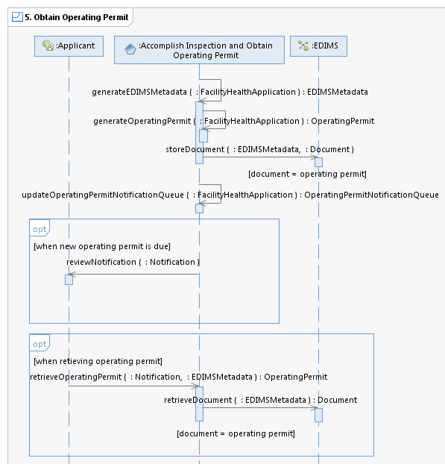

Obtain Operating Permit
Using relevant attribute values on the Inspection Request Application such as owner, address, name of establishment, etc., the system automatically generates an Operating Permit. The Operating Permit may include a conditional Operating Permit to include special operating conditions until follow up inspections provide opportunity for a full Operating Permit.
The system gathers relevant information from the Inspection Request Application among other client information stored in the system and generates EDIMS meta data.
For certain Operating Permits requiring re-occurring renewal, the system automatically adds the renewal date to the Operating Permit Notification Queue and notifies the Applicant prior to the expiration date that renewal is required - the notification period prior to renewal due date is modifiable by approved staff. The Notification include links to the renewal Facility Health Application for renewal along with the necessary details required for compliance such as Food Handler List requirements, etc.
Based on a link provided by the Notification message, the Applicant selects the link to retrieve the Operating Permit to print and display at the appropriate location in the establishment.

Slide 14
Recommendation
Streamlining existing paper processes yields only marginal time savings
Maximum time saving benefits are achieved through customer self service
Pursue architecture activities that allow customers to interact with EHS using Web enabled portal
Perform Intake
Submit Remittance
Quality Review Application

