Slide 1
Rob Byrd Chief Enterprise Architect
Enterprise Architecture
– A Citywide Service Delivery Strategy
Aligning Information Technology Services to the Citizen Needs of the City…

Slide 2
Enterprise Architecture Purpose and Value
Identify important business needs using a data-driven, decision-making framework
Align information technology services to produce maximum citizen value
Deliver "horizontally" integrated enterprise solutions while recognizing innovative strategies
Identify risk early to mitigate decisions and solutions

Slide 3
Capability Understanding Drives Successful Solutions
Capability: People, process and technology delivering value for a specific purpose. The quality of being capable; to have the capacity or ability to do something, achieve specific outcomes, effects or declared goals and objectives
Understanding enterprise-wide capabilities…

Slide 4
The Question
What technology investments best improve citizen services (i.e., business capabilities) delivered by city departments?

Slide 5

Managing Complexity
<<vision>>
Best Managed City
<<capability>>
Manage Infrastructure
<<capability>>
Clean Water
<<capability>>
Equal Opportunities
<<capability>>
Healthy Economy
<<capability>>
Safe Public
<<capability>>
Healthy Community
<<capability>>
Reliable Energy
<<capability>>
Mobile Community
Establish Goals
<<goal>>
Conserve Water Resources
<<goal>>
Integrate Case and Asset Management
<<goal>>
Sustain Environment
<<goal>>
Optimize Operations
<<goal>>
Increase Revenue
<<goal>>
Respond to Customer Needs
<<goal>>
Define Mobile User Processes

Slide 6
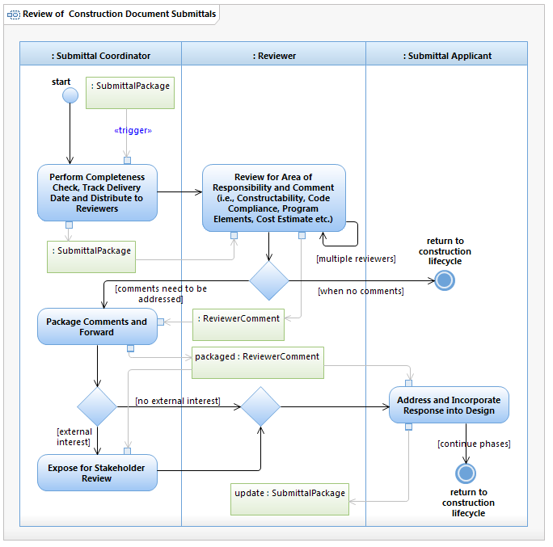
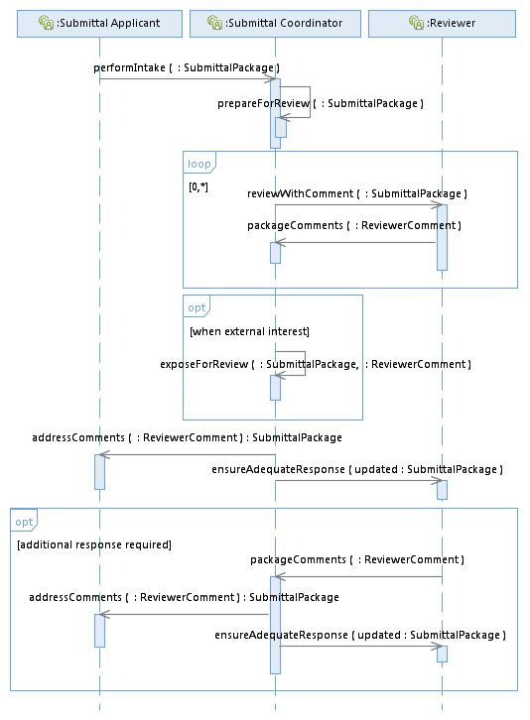

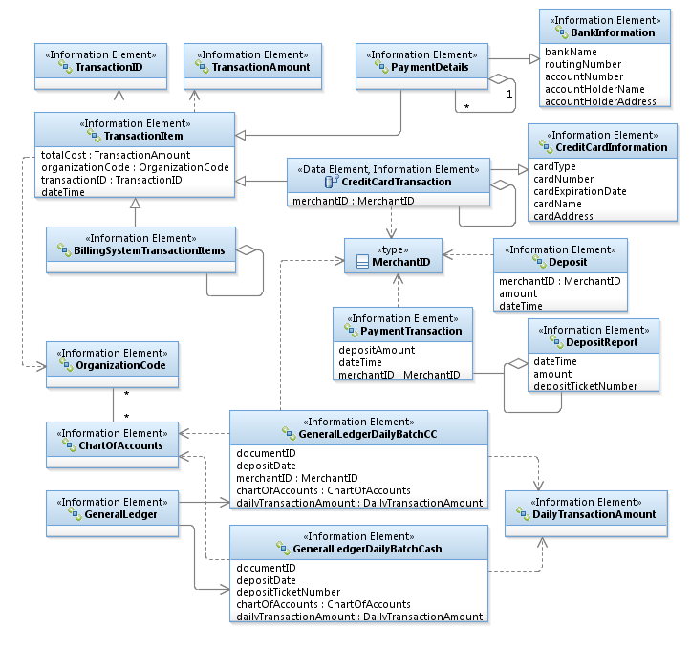
Managing Complexity
Process
Integration
Information
Business developed!

Slide 7
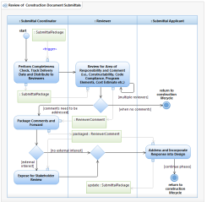
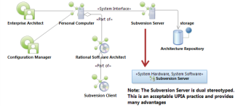
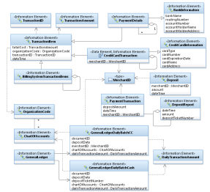
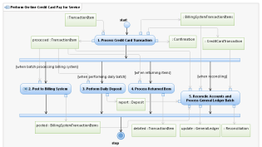
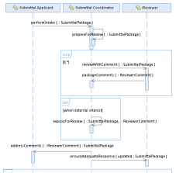
Identifying Common Opportunities
<<vision>>
Best Managed City
<<capability>>
Manage Infrastructure
<<capability>>
Clean Water
<<capability>>
Equal Opportunities
<<capability>>
Healthy Economy
Identify Common Capabilities
<<capability>>
Safe Public
<<capability>>
Healthy Community
<<capability>>
Reliable Energy
<<capability>>
Mobile Community
Identify Common Process
Goals Amplify Vision!
Identify Common Infrastructure
Identify Common Data
<<goal>>
Conserve Water Resources
<<goal>>
Integrate Case and Asset Management
<<goal>>
Sustain Environment
<<goal>>
Optimize Operations
Identify Common Goals
<<goal>>
Increase Revenue
<<goal>>
Respond to Customer Needs
<<goal>>
Define Mobile User Processes

Slide 8
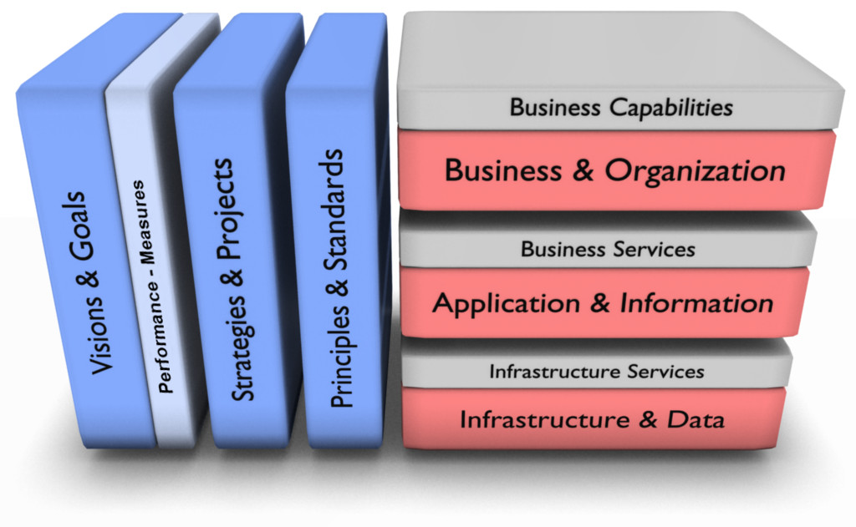
Managing the Service Delivery Stack

Slide 9
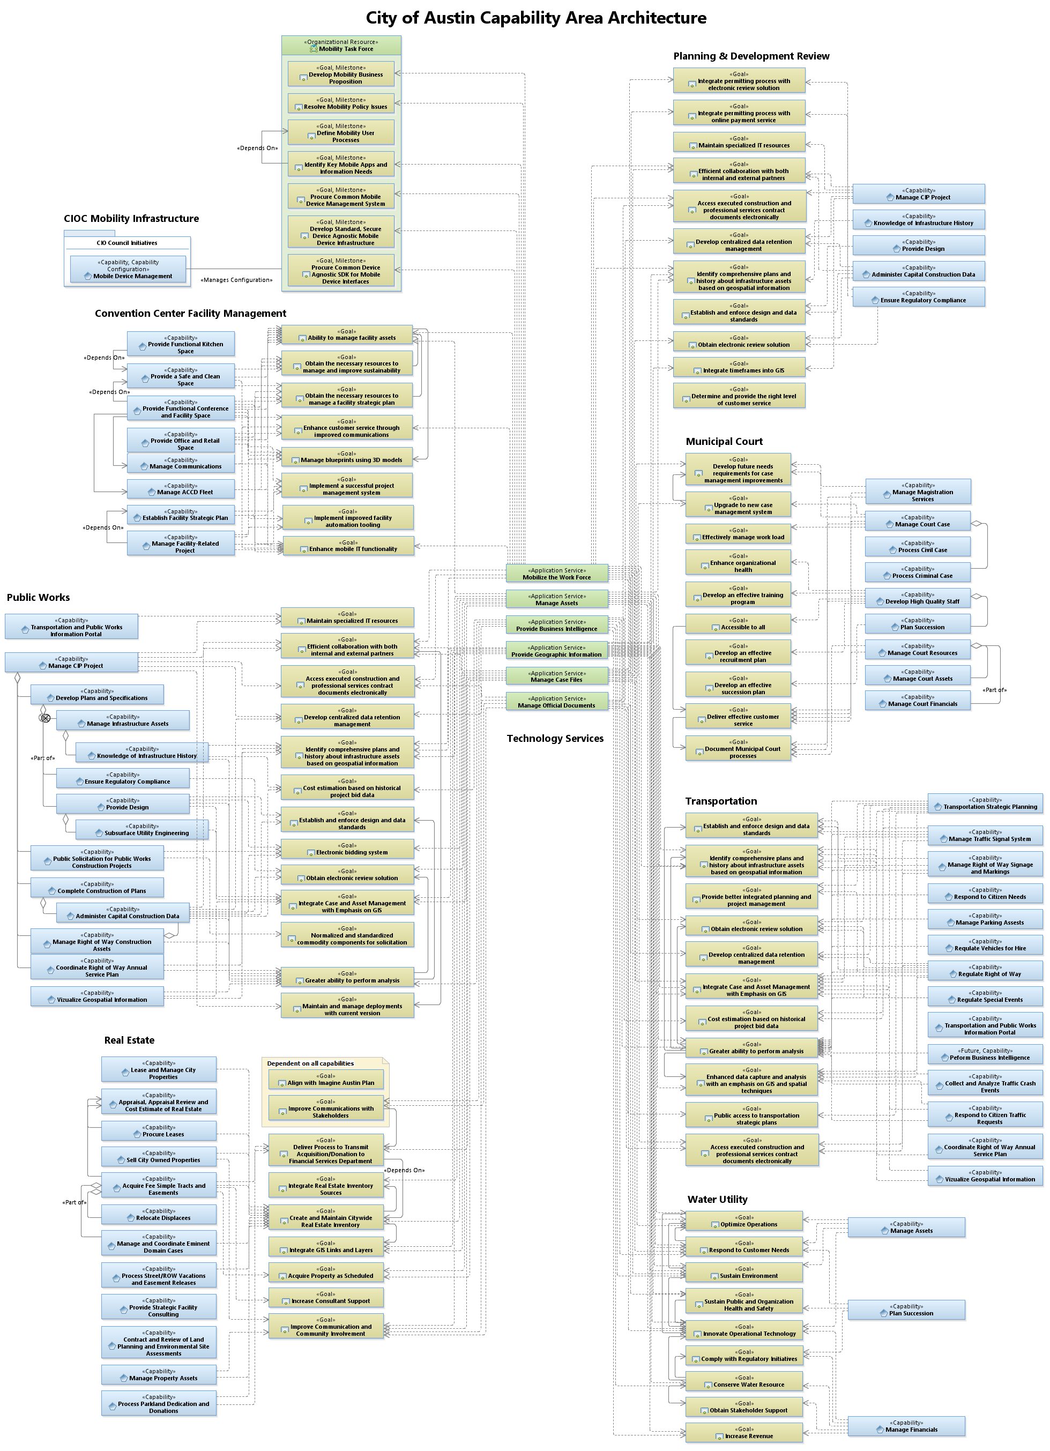
Capability Model

Slide 10
Data-Driven Knowledge of Technology Services
Data shows:
Application Service contributes directly to business goal
There are six Application Service types

Slide 11
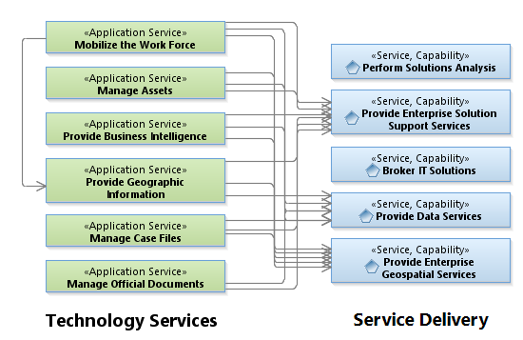
Delivering Technology Services
How Work is Performed
Service Delivery:
Dependency relationship between Technology Services and Service Delivery
Service Delivery organized by skill for efficiency; therefore, Service Delivery does not align one-to-one to Technology Services
Establish goals to increase Service Delivery with emphasis on Technology Services

Slide 12
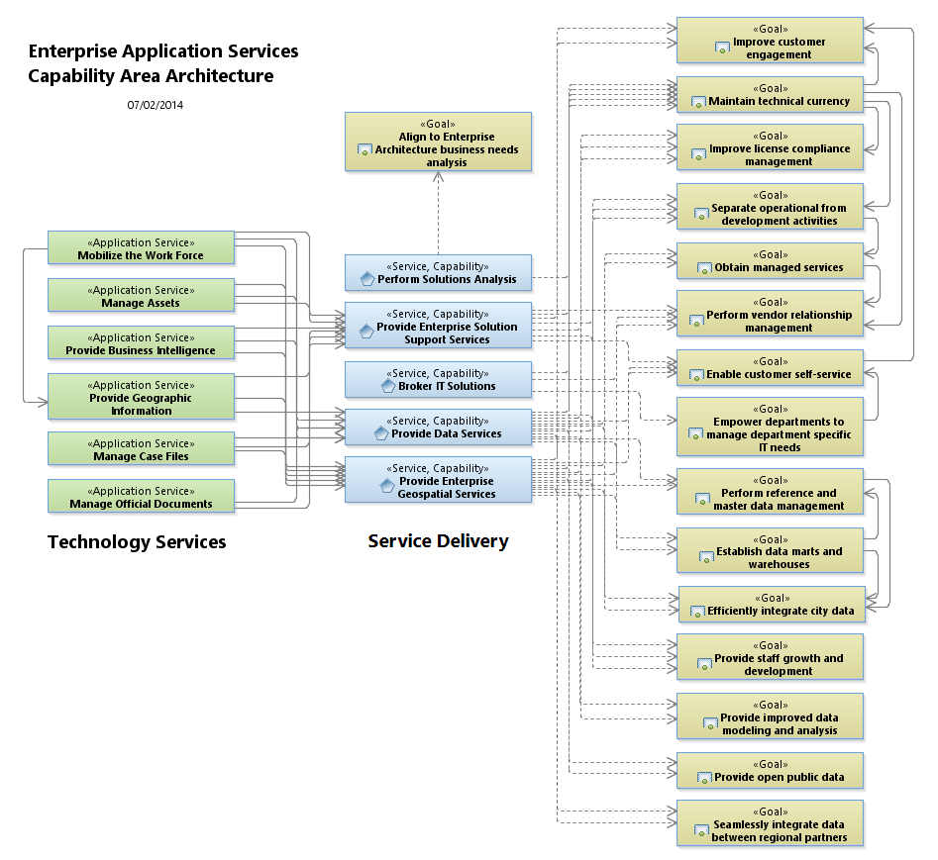
Service Delivery Goals Enhance Technology Services
In essence, Service Delivery goals improves Technology Services, which accomplishes business goals and improves citizen capabilities…"

Slide 13
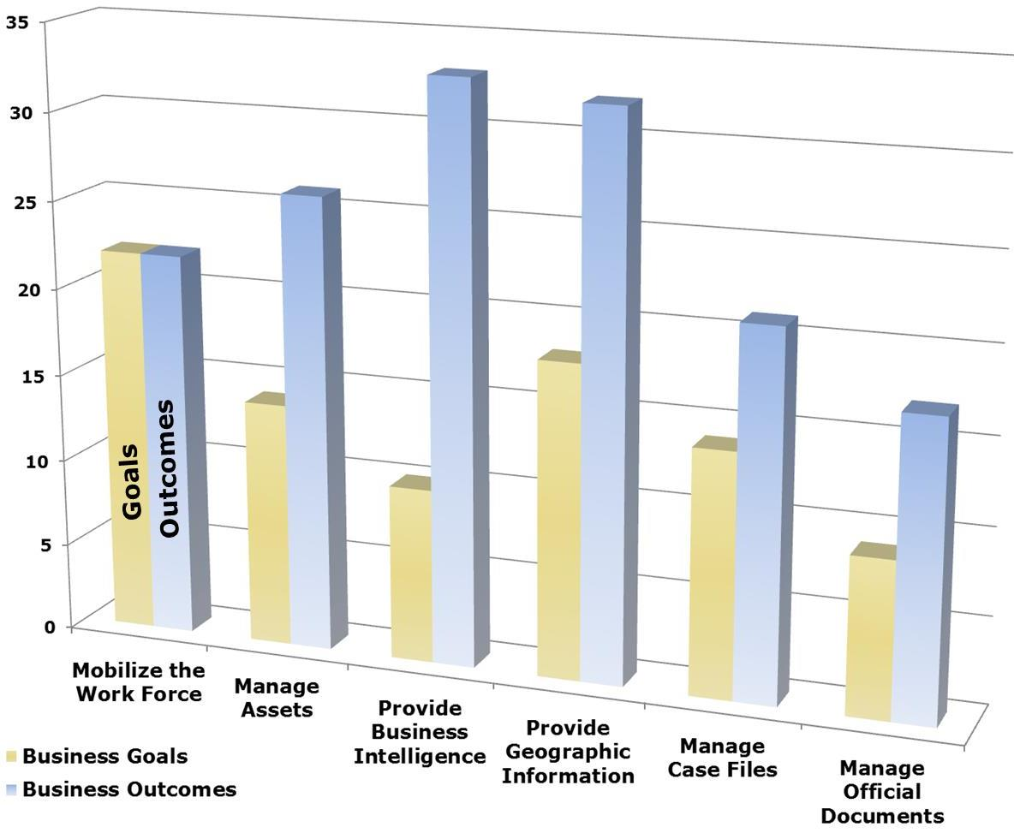
Capability Investment Model
Largest Efficiency Improvement to Citizen Service Delivery
Investment Made
Investment Made
Requires Investment
Requires Investment
Requires Investment

Slide 14
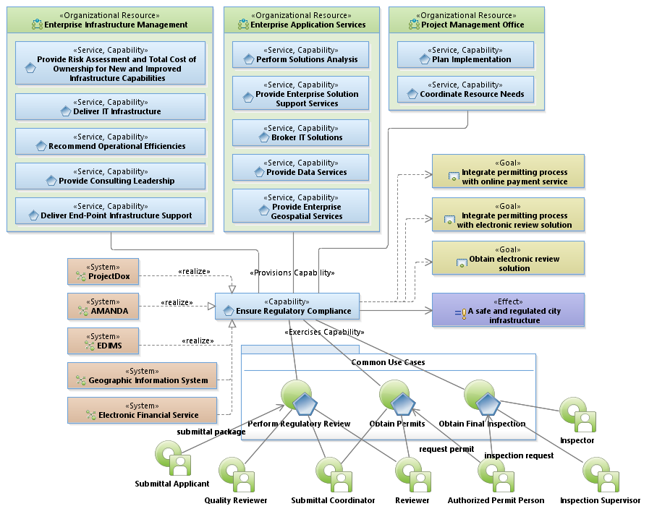
Permitting Service Model

Slide 15
Cloud Computing – Innovation?
Cloud computing, also known as on-demand computing, is a kind of internet-based computing, where shared resources and information are provided to computers and other devices on-demand. It is a model for enabling ubiquitous, on-demand access to a shared pool of configurable computing resources. Cloud computing and storage solutions provide users and enterprises with various capabilities to store and process their data in third-party data centers. It relies on sharing of resources to achieve coherence and economies of scale, similar to a utility (like the electricity grid) over a network. At the foundation of cloud computing is the broader concept of converged infrastructure and shared services.
~Source: http://Wikipedia.org

Slide 16
Summary…
Research and pilot case and work flow management cloud technologies
Enable business self-sustainment
Don't fear failure – learn from pilot activities
Encourage enterprise-wide cloud strategies such as Office 365
Expand managed services for developmental activities – train the workforce
Invest in enterprise architecture
Delivers well-thought through investment strategy focused on citizen desired outcomes
Reduces solution / implementation risk
Enterprise framework looks beyond department silos

