Slide 1
Overview of Enterprise Architecture Artifacts
Rob Byrd
rob.byrd@austintexas.gov

Slide 2

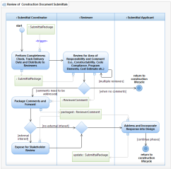
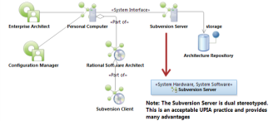
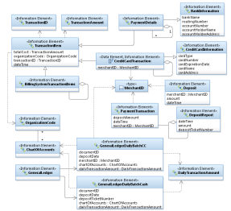
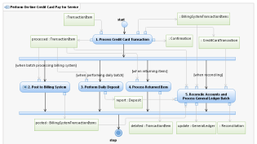
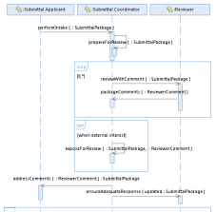
EA Identifies Common Elements
<<vision>>
Best Managed City
<<capability>>
Manage Infrastructure
<<capability>>
Clean Water
<<capability>>
Equal Opportunities
<<capability>>
Healthy Economy
Identify Common Capabilities
<<capability>>
Safe Public
<<capability>>
Healthy Community
<<capability>>
Reliable Energy
<<capability>>
Mobile Community
Top Down – Bottom Up
<<goal>>
Conserve Water Resources
<<goal>>
Integrate Case and Asset Management
<<goal>>
Sustain Environment
<<goal>>
Optimize Operations
Identify Common Goals
<<goal>>
Increase Revenue
<<goal>>
Respond to Customer Needs
<<goal>>
Define Mobile User Processes

Slide 3
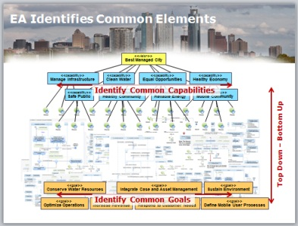
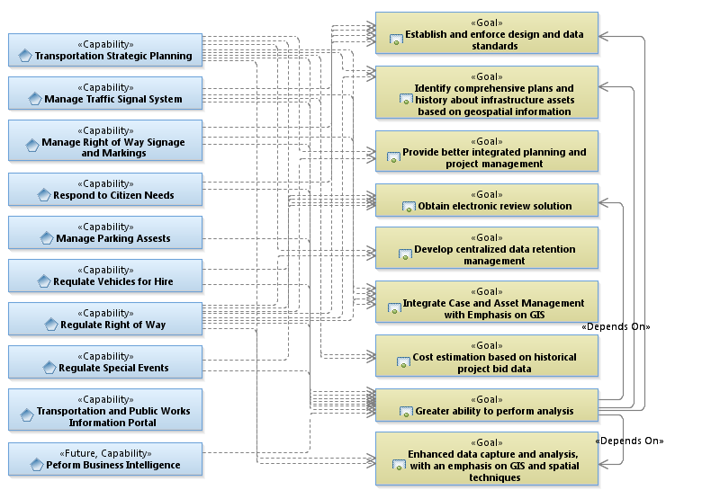
Goal setting… Concentration and Dependency Analysis
Has the greatest need
Provides the greatest solution
Significantly contributes to goal

Slide 4
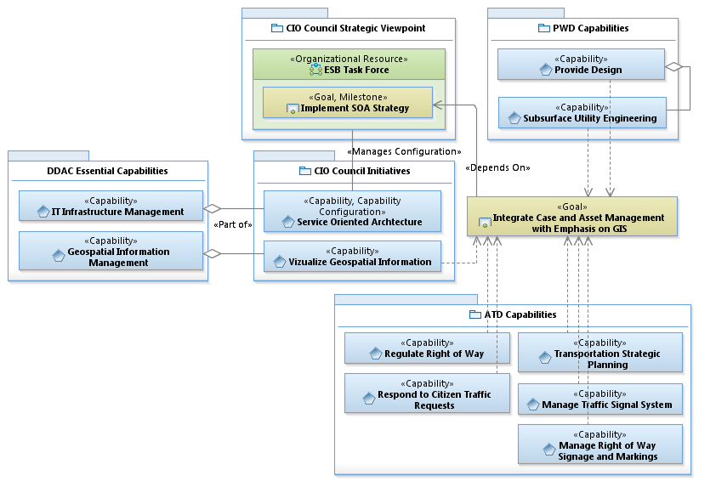
Requirements Analysis Example 1

Slide 5
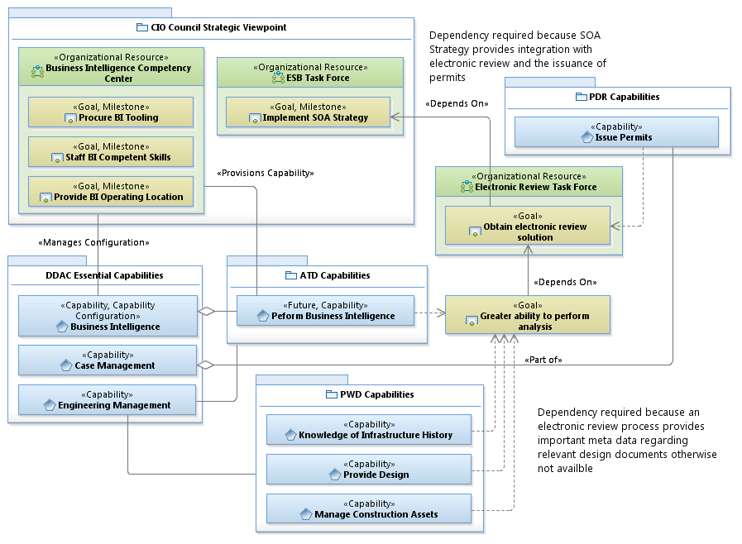
Requirements Analysis Example 2
<Depends On>

Slide 6
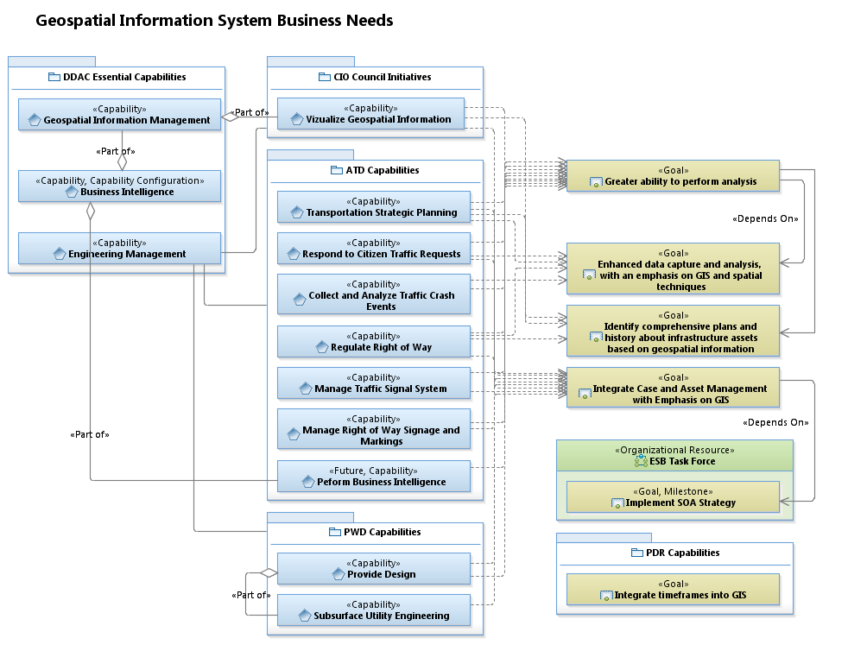
Requirements Analysis Example 3
<Depends On>

Slide 7
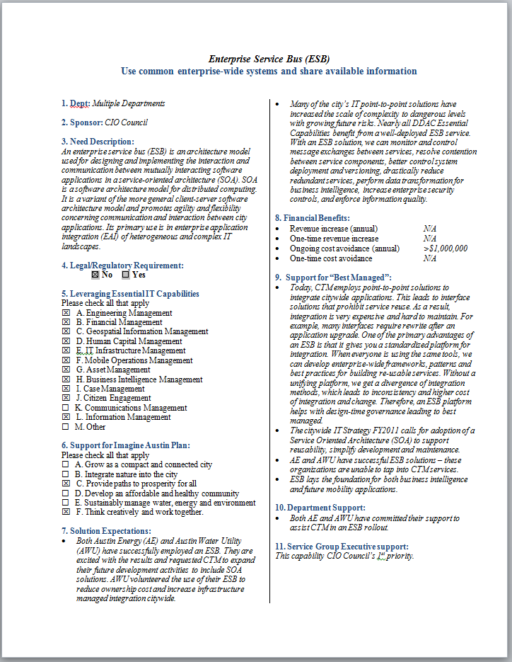
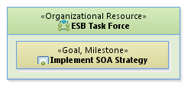
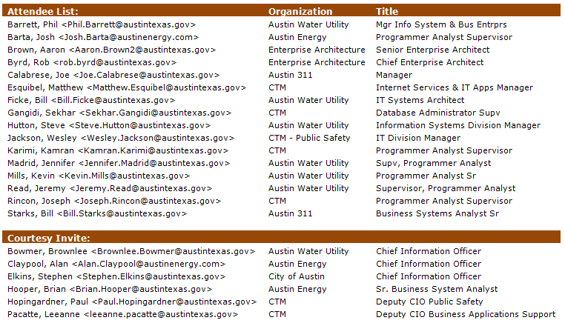
EA – Part of Governance
Business Need Statement
establishes
consists of

Slide 8

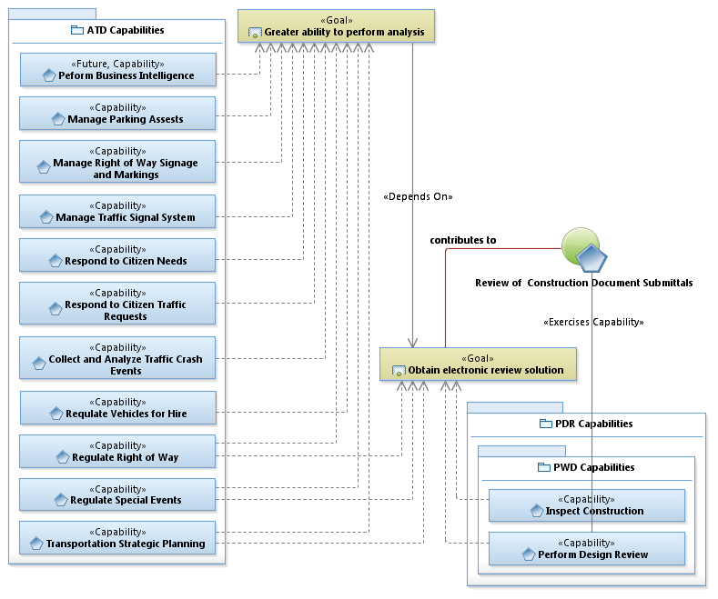
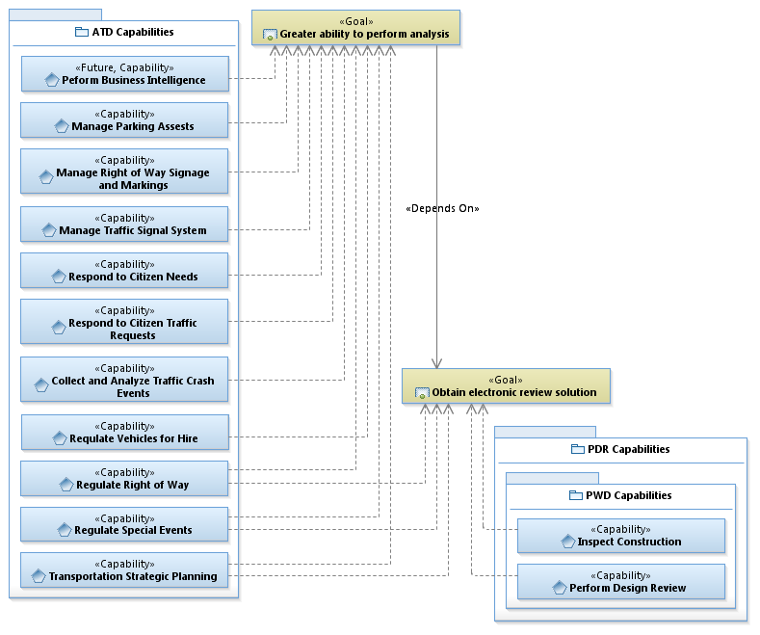
Identifying Common Process
Dependency due to the need for meta-data necessary for analysis
Use Case

Slide 9
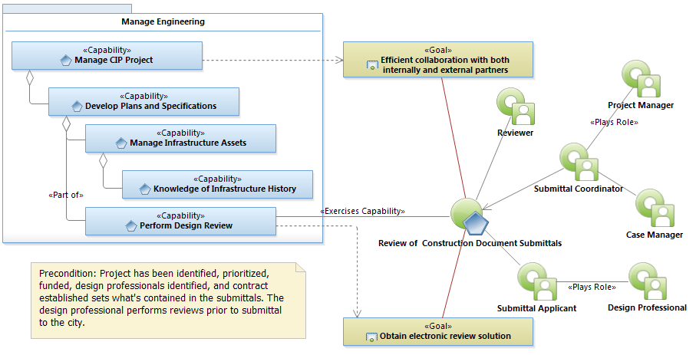
Use Case Diagram
Use Case Specification

Slide 10
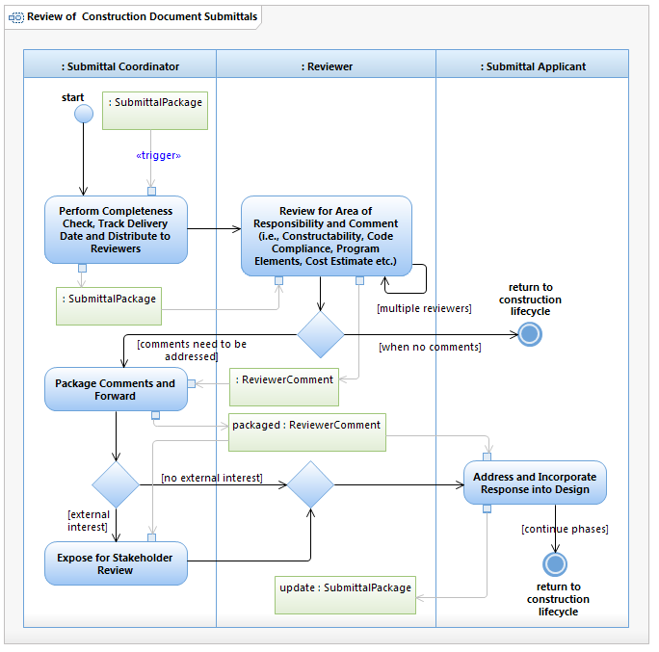
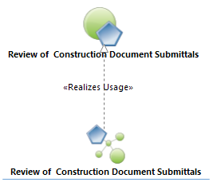
Use Case Realization

Slide 11
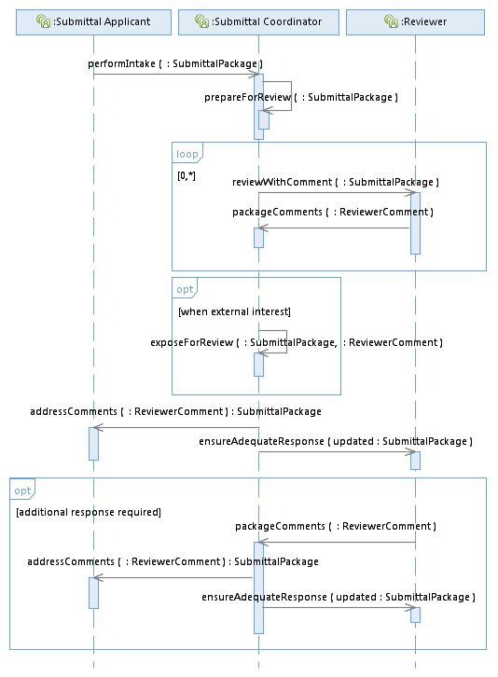
Interface Development
Arrow points to responsible entity
(not necessarily information flow)

Slide 12
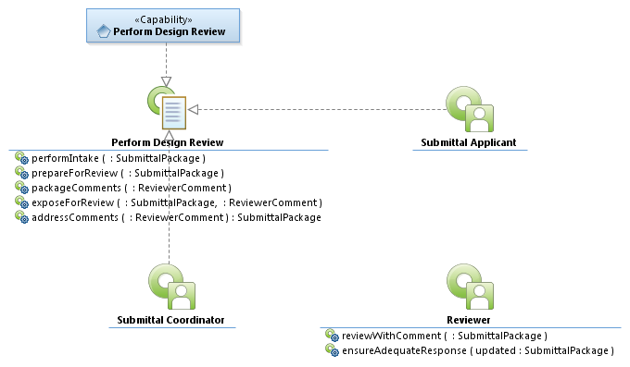
Interface Realization and Specification Development
Makes service request

Slide 13
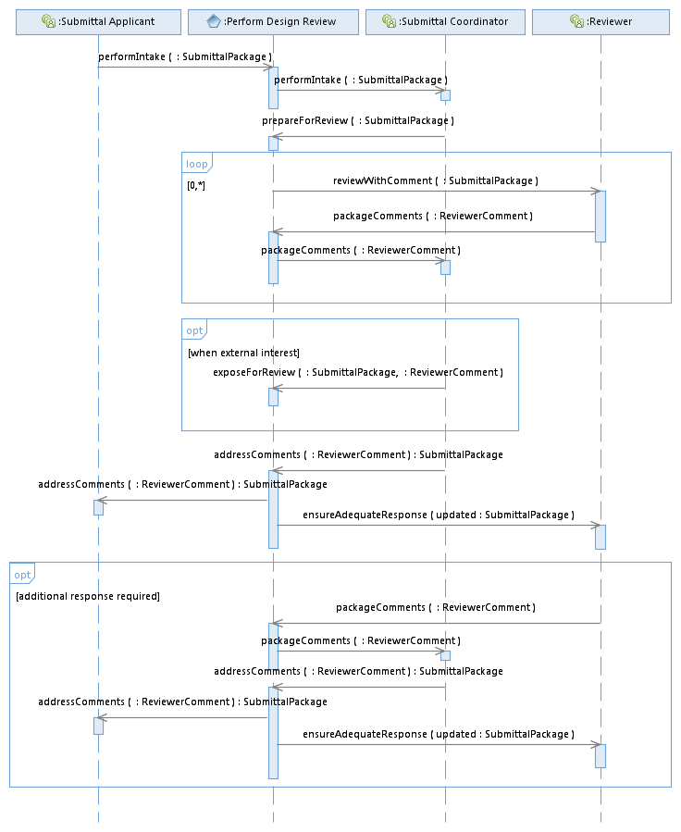
System Functional Requirements (example)
Identify Capability Interfaces

Slide 14
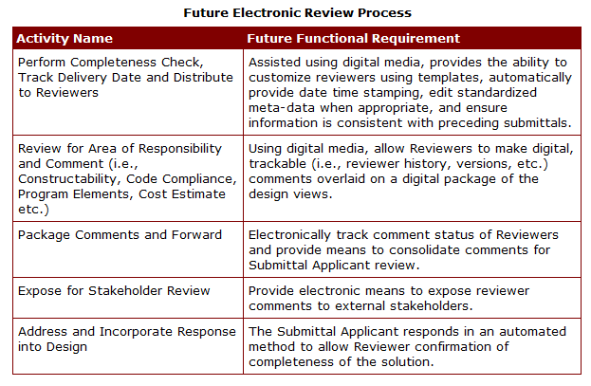
Functional Requirements
Reviewer ensures adequate response

Slide 15
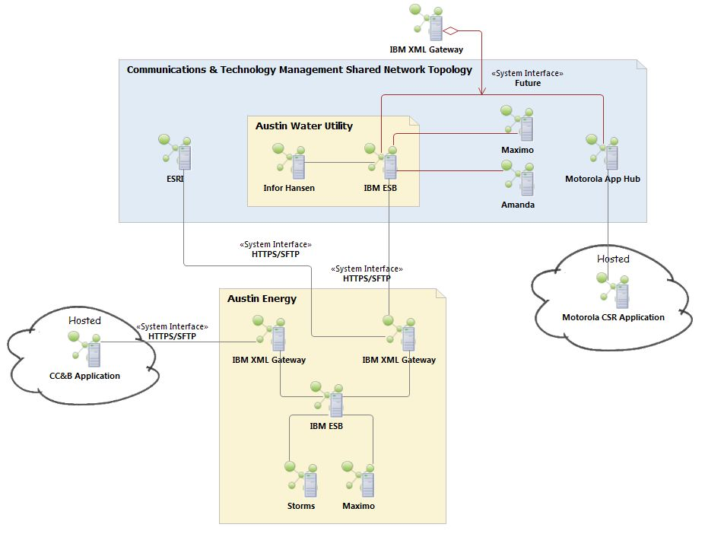
Example UML/UPIA System Diagram

Slide 16
Data Dictionary
Follow link to the Austin Data Dictionary

Slide 17
Summary
Strategic Viewpoints provide a means to understand complex relationships – assists in decision-making – identifies measurable goals and milestones
The Use Case provides a process to perform business analysis to derive business needs, identify interfaces and develop system solutions
EA provides a comprehensive critical mass of understanding to maintain project momentum

