Slide 1
AWU Architecture Principles
Use architecture to identify important interfaces to define mobile application and information needs
Collaborate and vet architecture with stakeholders
Define mobile application specifications for inclusion in statement of work

Slide 2
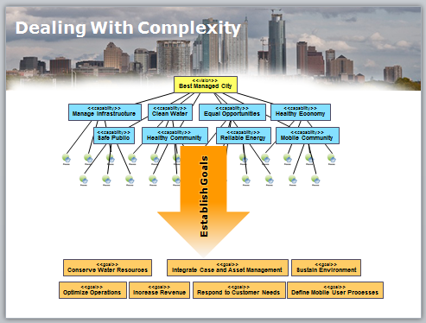
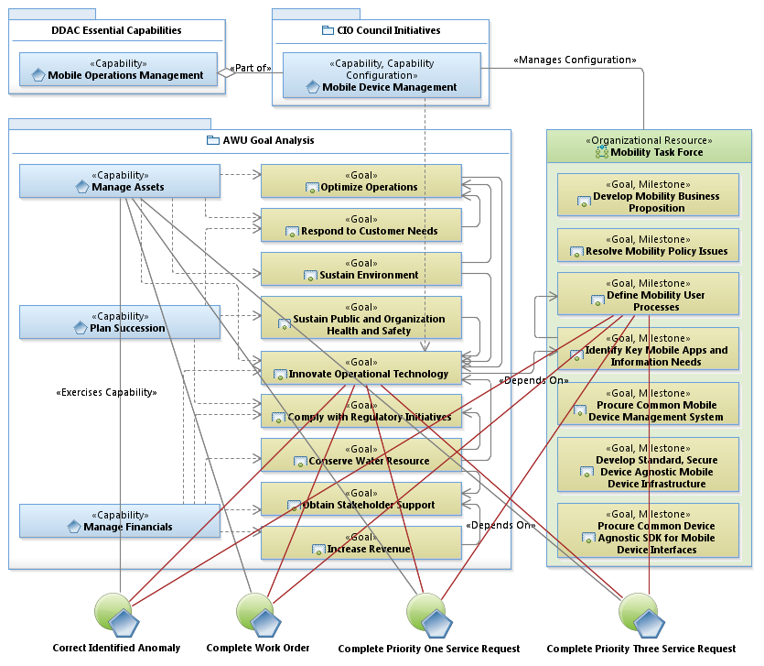
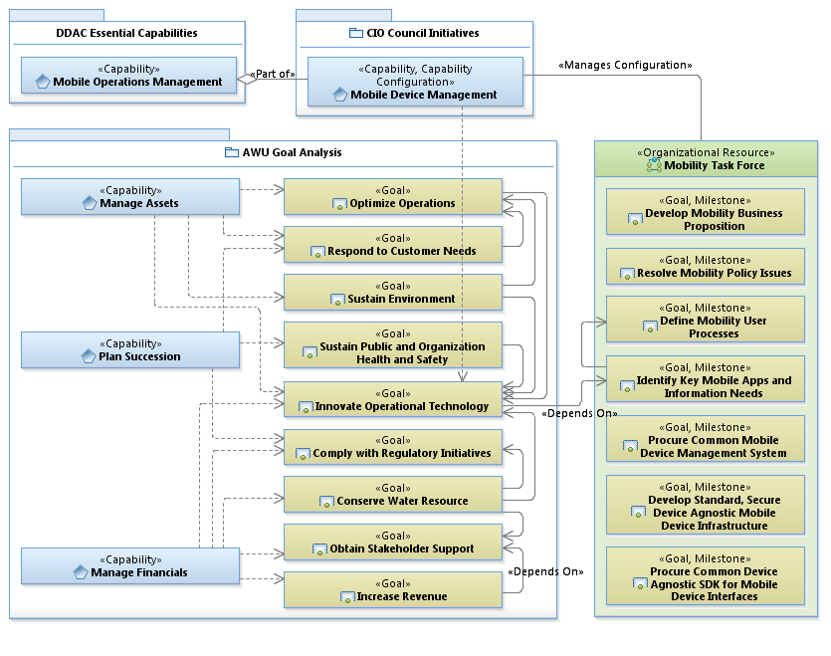
Improving Capability Using EA

Slide 3
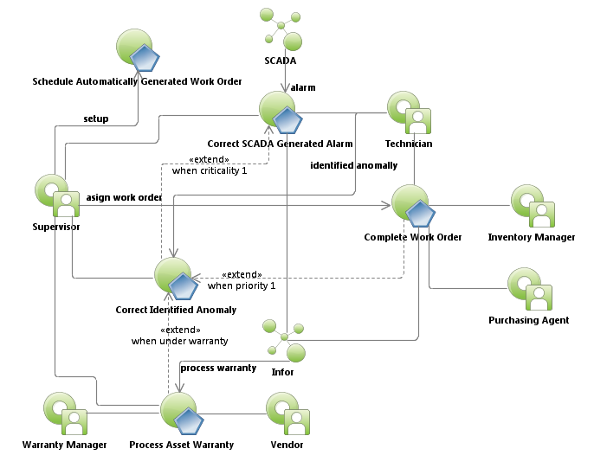
Water Treatment Plant Work Order Use Case Relationships
Requires Mobility

Slide 4
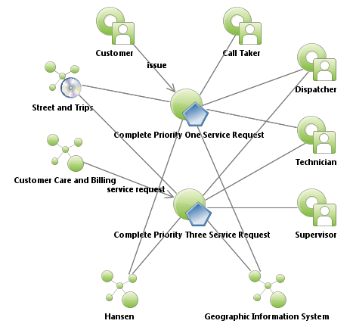
Water Distribution Field Service Request Use Case Relationships
Requires Mobility

Slide 5
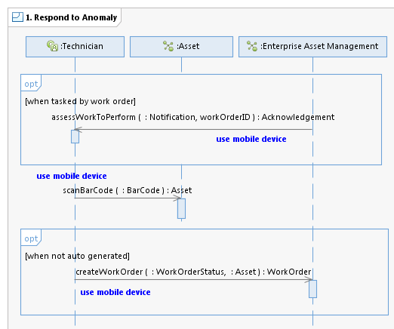
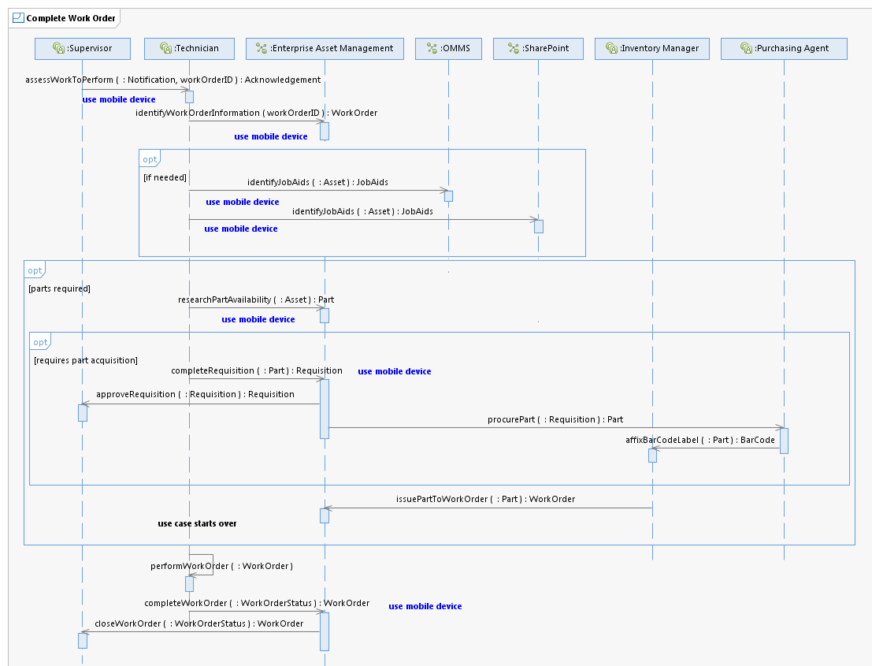
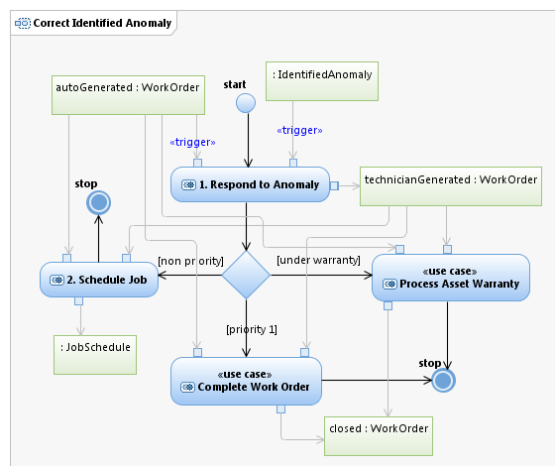
Correct Identified Anomaly
Designed in collaboration with field
Technicians. Stakeholder approved!

Slide 6
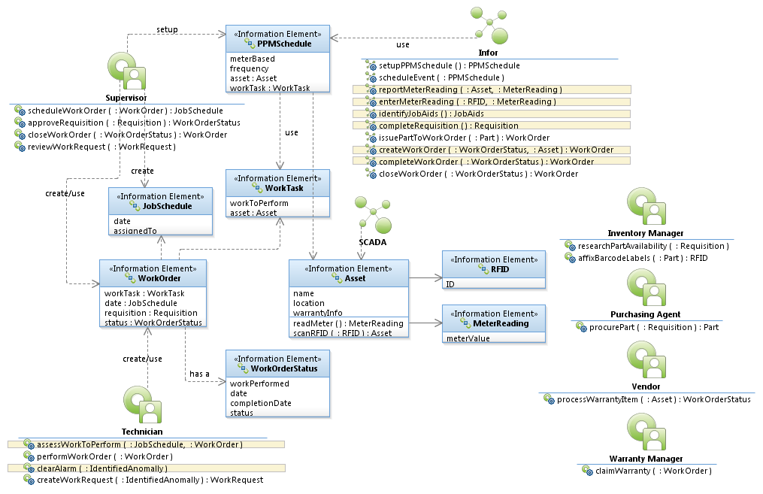
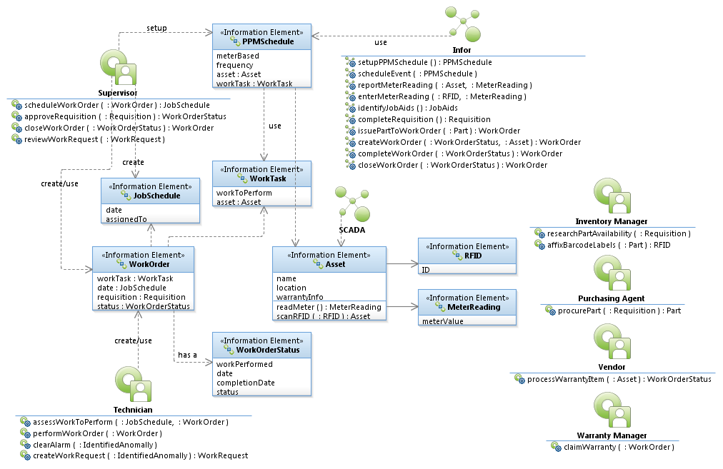



Work Order Logical Data Model

Slide 7
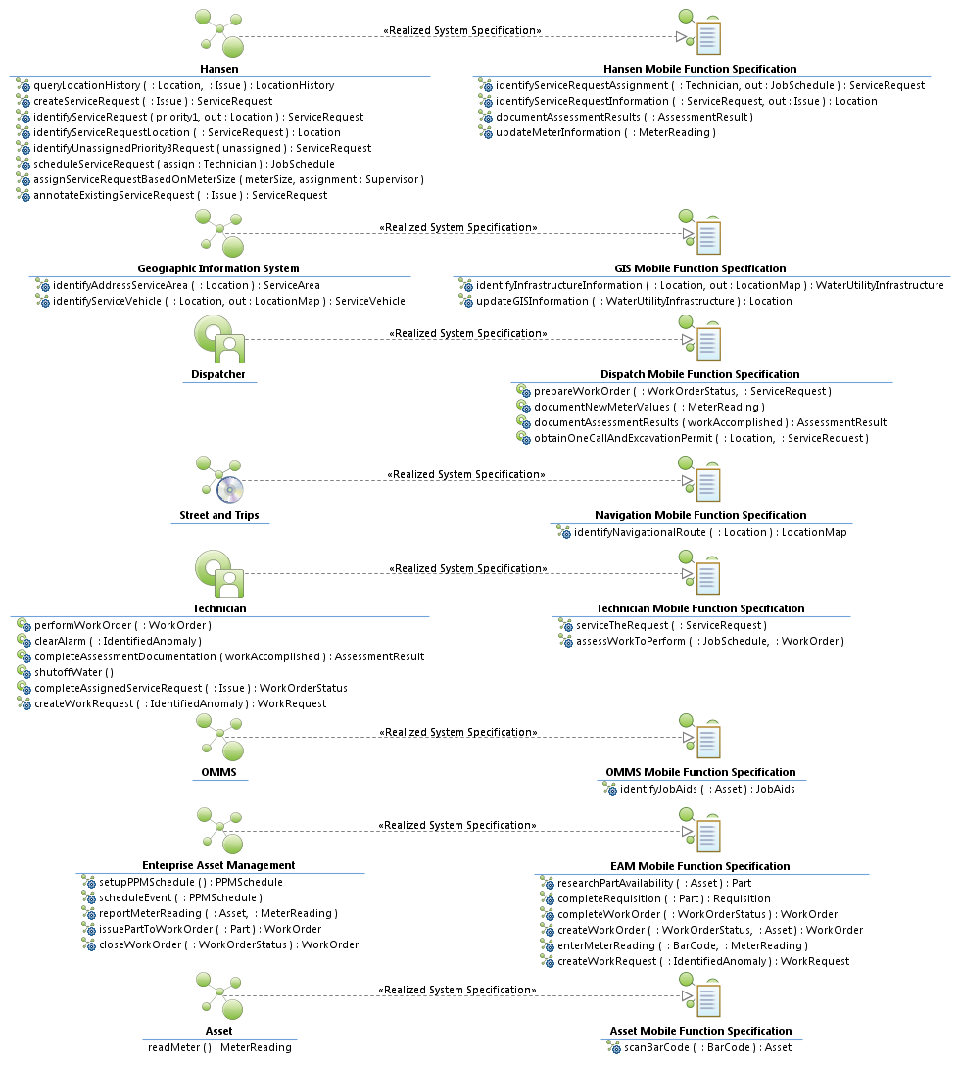
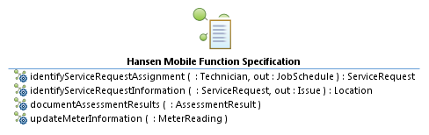
Mobile Function Specification

Slide 8
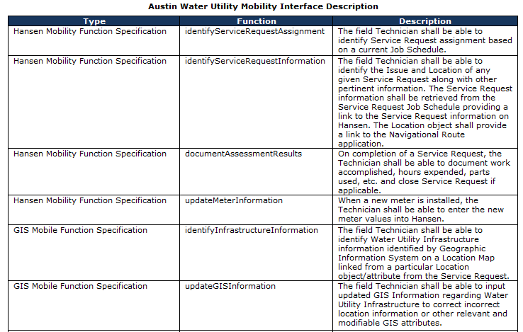
Interface Specification

Slide 9
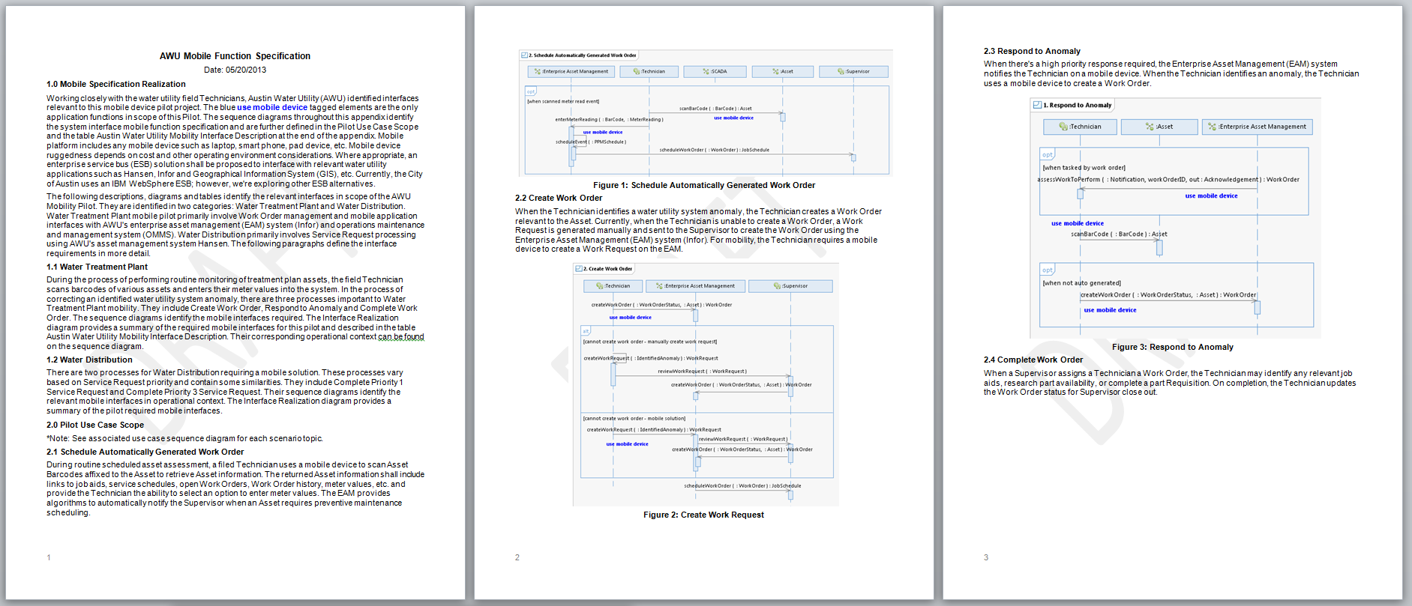
Specification for Inclusion in Statement of Work
“This is the best written SOW that we have ever seen.” Esri
Identifies clearly understood scope - provides means to scope level of effort and ensured pilot includes relevant technologies
Reduces contractor risk resulting in reduced cost
Yields additional cost savings because contractor did not perform the business analysis
Needs identified by user community – increased buy in

