Slide 1
COMMON MONOMIAL FACTORING

Slide 2
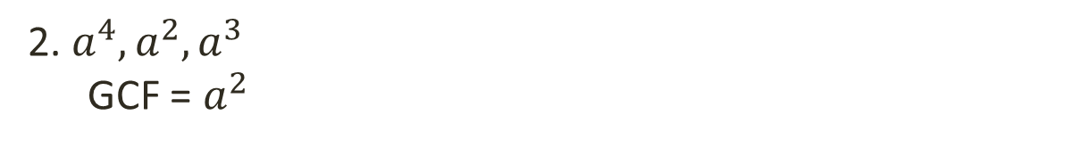
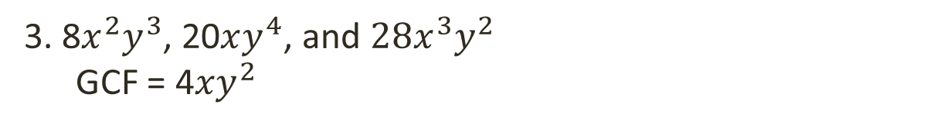
What is Greatest Common Factor (GCF)?
The greatest common factor or simply the gcf of two or more whole numbers is the largest factor or divisor common to all the given numbers.
Examples:
1. 12 and 18
GCF = 6
2. $a^{4}, a^{2},a^{3}$
GCF = $a^{2}$
3. 8$x^{2}y^{3}$, 20$xy^{4}$, and ${28x}^{3}y^{2}$
GCF = 4${xy}^{2}$

Slide 3


Methods for Finding the Greatest Common Factor
1. Prime Factorization Method - It is used to “break down” or express a given number as a product of prime numbers. More so, if a prime number occurs more than once in the factorization, it is usually expressed in exponential form.
Example:
1. Find the gcf of 12 and 18.
Solution:
$$12=4∙3=2^{2}∙3$$
2 ∙ 2 ∙ 3
$$18=2∙9={2∙3}^{2}$$
2 ∙ 3 ∙ 3
GCF = 2∙ 3
GCF = 6

Slide 4
Methods for Finding the Greatest Common Factor
1. Division Method – Dividing both numbers by their common factors until there is no more common factors then find the product of all the common factors. The product is the GCF of the given numbers.
Example:
1. Find the gcf of 12 and 18.
Solution:
2
12
18
Multiply to get the GCF.
3
6
9
2
3
No more common factor
GCF = 2 ∙ 3
GCF = 6
https://www.myqbook.com/MathConcept/245/Finding-GCF-by-repeated-division-method

Slide 5
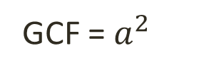


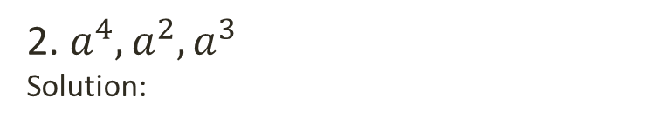




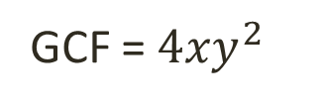





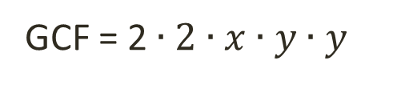

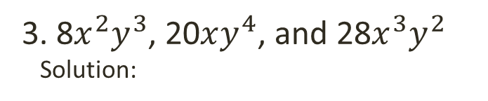

Find the greatest common factor
2. $a^{4}, a^{2},a^{3}$
Solution:
3. 8$x^{2}y^{3}$, 20$xy^{4}$, and 28$x^{3}y^{2}$
Solution:
$$a^{4}=a∙a∙a∙a$$
$$8= 2^{3}$$
$$2∙2∙2$$
$$a^{2}=a∙a$$
$$20= 2^{2}∙5$$
$$2∙2∙5$$
$$28= 2^{2}∙7$$
$$2∙2∙7$$
$$a^{3}=a∙a∙a$$
$$x^{2}y^{3}=x∙x∙y∙y∙y$$
GCF = $a ∙ a$
$$xy^{4}=x∙y∙y∙y∙y$$
$$x^{3}y^{2}=x∙x∙x∙y∙y$$
GCF = $a^{2}$
GCF = 2$∙2∙x∙y∙y$
GCF = ${4xy}^{2}$

Slide 6

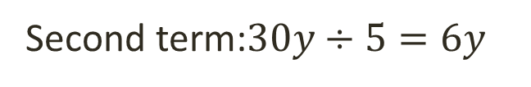
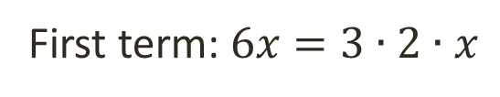

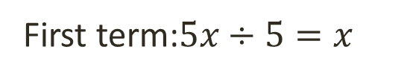
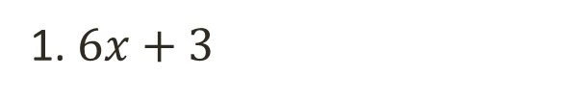
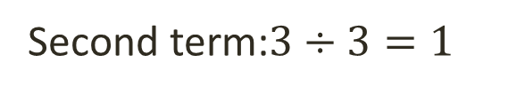
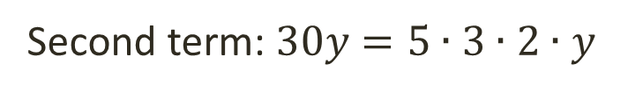
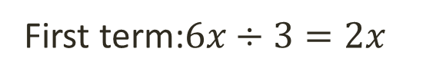

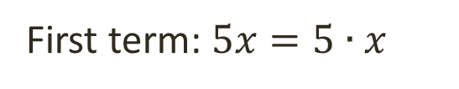
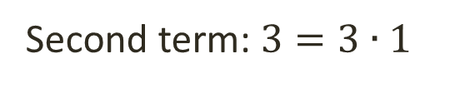
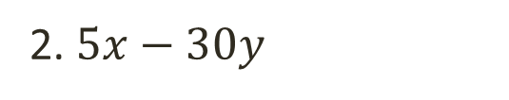

Common Monomial Factoring
Factor completely each polynomial.
1. $6x+3$
2. $5x−30y$
Solution:
Solution:
First term: $6x=3∙2∙x$
First term: $5x=5∙x$
Second term: $3=3∙1$
Second term: $30y=5∙3∙2∙y$
GCF = 3
GCF = 5
First term:$6x÷3=2x$
First term:$5x÷5=x$
Second term:$3÷3=1$
Second term:$30y÷5=6y$
= ( + )
3
$$2x$$
$$1$$
$$x$$
$$6y$$
= ( - )
5

Slide 7
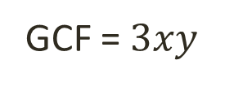





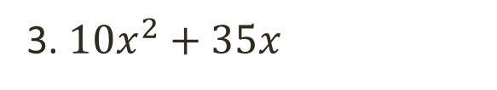



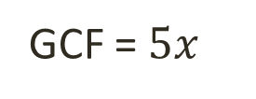

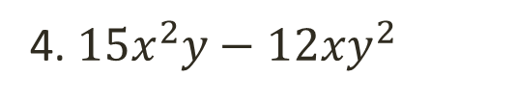



Common Monomial Factoring
Factor completely each polynomial.
3. $10x^{2}+35x$
4. $15x^{2}y−12{xy}^{2}$
Solution:
Solution:
First term: $10x^{2}=5∙2∙x∙x$
First term: $15x^{2}y=3∙5∙x∙x∙y$
Second term: $35x=5∙7∙x$
Second term:$12xy^{2}=3∙2∙2∙x∙y∙y$
GCF = $5x$
GCF = $3xy$
First term:$10x^{2}÷5x=2x$
First term:$15x^{2}y÷3xy=5x$
Second term:$35x÷5x=7$
Second term:$12xy^{2}÷3xy=4y$
= ( + )
5x
$$2x$$
$$7$$
$$5x$$
$$4y$$
= ( - )
$$3xy$$

Slide 8



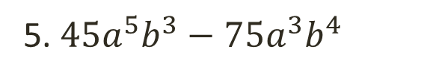






Common Monomial Factoring
Factor completely each polynomial.
5. $45a^{5}b^{3}−75a^{3}b^{4}$
Solution:
5
45
75
Multiply
3
9
15
3
5
No common factor
First term: $a^{5}b^{3}=a∙a∙a∙a∙a∙b∙b∙b$
Second term: $a^{3}b^{4}=a∙a∙a∙b∙b∙b∙b$
$${ a}^{3}b^{3}$$
GCF=$15$
First term:$45a^{5}b^{3}÷15a^{3}b^{3}=3a^{2}$
Second term:$75a^{3}b^{4}÷15a^{3}b^{3}=5b$
$$15a^{3}b^{3}$$
$$3a^{2}$$
$$5b$$
= ( - )

Slide 9


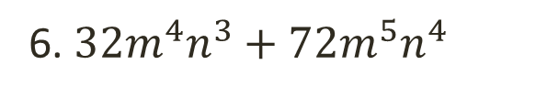




Common Monomial Factoring
Factor completely each polynomial.
6. $32m^{4}n^{3}+72m^{5}n^{4}$
Solution:
4
32
72
Multiply
2
8
18
4
9
No common factor
First term: $m^{4}n^{3}=m∙m∙m∙m∙n∙n∙n$
Second term: $m^{5}n^{4}=m∙m∙m∙m∙m∙n∙n∙n∙n$
GCF= 8
$$m^{4}n^{3}$$
First term:$32m^{4}n^{3}÷8m^{4}n^{3}=4$
Second term:$72m^{5}n^{4}÷8m^{4}n^{3}=9mn$
$$8m^{4}n^{3}$$
$$4$$
= ( + )
$$9mn$$

Slide 10
THANK YOU

