Slide 1
Factoring Quadratic Trinomial where a = 1

Slide 2


Factoring Quadratic Trinomial where a = 1
Trinomial is a polynomial with three terms.
$${ax}^{2}+bx+c$$
1st Term
2nd Term
3rd Term
where a = 1
$$x^{2}+9x+18$$
Usually when a = 1, the numerical coefficient 1 is invisible.

Slide 3





Review:
Multiplying Binomials using FOIL Method
$$(x+2)(x+3)$$
F – First Term: $x ∙x=x^{2}$
I – Inner Term: $2∙x=2x$
O – Outer Term: $x∙3=3x$
L – Last Term: $2∙3=6$
$$x^{2}+3x+2x+6$$
Add similar terms
$${=x}^{2}+5x+6$$

Slide 4


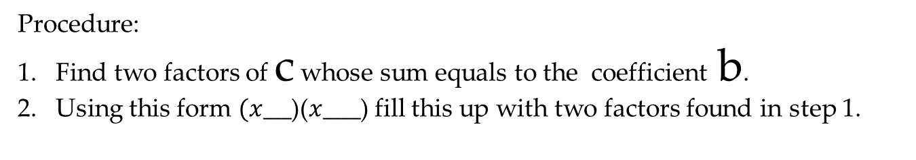


$$(x+2)(x+3)$$
$$x^{2}+5x+6$$
Adding the second term in the first binomial and second term in the second binomial.
Multiplying the second term in the first binomial and second term in the second binomial.
Factoring Quadratic Trinomial where a = 1
$$x^{2}+bx+c$$
$$=(x+ ?)(x+ ?)$$
Procedure:
Find two factors of c whose sum equals to the coefficient b.
Using this form $(x___$)($x____$) fill this up with two factors found in step 1.

Slide 5
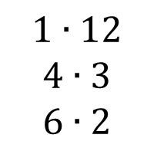


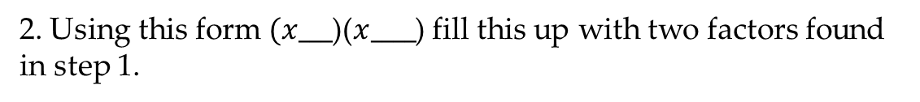
Factoring Quadratic Trinomial where a = 1
1.
$$x^{2}+8x+12$$
a
b
c
Find two factors of c = 12 and whose sum equals to the coefficient b = 8
Solution:
$$1∙12$$
$$4∙3$$
$$6∙2$$
2. Using this form $(x___$)($x____$) fill this up with two factors found in step 1.
$$=(x+6)(x+2)$$

Slide 6
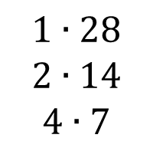


Factoring Quadratic Trinomial where a = 1
2.
$$y^{2}+11y+28$$
a
b
c
Find two factors of c = 28 and whose sum equals to the coefficient b = 11
Solution:
$$1∙28$$
$$2∙14$$
$$4∙7$$
2. Using this form $(x___$)($x____$) fill this up with two factors found in step 1.
$$=(y+4)(y+7)$$

Slide 7
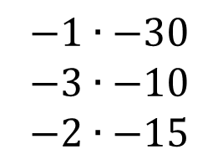


Factoring Quadratic Trinomial where a = 1
3.
$$x^{2}−13x+30$$
a
b
c
Find two factors of c = 30 and whose sum equals to the coefficient b = -13
Solution:
$$−1∙−30$$
$$−3∙−10$$
$$−2∙−15$$
2. Using this form $(x___$)($x____$) fill this up with two factors found in step 1.
$$=(x−3)(x−10)$$

Slide 8



Factoring Quadratic Trinomial where a = 1
4.
$$x^{2}−5x−24$$
a
b
c
Find two factors of c = -24 and whose sum equals to the coefficient b = -5
Solution:
$$−24∙1$$
$$−12∙2$$
$$−8∙3$$
$$−6∙4$$
2. Using this form $(x___$)($x____$) fill this up with two factors found in step 1.
$$=(x−8)(x+3)$$

Slide 9
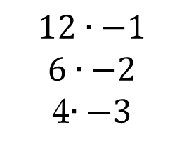


Factoring Quadratic Trinomial where a = 1
5.
$$y^{2}+4y−12$$
a
b
c
Find two factors of c = -12 and whose sum equals to the coefficient b = 4
Solution:
$$12∙−1$$
$$6∙−2$$
4$∙−3$
2. Using this form $(x___$)($x____$) fill this up with two factors found in step 1.
$$=(y+6)(y−2)$$

