Slide 1
IT Workshop – January 2018 Data Sources in Microsoft Excel 2016
Please have a seat at any workstation with a survey!

Slide 2
Before We Start
If you have questions or are stuck on something, don’t be shy.
There are MANY ways to do the exact same thing.
I’m not an Excel expert!
All that said,
let’s get started!
Notes:
Ask questions.
- After all, this is a workshop.
Not an Excel expert.
- I will do my best to answer your questions.

Slide 3
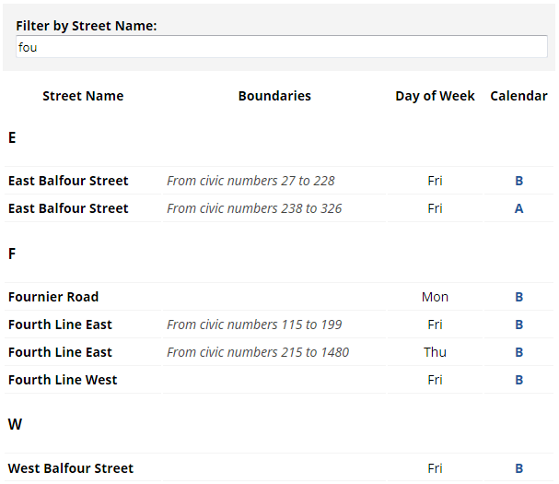
Project One – Waste Collection
The City website has a searchable table of city street names with their corresponding collection days.
The City has a list of civic holidays that it recognizes, most of which affect waste collection.
Using this information:
When is my next collection day?

Slide 4

Project Two – City Beautification Awards
Every year, the City releases a list of City Beautification Award winners.
The awards are assigned to addresses which could be displayed on a map.
Using this information:
Where in the city is the most award winning property?

Slide 5
Open Data
A recent movement in federal, provincial, and municipal governments.
Regularly release information in friendly formats to the public.
“Don’t take our word for it. Look at the data!”
Increases
Transparency
Decreases
Staff reporting
Encourages
Community Involvement
Notes:
Release monthly usages to help justify changes in service.

Slide 6

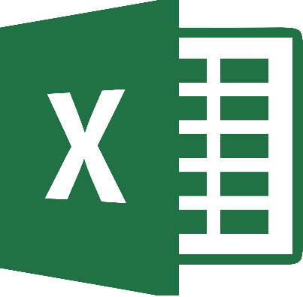
Thanks for participating!

