Slide 1
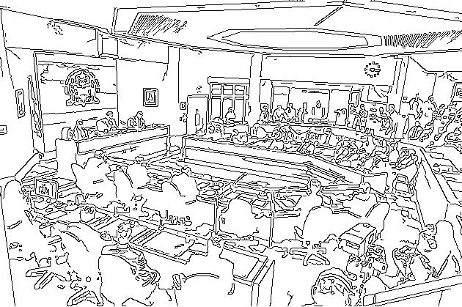




January 2019 IT Workshop
Do you have what it takes to run an accessible municipal election?
Elected!
This hands on workshop will identify and correct some common accessibility concerns in the documents we produce today, all in the context of a mock municipal election.
We will also work with
Microsoft Excel to tabulate the results.
All staff welcome.
All skill levels welcome.
Each workshop is limited to 10 participants.
All workshops will be held in the IT Training Room on Level 3 of the Civic Centre.
Tuesday January 29th
9 am to 10:30 am
Wednesday January 30th
2 pm to 3:30 pm
Thursday January 31st
2 pm to 3:30 pm
Friday February 1st
9 am to 10:30 am
To sign up, email Dan Gowans at d.gowans@cityssm.on.ca

