Slide 1


Team
“Weckers”
NLP solution on
extracting accounting information
LOW Zhi Hao
Yu Yue
SUN Chengyu
SUN Yuran
LOU Yang
GAN Dana
Notes:
natural language processing

Slide 2
Problem Statement
CITYHACK
Weckers
CITY UNIVERSITY OF HONG KONG
Extract certain information from BNP Paribas’ annual report
Legal Entity Name
Auditor
Audit Period
Auditor Opinion
Name of Auditor
Current Year Group Consolidated Financials
Total Income
Net Profit
Total Equity
Currency of financial items

Slide 3
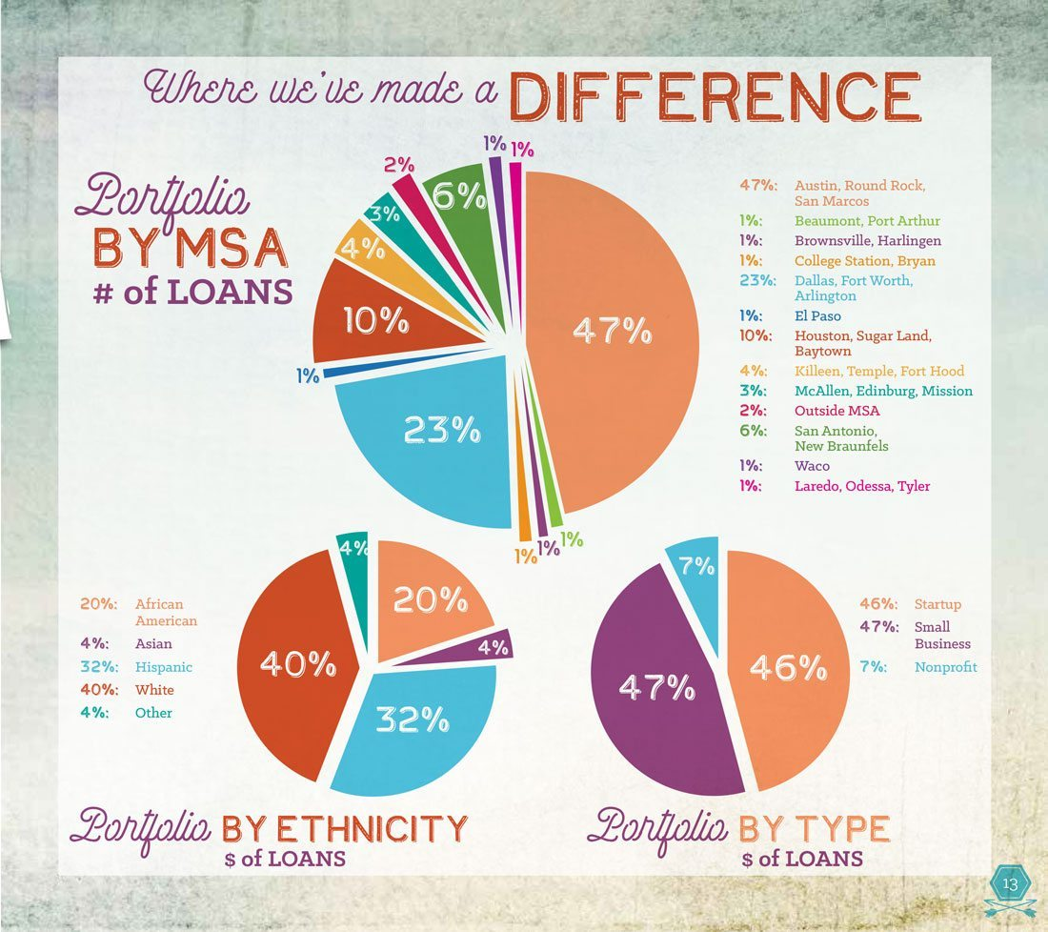
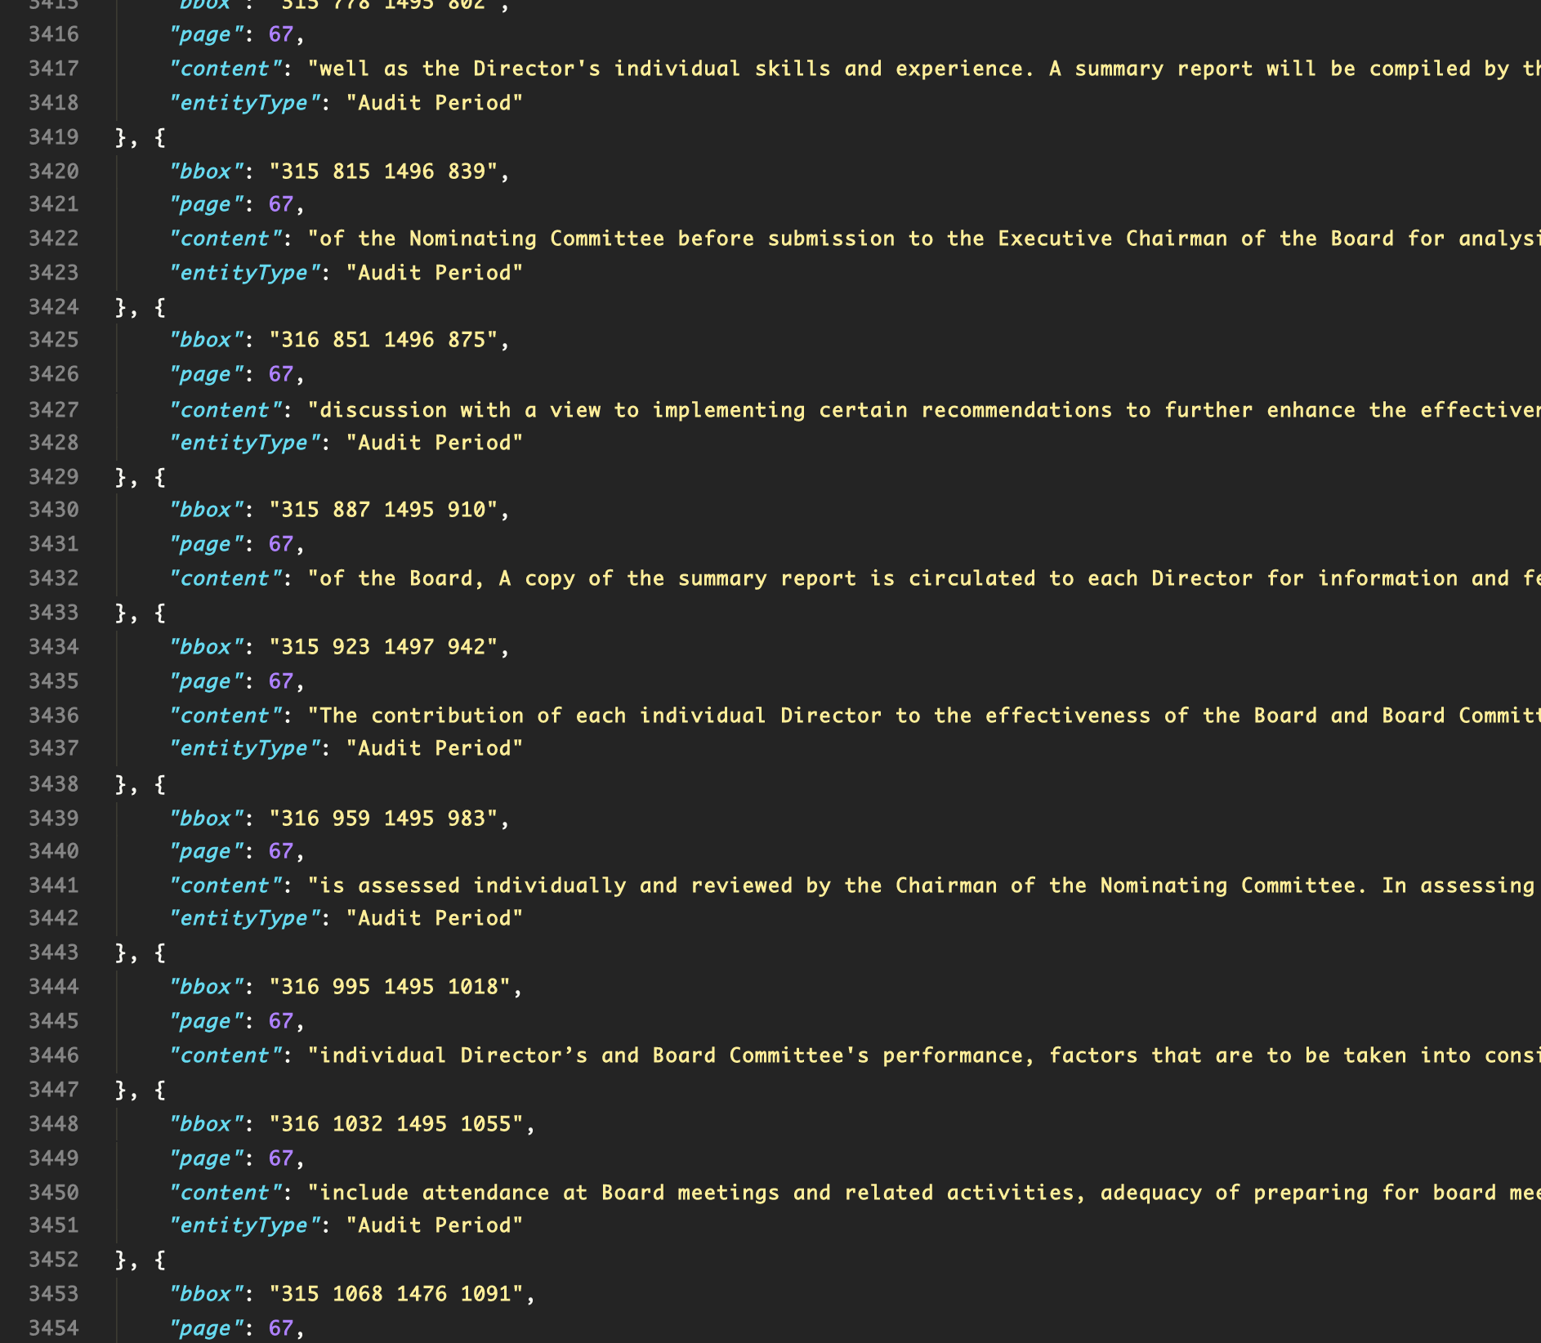
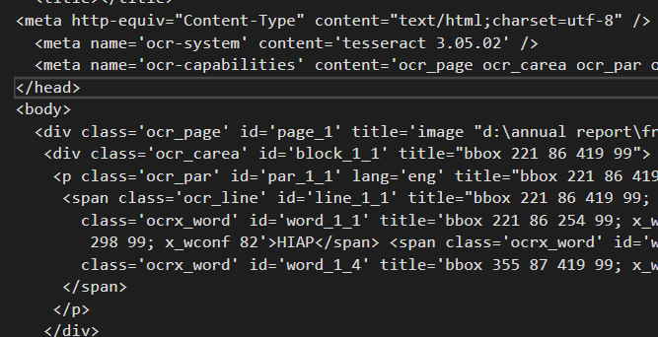
Data set
CITYHACK
Weckers
CITY UNIVERSITY OF HONG KONG
PDF
HOCR | JSON(training)
JSON(result)

Slide 4

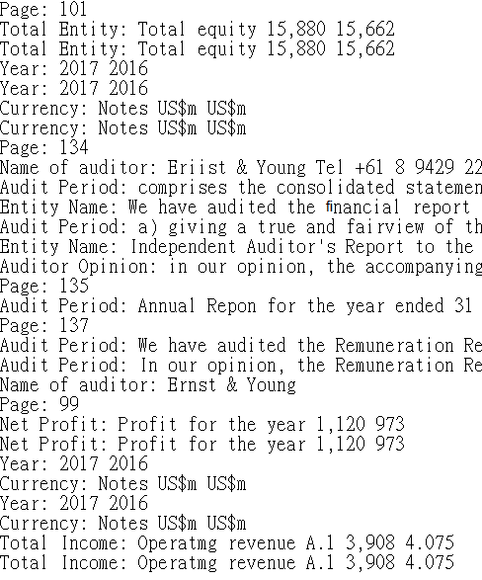

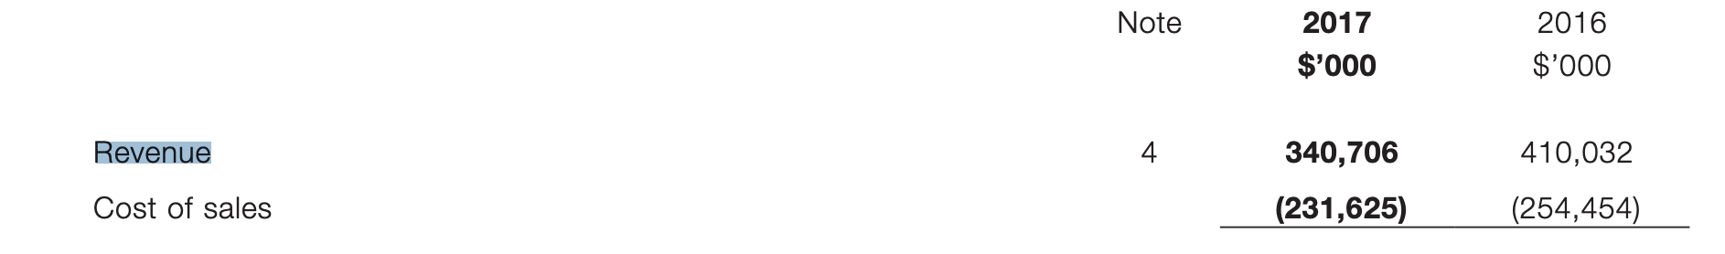
Extracted information with certain attribute
Weckers

Slide 5

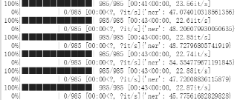
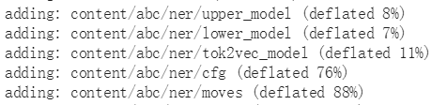
Solution
Justifying spaCy NER model
Train the Named Entity Recognizer
load the model (add customized entity recognizer to pipeline)
shuffle and loop over examples
save the trained model
test
Process
Traning
Training
Testing
Notes:
we use spacy for text classification, particularly the NER Model.
this model expect a list which have tagged position,
Machine learning to establish a code model
use machine learning to extract data from data set, basing on the spaCy model using Named Entity Recognizer technique. We added customized tag elements and justified it to fit our needs.

Slide 6

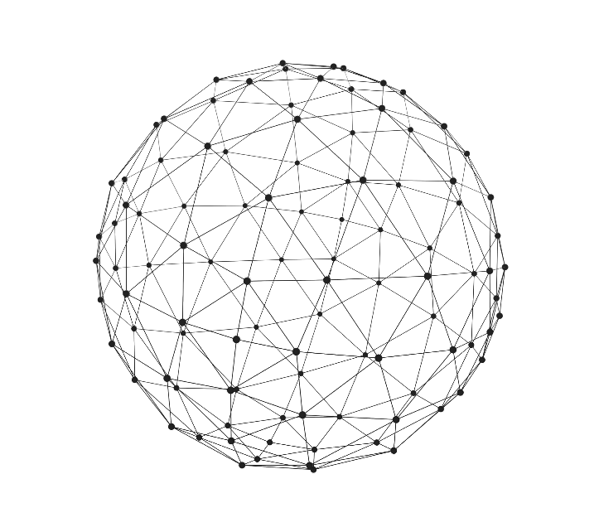
Part 4
Problem

Slide 7
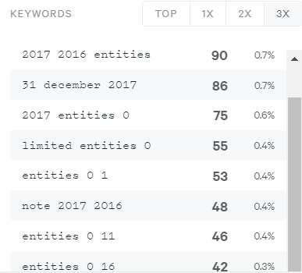

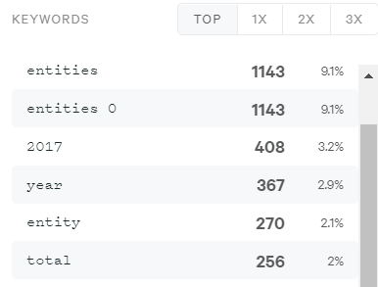


Accuracy
the influencing factors
Contextuality
New feature and meaning when words appear in phrase.
Word Locating
While human check the whole page and structure of the document, the model looks into a line.

Slide 8
Part 5
Results

Slide 9
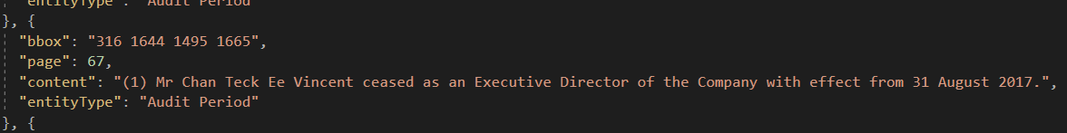
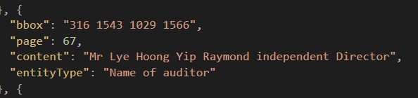
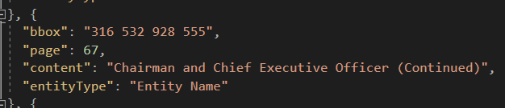
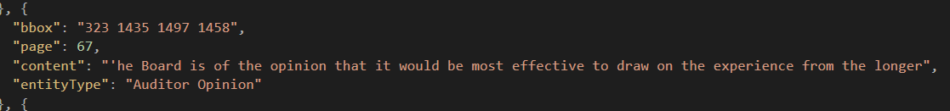
Output
CITYHACK
Weckers
CITY UNIVERSITY OF HONG KONG

Slide 10

Weckers

