Slide 1


UCOMPANION
HACKERMAN presents
One stop solution for all your campus needs

Slide 2

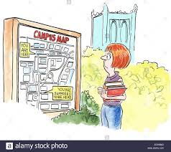
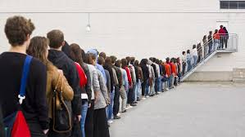
PROBLEMS
Difficulty in finding study spaces during exam season
On campus navigation
Long printer queues and waiting time

Slide 3
SOLUTIONS
Ucompanion senses real time data from the University server and relays it back to the user. Combines the use of Google Maps and CityUNav to offer the most convenient route between different locations. Makes use of ID card scanners and CV cameras positioned at printing locations and defined study spaces to inform users of waiting time.

Slide 4







Slide 5
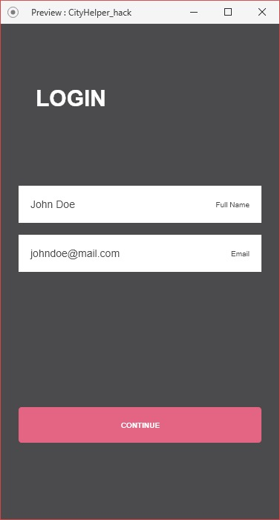
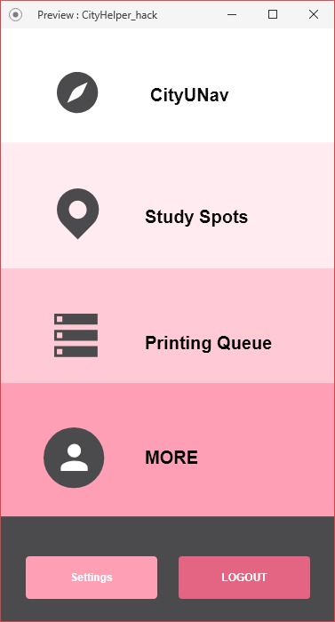
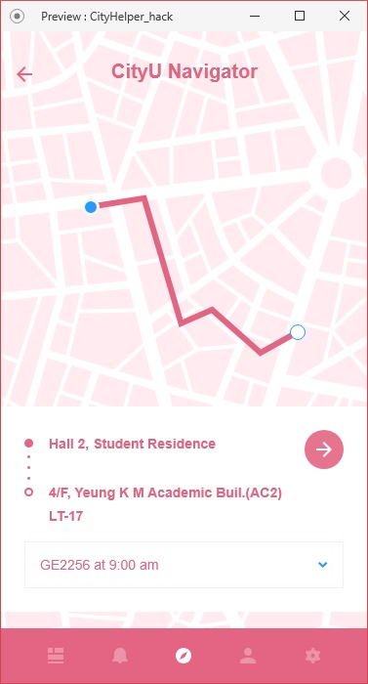
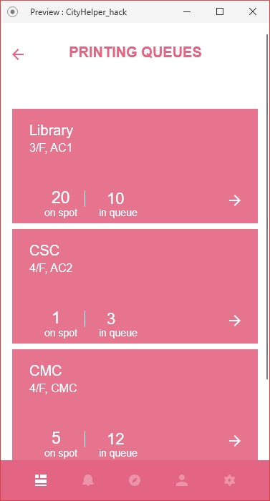
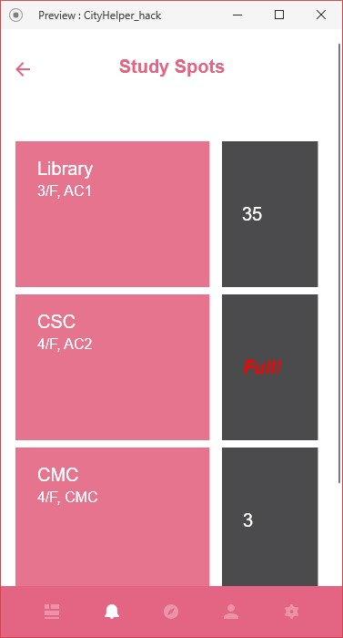
USER INTERFACE

Slide 6
Business Model
COST HEADS | $$
Research & Development | 30,000
Marketing (survey + free trial) | 15,000
Hardware | 20,000
REVENUE | SPECS
Volume based | Charge specified amount per user
Initial sale price | Sold to institutions to be integrated in individual systems
POST SALE SERVICE | FREE

Slide 7


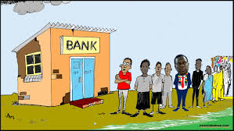


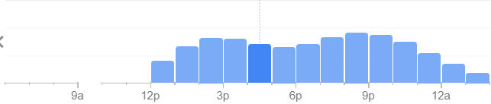

FURTHER APPLICATIONS

