Slide 1


Slide 2

ENERGY MANAGEMENT SMART SYSTEM
..…We Power the Future

Slide 3
INTRODUCTION
Have you noticed lights being on even if no one is nearby?
Do you feel that electricity is getting wasted in the form of unnecessary lighting?

Slide 4
Our Aim
To establish a smart campus we wish to introduce “Smart lighting System” which understands the lighting needs and adjust them accordingly using AI.

Slide 5
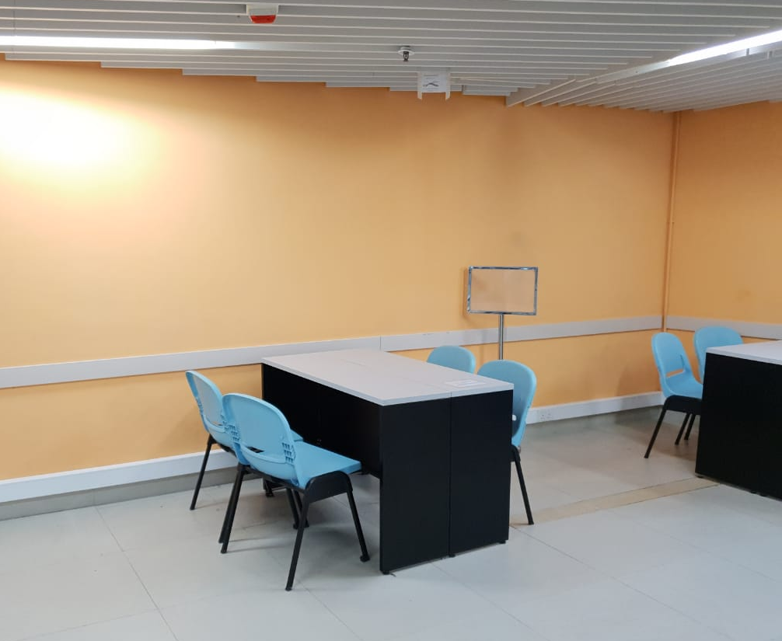
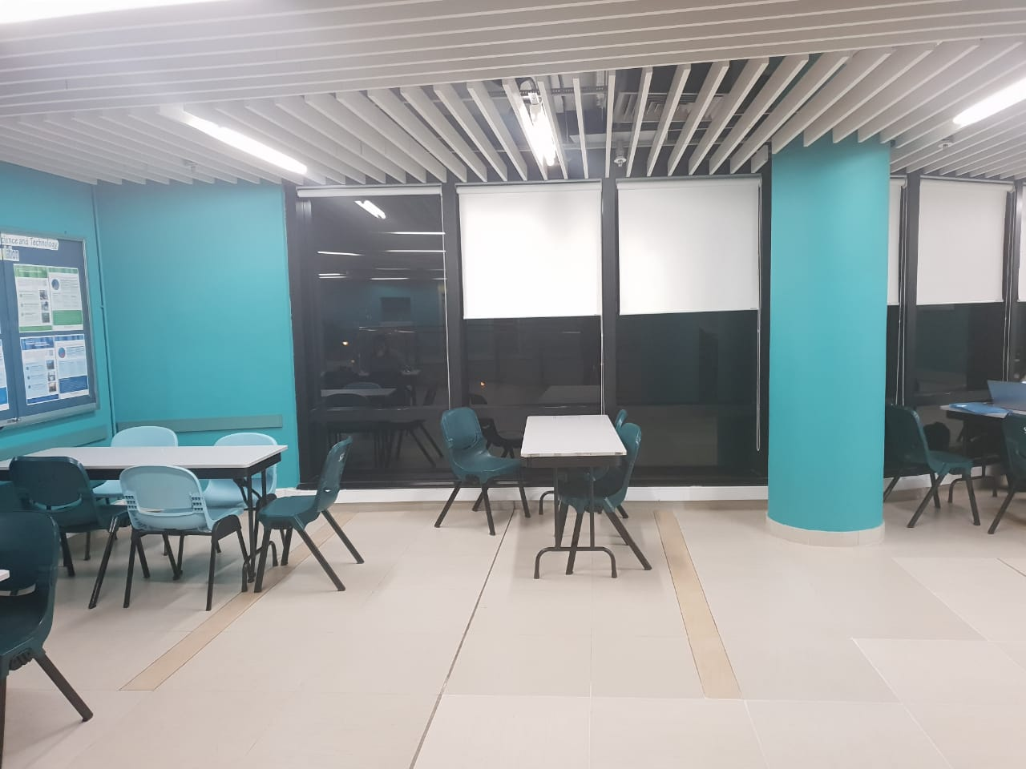
PROBLEM
As clearly depicted in the pictures, we can see that a lot of electricity is being wasted as no one is sitting but still all the lights are on.
We majorly deal with this problem by using new technology and save energy ,making a smart campus.

Slide 6
Statistics
2014-15 Energy consumption 63MkWh
Lighting uses approximately 11.08% of energy
Approximately 79million HKD is used in electricity per year.

Slide 7
Solution
We are using the with a technology called “Smart Lights”.
These lights work on a principle that they will light up when there are people and will dim-out when there is no one .
In the study area on campus, the AI technology will analyse if any student is sitting there and will make the light above the study table bright and will make it dim if no one is there.
All the other outdoor places, the light will be equipped with “Day light sensor” which will turn off the light when it already bright enough.
During the night ,the smart lights will sense the amount of people at a place and will make the light brighter only at that particular area using GPS and motion and image captured on camera.

Slide 8
Plan
Our product will be fully equipped to work in all the conditions.
To sense the amount of people in an area the system will get the info from CityU app which will ask the user to provide permission for GPS.
This is required for the analysis of the amount of people in the area and also if the someone if sitting in the study area.
If there is no motion for 15 minutes the lights will slowly start to dim off.

Slide 9
LIGHT 1
LIGHT 2
LIGHT 3
OUTPUT MODULE
INTELLIGENT SMART LIGHTING SYSTEM
DAY LIGHT SENSOR
MOTION SENSOR
LOCATION SENSOR
CAMERA VISION
Input model

Slide 10
WEBSITE
file:///C:/Users/PAYAS%20GOYAL/Downloads/EMSS/EMSS/index.html

