Slide 1
For data scientists: what the model does, and where it fails
Stroke classification, test n = 1,022 (50 positive cases, 4.9% prevalence) - XGBoost, SHAP TreeExplainer
Ranking quality is real but modest: ROC AUC 0.826, average precision 0.268 against a prevalence of 0.049. A no-skill classifier scores 0.049.
At the tuned threshold 0.60: recall 0.64, precision 0.20, F1 0.30. Confusion: TN 843, FP 129, FN 18, TP 32.
The cost asymmetry drives every choice: an undetected stroke costs far more than a screening referral, so the threshold maximises F1 for stroke = 1, not accuracy.
Global drivers (mean |SHAP|, log-odds): age first, then bmi, avg_glucose_level, smoking_status.
Explainer configuration: TreeExplainer, interventional, 100 training rows as background (seed 42), output = log-odds. Additivity verified to 7e-6.
Limitations: retrospective single-file data, 30% 'Unknown' smoking status, BMI missing 3.9% (median imputed inside the pipeline), no calibration analysis, and correlated predictors (age x ever-married) split credit arbitrarily between them.

Slide 2
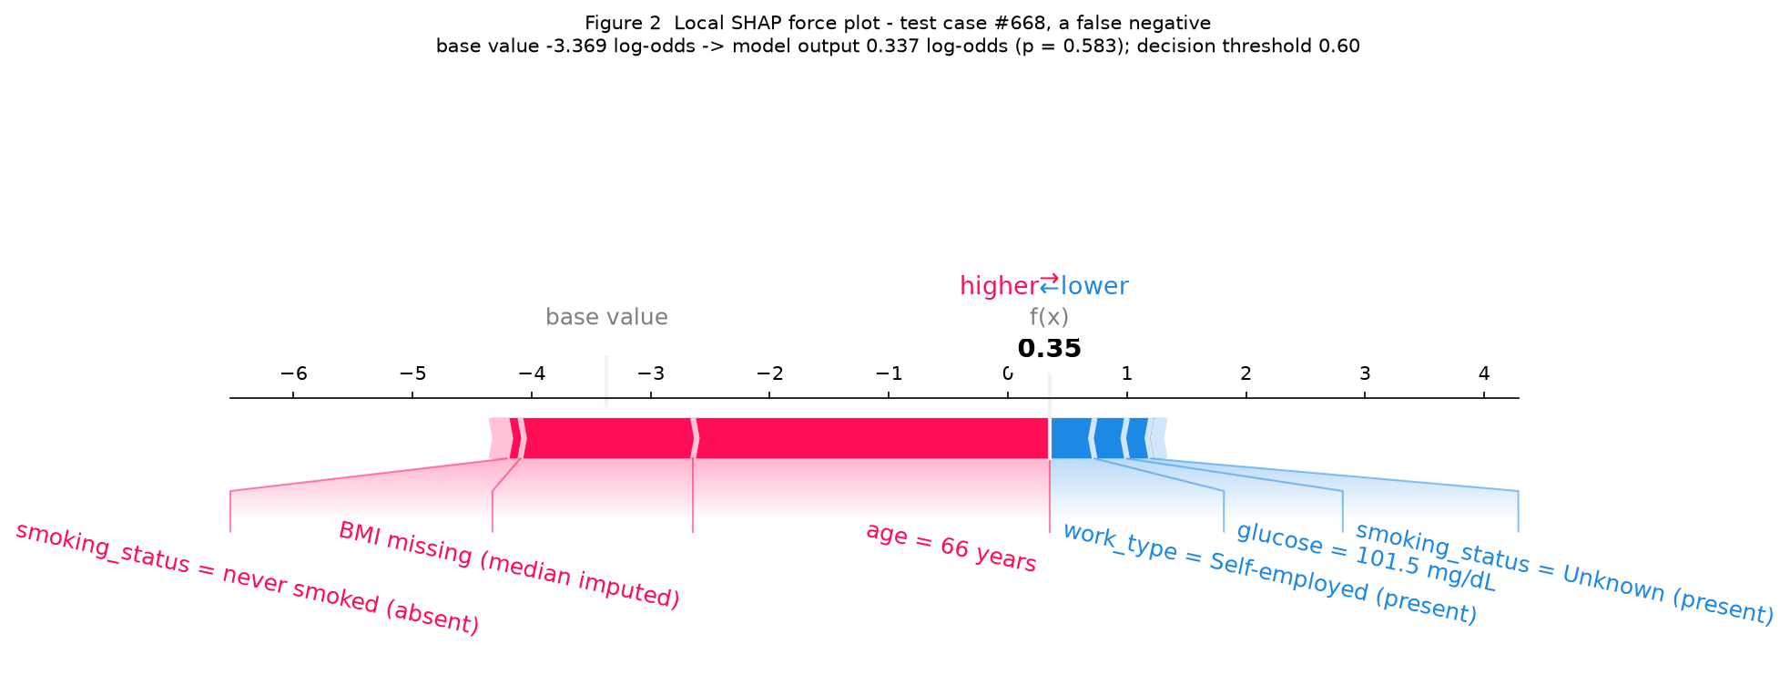
For clinicians: one patient the model missed
Test case #668, a 66-year-old woman - predicted stroke probability 0.58, threshold 0.60 - she had a stroke
What pushed the score up: age 66 and a missing BMI (imputed with the training median, 28.0, which lands near the risk boundary). What pushed it down: normal glucose (101.5 mg/dL), no hypertension, no heart disease, and the 'Unknown' smoking entry.
Sensitivity in this test split is 0.64: 18 of 50 stroke cases were missed. This patient was one of them - 0.02 below the decision line.
Read the SHAP values as model bookkeeping, not physiology: they explain why THIS model scored THIS patient this way, on retrospective records. They are not a diagnostic opinion and not a causal statement.
Before any clinical use: external validation, probability calibration, and a rule for the missing-BMI and 'Unknown'-smoking patterns, which are frequent enough to move scores on their own.

Slide 3
For patients: what this computer prediction means - and what it does not
Plain-language version of the same result
A computer program looked at recorded health information - age, blood sugar, weight records, smoking and work details - and gave a score from 0 to 1 that estimates how similar a patient's record is to records of past stroke patients.
For one 66-year-old woman, the program gave 0.58, just under its alert line of 0.60, so no alert was raised. She did have a stroke. Two things moved her score up - her age and a missing weight record - and three things moved it down: normal blood sugar, no blood-pressure or heart condition on record.
The score is not a diagnosis, not a percentage chance of having a stroke, and not medical advice. It was built from old records, and it is wrong often enough that a doctor must always read it together with everything else known about the patient.
If you want to lower your risk, the proven steps are the usual ones: blood pressure control, not smoking, movement, and regular check-ups. The computer score cannot substitute for that conversation with your doctor.

