Slide 1



Papermerge
Document Management System
for Scanned Documents
https://github.com/ciur/papermerge
www.papermerge.com
Notes:
Hi everybody,
my name is Eugen, and I in next couple of minutes I am going to
talk about a open source project, called Papermege, which is a document management system for scanned documents.
(btw, it is written in Python)

Slide 2

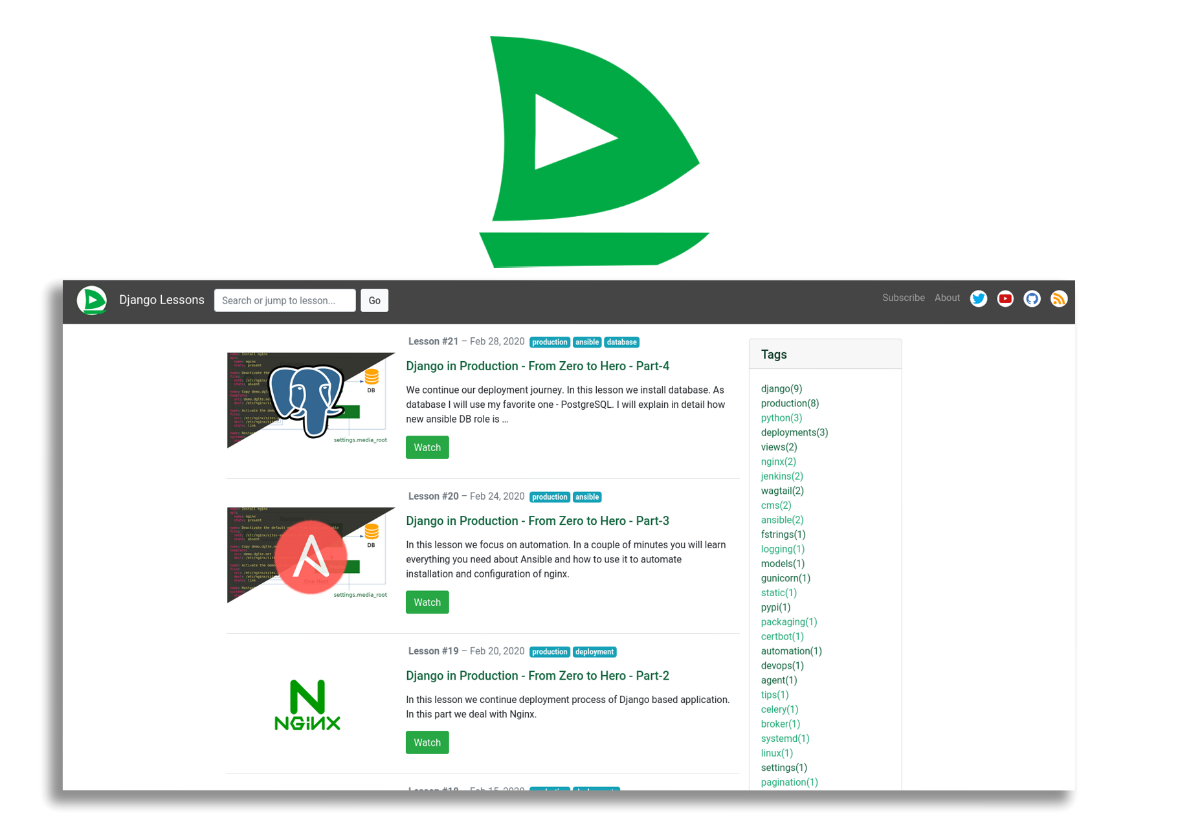
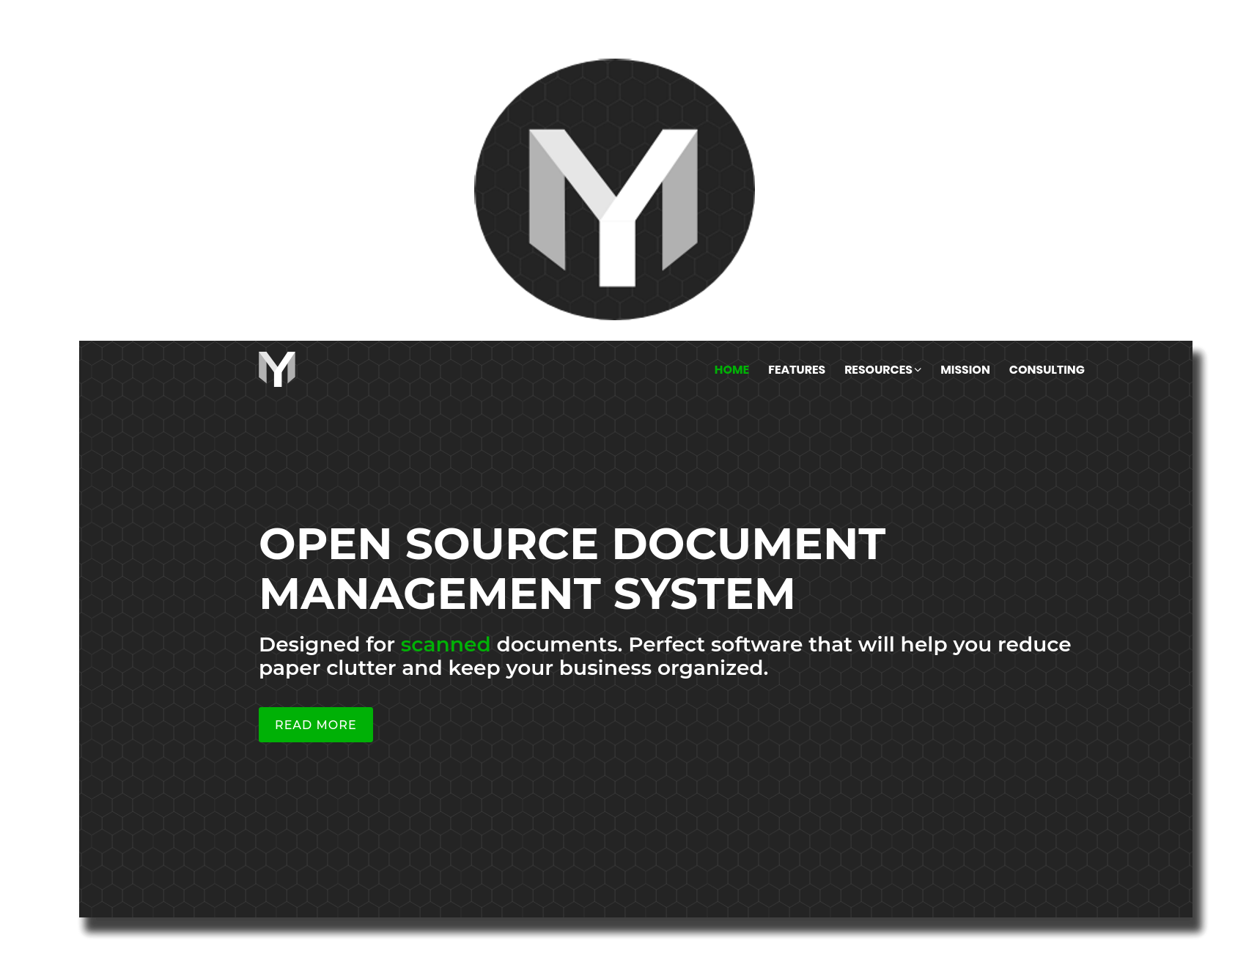
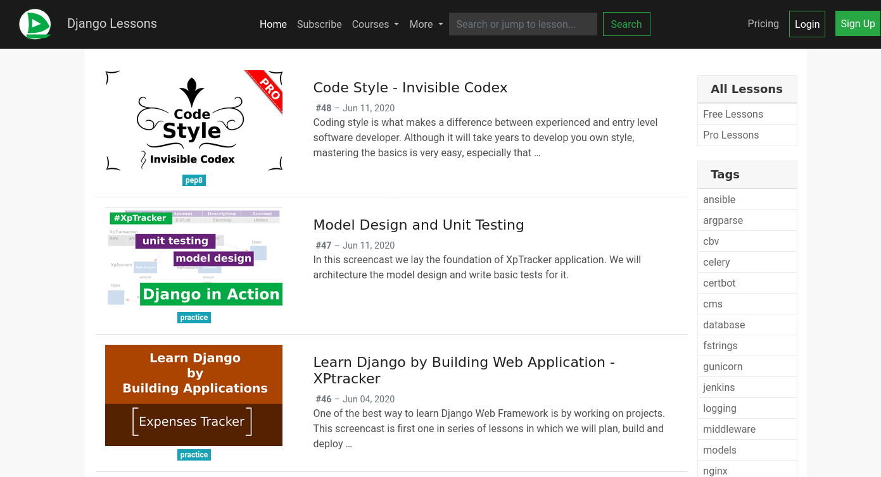
Eugen
Ciur
I am self-employed Software Developer
Software, Devops, Python, Django, Cloud , Web Services etc
https://django-lessons.com
https://papermerge.com
Notes:
I am Software Engineer and I work as freelancer. I have two projects which I spend a lots of time with. One of them is Papermerge which I am going to talk about today. Another one is django lessons, which is weekly screencasts about django ecosystem. If you want to learn how to deploy a django project, some python programming or learn about devops topics – django lessons is for you.

Slide 3
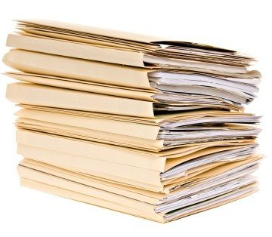
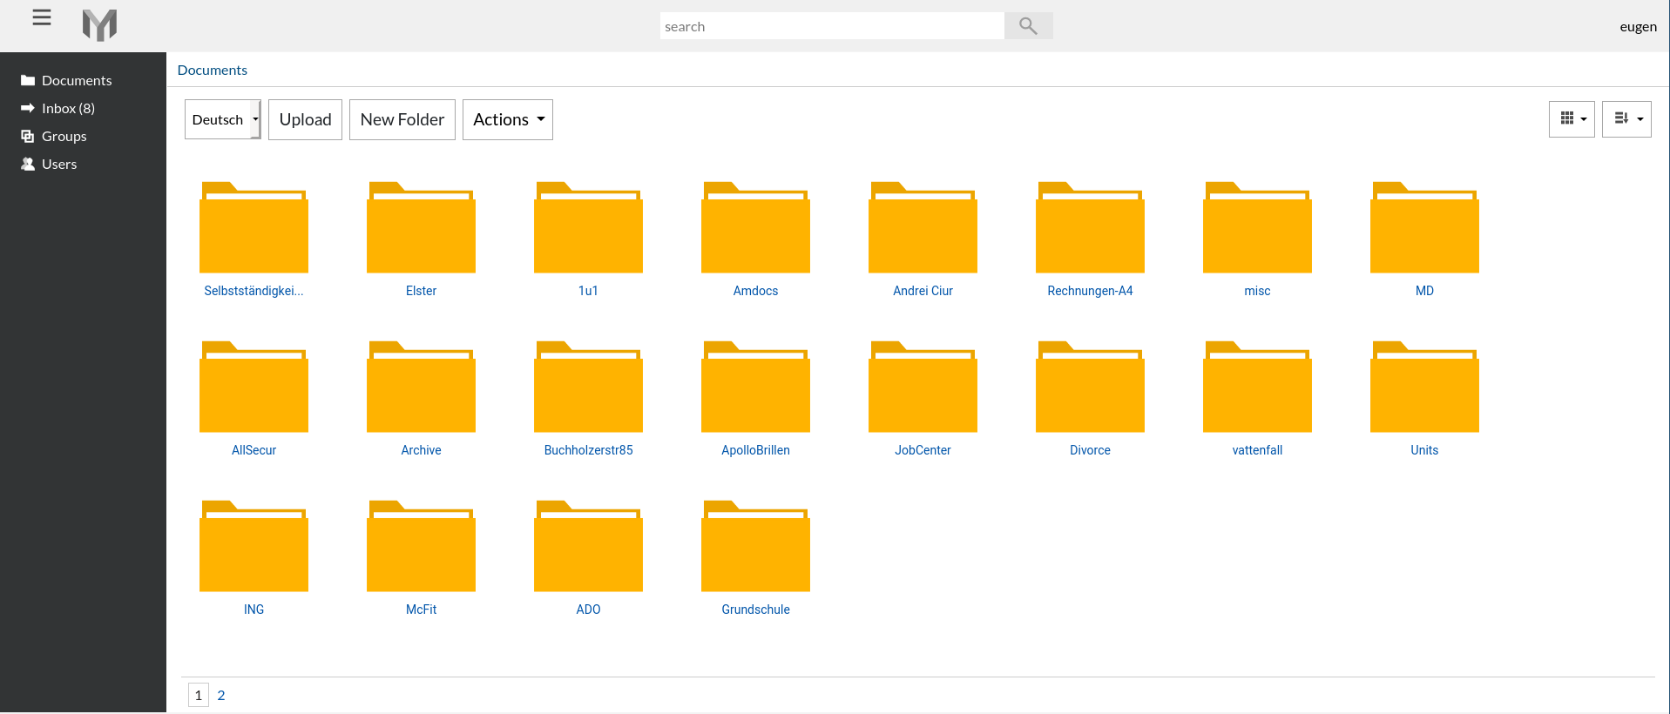
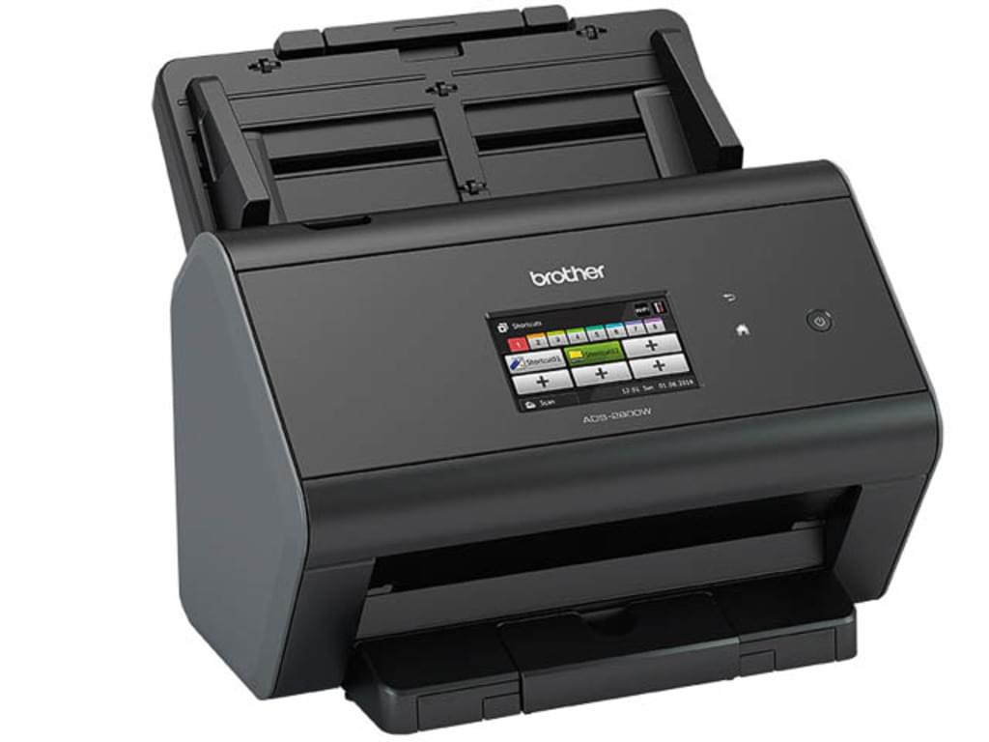
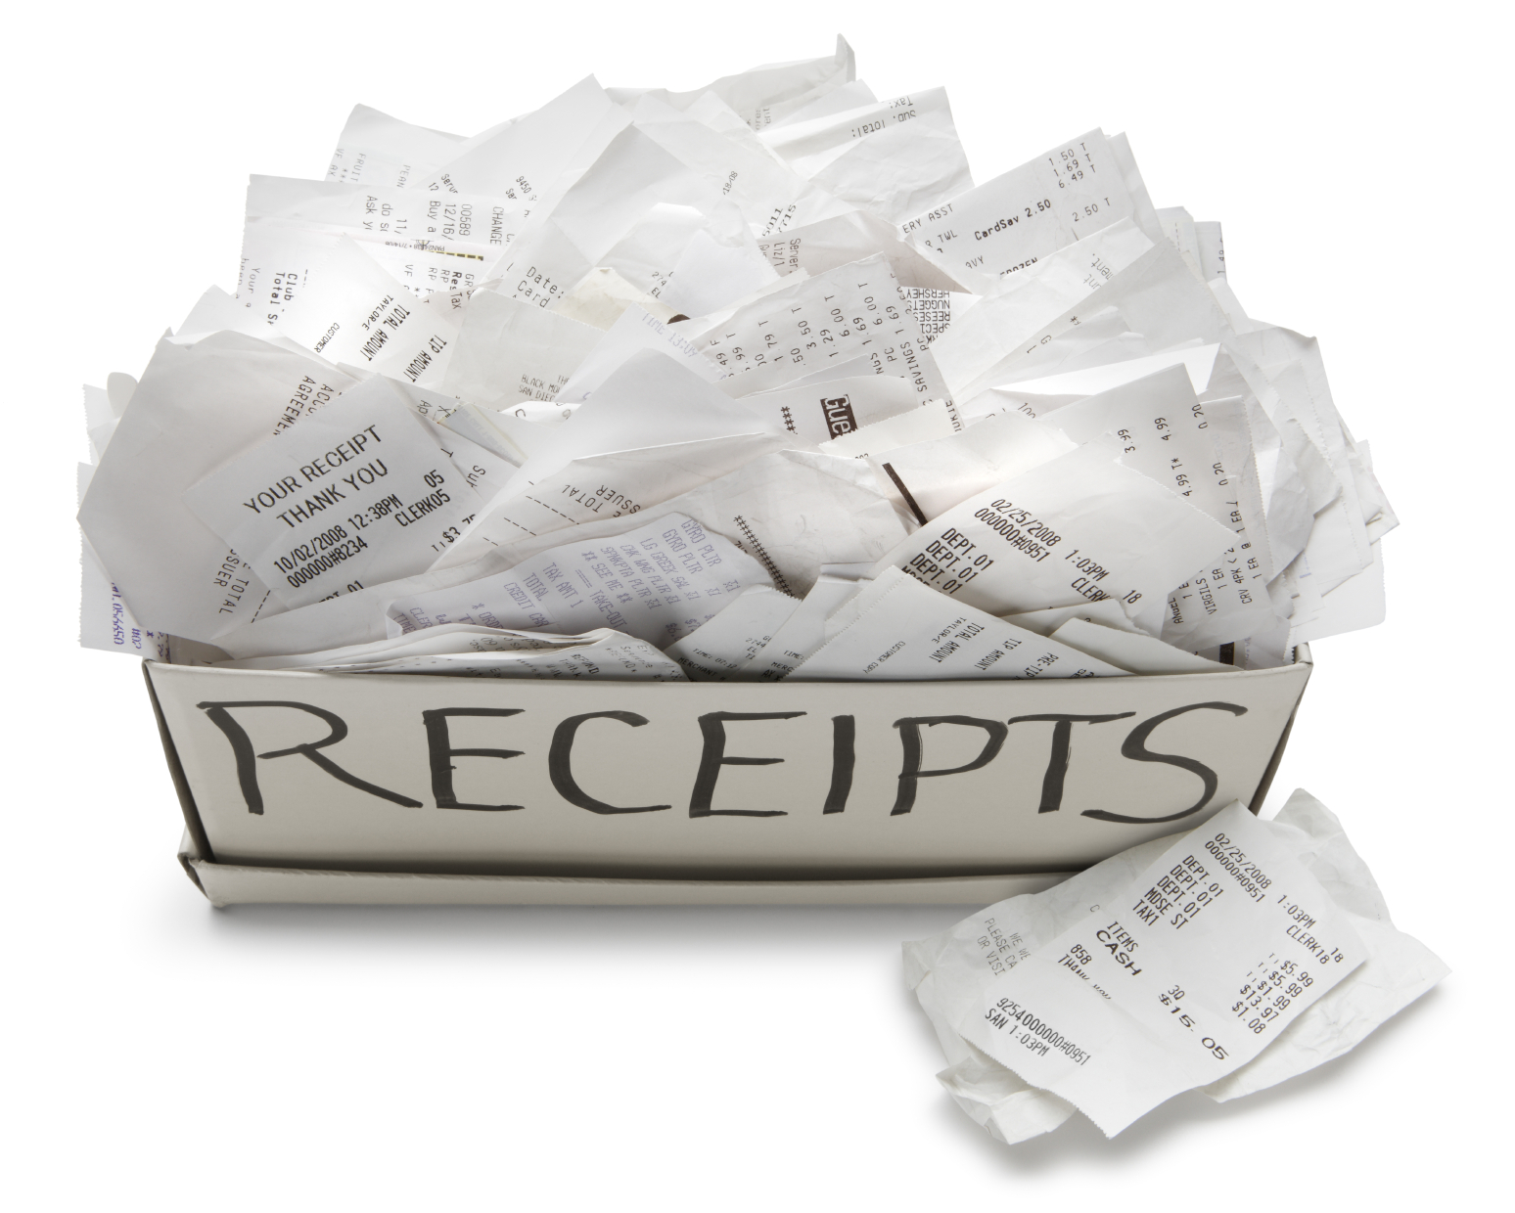



Papermerge DMS
scanner
JPEG, PDF, TIFF
via python’s
imapclient
SMTP/email
+ PDF attachment
REST API
john_imports@example.com
SFTP, Dropbox etc
Notes:
Instead of storing piles of paper based documents in drawers, on the desk or in physical folders – is it more convinient to scan all of them and feed to centralized location.
With Papermerge you basically can import documents from virtually any location – from your email account, from you computer of from any cloud location like Dropbox or SFTP

Slide 4
Demo

Slide 5
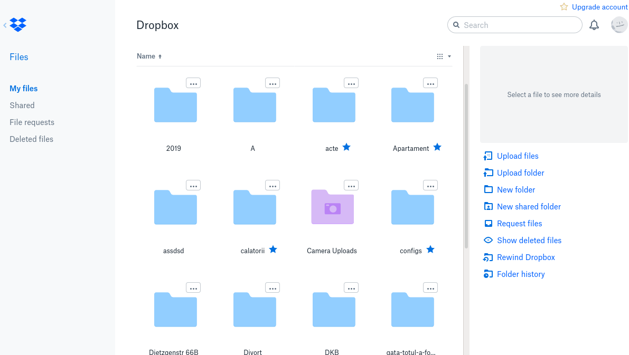
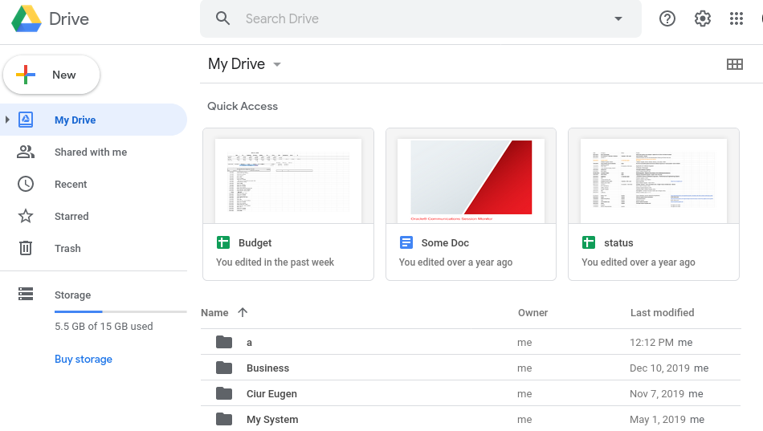
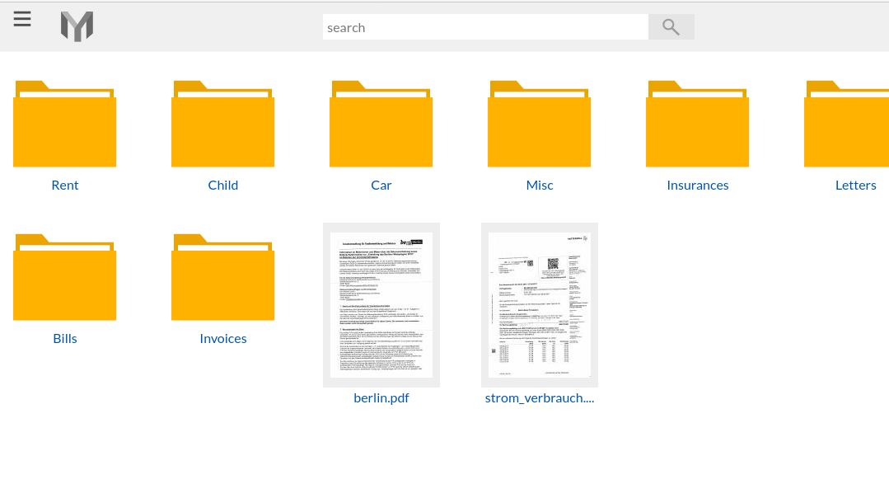
What’s the diff?
Notes:
Many people use solutions like Dropbox and Google Drive. It makes Perfect sense to ask, especially after seeing that demo, and getting to know better the application – what is the different between Papermerge, and mainstream applications like dropbox and Google Drive ?
Why bother to create an entirely new application when there are so powerful solutions offered by big guys like google?

Slide 6





Comparison Matrix
Open Source?
OCR
File Types | PDF, JPEG, PNG, TIFF (archives) | ALL | ALL
Page Management
Data is Yours
Notes:
Obvious and number one difference
is that Papermege is an open source project.
If you upload a scanned document to google drive - it will OCR it and make it available via full text search. Same with Dropbox.
Papermerge is specialized solution. It works only with scanned documents, PDFs, PNG, TIFF.
Because it is a specliazed solution, papermerge has so called Page Management. Which means you can cut, copy, delete pages from documents. This is very useful because many times scanned pages end up in foregn documents.

Slide 7
Page Management
Demo

Slide 8
Version 1.3
Available in ~ July 2020
Metadata

Slide 9
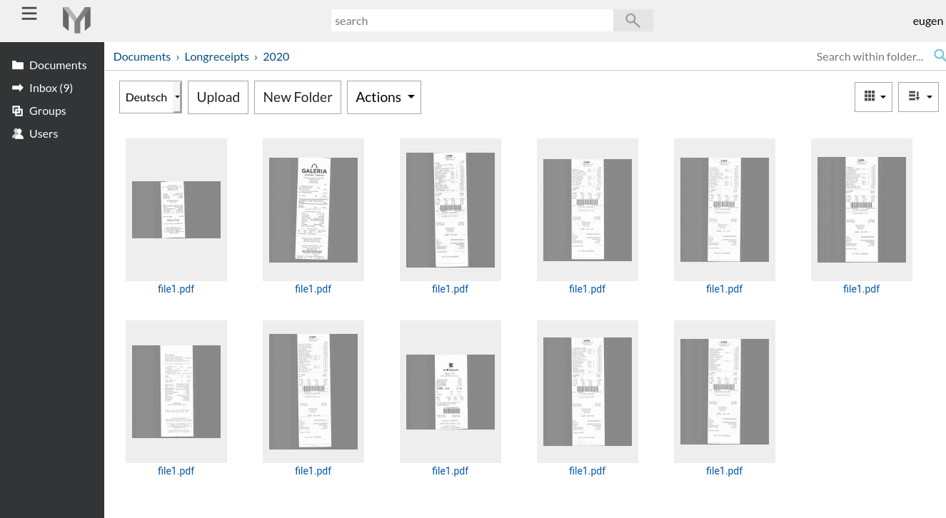
Physical Mess = Digital Mess
=

Slide 10
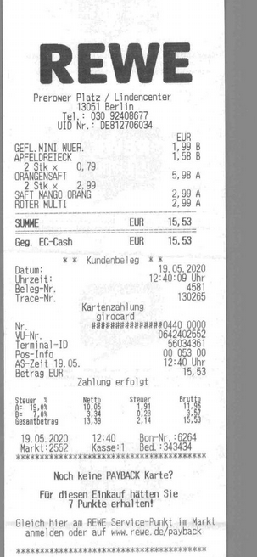
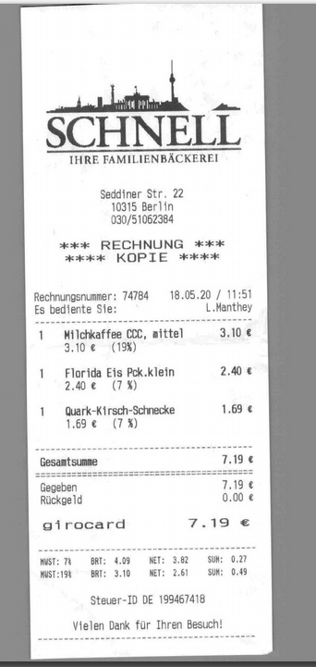
shop
date
price

Slide 11
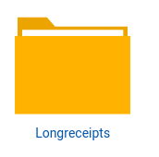
shop
date
price
Sort/View documents in this folder based on shop, price, date (in receipts)!
All folders in this document will define this metadata

Slide 12
Automate
Expenses tracking
Accounting

Slide 13
Thank you!
Papermerge
www.papermerge.com

