Slide 1
Software Engineering and Programming Skills
SCRL
Wenming Zhang

Slide 2
Software Engineering
History
Sub disciplines
Systems development life cycle
Software Development Model
Software Agile Development
Extreme programming
Review - Code Review
OOP-Design pattern
Programming Skills
Performance Upgrade
Loop
Bit Operation
Matrix Operation

Slide 3
Software Engineering – 1. History
Early 1940s – First digital computer appeared
Early 1950s – Programming language started to appear: Fortran, ALGOL, COBOL
1960s - The systems development life cycle originated to develop large scale functional business systems in an age of large scale business conglomerates. Software development methodology (also known as SDM) emerged.
1968 – First International Conference on Software Engineering
1984 - Software Engineering Institute (SEI) was established headquartered on the campus of Carnegie Mellon University
Now - Software Engineering Body of Knowledge is an international standard ISO/IEC

Slide 4
Software Engineering - 2. Sub disciplines
Software engineering can be divided into sub-disciplines:
Software requirements
Software design
Software construction
Software testing
Software maintenance
Software configuration management
Software engineering management
Software development process
Software engineering models and methods
Software quality
Software engineering professional practice
Software engineering economics
Computing foundations
Mathematical foundations
Engineering foundations
An empirical, technical investigation conducted to provide stakeholders with information about the quality of the product or service under test
The definition, implementation, assessment, measurement, management, change, and improvement of the software life cycle process itself
is about making decisions related to software engineering in a business context
Notes:
Software requirements (or Requirements engineering): The elicitation, analysis, specification, and validation of requirements for software.
Software design: The process of defining the architecture, components, interfaces, and other characteristics of a system or component. It is also defined as the result of that process.
Software construction: The detailed creation of working, meaningful software through a combination of coding, verification, unit testing, integration testing, and debugging.
Software testing: An empirical, technical investigation conducted to provide stakeholders with information about the quality of the product or service under test.
Software maintenance: The totality of activities required to provide cost-effective support to software.
Software configuration management: The identification of the configuration of a system at distinct points in time for the purpose of systematically controlling changes to the configuration, and maintaining the integrity and traceability of the configuration throughout the system life cycle.
Software engineering management: The application of management activities—planning, coordinating, measuring, monitoring, controlling, and reporting—to ensure that the development and maintenance of software is systematic, disciplined, and quantified.
Software development process: The definition, implementation, assessment, measurement, management, change, and improvement of the software life cycle process itself.
Software engineering models and methods impose structure on software engineering with the goal of making that activity systematic, repeatable, and ultimately more success-oriented
Software engineering professional practice is concerned with the knowledge, skills, and attitudes that software engineers must possess to practice software engineering in a professional, responsible, and ethical manner
Software engineering economics is about making decisions related to software engineering in a business context

Slide 5
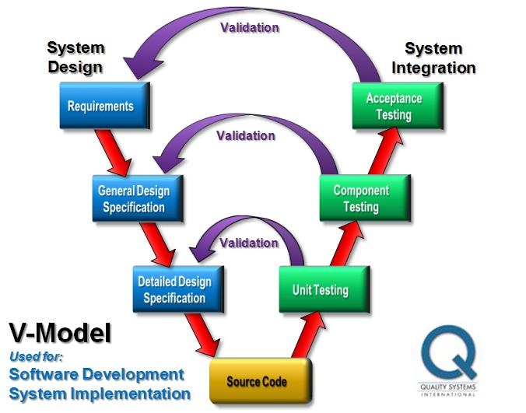
Software Engineering – 3. Systems development life cycle
Preliminary analysis
Systems analysis, requirements definition
Systems design
Development
Integration and testing
Acceptance, installation, deployment
Maintenance
Evaluation
Disposal

Slide 6
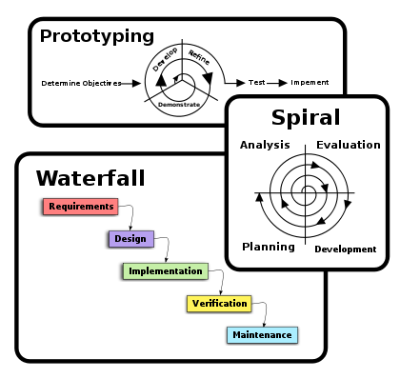
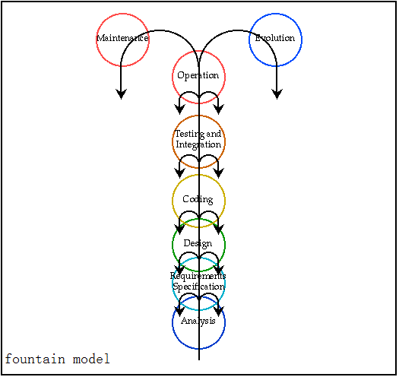
Software Engineering – 4. Software Development Model
Waterfall Model
Build-and-Fix Model
Rapid Prototype Model
Incremental Model
Spiral Model
evolution model
fountain model
hybrid model
Agile Development
…
The earliest model published in 1970
Very simple and only can be used for small program
The software designer and implementer can get valuable feedback from the users early in the project
breaking a project into smaller segments and providing more ease-of-change
combines some key aspect of the waterfall model and rapid prototyping methodologies
Combination of several models

Slide 7
Software Engineering – 5. Software Agile Development
Agile software development :
Describes a set of principles for software development under which requirements and solutions evolve through the collaborative effort of self-organizing cross-functional teams.
It advocates adaptive planning, evolutionary development, early delivery, and continuous improvement, and it encourages rapid and flexible response to change.
These principles support the definition and continuing evolution of many software development methods
Requirements
Design & Code
Test & Validate
Product & Release
Iteration
Apply:
Compared to traditional software engineering, agile software development mainly targets complex systems and product development with dynamic, non-deterministic and non-linear characteristics
Overview:
Iterative, incremental and evolutionary
Efficient and face-to-face communication
Very short feedback loop and adaptation cycle
Quality focus
Agile methods:
Agile modeling
Extreme programming
Feature-driven development
Rapid application development
…

Slide 8
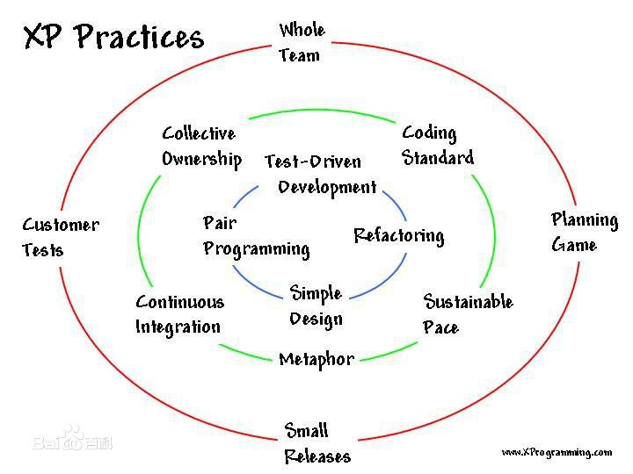
Software Engineering – 6. Extreme programming
Value:
Communication
Simplicity
Feedback
Courage
Modesty

Slide 9
Software Engineering – 7. Review-Code Review
Purpose
Less vulnerabilities
Better quality code
Better structured code
Mentoring tool
Sharing knowledge
Form
formal code review
lightweight code review
Tools
FishEye, Crucible, GitLab, Review Board, …

Slide 10
Software Engineering – 8. OOP-Design pattern
Design patterns can speed up the development process by providing tested, proven development paradigms
Creational Patterns
Structural Patterns
Behavioral Patterns
Factory Method
Abstract Factory Pattern
Singleton Pattern
Builder Pattern
Prototype Pattern
Adapter Pattern
Bridge Pattern
Filter、Criteria Pattern
Composite Pattern
Decorator Pattern
Facade Pattern
Flyweight Pattern
Proxy Pattern
Chain of Responsibility Pattern
Command Pattern
Interpreter Pattern
Iterator Pattern
Mediator Pattern
Memento Pattern
Observer Pattern
State Pattern
Null Object Pattern
Strategy Pattern
Template Pattern
Visitor Pattern

Slide 11
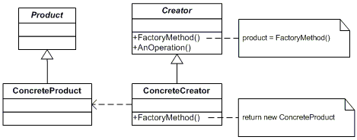
Software Engineering – 8. OOP-Design pattern
Factory Method:
Define an interface for creating an object, but let subclasses decide which class to instantiate. Factory Method lets a class defer instantiation to subclasses.

Slide 12
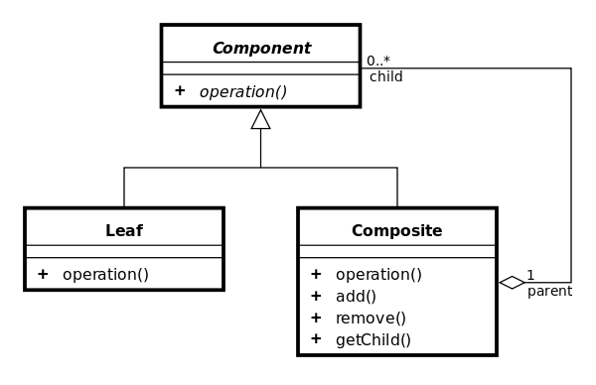
Software Engineering – 8. OOP-Design pattern
Composite Pattern:
Describes that a group of objects is to be treated in the same way as a single instance of an object. The intent of a composite is to "compose" objects into tree structures to represent part-whole hierarchies. Implementing the composite pattern lets clients treat individual objects and compositions uniformly

Slide 13
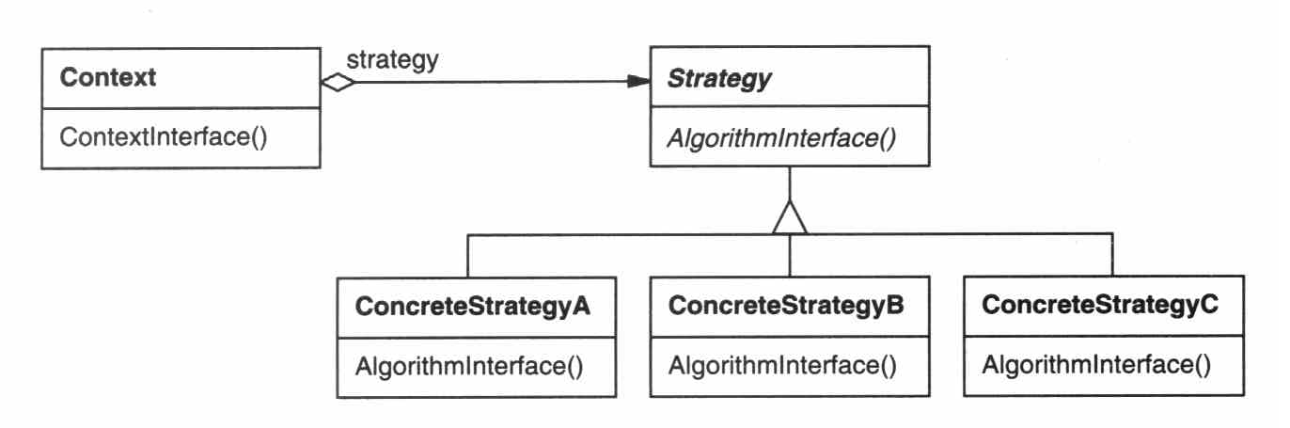
Software Engineering – 8. OOP-Design pattern
Strategy Pattern:
defines a family of algorithms,
encapsulates each algorithm, and
makes the algorithms interchangeable within that family.

Slide 14
Programming Skills – 1. Performance Upgrade
Logic and algorithm
Use basic type but not object
Using local variable but not global variable
Using bit operation to replace divide and multiply operation
Using macro but not function if possible
Make function be final or inline
Using row-column loop
Reduce the calculate of repeated process
Use StringBuilder and StringBuffer for string connect(java)
Use HashMap, ArrayList for single thread rather than HashTable, Vector(java)
Release the object won’t be used (java)
Rewrite the system function for particular case.

Slide 15
Programming Skills – 2. Loop
for(j = 0; j<1000;j++ ){
for(k = 0; k<1000;k++ ){
array[j][k] = 1;
}
}
for(j = 0; j<1000;j++ ){
for(k = 0; k<1000;k++ ){
array[k][j] = 1;
}
}
0.6ms
2.8ms
for (i = 0; i<n; i++)
{
if (true)
{
DoOneThing(i);
}
else if (true)
{
DoSomethingElse(i);
}
else
{
DoYetAnotherThing(i);
}
}
if (true)
{
for (i = 0; i<n; i++)
{
DoOneThing(i);
}
}
else if (true)
{
for (i = 0; i<n; i++)
{
DoSomethingElse(i);
}
}
else
{
for (i = 0; i<n; i++)
{
DoYetAnotherThing(i);
}
}

Slide 16
Programming Skills – 2. Loop
float f[100], sum;
...
/* Back to back dependent
adds force the thoughput
to be equal to the total
FADD latency. */
sum = 0;
for (i = 0; i<100; i++) {
sum += f[i];
}
float f[100],sum0,sum1;
float sum2,sum3,sum;
...
/* Optimized for a 4-cycle
latency fully pipelined
FADD unit. The throughput
is one add per clock. */
sum0 = sum1 = sum2 = sum3 = 0;
for(i=0;i<100;i+=4) {
sum0 += f[i];
sum1 += f[i+1];
sum2 += f[i+2];
sum3 += f[i+3];
}
sum = (sum0+sum1) + (sum2+sum3);

Slide 17
Programming Skills – 3. Bit Operation
int I,J; I = 257 /8; J = 456 % 32;
int I,J; I = 257 >>3; J = 456 - (456 >> 4 << 4);

Slide 18
Programming Skills– 4. Matrix Operation
convolution

Slide 19
Programming Skills– 4. Matrix Operation
Repeat
Original extend and copy the matrix elements one by one

Slide 20
Programming Skills – 4. Matrix Operation
Repeat
Extend and copy the matrix row one by one

Slide 21
Programming Skills – 4. Matrix Operation
Repeat
Example
1
1
2
2
1 | 2
3 | 4
5 | 6
3
3
4
4
5
5
6
6
1 | 2
3 | 4
5 | 6
1
3
5
1 | 1 | 2 | 3
3 | 3 | 4 | 5
5 | 5 | 6 | 6
1
3
5
1
3
5
2
2
4
2
4
6
4
6
6

Slide 22
Programming Skills – 4. Matrix Operation
Multiply -> Dot
ctx_ = (_input.dimshuffle(0, 'x', 1, 2) * alpha[:, :, :, None]).sum(0)
(40L, ‘x’, 1L, 300L) * (40L, 40L, 1L, None).sum(0)
->
alpha.permute(1, 0).mmul(input).dup()
(40L, 40L). Permute(1, 0).dot(40L,300L)
From json N dimension to Nd4j INDArray
INDArray load_json_to_NDArray(JsonElement json_array, int depth)

Slide 23
End

