Slide 1
Spectrum server specification
Outline
Service framework
Environment setup
Server Access URL
Software development: URL fetch server
Software development: Main server
Software development: Database

Slide 2
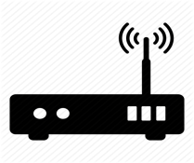


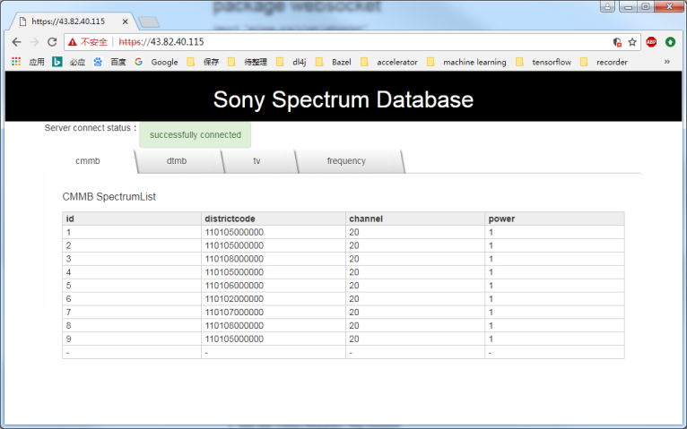
Service framework
Slave client
URL fetch server (Golang)
HTTP
Master server
Get the database service address
Slave client
HTTPS
Database server
Spectrum request
Main server (Golang)
Spectrum allocation algorithm
HTTPS WebSocket
Database information request
Database (SQL)
Frequency
DTMB
LocationPostalNumber
CMMB
TV

Slide 3
Environment setup
Software: go program language and MySQL installed
Examples:
Win7 64bit
Download and install go1.10.windows-amd64.msi
Download and install mysql-5.7.21-winx64.msi
Create username with “sony” set password also as “sony”.
Install mysql and configuration lib for go
Run following command in windows command line:
go get github.com/go-sql-driver/mysql
go get github.com/robfig/config
go get -u github.com/golang/net/websocket
Copy net directory to C:\Go\src\golang.org\x\
Import MySQL database
Open windows command line
Login in mysql: ”mysql -usony -psony”
Create spectrum database: “create database spectrum_v1;”
Import the spectrum tables “source E:\Work\RSS_DEMO\spectrum\database_creation\tables.sql”
“E:\Work\RSS_DEMO\spectrum\database_creation\tables.sql” is the full path of the tables.sql
Start up “URL fetch service” and “Database service”
Run the executed file “url-fetch-server.exe”
Run the executed file “spectrum.exe”

Slide 4
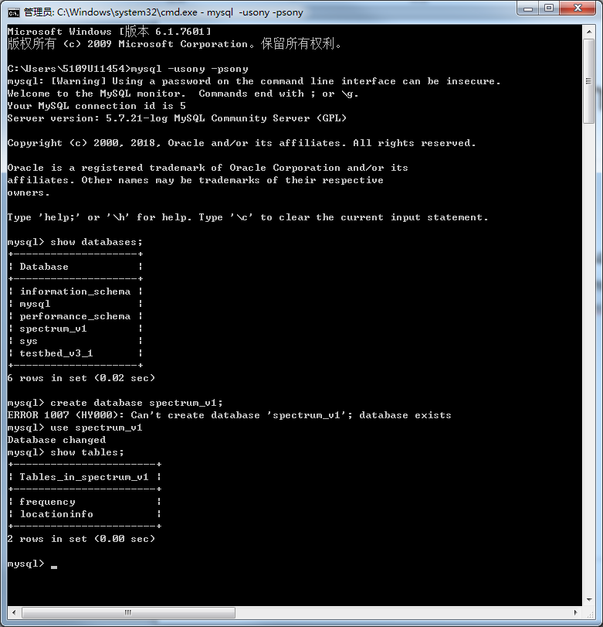
Environment setup
Import MySQL database example.
Login in mysql
1
Create database
2
Change database
3
4
Import MySQL database as said in previous one slide

Slide 5
Server Access URL
Database access from AP:
https://serverIP/data
Example:https://43.82.40.115/data
Access database information from brower
https://serverIP
Example:https://43.82.40.115

Slide 6
Software development: URL fetch server
File list:
main.go //service main file
url-fetch-server.config // configuration file
Compile steps:
Open windows cmd
Go into the project file path “spectrum\url-fetch-server”
Run command “go build”
Configuration:
URL fetch server IP: url-fetch-server.config - IP
URL fetch server port: url-fetch-server.config - port
Database service address: url-fetch-server.config - url_db
Using:
Open windows cmd
Go into the project file path “spectrum\url-fetch-server”
Run the executed file “url-fetch-server.exe”

Slide 7

Software development: Main server
Configuration IP:
Update local server in main function in main.go
Compile steps:
Same with “URL fetch server”
Using:
Open windows cmd
Go into the project file path “spectrum\spectrum”
Run the executed file “spectrum.exe”
spectrumserver.go
Handle request from master device and give respond message
Master device
getvalidspectrum.go
Spectrum allocation algorithm
main.go
https service
WebSocket service
mysql.go
SQL access interface
Sql database
Brower Information page
index.html
Information web page
Setup database
server.crt
server.key
Certificate file and related key file used by HTTPS protocol
messagetype.go
Define message type used between database server and master device
mysqltype.go
Define message type used between database server and SQL database table
tables.sql
Used for setup SQL database

Slide 8
Software development: Database
Database name: spectrum_v1
Tables:
Frequency //spectrum list
CMMB //spectrum channel used by CMMB
DTMB //spectrum channel used by DTMB
TV //spectrum channel used by TV
LocationInfo //location postal code information
FreqUsing // spectrum using list by dynamic allocated to master device
Useful commands:
show databases;
show tables;
show columns from table_name
select * from columns from table_name

