Slide 1
Spectrum server specification
Outline
Service framework
Environment setup
URL fetch server
Main server
Database
Service: HTTP service (Golang)
Interface type: Public IP
Function: Offer the “Main service” IP address
Service: HTTPS service (Golang)
Interface type: Public IP
Function: Hand the spectrum request
Service: SQL service (MySQL)
Interface type: Located in the same place with “Main service”
Function: Offer spectrum basic information for “Main service”

Slide 2


Service framework
Slave client
URL fetch server (Golang)
HTTP
Get the database service address
Slave client
Database server
Master server
Main server (Golang)
HTTPS
Spectrum allocation algorithm
Spectrum request
Slave client
Database (SQL)
Frequency
DTMB
LocationPostalNumber
CMMB
TV

Slide 3
Environment setup
Software: go program language and MySQL installed
Examples:
Win7 64bit
Download and install go1.10.windows-amd64.msi
Download and install mysql-5.7.21-winx64.msi
Create username with “sony” set password also as “sony”.
Install mysql and configuration lib for go
Run following command in windows command line:
go get github.com/go-sql-driver/mysql
go get github.com/robfig/config
Import MySQL database
Open windows command line
Login in mysql: ”mysql -usony -psony”
Create spectrum database: “create database spectrum_v1;”
Import the spectrum tables “source E:\Work\RSS_DEMO\spectrum\database_creation\tables.sql”
“E:\Work\RSS_DEMO\spectrum\database_creation\tables.sql” is the full path of the tables.sql
Start up “URL fetch service” and “Database service”
Run the executed file “url-fetch-server.exe”
Run the executed file “spectrum.exe”

Slide 4
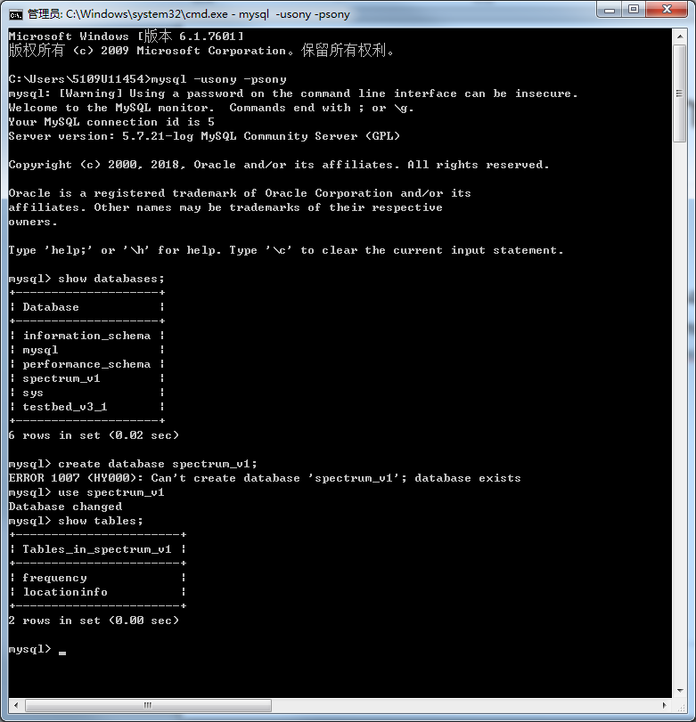
Import MySQL database example.
Login in mysql
1
Create database
2
Change database
3
4
Import MySQL database as said in previous one slide

Slide 5
URL fetch server development
File list:
main.go //service main file
url-fetch-server.config // configuration file
Compile steps:
Open windows cmd
Go into the project file path “spectrum\url-fetch-server”
Run command “go build”
Configuration:
URL fetch server IP: url-fetch-server.config - IP
URL fetch server port: url-fetch-server.config - port
Database service address: url-fetch-server.config - url_db
Using:
Open windows cmd
Go into the project file path “spectrum\url-fetch-server”
Run the executed file “url-fetch-server.exe”

Slide 6
Main server development
File list:
main.go //service main file
mysql.go // SQL access function
spectrumserver.go // spectrum request process function
messagetype.go // spectrum request and responds message type definition
mysqltype.go // SQL data type definition based on SQL tables columns
Compile steps:
Same with “URL fetch server”
Using:
Open windows cmd
Go into the project file path “spectrum\spectrum”
Run the executed file “spectrum.exe”

Slide 7
Database development
Database name: spectrum_v1
Tables:
Frequency //spectrum list
CMMB //spectrum channel used by CMMB
DTMB //spectrum channel used by DTMB
TV //spectrum channel used by TV
LocationInfo //location postal code information
Useful commands:
show databases;
show tables;
show columns from table_name
select * from columns from table_name

