Slide 1
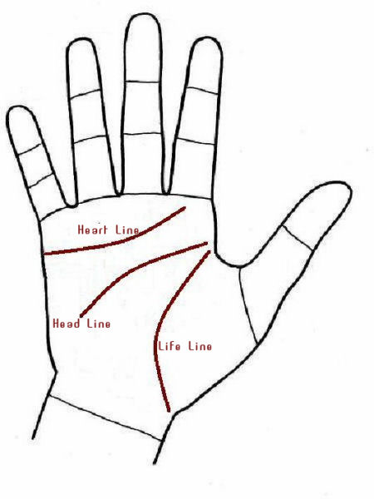
PALM PREDICTION SYSTEM
BSACET (PART 1)
Mini PROJECT

Slide 2
Cotributor
Shivam Dixit
2200650100100

Slide 3
Motivation
Our College – Babu Shivnath Agrawal College of Engineering and Technology
Mr. Shahid Hussain Sir– Mentor
My passion for making and idea come to life
Dedication towards Coding

Slide 4
What is this Project about?
The Project titled “Ritual Guru” with the aim of implementing key concepts in OpenCV was found to meet all objectives. Utmost care has been taken to see that the results obtained are true and the underlying procedures are implemented in true form. The aim of this project is to present a novel software based selection method that can be used by anyone to get Informatiom by scanning only the image of their hands.

Slide 5



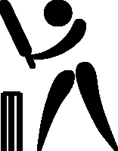

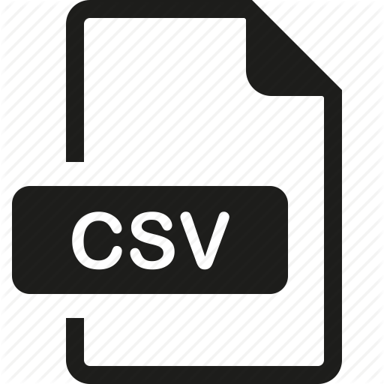
Limitations..
 | Currently lack to analyse the Lines
 | CLI Based (Overcomed)
 | Uses less research.

Slide 6
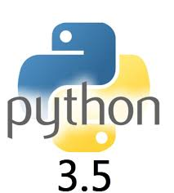
Technology used

Slide 7

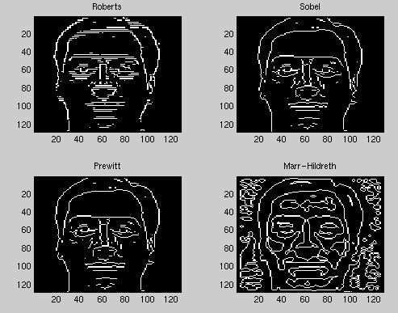
Project overview
Read Image.
Digitalize and filter
Apply logic
Use Data in Json

Slide 8
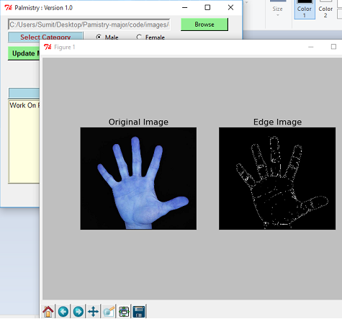
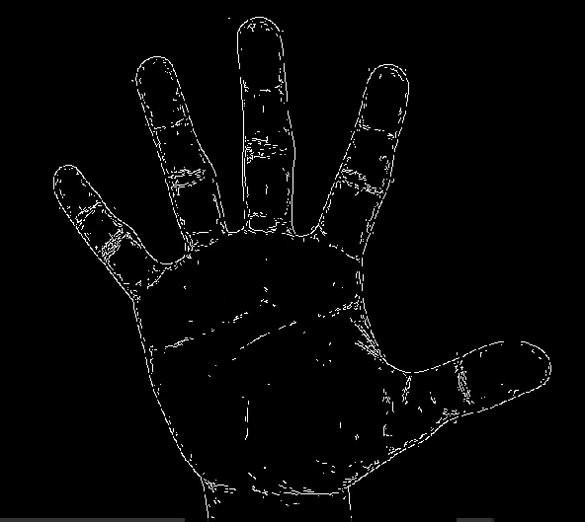
Canny Edge Detection Method Applied:

Slide 10
Objective
Palmistry deals with studying the lines ,their lengths and ratios. As stated earlier in older times the manual calculation of ratios was not always correct .Let alone common man could not differentiate the frauds from the learned .The validation of any universal rule made during the ancient time does not exist even in the modern time. The problem is “Pattern Classification in the field of palmistry and validation of traditional rules.”

Slide 11
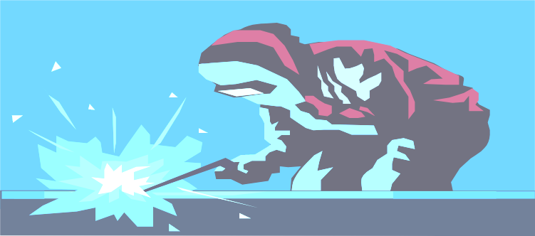
IMPLEMENTATION
Range detection
Ratio Calculation
Prediction
Validation

Slide 12
Conclusion
Predicting human’s past ,present or future hundred percent accurately is an impossible task. Data mining algorithms can only predict it accurately to some extent. Also not every predicting rule is error proof.This newly developed model could help to validate the accuracy of each rule.Until now palmistry did not have a solid data set to prove if it correct but now slowly and gradually as the data set increases new trends will come into action. It is a simple and an accurate mathematical approach used for classification of ratios into good,average or bad category. This model will provide a mathematical fact for the fixation of certain value for a particular rule and also apply it . Not only will palmistry gain trust of people it will also be recognized as a mainstream research area with some solid results to back up the predictions.It will also save people to hire any astrologer ,rather they can do this on their own ,which also saves them from frauds and fake astrologers.

Slide 13
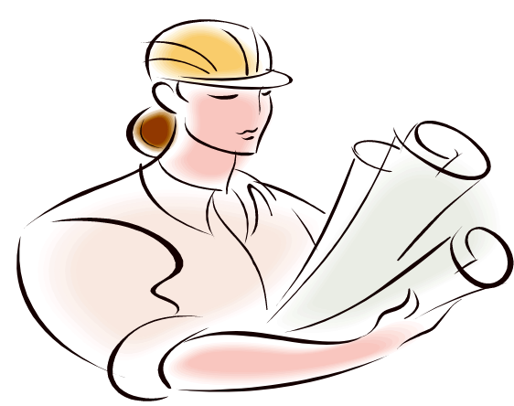
Future Work
Validating lines and more rules.
Implement the dataset and Data Analytics and Machiene Learning.
Making plots more insightful for better comparisons.
Making system more robust and scalable. More techniques for the visualization for the results.
GUI integration

Slide 14
Thank You

