Slide 1

Notes:
Stakeholder convening

Slide 2
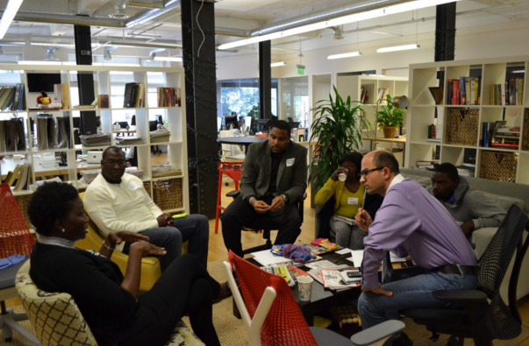
Notes:
User journeys

Slide 3
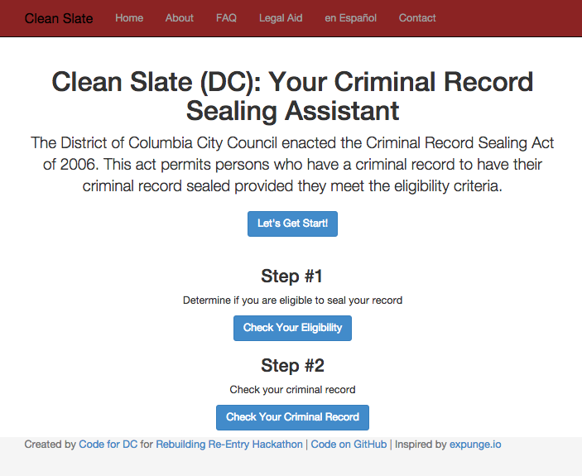
Notes:
Building for & with the user

Slide 4
B2B vs. B2C

Slide 5
B2B=Safety Net of Legal Aid
B2C=Pro Se

Slide 6
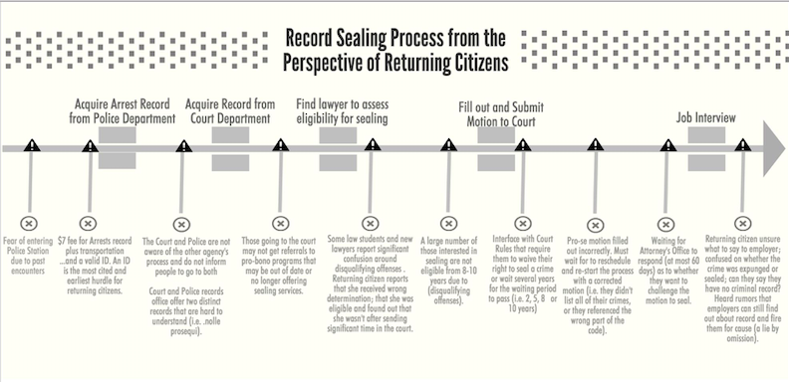

Slide 7
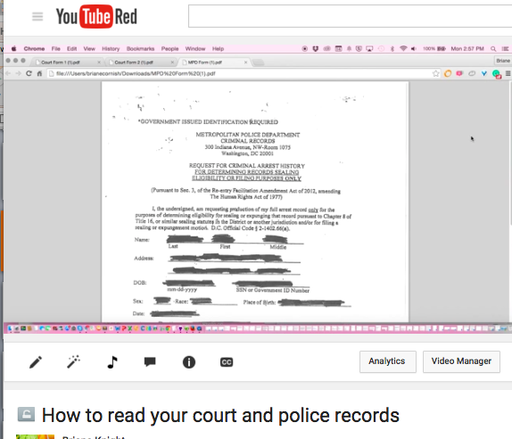

Slide 8
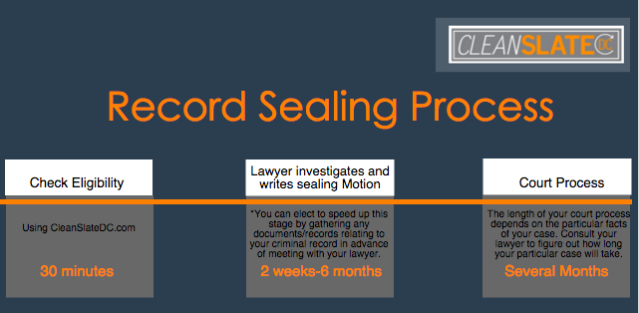
Notes:
Up-to-date Pathways

Slide 9

Notes:
Up-to-date Pathways

Slide 10
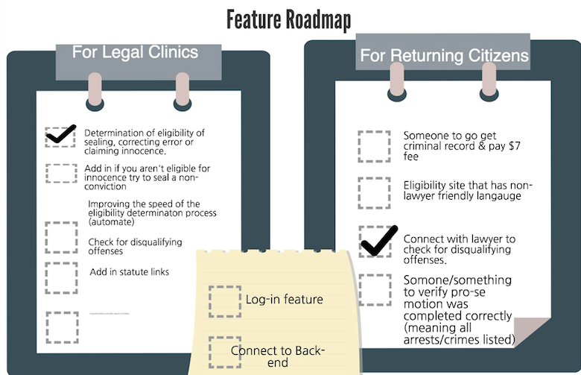

Slide 11
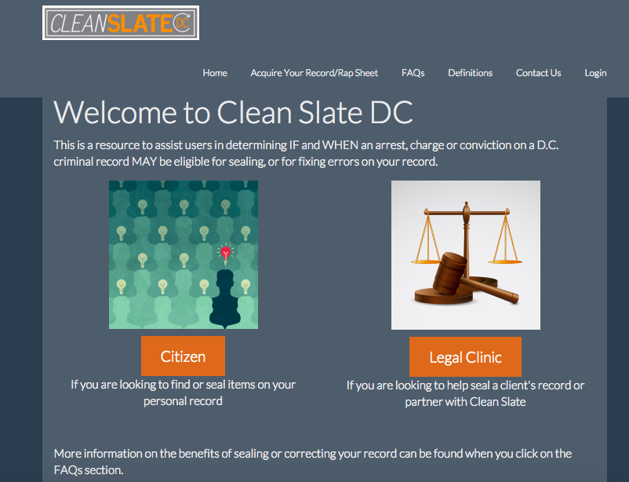

Slide 12
