Slide 1
Advanced Computational Methods in Geotechnical Engineering
Lecture
April 02, 2008

Slide 2
Consolidation Settlement &
Average Degree of Consolidation
FD Solution
Conventional consolidation settlement analysis using empirical equations has the following limitations:
The coefficient of consolidation C_{v} is assumed to be
constant, however, it is well known that C_{v}
changes with time in the consolidation process.
Variation in application of load such as stage
loading (load increasing by a certain rate), and
abrupt change of load (the case of surcharge
preloading) are not considered.

Slide 3
Numerical solution using the finite difference method
can be used to overcome the problem.
The numerical solution does not require the empirical
correlation for T_{v} because it can be done by using the
original formula and load application and other
variations can be modeled almost correctly.

Slide 4
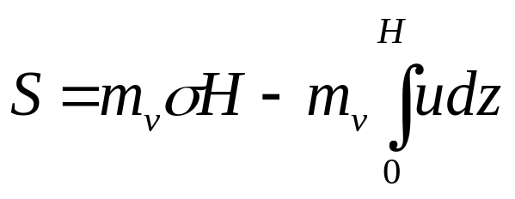
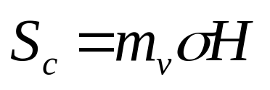
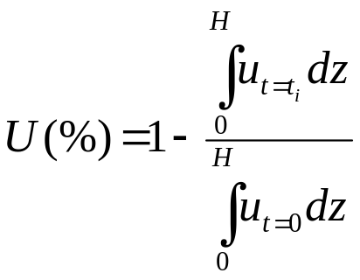
Consolidation Settlement &
Average Degree of Consolidation
(A)
When the pore pressures is completely dissipated.
Average degree of consolidation

Slide 5
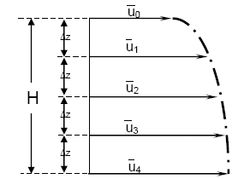
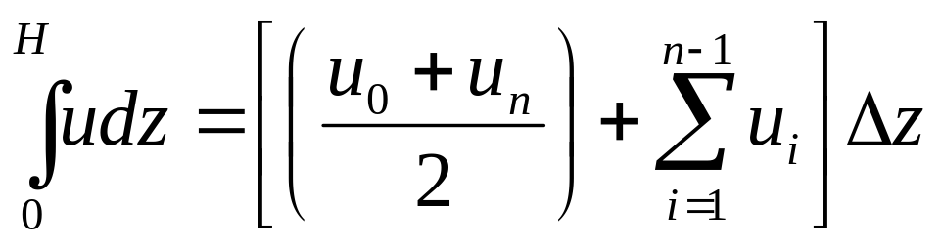
In Eqn. (A), the integral of the excess pore pressure cannot be evaluated exactly because the excess pore pressure is only at the grid points.
However, the integral can be evaluated approximately using some numerical techniques. The simplest approach is to use the Trapezoidal Method.

Slide 6
Variable Loading
In reality, a loading is never placed instantaneously and the problem can be easily handled through finite difference formulation.
Variable loading usually occurs when there is a structure being built on top of the soil layer. As the construction of the structure proceeds, the load induced onto the ground gradually increases with time.
Considering that the construction is a time consuming process, we cannot assume a formulation of instantaneous load to be used in the calculation of settlement.

Slide 7
Abrupt Change of Load
When the existing soil layers are too weak, it has to be loaded in stages. Loading in stages will increase the shear strength and bearing capacity of the soil as it consolidates.

Slide 8
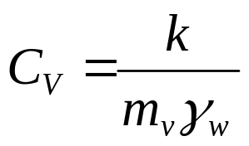
Variable Coefficient of Consolidation (Cv)
The coefficient of consolidation is usually considered as constant in consolidation analysis although it is a variable quantity.
It is known empirically that C_{V} changes during consolidation as the void ratio of the soil changes causing a decrease in permeability and compressibility of the soil.

Slide 9
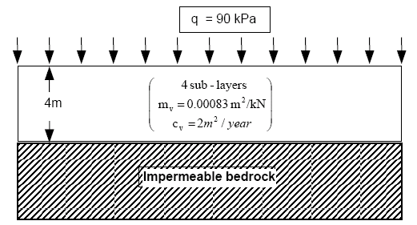
Example Problem (Assignment #3)
Drainage Boundary
Analyze the pore water pressure, settlement and average degree of consolidation of the soil layer after 2 years of consolidation using FDM.

Slide 10
Loading Scenarios
Case 1: constant load scenario: a uniform load of 90 kPa is applied onto the soil layer at once.
Settlement (mm) | 0.0 | ※
t(yrs) | 0 | 0.2 | 0.4 | 0.6 | 0.8 | 1.0 | 1.2 | 1.3 | 1.4 | 1.6 | 1.8 | 2.0
q(kPa) | 90 | 90 | 90 | 90 | 90 | 90 | 90 | 90 | 90 | 90 | 90 | 90
z=0 m | 0 | ※
z=1 m | 90 | ※
z=2 m | 90 | ※
z=3 m | 90 | ※
z=4 m | 90 | ※
U_{av}(%) | 0.0 | ※

Slide 11
Example
Case 1: constant load scenario: a uniform load of 90 kPa is applied onto the soil layer at once.
Settlement (mm) | 0.0
t(yrs) | 0 | 0.2 | 0.4 | 0.6 | 0.8 | 1.0 | 1.2 | 1.3 | 1.4 | 1.6 | 1.8 | 2.0
q(kPa) | 90 | 90 | 90 | 90 | 90 | 90 | 90 | 90 | 90 | 90 | 90 | 90
z=0 m | 0 | 0
z=1 m | 90 | 54
z=2 m | 90 | 90
z=3 m | 90 | 90
z=4 m | 90 | 90
U_{av}(%) | 0.0

Slide 12
Loading Scenarios
Case 2: variable load scenario: a fill having a unit weight 15 kN/m³ is placed at a rate of 0.5 m/month during the first year and the filling stops after one year. The final load would be 90 kPa.
Settlement (mm) | 0 | ※
t(yrs) | 0 | 0.1 | 0.2 | 0.3 | 0.4 | 0.5 | 0.6 | 0.7 | 0.8 | 0.9 | 1.0
q(kPa) | 0 | 9 | 18 | 27 | 36 | 45 | 54 | 63 | 72 | 81 | 90
z=0 m | 0 | ※ | ※
z=1 m | 0 | ※ | ※
z=2 m | 0 | ※
z=3 m | 0 | ※
z=4 m | 0 | ※

Slide 13
Loading Scenarios
Case 2: variable load scenario (continued):
Settlement (mm)
t(yrs) | 1.1 | 1.2 | 1.3 | 1.4 | 1.5 | 1.6 | 1.7 | 1.8 | 1.9 | 2.0
q(kPa) | 90 | 90 | 90 | 90 | 90 | 90 | 90 | 90 | 90 | 90
z=0 m
z=1 m
z=2 m
z=3 m
z=4 m
U_{av}(%)

Slide 14
Example
Case 2: variable load scenario: a fill having a unit weight 15 kN/m³ is placed at a rate of 0.5 m/month during the first year and the filling stops after one year. The final load would be 90 kPa.
Settlement (mm) | 0 | 3.735
t(yrs) | 0 | 0.1 | 0.2 | 0.3 | 0.4 | 0.5 | 0.6 | 0.7 | 0.8 | 0.9 | 1.0
q(kPa) | 0 | 9 | 18 | 27 | 36 | 45 | 54 | 63 | 72 | 81 | 90
z=0 m | 0 | 0 | 0
z=1 m | 0 | 9 | 16.2
z=2 m | 0 | 9
z=3 m | 0 | 9
z=4 m | 0 | 9

Slide 15
Loading Scenarios
Case 3: abrupt change of load scenario: In the abrupt change of load scenario, the soil layer will be loaded with fill of 60 kPa and after one year, an additional fill of 30 kPa will be laid on the existing fill.
Settlemnt (mm)
t(yrs) | 0 | 0.2 | 0.4 | 0.6 | 0.8 | 1.0 | 1.2 | 1.4 | 1.6 | 1.8 | 2.0
q(kPa) | 60 | 60 | 60 | 60 | 60 | 60 | 90 | 90 | 90 | 90 | 90
z=0 m | 0.0
z=1 m | 60
z=2 m | 60
z=3 m | 60
z=4 m | 60
U_{av}(%) | 0.0

Slide 16
Loading Scenarios
Case 4: constant Load with Variable C_{v}: the C_{v} is assumed to decrease with a rate of 0.1 m²/year.
Settlemnt (mm)
C_{V} | - | 2.0 | 1.98 |  |  | 1.9 |  |  |  |  | 1.8
t(yrs) | 0 | 0.2 | 0.4 | 0.6 | 0.8 | 1.0 | 1.2 | 1.4 | 1.6 | 1.8 | 2.0
q(kPa) | 90 | 90 | 90 | 90 | 90 | 90 | 90 | 90 | 90 | 90 | 90
z=0 m | 0.0
z=1 m | 90
z=2 m | 90
z=3 m | 90
z=4 m | 90
U_{av}(%) | 90

Slide 17
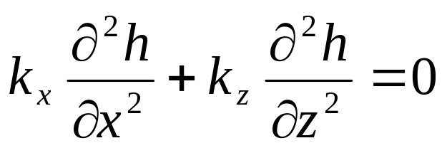
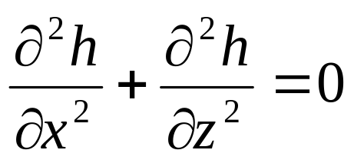
3. FD Solution for Two-dimensional Flow
Flow of Water through soils is governed by Laplace’s equation:
where h is total head, k_{x} & k_{z} coefficients of permeability
in x & z directions.
- If the soil is isotropic k_{x} = k_{z}. Therefore:

Slide 18
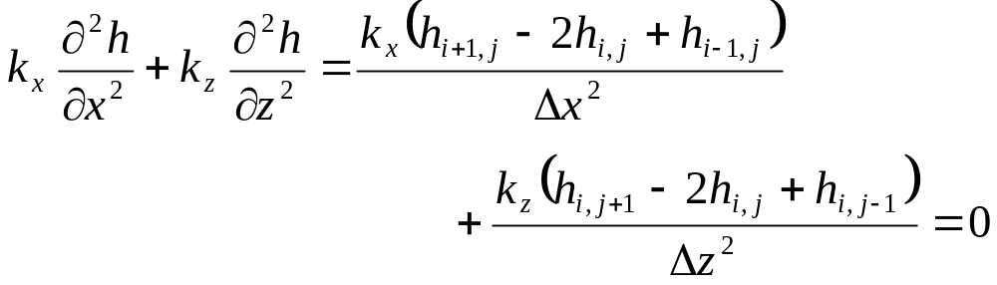


















3.1 FD Equation for 2D flow
Row L
Fig. 3.1: Partial grid of the flow domain
Row K

Slide 19
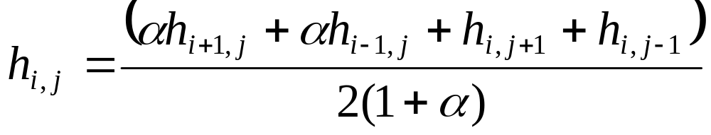
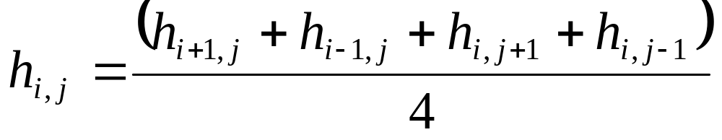
Let α = k_{x}/k_{z} and Δx = Δz (square grid), then:
For isotropic condition α = 1 (k_{x} = k_{z}), hence:
(3.1)

Slide 20





This equation shows that, in a square grid, the total head at every grid is the average of the total heads at the four adjacent grids.

Slide 21
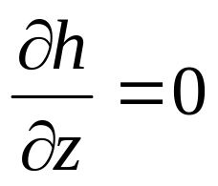
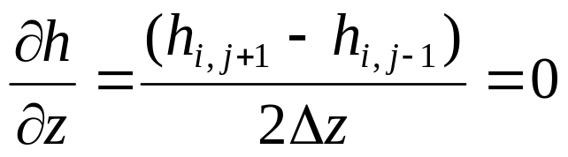
3.2 Boundary Conditions
Flow can not cross impermeable boundaries, therefore, for a horizontal impermeable surface:
Neumann Boundary
Condition
FDE for the boundary conditions is:

Slide 22
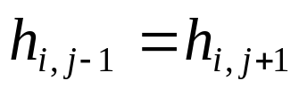
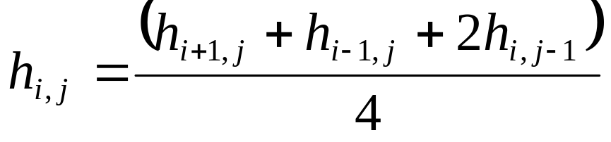
Therefore:
Substituting into eqn. (3.1), we get:
(3.2)

Slide 23





Various types of geometry of impermeable boundaries are encountered in practice. Following are three examples:
Impermeable
Impermeable
Impermeable
Impermeable
(a)
(b)
(c)

Slide 24
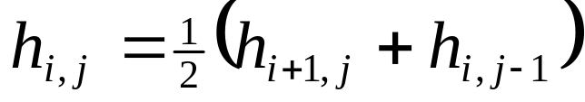
The FDE for Figures (a) & (b) is:
(3.3)
The FDE for Figure (c) is:
(3.4)

Slide 25
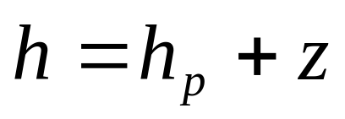
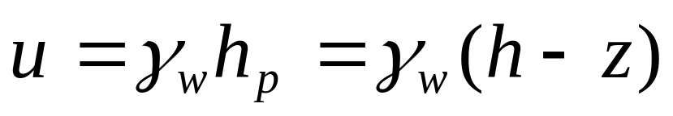
3.3 Pore Water Pressure
Where h is total head, h_{p} is pressure head and z is elevation head.
Pore water pressure is obtained by:

Slide 26
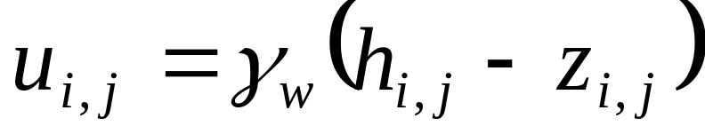
Therefore:
(3.5)
Contours of potential heads can be drawn from the discrete values of h_{i,j}.

Slide 27
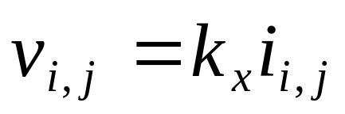
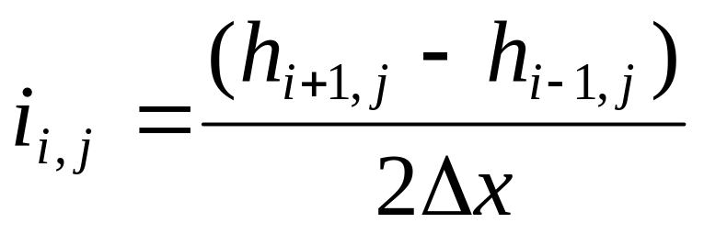
3.4 Velocity
The horizontal velocity of flow at any node is given by Darcy’s law:
Where i_{i,j} is the hydraulic gradient expressed as:

Slide 28
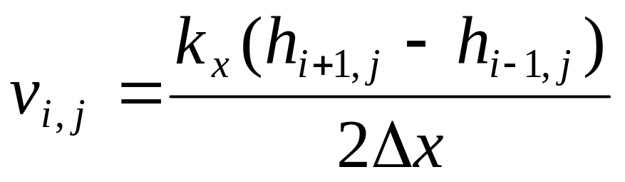
Therefore:

Slide 29
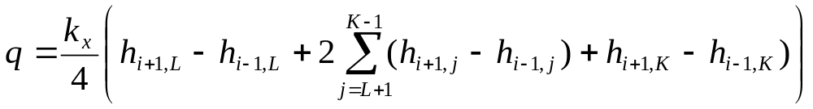
3.5 Flow rate
- The flow rate, q, is obtained by considering a vertical plane across the flow domain.
- Let L be the top row and K be the bottom row of a vertical plane defined by column i (Fig. 3.1 slide 18). Then the expression for q is:
(3.6)

Slide 30
3.6 Procedure for using FDM in 2D flow in soils
Step 1:
- Divide the flow domain into a square grid.
- Generally, finer grids give more accurate solution than coarser grids.
- If the flow is symmetrical, you only need to consider one-half of the flow domain (below is an example).

Slide 31
C
L
Fig. 3.2: A sheet pile wall.
Impermeable
- The total flow domain should have a width of at least four times the thickness of the soil layer.

Slide 32
Step 2:
- Identify boundary conditions, example, impermeable boundaries (flow lines) and permeable boundaries (equipotential lines).
C
L
A
B
Equipotential boundary
2D
Flow Line
E
D
H₁
C
F
Flow Line
Impermeable

Slide 33
Step 3:
- Determine the heads at the permeable or equipotential boundaries. For example, the heads along the equipotential boundary AB (Fig. 3.2) is ΔH.
Therefore, all the nodes along this boundary will have a constant head of ΔH.
Because of symmetry, the head along nodes directly under the sheet pile wall (EF) is ΔH/2.

Slide 34
Step 4:
Apply the known heads to the corresponding nodes and assume reasonable initial values for the interior nodes.
Step 5:
Apply Eqn. (3.1) if the soil is isotropic (slide 19) to each node except:
a) at impermeable boundaries – eqn. (3.2) (slide 22)
b) at corners – eqn. (3.3) & (3.4) (slide 24)
c) at nodes where the heads are known

Slide 35
Step 6:
Repeat item 5 until the new value at the node differs from the old value by a small numerical tolerance for example 0.001 m.
Step 7:
Arbitrarily select a sequential set of nodes along a column of nodes and calculate the flow, q, using eqn. (3.6) (slide 29) . It is best to calculate q’ = q for a unit permeability value to avoid too many decimal points in the calculations.

Slide 36
Step 8:
Repeat items 1 to 6, to find the flow distribution by replacing heads by flow q’. For example, the flow rate, calculated in item 7 is applied to all nodes along AC and CF (slide 32).
Step 9:
Calculate the pore water pressure distribution using eqn. (3.5) (slide 26).

Slide 37
A spreadsheet program can be prepared to automatically carry out the above procedure. However, you should carry out hand calculations at selected nodes to verify that the spreadsheet calculation is correct.

Slide 38

EXAMPLE 3.1
Determine the flow under the sheet pile wall (Fig. E3.1) and the pore water pressure distribution using the Finite Difference Method.
5 m
2 m
6 m
Silty sand
6 m
Impermeable
Fig. E3.1
Strategy Use a spreadsheet and follow the procedures.

Slide 39

SOLUTION 3.1
Step 1:
Divide the flow domain into a grid. See Fig. E3.1a
A
B
12 m
C
2 m×2m
grid
6 m
E
D
24 m
Fig. E3.1a

Slide 40
Step 2:
Identify the boundary conditions.
Permeable boundaries: AB and CD are equipotential lines.
Impermeable boundaries: BC, AE and ED are flow lines.
Step 3:
Determine the heads at equipotential boundaries.
Along AB the head difference is 5 - 2 = 3 m.
Along CD the head difference is 3/2 = 1.5 m.

Slide 41
Go to Spreadsheet Program
Step 4:
Insert the heads at the nodes.
- Set up the initial parameters in column B, rows 3 to 9.
In cells B12 to N12 copy cell B5.
In cells N15 to N18 insert cell B5/2.
Arbitrarily insert values in all other cells from B13 to M18, N13 & N14.

Slide 42
Step 5:
Apply the appropriate equations.
- On the impermeable boundaries – cells B13 to B18, C18 to M18, and N13 to N14, apply eqn. (3.2) (slide 22)
- Apply eqn. (3.1) (slide 19) to all other cells except cells with known heads.

Slide 43
Step 6:
Carry out the iterations.
In excel, go to Tools … Options…Calculation. Select the following:
…Next Slide…

Slide 44
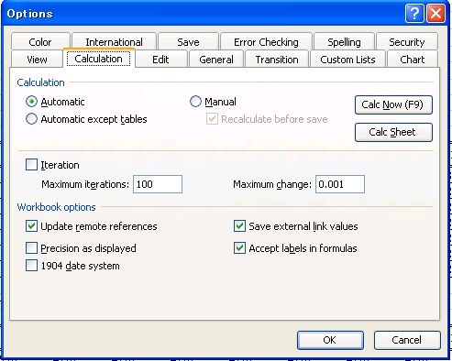
You can then click on CalcNow (F9) or CalcSheet

Slide 45
Step 7:
Calculate q.
- Use eqn. (3.6) (slide 29) to calculate q’ for a unit value of permeability. In the spreadsheet for this example q’ is calculated in cell C 20 as:
- The actual value of q is

Slide 46
Step 8:
Calculate the flow for each cell.
In cells B36 to B42, and C42 to N32, copy q’. The flow at the downstream end (cells N36 to N39) is zero.
Apply eqn. (3.2) (slide 22) to cells C36 to M41 and N40 to N41.
-Apply eqn. (3.1) (slide 19) to all other cells except the cells with known values of q’. Carry out the iterations.

Slide 47
Step 9:
Calculate the pore water pressure.
From the potential heads, you can calculate the pore water pressure using eqn. (3.5) (slide 26) . A plot of the pore water pressure distribution is shown in Fig. E3.1b.

Slide 48
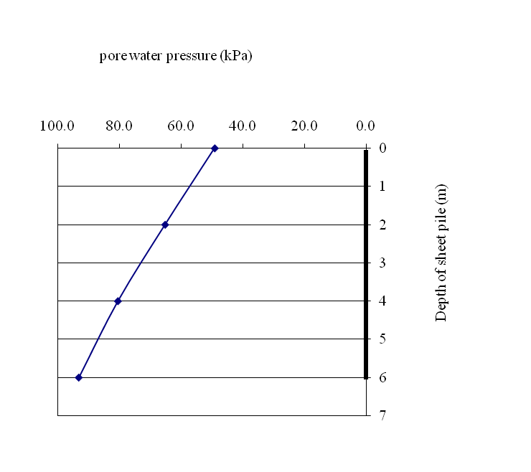
Fig. E3.1b

Slide 49

Assignment # 4
Determine the flow under the sheet pile wall (Fig. A3) and the pore water pressure distribution using the Finite Difference Method.
6 m
8 m
Sand
6 m
Impermeable
Fig. A3

