Slide 1
Advanced Computational Methods in Geotechnical Engineering
Lecture
April 30, 2009

Slide 2
5 INTERPOLATION MODELS
In FEM, the solution of a complicated problem is obtained by dividing the region of interest into small regions (finite elements) and approximating the solution over each sub-region by a simple function.
Thus. choosing a simple function for the solution in each element is a necessary and important step.
The functions used to represent the behavior of the solution within an element are called interpolation functions or approximating functions or interpolation models.

Slide 3
Interpolation models define the given distribution of the unknown variable (s) through the element.
Polynomial-type interpolation functions have been most widely used in the literature due to the following reasons:
① it is easier to formulate and computerize the finite element equations with polynomial type of interpolation functions. Specifically, it is easier to perform differentiation or integration with polynomials.
② it is possible to increase the accuracy of results by increasing the order of the polynomial, as shown in figure 5.1.

Slide 4
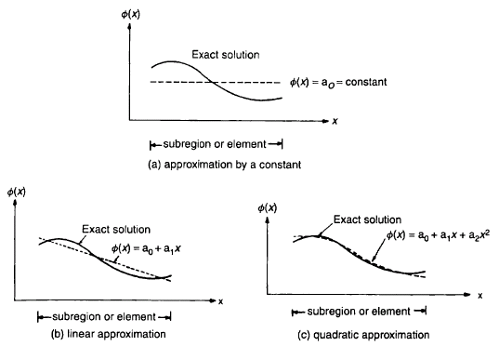
Figure 5.1a: Polynomial approximation in 1D.

Slide 5
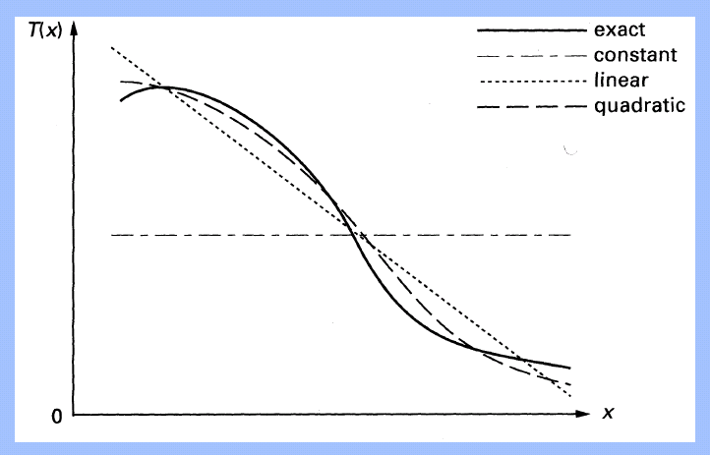




Figure 5.1b: Polynomial approximation in 1D.

Slide 6
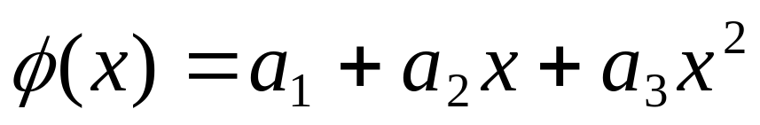
But the number of calculations needed to evaluate a model increases with the order of the interpolation function.
eg. a quadratic element requires 2 or 3 times more computing time than a linear one.
The order of an element and the number of nodes are connected.
e.g. a quadratic interpolation function in 1D has 3 constants and requires information from 3 nodes.

Slide 7
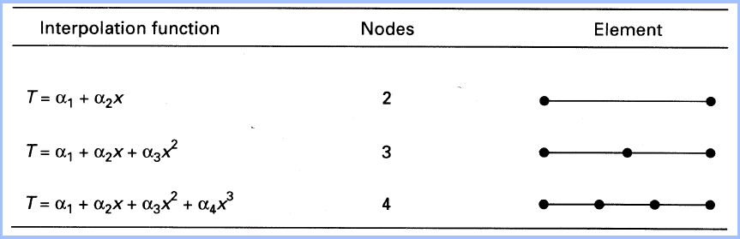

1D elements and their interpolation functions:

Slide 8
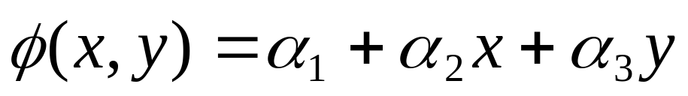
- Extension to 2- and 3- dimensions is easy. For example,
requires 3 nodes for evaluation of the 3 constants.

Slide 9
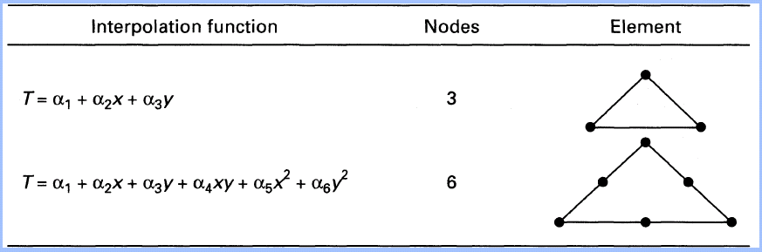

Some 2-D elements and their interpolation functions:

Slide 10
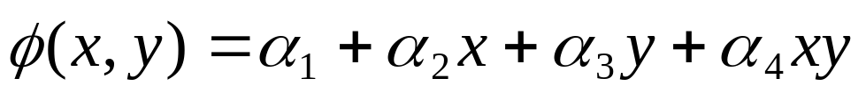
- No need to use pure linear, quadratic,…, functions:
- eg.
(4 nodes on a rectangular element)
is a very popular interpolation function.
Theoretically, a polynomial of infinite order corresponds to the exact solution. But in practice we use polynomials of finite order.
in most of the practical applications, the order of the polynomial interpolation functions is taken as one, two, and three.

Slide 11
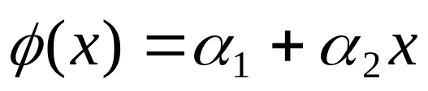
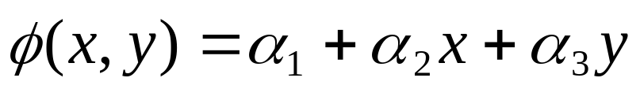
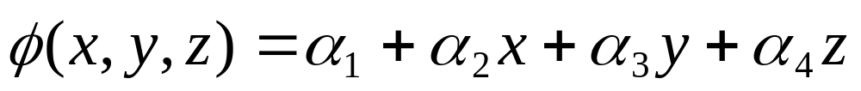



5.1 1D, 2D & 3D Interpolation Functions
For n = 1 (linear model – linear element)
One-dimensional case
Two-dimensional case
Three-dimensional case
Where:
: is the degree of the polynomial.
: the field variable (eg. displacement).
: the coefficients of the polynomial, a.k.a generalized coordinates.

Slide 12

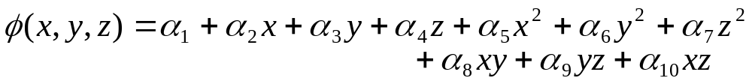
For n = 2 (quadratic model – higher order element)
One-dimensional case
Two-dimensional case
Three-dimensional case

Slide 13

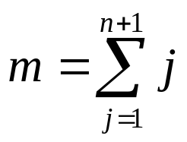
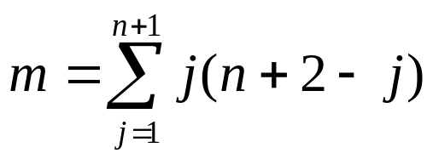
: for 1D elements.
: for 2D elements.
: for 3D elements.

Slide 14
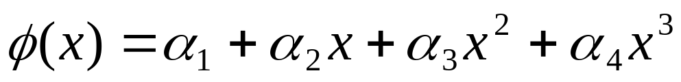
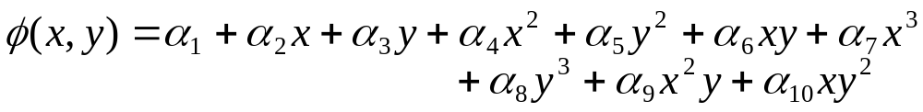
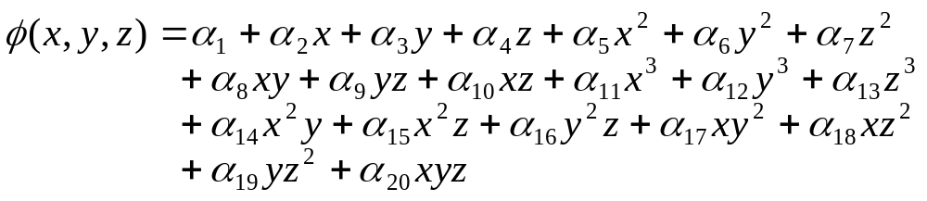
For n = 3 (cubic model – higher order element)
One-dimensional case
Two-dimensional case
Three-dimensional case
13

Slide 15
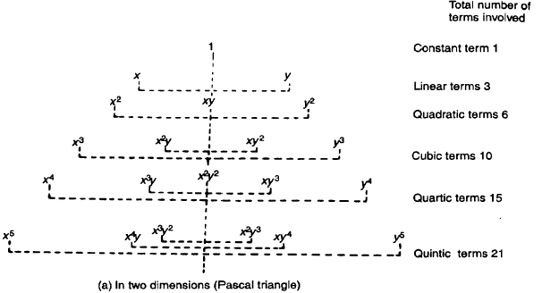
Array of terms in complete polynomial of various order – 2D
slide 11
slide 12
slide 14
- Symmetrical: this property is called Geometric Isotropy.

Slide 16
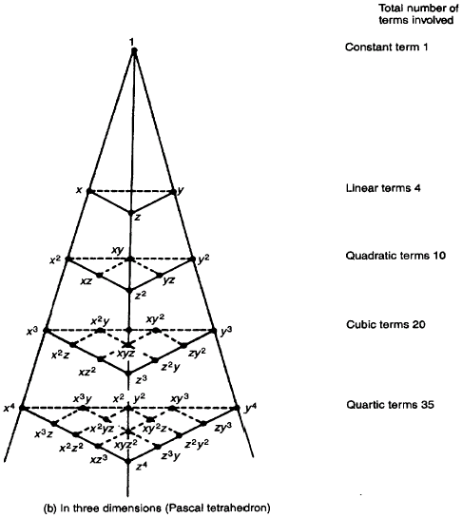
Array of terms in complete polynomial of various order – 3D
slide 11
slide 12
slide 14

Slide 17
5.2 Simplex, Complex & Multiplex Elements
Finite elements can be classified into three categories:
Simplex
- Order of the polynomial.
- Geometry.
Complex
Multiplex
Simplex: - Polynomials with constant and linear terms only.
Nodes at corners only. (eqns. slide 11, figs. slide 19)

Slide 18
Complex: - higher order interpolation polynomials.
Shape as simplex class but with additional nodes.
(eqns. slides 12, figs. slide 19)
Multiplex: - higher order interpolation polynomials.
But with boundaries parallel to the coordinate axis.

Slide 19
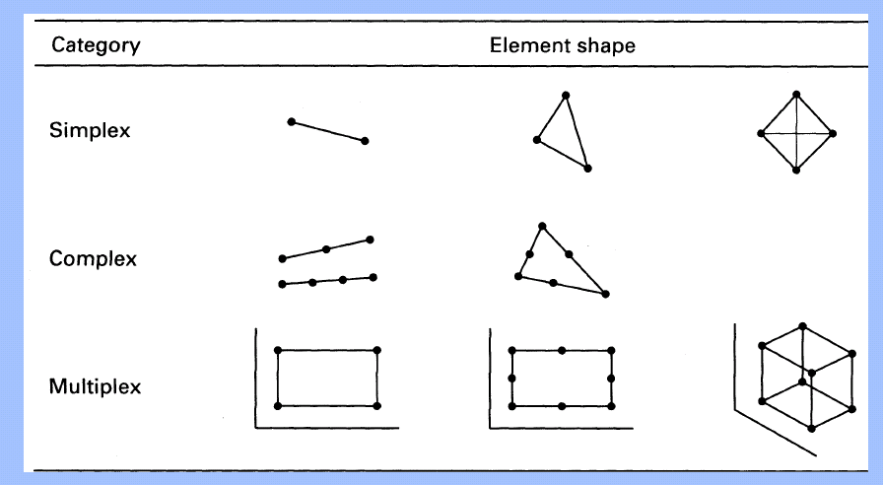


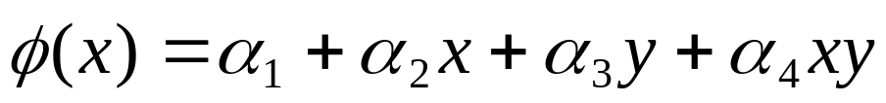
The Multiplex elements shown above are without complete polynomial expression.
(No term like x², y²)

Slide 20
5.3 Interpolation Functions in terms of
Nodal Degrees of Freedom
Basic idea of FEM:
- to consider a body as composed of several elements connected at nodes.
- unknown solution (eg. diplacement) inside any finite element given by a simple function in terms of the nodal values of that element.
- the nodal DOF are treated as unknowns in formulating the overall equations (eg. equilibrium equations).

Slide 21
- the solution of overall equations gives the unknown nodal DOF.
- once the nodal DOF are known, the solution within any finite element (and hence within the body) will also be known.
- thus, we need to express the interpolation polynomial in terms of the nodal degrees of freedom.

Slide 22

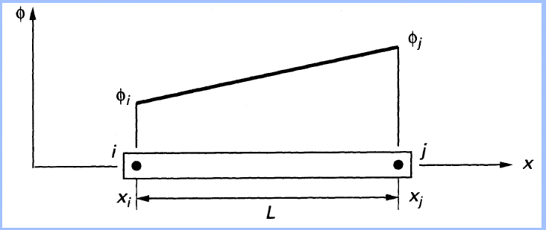




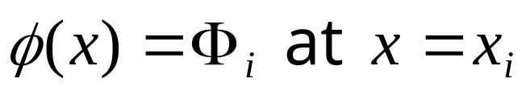
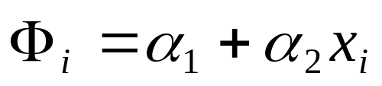
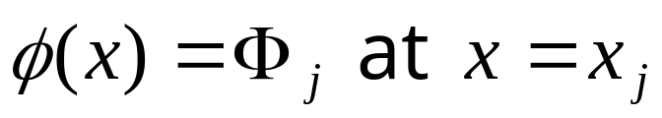
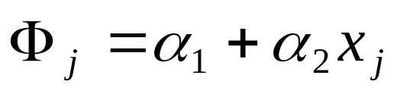
5.3.1 SIMPLEX ELEMENTS:1D Simplex Elements.
Nodal conditions:

Slide 23
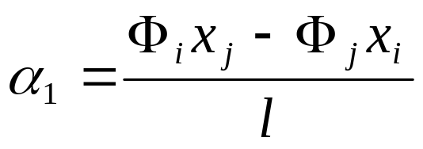
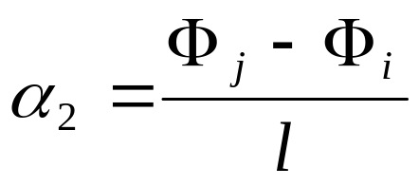



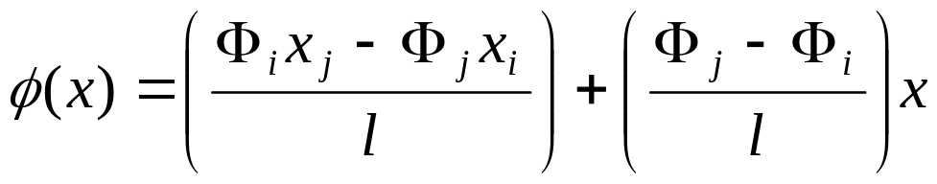
The solution of the above equation gives:
and
and
are global coordinates of nodes i and j .
Substituting into the interpolation polynomial, we get:

Slide 24
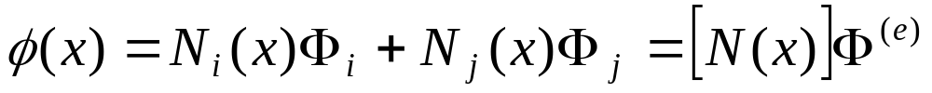
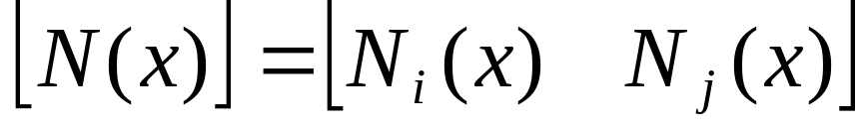
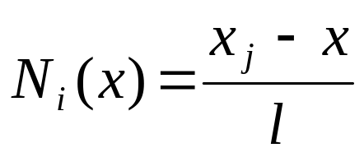
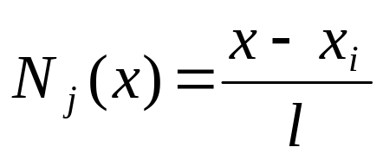
Rearranging the above equation gives:
where:
- Shape Functions
= 1 at its own node.
= 0 at other nodes.

Slide 25
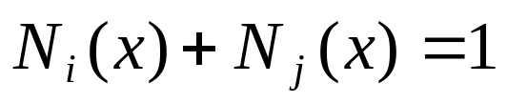
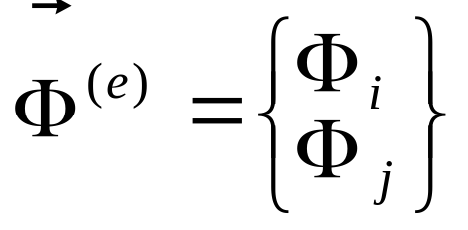
at any point in the element.
and
= vector of nodal unknowns of element e.

Slide 26
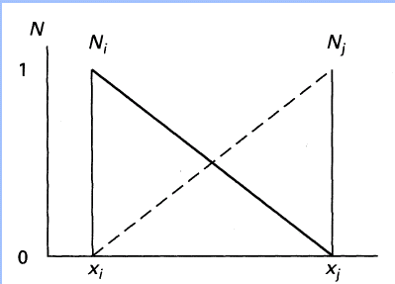




Variation of shape functions for a 1D Simplex element:

Slide 27
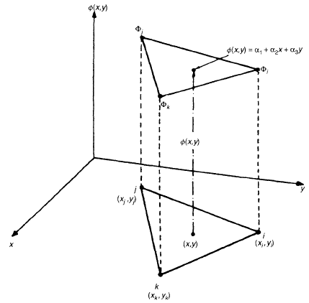
2D Simplex Elements

Slide 28



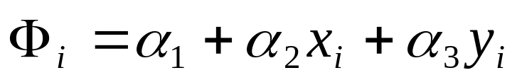
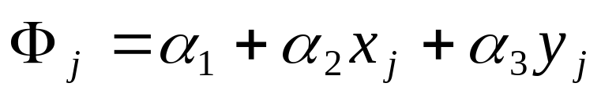
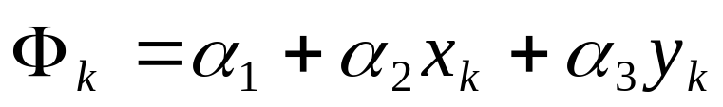
Nodal Conditions:
Lead to the system of equations:

Slide 29
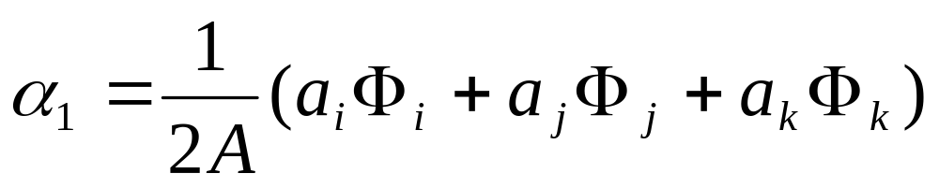
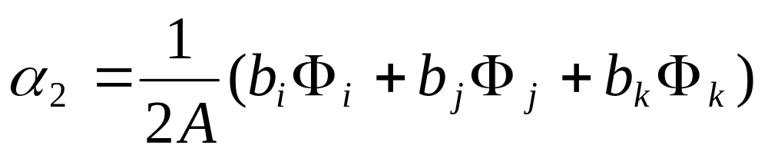
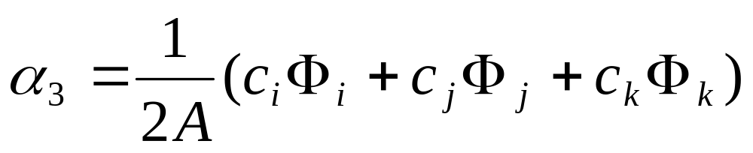
The solution of the above equations gives:

Slide 30
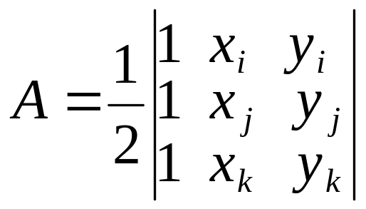
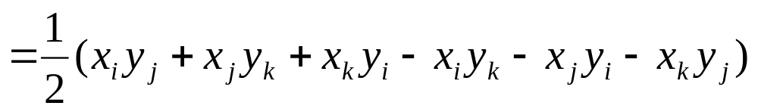
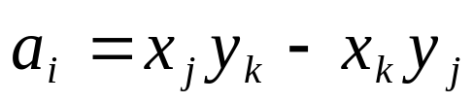
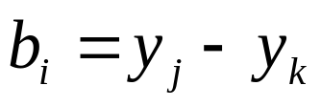
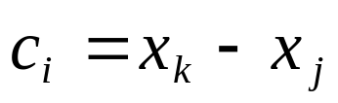
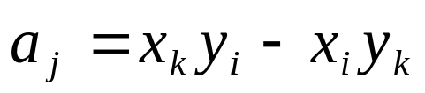
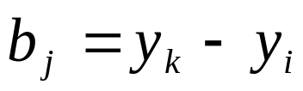
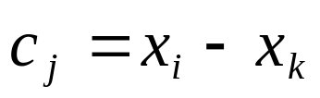



Where A is the area of the triangle ijk given by:
and:

Slide 31


Substituting (as given in slide 29) into the interpolation polynomial and rearranging gives:

Slide 32




Where:
= vector of nodal unknowns of element e.

Slide 33




Example:
Find:
&

Slide 34





Notes:
- The shape function N_{i}(x,y) when evaluated at node i(x_{i}, y_{i}) gives:
And
at nodes j and k (i.e. &
)
- Similarly, the shape functions N_{j} and N_{k} have a value of 1 at nodes j and k and 0 at other nodes.
eg. Variation of shape function N_{j} for a 2D Simplex element.

Slide 35



3D Simplex Elements

Slide 36








Nodal Conditions:
Lead to the system of equations:

Slide 37




The solution of the above equations gives:

Slide 38



Where V is the volume of the tetrahedron ijkl given by:

Slide 39




and other constants obtained by cyclic interchange of indices.
Substituting (as given in slide 36) into the interpolation polynomial and rearranging gives:

Slide 40





Where:
= vector of nodal unknowns of element e.

