Slide 1
Advanced Computational Methods in Geotechnical Engineering
Lecture
May 30, 2008

Slide 2
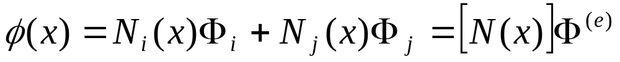
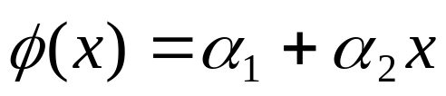
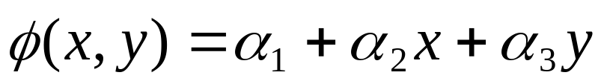

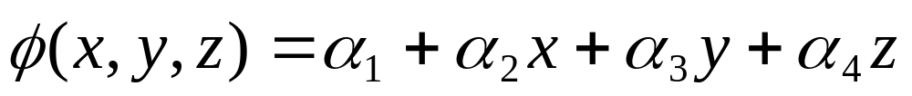
In our last class we have discussed:
Interpolation functions.
Simplex, Complex and Multiplex Elements.
Interpolation models in terms of nodal DOF.
as Scalar

Slide 3
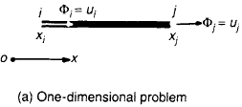
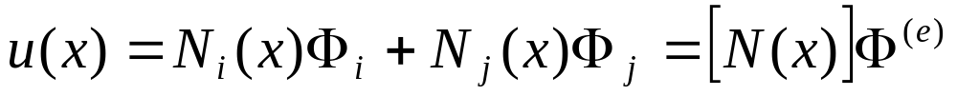

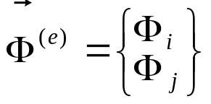
5.3.2 Interpolation Polynomials for Vector Quantities
Vector Quantity for 1D
- In 1D: only 1 DOF at each node - same as for the scalar quantity

Slide 4
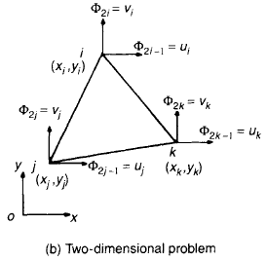
Vector Quantity for 2D
- In 2D: 2 DOF at each node (u, v).
- 6 DOF for the element.

Slide 5
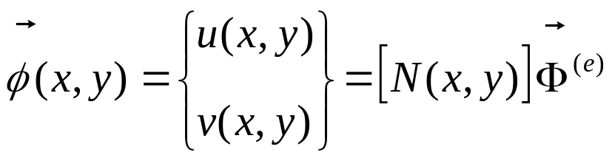
- The element requires 2 interpolation polynomials, one for each direction.
- The above equation can be re-written as:

Slide 6
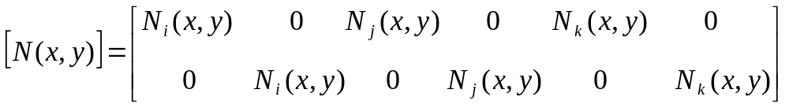
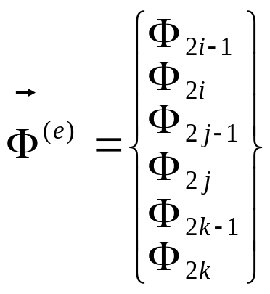
- where:
= vector of nodal DOF of element e.
- Used in programs since the computer does not differentiate u,v,w.

Slide 7
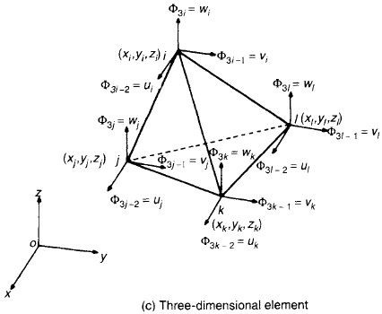
Vector Quantity for 3D
- In 3D: 3 DOF at each node (u,v,w).
- 12 DOF for the element.

Slide 8
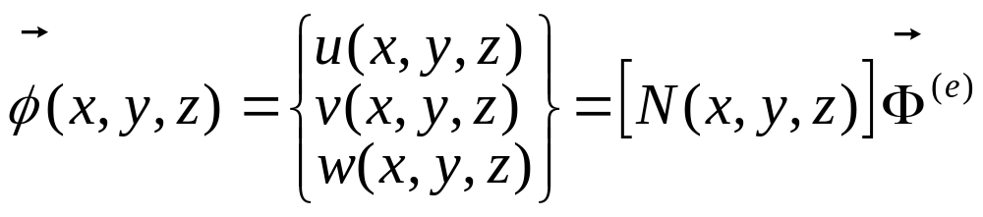
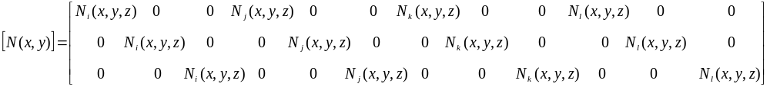
Extending the above procedure to 3D, we get:
- where:

Slide 9
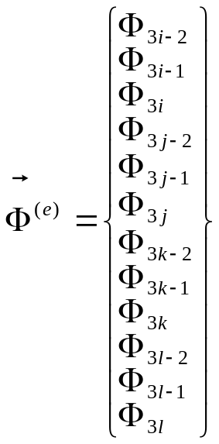
= vector of nodal DOF of element e.

Slide 10
5.3.3 Linear Interpolation Polynomials in terms of Local (Natural) Coordinates
Calculations of element stiffness matrices involve integration of the shape functions or their derivatives or both over the element.
Example (SIGMA/W)
This is not difficult for simplex elements since the shape functions are simple linear terms of x, y and z, but it can be made easier by the introduction of natural coordinates.
The integration of higher-order elements is more complicated and is usually done numerically taking advantage of the natural coordinate system.

Slide 11
A natural coordinate system is a local coordinate system which permits the specification of any point inside the element by a set of non-dimensional numbers with maximum absolute magnitude of 1.
Natural coordinate systems are local (i.e individual) to each element.

Slide 12











Natural Coordinate for 1D Simplex Element
Natural coordinates for 1D element are shown in the figure below.
Node 1
Node 2

Slide 13
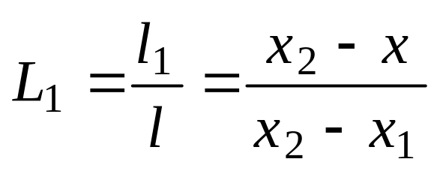
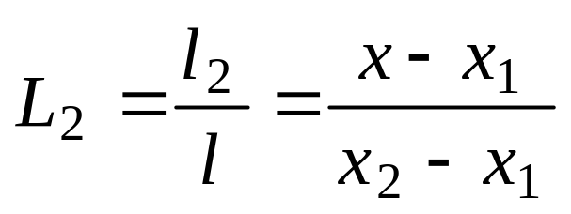
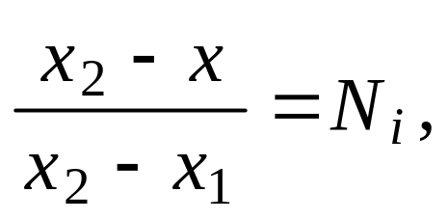
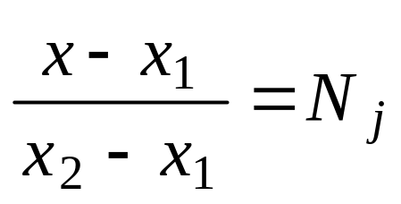
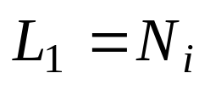
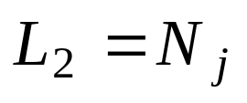
Any point P inside the element is identified by two natural coordinates L₁and L₂ which are defined as:
But we know that:
Shape Functions

Slide 14
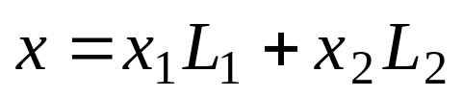
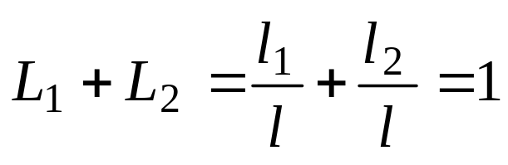

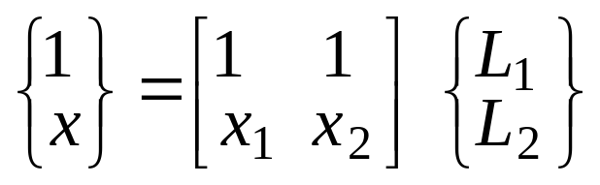
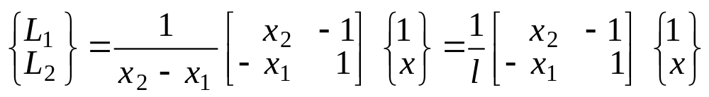
Any point x within the element can be expressed as:
And since :
Therefore, the relationship between the natural and global (Cartesian) coordinates of any point P can be written in matrix form:
or

Slide 15

















Natural Coordinate for 2D Simplex Element:
3
2
1

Slide 16
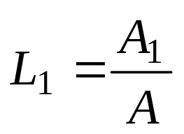
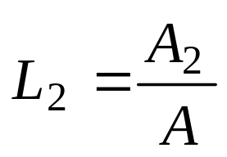

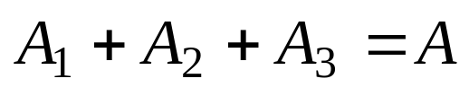
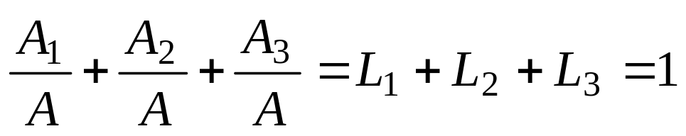
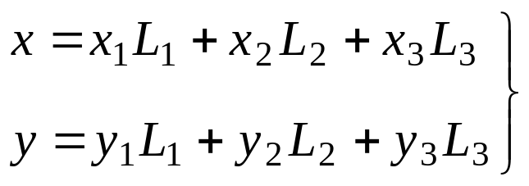
The three natural coordinates for a triangular element are:
-Since
The relation between the natural and Cartesian coordinates is given by:

Slide 17
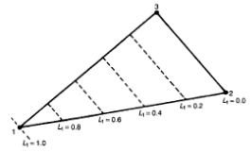
Contours of L₁ : equally placed straight lines parallel to the side 2,3 (where L₁=0).

Slide 18
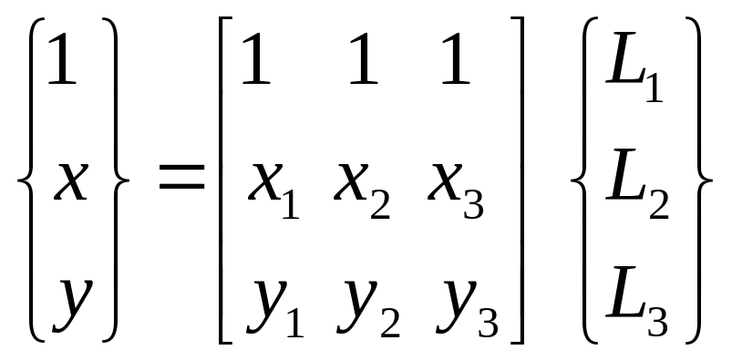
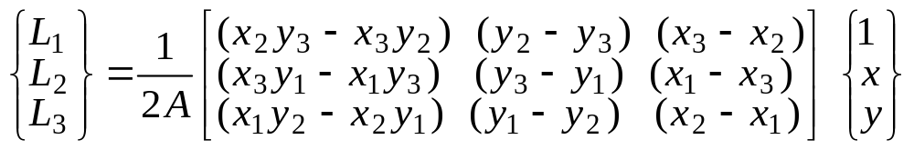
The relation between the natural and Cartesian coordinates can be written in matrix form as:
The above equation can be inverted to obtain:

Slide 19
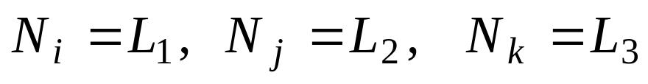
It can be noticed that the above equation is identical to the equations of the shape functions for 2D simplex element (previous lecture – Slide 31).
Thus, for 2D simplex element also, L1,L2 and L3 are the same as the shape functions.:
Local coordinates (L₁, L₂, L₃) and the shape functions (N_{i}, N_{j}, N_{k}) are the same for simplex elements.

Slide 20
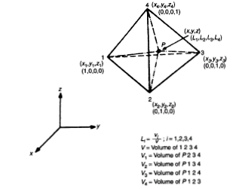
Natural Coordinate for 3D Simplex Element
Refer text (pp. 106~).

Slide 21
5.3.4 Higher Order and Isoparametric Elements
Higher Order Element: Interpolation polynomial of order two or more. It can be either a complex or multiplex element.
In Higher Order Elements some secondary (midside and/or interior) nodes are introduced in addition to primary (corner) nodes in order to meet the nodal DOF with the number of constants in the interpolation polynomial.
Isoparametric elements: the same interpolation functions used to define the element geometry are also used to describe the variation of the field variable within the element.

Slide 22
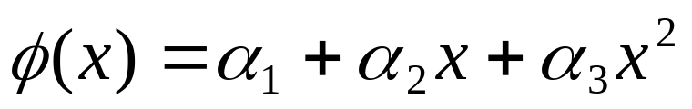
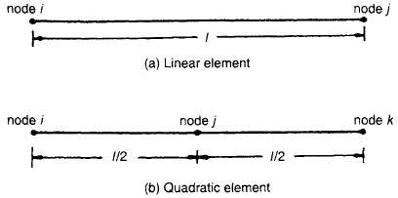
Higher Order 1D Elements
Quadratic Element
-Three constants 3 DOF (2 at end and 1 at middle)

Slide 23
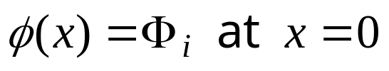
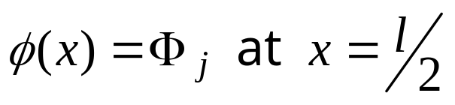
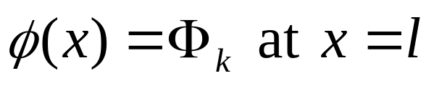


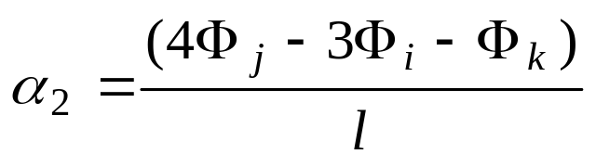
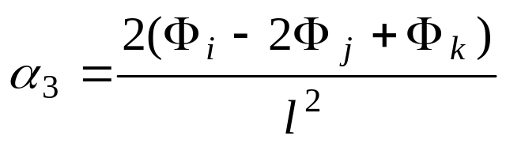

Nodal conditions:
The constants and are given as:

Slide 24
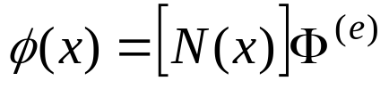

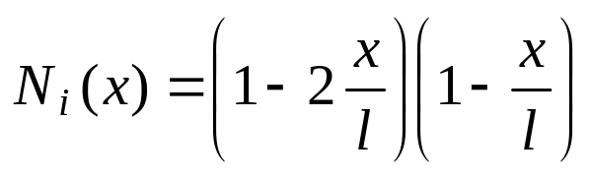
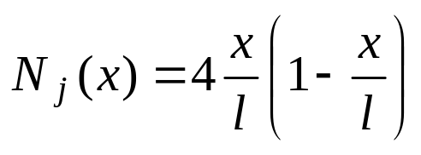
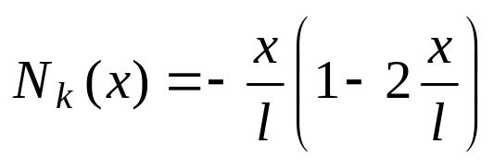
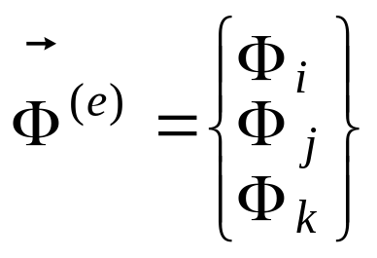
The interpolation polynomial in terms of nodal values is given as:
Where:

Slide 25
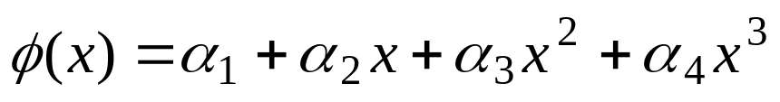

Cubic Element
Four constants 4 DOF as shown in the fig. below.

Slide 26
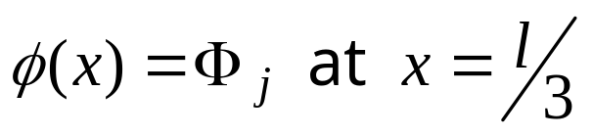
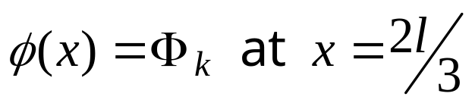

Nodal conditions:
Leading to:

Slide 27





Where:
And:

Slide 28
Higher Order Elements in terms of Natural Coordinates
NEXT CLASS

