Slide 1

LGBT+ Allies Training
Supporting your LGBT+ colleagues

Slide 2
Note to Users & Menu
This PowerPoint contains material for an hour and a half training session. There is also a script to support you in delivering the training.
For flexibility, it has been divided into smaller sections. These smaller sections can be used alone or combined as needed. Approximate timings are listed:
Introduction & Objectives (5 minutes)
Exercise: Hiding Your Identity (8 minutes)
Why We Need Allies Training (13 minutes)
Exercise: Terminology (40 minutes)
Language to Avoid (6 minutes)
Ally Best Practice & Scenarios (14 minutes)
End (5 minutes)
Please feel free to edit the structure of the presentation to suit your requirements.

Slide 3
1. Introduction & Objectives

Slide 4

Introductions & Housekeeping
Presenters to add name, pronouns, job title, and email address.
This is a safe space – ask questions at any point and don’t be afraid to get things wrong!
We use the term ‘LGBT+’ to be inclusive of all identities. The term includes allies.
Notes:
Important to note that we will be referring to derogatory terms, but only in the context of making it clear what you should not say.

Slide 5

Objectives
To understand the context of LGBT+ rights and inclusion and why ally training is necessary.
To know what language to use and to avoid.
To know best practice for being an ally.
To explore how to be an ally in practice.

Slide 6
2. Exercise: Hiding Your Identity

Slide 7
Exercise
Split into pairs.
Person B try and find out as much as you can about person A’s weekend by asking open questions. Try to interrogate them!
Person A answer questions about your weekend in as much detail as possible for 3 mins but without using:
The pronouns he/she
Any ‘gendered’ language e.g. boyfriend, girlfriend, woman, man, husband, wife.
Names of people
Places
Switch places and repeat.
Notice how many times your partner slips and uses a pronoun, place or name.
Notes:
At the end of the time, ask the group what they thought the exercise was for. Key idea:
Every lesbian, gay or bisexual person has to make a conscious decision about whether they will be open about their sexual orientation at work. However, it’s not simply a case of coming out once. Gay people have to decide to come out every time they meet new colleagues, clients, suppliers or stakeholders.
Lesbian, gay and bisexual people who do not feel able to be out at work often expend significant amounts of energy on avoiding being outed, energy that could be spent on performing more effectively in their job.

Slide 8
3. Why We Need Allies Training

Slide 9
What is an ally?
“LGBT+ ally” is a term used to describe people who believe that lesbian, gay, bisexual and trans people should experience full equality in the workplace.
Good allies recognise that LGBT+ people can perform better if they can be themselves and allies use their role within an organisation to create a culture where this can happen.
The Civil Service aims to be the most diverse and inclusive employer in the UK. That means not just attracting LGBT+ staff but ensuring they stay and thrive within the Civil Service.

Slide 10
LBGT+ rights in the UK: a timeline
1967: Sex between two men over 21 decriminalised in England/Wales.
1992: The WHO declassifies same-sex attraction as a mental illness.
2003: Section 28 is repealed.
1969: The Stonewall Riots in Manhattan.
1990: The first Pride event is held in Manchester
2003: Employment Equality Regulations become law.
1971: The Nullity of Marriage Act bans same-sex marriage.
1988: Section 28 introduced.
2013/2014: Equal marriage is passed in England and Wales.
Notes:
Key information to emphasise:
Gay sex was criminalised until 1967.
Section 28 legislation from 1988 onwards meant that teachers couldn’t talk about same-sex relationships with their students or tackle any sort of homophobic bullying.
The WHO classified homosexuality as a mental illness until 1992.
You could be fired for being LGBT+ until 2003.
Trans people must currently provide medical evidence to be able to be legally recognised in their preferred gender.
There is currently no legal recognition of non-binary people.
All information taken from Stonewall.
1967: The Sexual Offences Act 1967 decriminalises sex between two men over 21 and ‘in private’. It did not extend to Scotland, Northern Ireland, the Channel Islands or the Isle of Man.
1969: The Stonewall riots in America – a series of spontaneous, violent demonstrations by members of the LGBT+ community against a police raid on the Stonewall Inn, NYC. This key event triggers the modern LGBT+ liberation movement in America and beyond.
1988: Margaret Thatcher introduces Section 28, which states that a local authority ‘shall not intentionally promote homosexuality or publish material with the intention of promoting homosexuality’ or ‘promote the teaching in any maintained school of the acceptability of homosexuality as a pretended family relationship’.
1990: The first Pride event is held in Manchester.
1992: The World Health Organisation declassifies same-sex attraction as a mental illness.
2003: Section 28 is repealed in England, Wales and Northern Ireland.
2003: Employment Equality (Sexual Orientation) Regulations becomes law in the UK, making it illegal to discriminate against lesbians, gay and bi people in the workplace.
2013: Marriage (Same-Sex Couples) Act is passed in England and Wales. It comes into force in 2014.

Slide 11
Why do we need allies training?
According to LGBT+ equality group Stonewall:
35% of LGBT+ staff have hidden that they are LGBT+ at work for fear of discrimination.
10% of black, Asian and minority ethnic LGBT+ employees have been physically attacked by customers or colleagues in the last year.
38% of bi people aren’t out to anyone at work.
12% of trans people have been physically attacked by customers or colleagues in the last year due to being trans.

Slide 12

Legal obligation
Among other things, the Equality Act 2010 outlaws:
Direct discrimination
Indirect discrimination
Harassment
Victimisation
Notes:
Direct – someone being treated less favourably because of their sexual orientation or gender identity, such as a colleague purposefully ignoring someone because they're gay. Indirect - a policy or rule for all employees that discriminates against an LGBT+ employee, such as requiring staff to disclose their trans history. Harassment – unwanted conduct that violates an LGBT+ person's sense of dignity or creates a hostile and degrading environment, such as verbal or physical abuse. Victimisation: – unfair treatment of a staff member because they have complained of discrimination in the workplace. This could include a manager not promoting an employee because they believe the person made a complaint about biphobia.

Slide 13
The Business Case
LGBT+ workers are estimated to be 32% more productive when they can be themselves (Out now Global LGBT 2010 Study).
An Out Now Global LBGT2020 Study suggests that the UK economy could save around £678m a year if businesses ensure that their policies encourage LGBT+ people to be themselves.
It's not only the right thing to do to treat people with respect but the study also suggests that LGBT+ staff as well as being more productive are more inclined to stay with the business if they can be themselves.
Notes:
If you remain unconvinced…

Slide 14
4. Exercise: Terminology

Slide 15
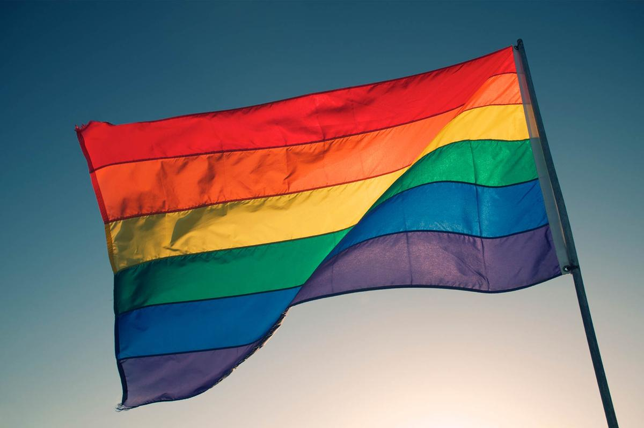
Match up the terminology to the definitions
You have 15 minutes to work together and match the terminology to the correct definitions.
Being informed about the right language to use is a key part of being an ally.
Notes:
See word document for resources – these need printing in advance OR use the following slide as an alternative to avoid printing.
Work in pairs or groups of three.

Slide 16
Alternative Slide: How many of these terms can you define?
Bi
Passing
Cisgender
Gender identity
Deadnaming
Ace
Intersex
Trans
Non-binary
Queer
Gender
Gender dysphoria
Gender reassignment
Sex
Pan
Notes:
To be used if you need to avoid printing resources.
Suggest working in pairs or small groups.

Slide 17




Key Terminology
Sexual and Romantic Attraction:
Who you are sexually and/or romantically attracted to. Sexual orientations can include heterosexual, lesbian, gay, bisexual, queer, and asexual.
Gender Identity:
How people interpret and view themselves, within the context of wider society and culture.
Gender Expression:
How people present themselves. People might present as feminine, masculine, neutral or a combination, and this may vary.
Sex: The biological characteristics of a person’s body, i.e. organs and DNA. Usually this is male, female, or intersex.
Notes:
Understand the difference between sex, sexual orientation, gender identity and gender expression:
Sex – assigned, determined, defined at birth by your doctor (either female or male).
Sexual orientation – how we describe our emotional, physical, spiritual and romantic attraction e.g. gay / lesbian, bisexual, heterosexual (and many more)
Gender identity – a person’s deeply held, internal sense of their gender identity e.g. woman, man, non-binary, genderqueer, gender fluid.
Gender expression – how people express their gender e.g. through clothing, how they act and speak

Slide 18
Optional Slides: Did you get them right 1?
Term | Definition
Ace | This is an umbrella term used to describe a variation in levels or romantic and/or sexual attraction, including a lack of attraction. People may also use the term asexual or aromantic.
Bi | This is an umbrella term used to describe a romantic and/or sexual orientation to more than one gender.
Cisgender or cis | Someone whose gender identity is the same as the sex they were assigned at birth. Non-trans is also used by some people.
Deadnaming | Calling someone by their birth name after they have changed their name. This term is often associated with trans people who have changed their name as part of their transition.
Gender | This is often expressed in terms of masculinity and femininity. It is largely culturally determined and is assumed from the sex assigned at birth.
Gender dysphoria | Used to describe when a person feels discomfort or distress because there is a mismatch between their sex assigned at birth and their gender identity.
Gender identity | A person’s innate sense of their own gender, whether male, female or something else. This may or may not match the sex assigned at birth.
Notes:
Only the lesser known phrases are included.
Chosen to skip through well known terms like ‘gay’.

Slide 19
Optional Slides: Did you get them right 2?
Term | Definition
Gender reassignment | Another way of describing a person’s transition. It can include medical intervention, changing names, pronouns, dressing differently, and living in their self-identified gender.
Intersex | A term used to describe a person who may have the biological attributes of both sexes or whose biological attributes do not fit with societal assumptions about what constitutes male or female.
Non-binary | An umbrella term for people whose gender identity doesn’t sit comfortably with ‘man’ or ‘woman’.
Pan | Refers to a person whose romantic and/or sexual attraction towards others is not limited by sex or gender.
Passing | If someone is regarded, at a glance, to be a cisgender man or cisgender woman.
Queer | This is a term used by those who want to reject specific labels or orientation or gender identity. Some people view it as a slur, but it was reclaimed in the late 80s by the LGBT community.
Sex | This is assigned to a person based on primary sex characteristics (genitalia) and reproductive functions.
Trans | An umbrella term to describe people whose gender is not the same as, or does not sit comfortably with, the sex they were assigned at birth.
Notes:
Only the lesser known phrases are included.
Chosen to skip through well known terms like ‘gay’.

Slide 20
Be Aware…
A person’s sex, gender identity, and gender expression may vary and not correspond.
Trans status is not the same as sexuality. For example, you can be trans and heterosexual, or you can be trans and gay.

Slide 21

Intersex People
Intersex refers to people who are born with primary sex characteristics – such as genitals and chromosome patterns – that do not fit typical binary notions of male and female.
This is about chromosomal or physical sex and not gender identity.
Some intersex people might be trans or gender diverse, while other intersex people might identify with the gender they were assigned at birth.
Specific provision and support for intersex people is required, as needs and circumstances often differ from those of trans and gender diverse people.
Notes:
Some facilitators have expressed that this slide is the most challenging to deliver due to their own lack of knowledge around intersex people. Some helpful reading is provided below. We suggest you read these in advance, so you feel more prepared.
https://www.theguardian.com/world/2016/jul/02/male-and-female-what-is-it-like-to-be-intersex
https://www.minus18.org.au/index.php/articles/item/2-847-im-intersex-heres-what-that-means
https://www.amnesty.org/en/latest/news/2018/10/its-intersex-awareness-day-here-are-5-myths-we-need-to-shatter/

Slide 22
Intersex Facts
1.7% of the population are intersex (comparable to the number born with red hair).
It is a natural variation, not a ‘medical condition’.
Many intersex people are unaware of their status; some find out upon fertility investigation, some find out later, or not at all.
Medical professionals may refer to intersex people as having ‘disorders of sexual development’, a description widely rejected by intersex people.
Intersex people have no specific legal protection from discrimination.
Intersex people often endure many invasive tests and unnecessary and non-consensual surgeries are not uncommon.

Slide 23

Non-Binary People
Non-binary people can:
Identify as neither male nor female
Identify as a combination of genders
Identify as fluid between genders
Not identify with gender at all
Identify with a gender outside of male and female.
Genderqueer is a blanket term for those who don’t define their gender in binary terms.
It is not a modern invention.
Each identity is valid and deserves respect
Notes:
The term ‘non-binary’ refers to people who experience a sense of their own identity that falls outside of the gender binary.
Non-binary people class themselves as neither exclusively male nor female. They may or may not consider themselves to be trans. Some nonbinary people experience gender dysphoria.
Nonbinary identities are not a modern or Western invention. They have existed in multiple cultures throughout history.

Slide 24
Non-Binary Pronouns
Not all non-binary people use ‘he’ or ‘she’ pronouns.
Many use ‘they’ and ‘them’.
Neopronouns like ‘zie’ or ‘ey’ also exist.
Notes:
Some people argue that they and them are not grammatically correct for singular usage but we do in fact use these pronouns in the singular all the time, you might hear someone say “Oh look, someone has left THEIR phone on the table, I wonder if THEY will come back for it?”

Slide 25
5. Language to Avoid

Slide 26
Language to avoid
Butch – this is used to describe someone who expresses themselves in a typically masculine way. You shouldn’t use this term about someone unless you know they identify with it.
Femme – this is used to describe someone who expresses themselves in a typically feminine way. As above.
Homosexual/homosexuality – generally considered a medical term now. People tend to use gay instead. Can reduce the person to purely sexual terms.
Anything that implies being LGBT+ is a choice e.g. sexual preference or gay lifestyle.
Anything that implies that bi people are ‘greedy’, ‘undecided’ or ‘going through a phase’.

Slide 27
Language to avoid cont.
Hermaphrodite for intersex people.
Transsexual – this was used in the past as a medical term. Some people still use it, but many prefer the term trans or transgender.
Transgendered – suggests a condition of some kind.
Transgenderism – suggests an ‘ideology’ that could be argued against.
Transvestite, tranny, or shemale.
Sex change, sex-change operation, pre-operative, post-operative.
Don’t deadname or misgender.
Notes:
Transition is the accurate term that does not fixate on surgeries, which not all transgender people wish to have or are able to undergo. Terms like pre-operative or post-operative unnecessarily fixate on a person’s anatomy.

Slide 28
6. Ally Best Practice & Scenarios

Slide 29
Best Practice
Use the right language and listen actively to the language others use
Be clearly and openly supportive, sharing personal experiences:
Rainbow lanyards, email signatures, join the LGBT+ network
Tell your colleagues you have completed the training!
Understand your own unconscious bias
Challenge inappropriate language/comments
Ask about pronouns and introduce your own
Be aware of intersectionality and the dual discrimination some LGBT+ people may face
Pick up on neutral language – don’t assume the gender of a person’s partner
If you’re not sure, ask! But avoid intimate questions about body parts, sex life, relationships etc.
Notes:
Don’t just leave it to LGBT+ colleagues to champion LGBT+ causes, and don’t assume that they want to visibly do so, or do so at all

Slide 30
How would you react? Scenario 1
Your department is running a pilot of gender-neutral toilets and this has caused quite a stir in the office…
Your colleague mentions to you that they “don’t believe in transgendered people” and that the toilets are a total waste of taxpayers’ money.
How do you respond?
Notes:
Do participants pick up on “transgendered”
People are more productive if they feel comfortable at work
It’s not about “belief” rather acceptance of reality and fair treatment

Slide 31
How would you react? Scenario 2
You overhear one of your colleagues mentioning to your line manager that they are unhappy at work due to assumptions being made about their sexuality by their team.
Recalling previous conversations you have had with this colleague, you realise you may have done so yourself.
How do you proceed?
Notes:
Apologise
Don’t make assumptions going forward

Slide 32
How would you react? Scenario 3
Noticing your rainbow lanyard, one of your colleagues confronts you, arguing that gay rights are “sorted now” and that an unfair amount of attention is given to the “LGBT+ lifestyle”.
They argue that there are other underrepresented groups that need more support than the LGBT+ community, and other more pressing issues.
How do you respond?

Slide 33
7. End

Slide 34
Objectives – recap
To understand the context of LGBT+ rights and inclusion and why ally training is necessary
To know what language to use and avoid
To know best practice for being an ally
To explore how to be an ally in practice

Slide 35
To finish…
Be aware of layers of intersectional discrimination.
Be visible by wearing a rainbow lanyard.
Challenge inappropriate language or comments.
List 3 ways of being an ally with the person next to you. Be prepared to share with the group.
Confront your own prejudices and bias.
Be educated about the prejudice and discrimination faced by the LGBT+ community.
Ask about pronouns.
Don’t make assumptions.
Get the language right.
Listen to LGBT+ colleagues.
Ask for help if you’re unsure about something.

Slide 36

Thank you!
Thank you for attending the training today and for the work you will do in the future as an ally of the LGBT+ community.
You are now qualified to deliver this training yourself – please ask your facilitators for a ‘clean’ copy and script if you would like to facilitate it.

