Slide 1
Prism
x
y
z
length
thickness
depth

Slide 2
Cube
x
y
length
z

Slide 3
Cube
diameter
x
y
z
length

Slide 4
Beam
x
thickness
y
z
depth
length
beam_span

Slide 5
Notched beam
centerline
x
thickness
y
notch_offset
z
depth
notch_tip_radius
notch_depth
notch_width
length
beam_span

Slide 6
Panel/Wall
x
thickness
y
z
depth
length

Slide 7
Plate
x
thickness
depth
y
z
length

Slide 8
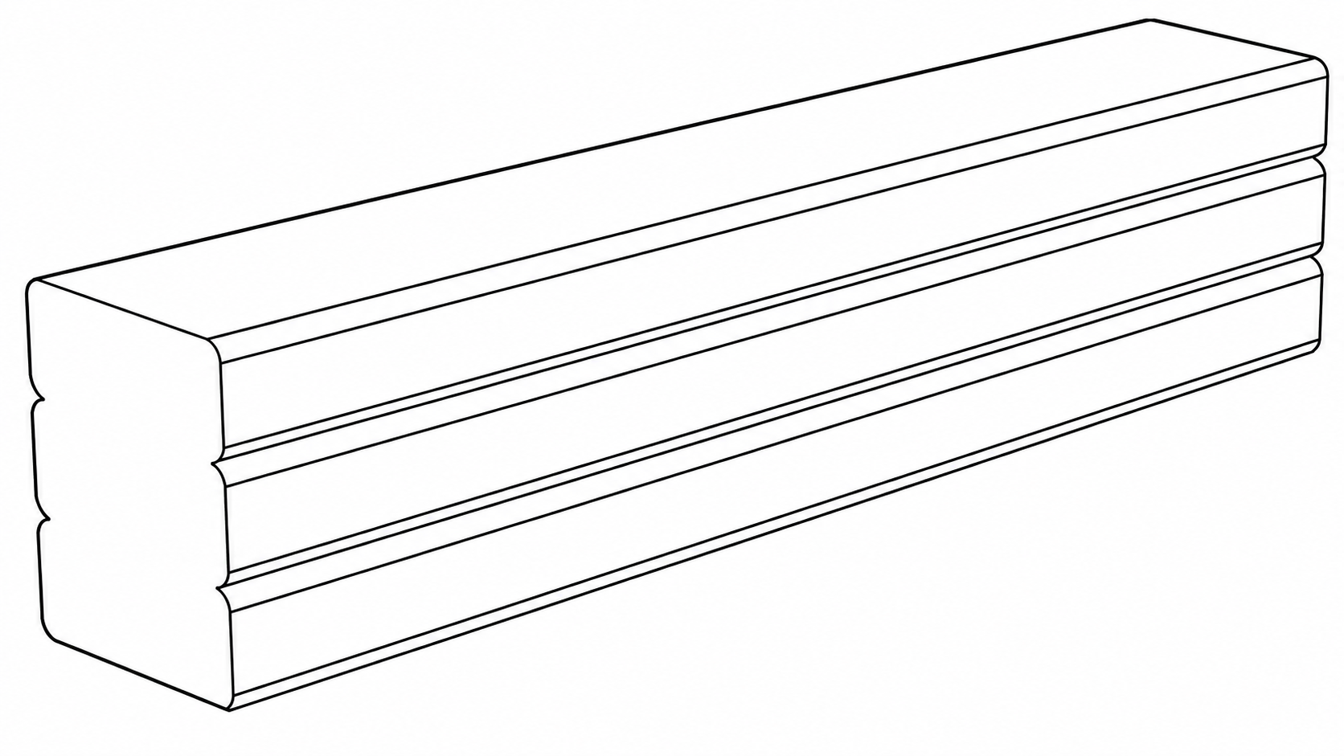

x
longitudinal
Transverse 2
z
y
Transverse 1
d
s
H
w

Slide 9
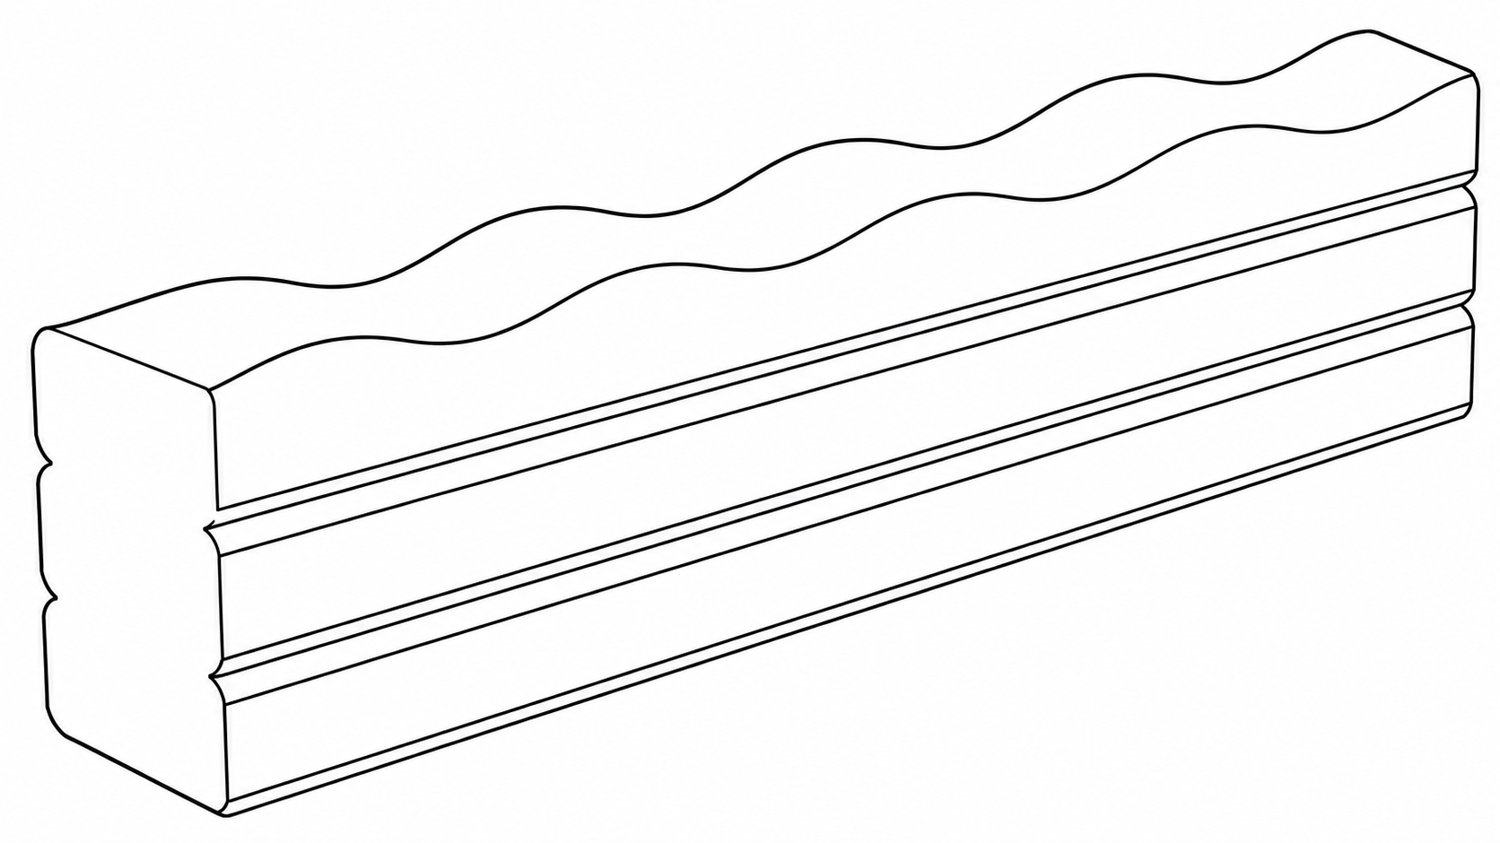
3D Printing: General features
d1
x
longitudinal
s1
Transverse 2
z
y
Transverse 1
d3
H
w

Slide 10
3D Printing: Single Line Wall
x
y
z
Height
Length
Width

Slide 11
3D Printing: Hollow Rectangular Prism
Total
Width
Plan
Length
x
y
z
Height
Length
Width

Slide 12
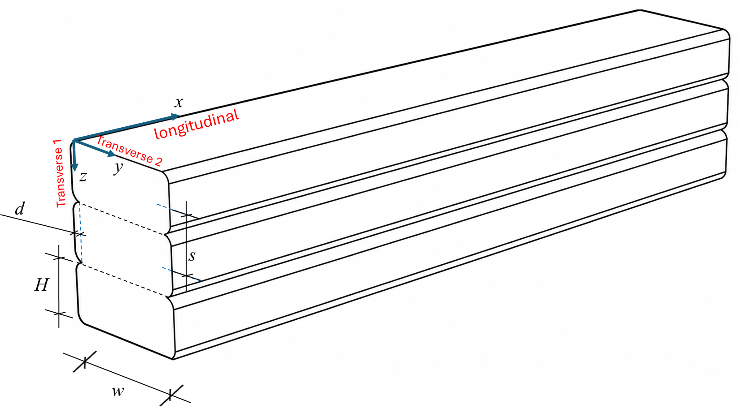
3D Printing: Curved Section
Inner height
Plan
thickness
Span
x
y
z
Height
Length

Slide 13
Printed L-Shape
Leg Width
Wall width
Leg Length
Plan

Slide 14
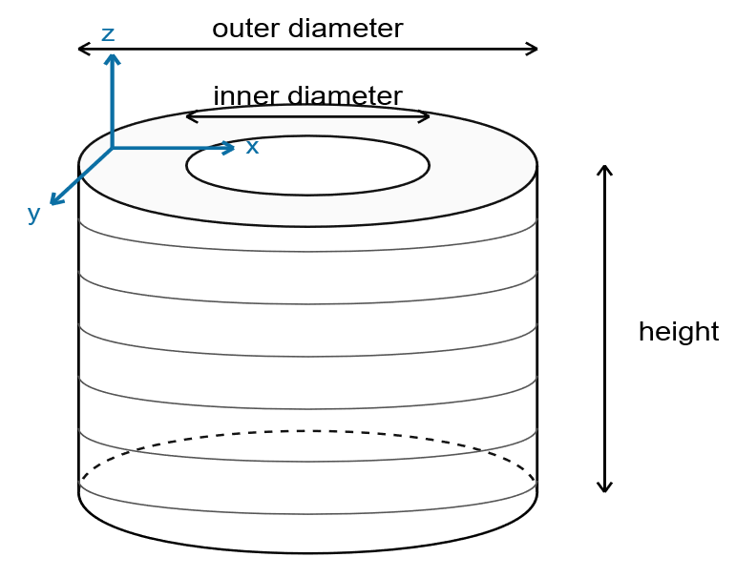
3D Printing: Hollow Cylinder

Slide 15
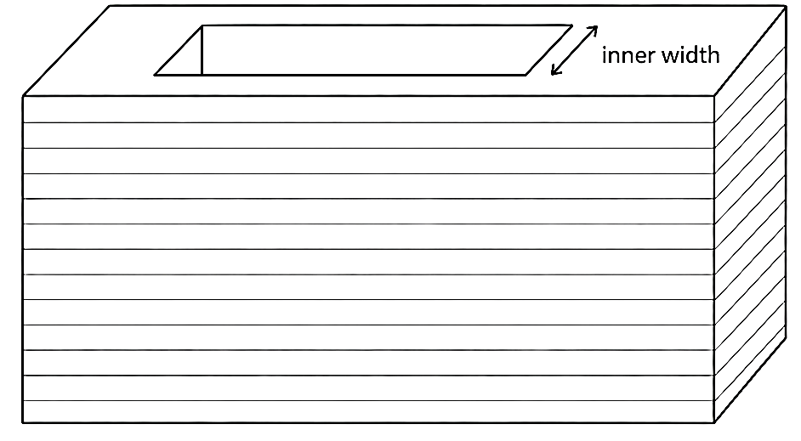
3D Printing: Hollow Rectangular Prism
Heigth
Width
Length

Slide 16
3D Printing: Pyramid
Height
Base 2
Base 1

Slide 17
3D Printing: Hemisphere
Height
Diameter

Slide 18
3D Printing: Slab
x
thickness
depth
y
z
length

Slide 19
3D Printing: Slab Laminates
x
thickness
depth
y
z
length

