Slide 1
DAU Forecasting With ARIMAX
ÇİYA BARAN ÖNER

Slide 2
TABLE OF CONTENTS
INTRODUCTION AND PROJECT PURPOSE
PROJECT DESCRIPTION, PROJECT PURPOSE
DATA ANALYSIS
MODELING APPROACH
STATIONARITY TEST WITH ADF TEST
SELECTING THE BEST PARAMETERS WITH ACF AND PACF
TRAINING OF THE ARIMAX MODEL (FOR DAU)
TRAINING THE ARIMA MODEL (FOR NEW USERS DAILY)
NEW USERS DAILY FORECAST FOR 30 DAYS
FORECAST FEEDS ARIMAX MODEL AND DAU FORECAST FOR THE NEXT 30 DAYS
CONCLUSIONS AND TAKEAWAYS

Slide 3
INTRODUCTION AND PROJECT PURPOSE
Project Description: This project predicts DAU data for the next 30 days by using the ARIMAX model with the DAU information obtained from the session recordings of the players and provides a strong estimate by using the number of new users per day as well as the DAU information.
Purpose of the Project: It aims to develop a forecasting model to predict the number of daily active users for 30 days after the last available session data.

Slide 4
DATA ANALYSIS – Data Exploration
This stage involves the discovery of data. It allows us to find the relationship between the metrics, the differences in difficulty between the levels, the relationships between the data sets, and the features required for our model.

Slide 5

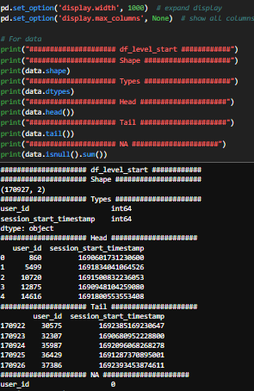
- Selecting and uploading data sets that will be useful for grouping users.
- A pre-examination step of the dataframe.
- It includes steps such as learning the types of data, examining the number of data, examining the columns in the data and Null data control.

Slide 6
DATA ANALYSIS – Data Manipulation
This stage; It also includes creating new metrics, merging data sets, and data transformations.

Slide 7
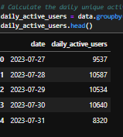
Calculation of the Number of Daily Active Users
- The number of users per day has been successfully calculated.

Slide 8
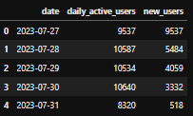
Calculation of the Number of New Users Per Day
- The number of new users per day has been successfully calculated. This metric will enable the use of the ARIMAX model. Thus, the model will produce more reliable predictions.

Slide 9
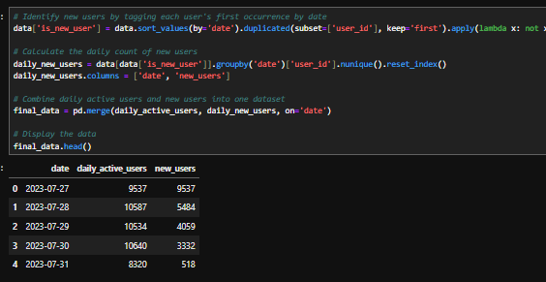
Consolidation of Data
- After calculating the number of new users per day, these columns were merged.

Slide 10
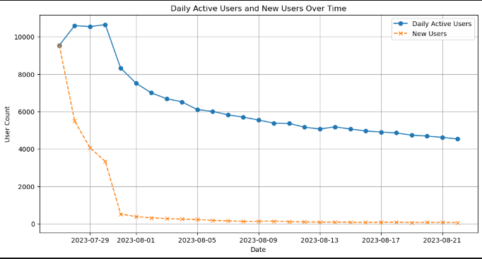
DATA ANALYSIS – Data Visualization
- The graph of the number of DAU and Daily New Users is as follows.

Slide 11
MODELING APPROACH
At this stage, respectively;
With the ADF test, it was determined that the time series was stationary.
ACF and PACF tests were performed to determine p and q values.
The best parameter values have been identified.
An ARIMAX model has been trained for DAU estimation. The number of new users per day has been added as an auxiliary metric.
To feed the ARIMAX model, the number of new users for the next 30 days was estimated with ARIMA.
Finally, with the ARIMAX model, the DAU after 30 days was estimated.

Slide 12
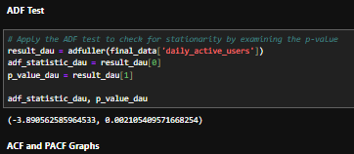
ADF Test
- It is seen that the time series has a stationary structure. Based on this test, it was decided that the ARIMAX model was suitable.

Slide 13
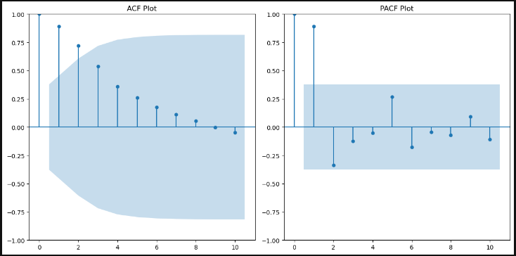
ACF and PACF Tests
- ACF and PACF tests were performed to determine q and p values. The ACF graph quickly approaches zero with the first few delays. Low values for the q value indicate that it would be ideal.
- In PACF, the initial latency is high, then there is a decrease. Again, low values for the p-value indicate that it would be ideal.

Slide 14

Determination of Training Test Data
- We know that we have 27 days of data. The last 5 days were determined as test data. Thus, the model will be trained with as many days as possible.

Slide 15
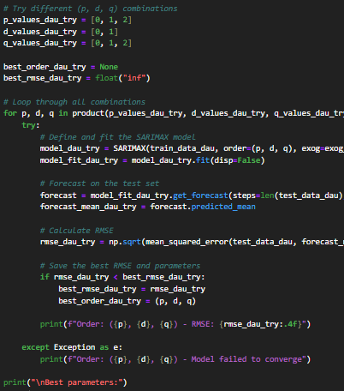

Finding the Best Parameters
The parameters with the least error rate for the ARIMAX model were determined as (2,0,0).

Slide 16
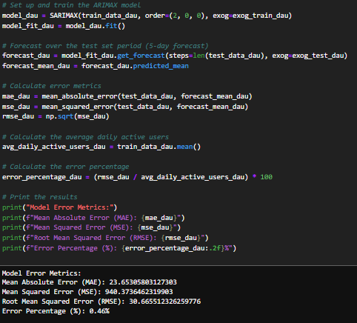
Training the ARIMAX Model
The results of the ARIMAX model are as follows. The values are quite good and the margin of error is quite low.

Slide 17
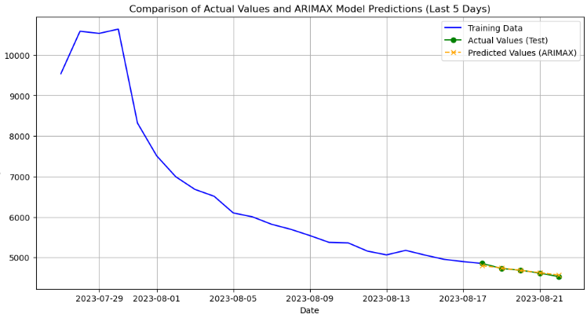
Test of the ARIMAX Model
- Graph with forecast, real data and training data of the ARIMAX model. As can be seen, the model predicts well.

Slide 18
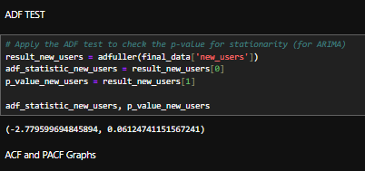
ADF Test for ARIMA Model
- There should be a number of new users per day for the next 30 days to feed the ARIMAX model. It was made with the ARIMA model in order to have the best results. Therefore, the process for the ARIMAX model will be the same for ARIMA.
- In order for the time series to be considered stationary in general, the p value must be less than 0.05, but if we accept the 10% significance level (p < 0.1), we can consider the series to be stationary.

Slide 19
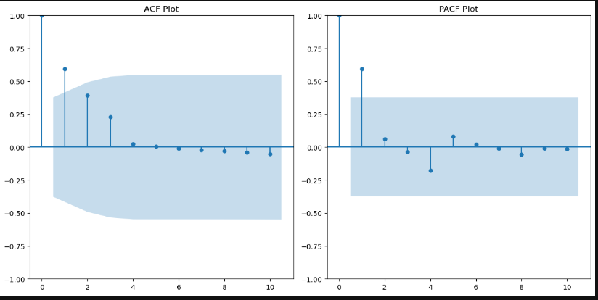
ACF And PACF Test For ARIMA Model
- Again, it was deemed appropriate to choose p and q parameters low.

Slide 20

Generation of Training and Test Data for the ARIMA Model
- Again, we have determined the last 5 days as a test.

Slide 21

Generation of Training and Test Data for the ARIMA Model
- Again, we have determined the last 5 days as a test.
Selecting the Best Parameters for the ARIMA Model
- The best parameters are determined as (1,1,1).

Slide 22
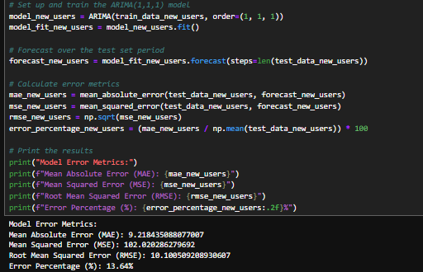
ARIMA Model Tests
It has been shown to be a satisfactory result to continue.

Slide 23
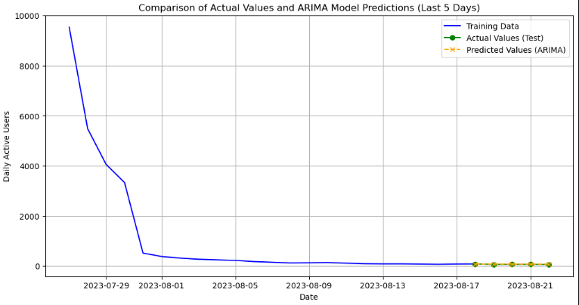
Testing of the ARIMA Model
- Graph with prediction, real data, and training data of the ARIMA model. As can be seen, the model predicts at a good level.

Slide 24
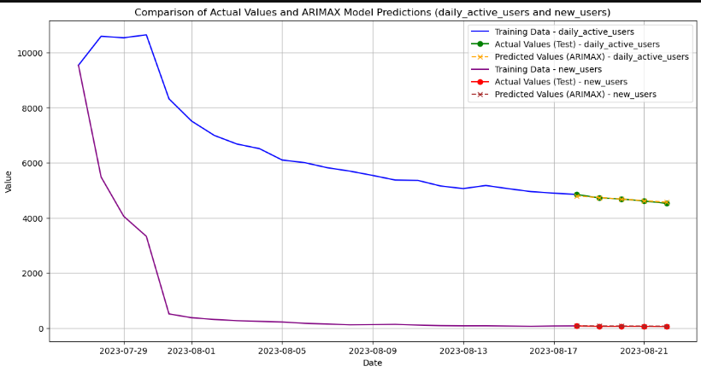
Graph of the Results of the Two Models
- Below is a combined version of the results of the two models. The models work at a good level.

Slide 25
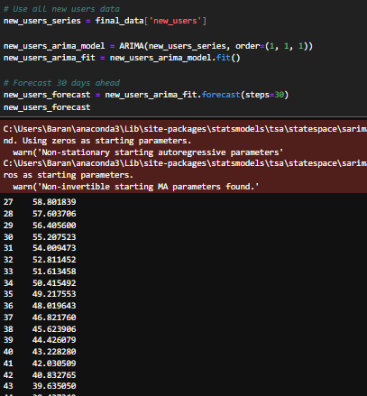
Estimation of Daily New Users with ARIMA
- It is necessary to estimate the number of new users per day for the next 30 days. In order for the forecast result to be strong, all the days that the model was owned and the best parameters previously determined for this data set are given. Forecasts for the next 30 days will feed into the ARIMAX model.

Slide 26
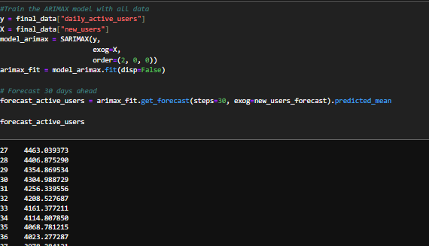
Next 30 Days DAU Forecast with ARIMAX
- Estimating the number of daily active users for the next 30 days. Again, in order for the model to be strong, all the available data are given to the model and the best parameters determined previously for this data set are given.
- Outputs from the ARIMA model are given as auxiliary metrics.

Slide 27
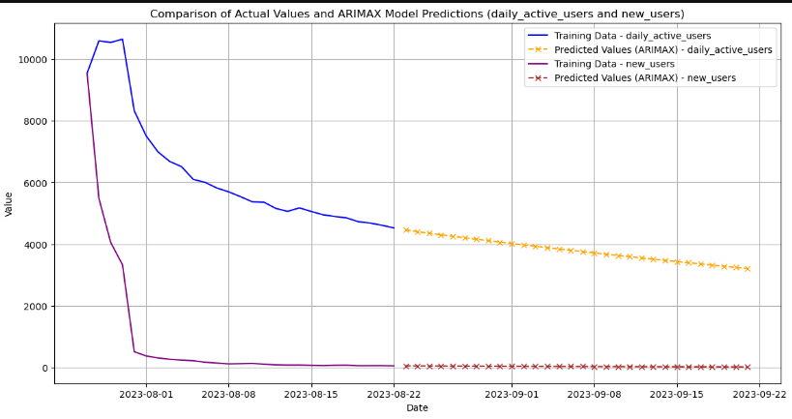
VISUALIZATION OF FORECASTS AND CONCLUSION
RESULT:
With the models that gave good results, the next 30 days of DAU and the number of new users per day were predicted.

