Slide 1
Data Science Insight Into the History of Video Games
CENG313 - Introduction to Data Science Final Project

Slide 2

Team Heatran (23)
Ayşe Orkan (181180055)
Çiya Baran Öner (181180056)
Mert Sağır (181180061)
Mustafa Nesin (181180054)

Slide 3
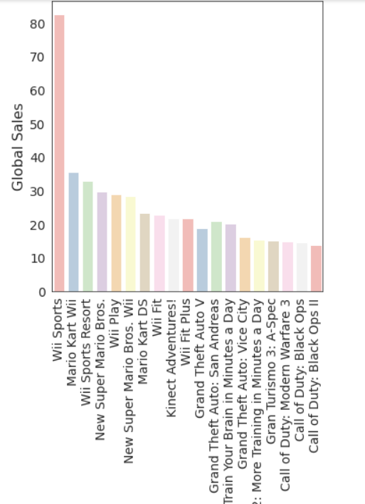
Games with Highest Global Sales
Developers and gamers can come to the conclusion which game is a good game by looking at the sales data of the games.

Slide 4
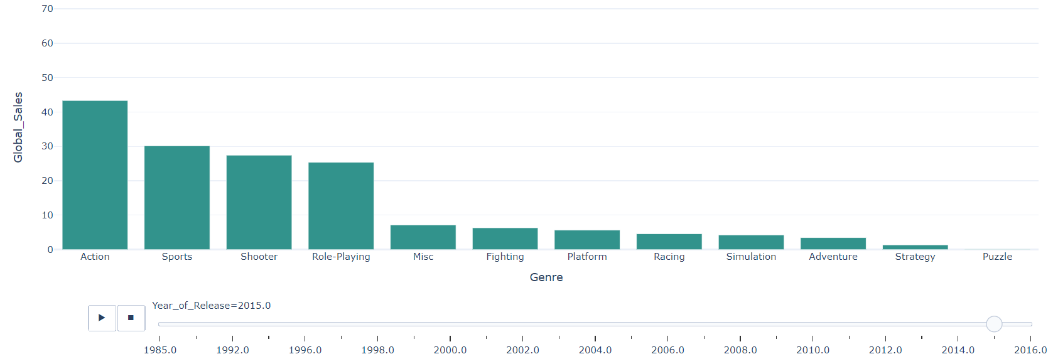
Global Sales for Genres by Years
According to the demand for game types, game companies can develop games.

Slide 5
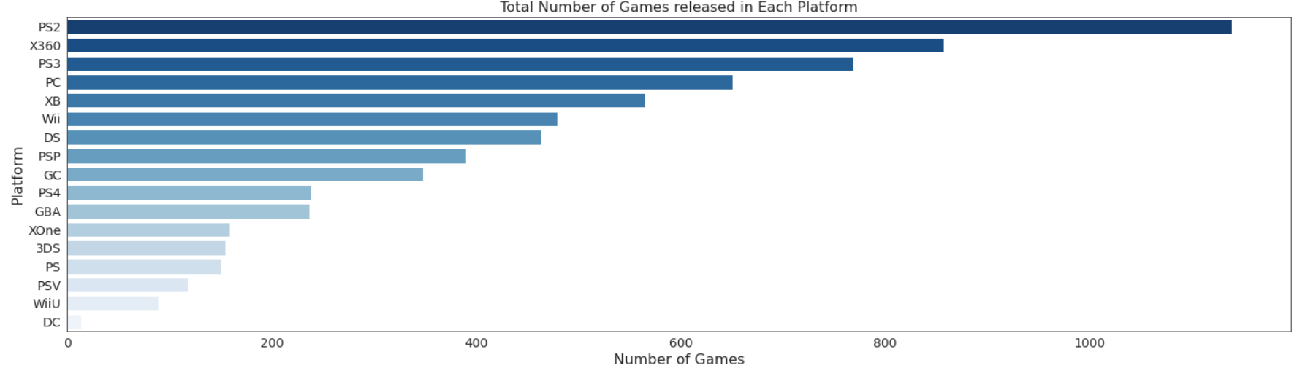
Which platforms have more games?
Players may want to evaluate it according to the game scale when buying a device. In addition, developers can devote time to game development for multi-option gaming platforms.

Slide 6
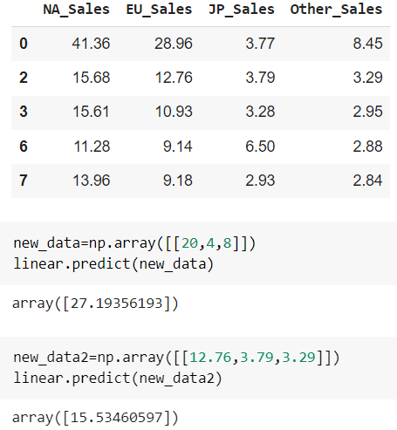
What are the North American sales relative the other sales?
This prediction is very important for game companies because they can see what strategy they will follow according to their sales in the regions or how many games they will import to which region.

Slide 7
Which platform should be focused on for the new games from the publisher’s perspective?
Here, we will give some information about platforms that a publisher could generate most incomes.
We will have shown that with some graphics and visualizations with some algorithms.

Slide 8
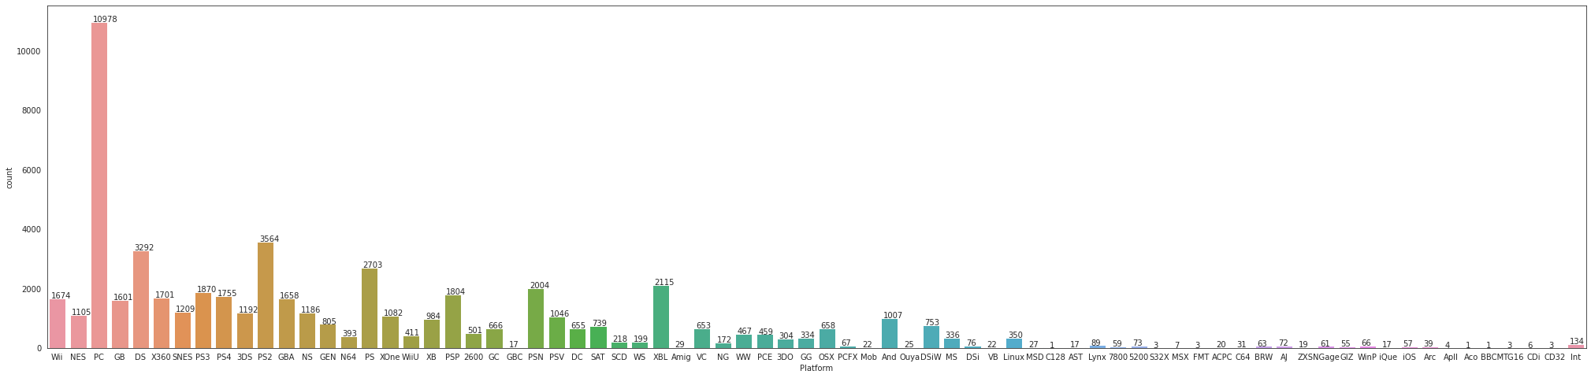
As we can see, this graphic shows game counts on each platform from the past to the present. The highest platform is computer platform but PS series have large count, as well. (Seaborn)

Slide 9
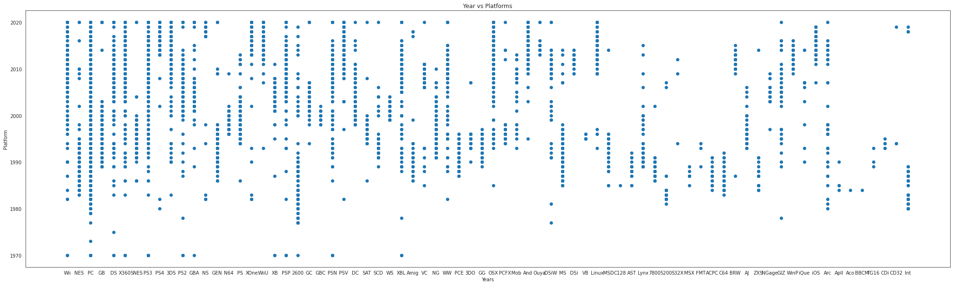
But some platforms don’t prefer in the recent past. Therefore, we decided to examine after 2015. (matplotlib.pyplot)

Slide 10
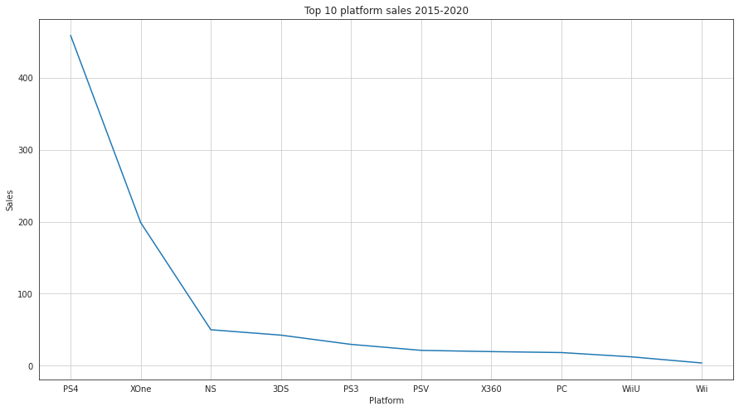
Firstly,this graphic sums up sales in each platform. Secondly, we sorted them in descending order. Publishers can examine that and therefore, they will be able to make decision more efficiently.

Slide 11
On which platforms are the games played the most?
For developers, it is very important to know which games are played on which platforms. Because the same game comes out on different platforms which cause different sales numbers. Also platforms have different sales numbers too. Today, nearly everyone has a PC but not everyone has a PS3 etc. So developers should know on which platform each game is played the most.

Slide 12
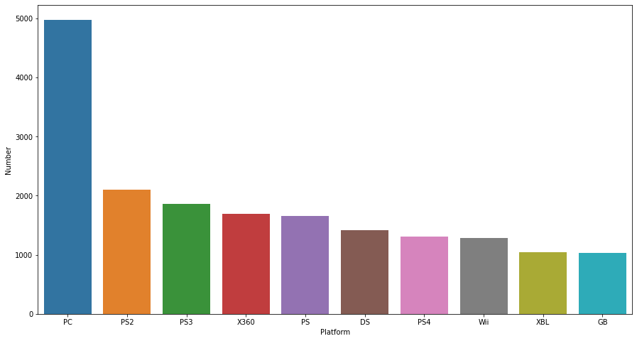
This graph shows on which platforms are the games played the most. As you can see, the PC is the main platform for playing games. But if we look between gaming consoles then PS2 is higher than the others although it is an older console when there weren't as many people playing games as now. That is mainly because the PS2 is the most sold gaming console of all time.

Slide 13
What are the most played games over time?
Hundreds of millions of games are sold every year around the world. We can generally determine the success of a game by how much that game sells. Therefore, it is important to know which games are the most played from the past to the present.

Slide 14
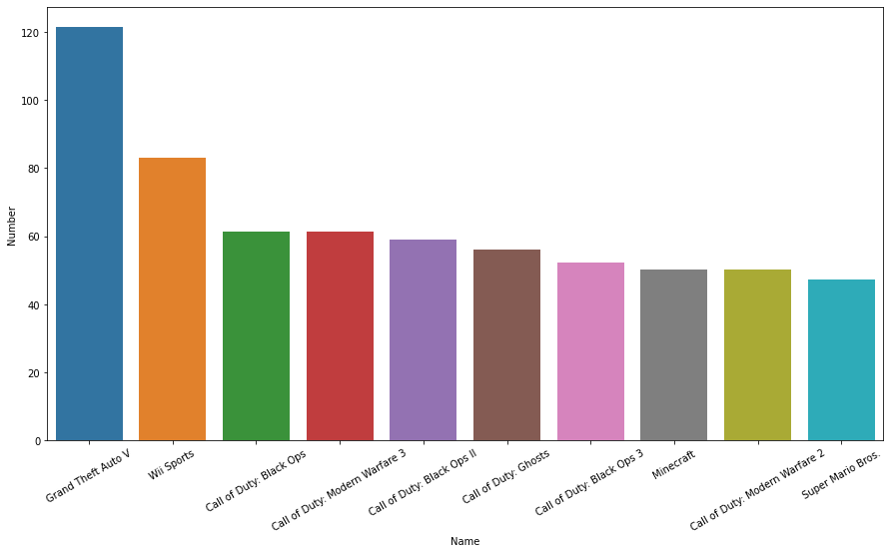
As you can see in the graph above, Grand Theft Auto 5 is by far the most played game according to the selected database. Wii sports is in second place after it. And the rest of the games on the list are closer playtimes to each other after these two.

Slide 15
What will be the score of the newly released game?
One of the questions we sought to answer in the project was what score a newly released game would get from critics or users.
We can use Video Game Sales with Ratings dataset.
The dataset contains information about games such as genre, rating, platform, sales, score…
Can we make a score prediction based on the information in the data set with linear regression?

Slide 16
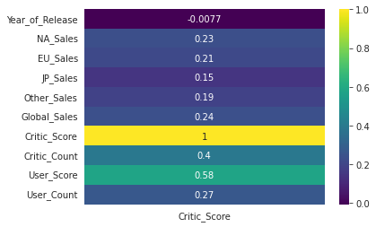
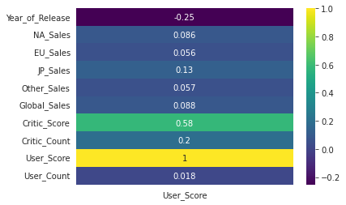
What will be the score of the newly released game?
Correlation between columns in the dataset as follows.
There is not enough correlation between the score columns and the other columns. Therefore, we will not be able to apply linear regression for this question.

Slide 17
What will be the score of the newly released game?
Instead, we can use the average score of previous games from the developers and publishers.
Rank | Developer | Score
1. | DMA Design | 97.0
2. | Irrational Games, 2K Marin | 96.0
3. | Digital Extremes, 2K Marin | 94.0
4. | Bungie Software | 93.6
5. | DMA Design, Rockstar North | 93.0
 | … | …
1023. | Red Tribe | 29.0
1024. | Santa Cruz Games | 28.0
1025. | AI | 26.0
1026. | Neko Entertainment | 23.0
1027. | Idol FX | 22.0
Rank | Publisher | Score
1. | Valve | 96.0
2. | Valve Software | 93.0
3. | 2D Boy | 90.0
4. | SquareSoft | 89.2
5. | Devolver Digital | 88.0
 | … | …
191. | Mad Catz | 49.0
192. | Phantom EFX | 44.0
193. | Telltale Games | 40.0
194. | Evolved Games | 38.0
195. | Avanquest | 31.0

Slide 18
Which continent plays which game more?
North America Top 5
Europe Top 5
Rank | Game | Sales (in millions)
1. | Wii Sports | 41.36
2. | Super Mario Bros. | 29.08
3. | Duck Hunt | 26.93
4. | Tetris | 23.20
5. | Mario Kart Wii | 15.68
Rank | Game | Sales (in millions)
1. | Wii Sports | 28.96
2. | Mario Kart Wii | 12.76
3. | Nintendogs | 10.95
4. | Wii Sports Resort | 10.93
5. | Brain Age: Train Your Brain in Minutes a Day | 9.20

