Slide 1
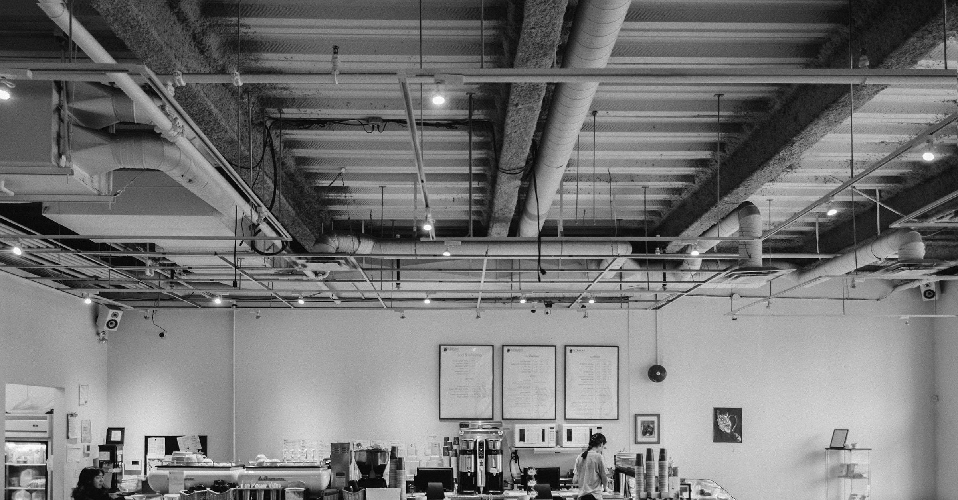

Andrew Busto, Tyler Da Costa, Connor Goudie, Sheldon Lynn and Thomas McKay

Slide 2
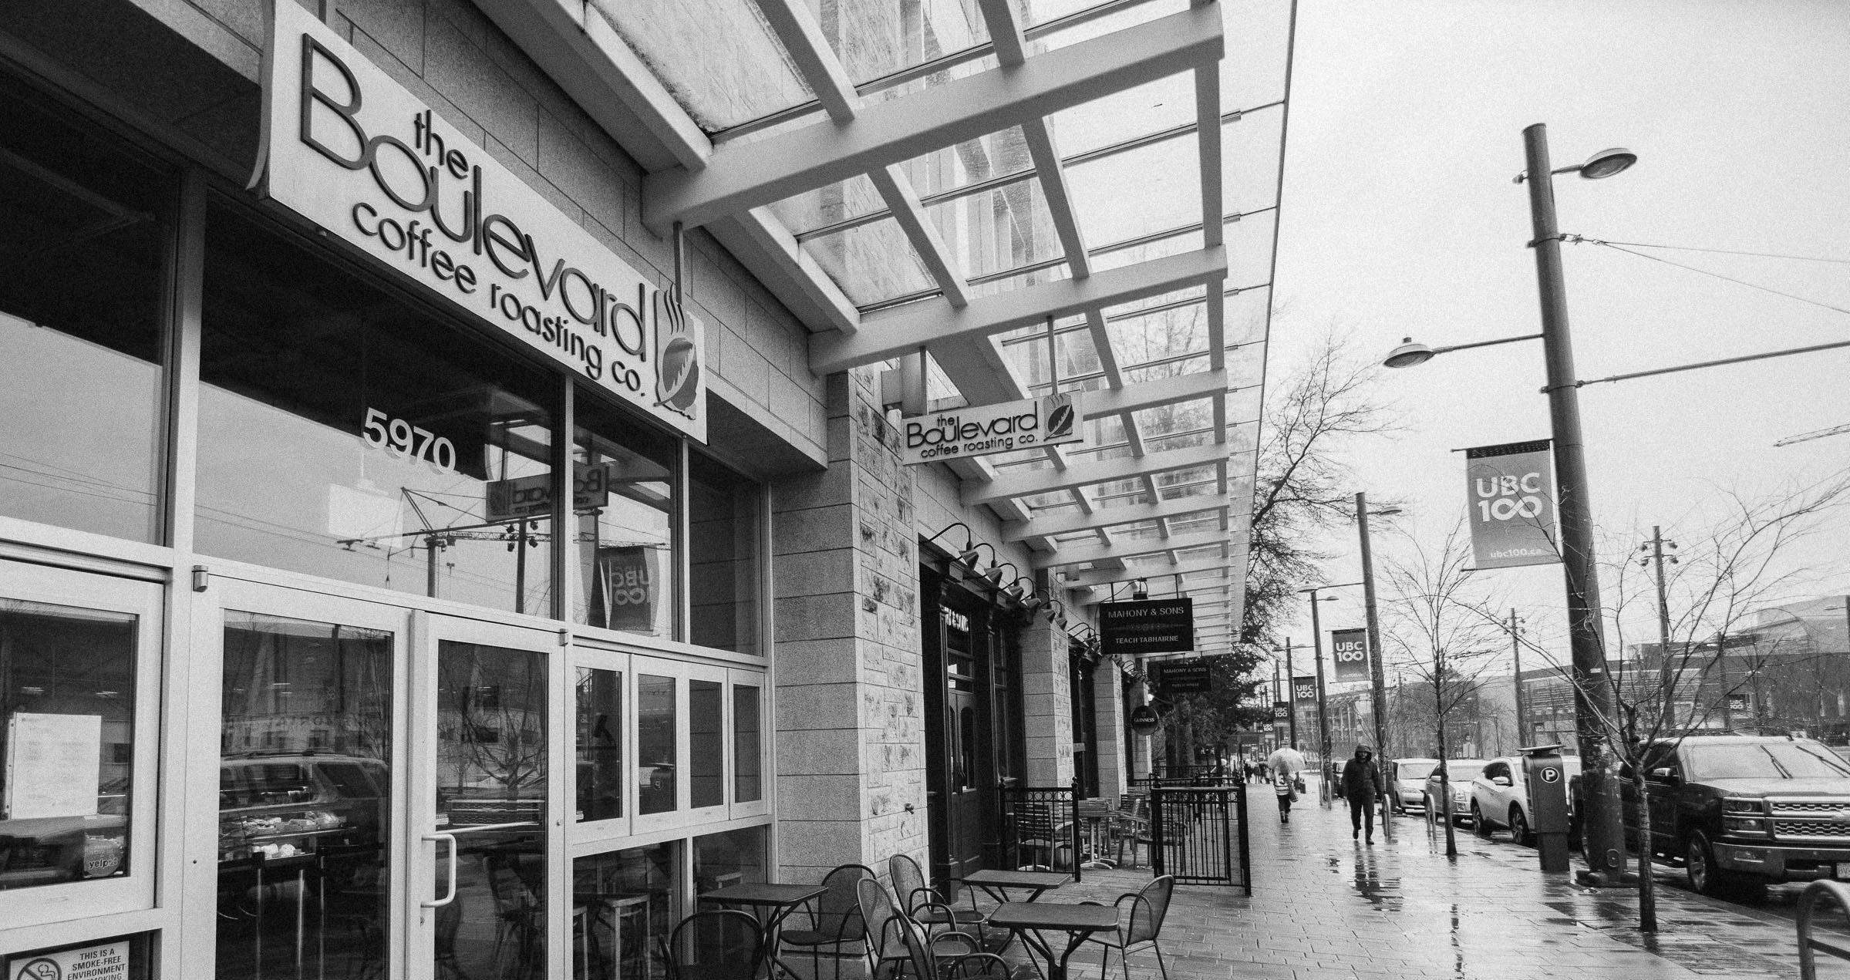
Motivation and Solution

Slide 3
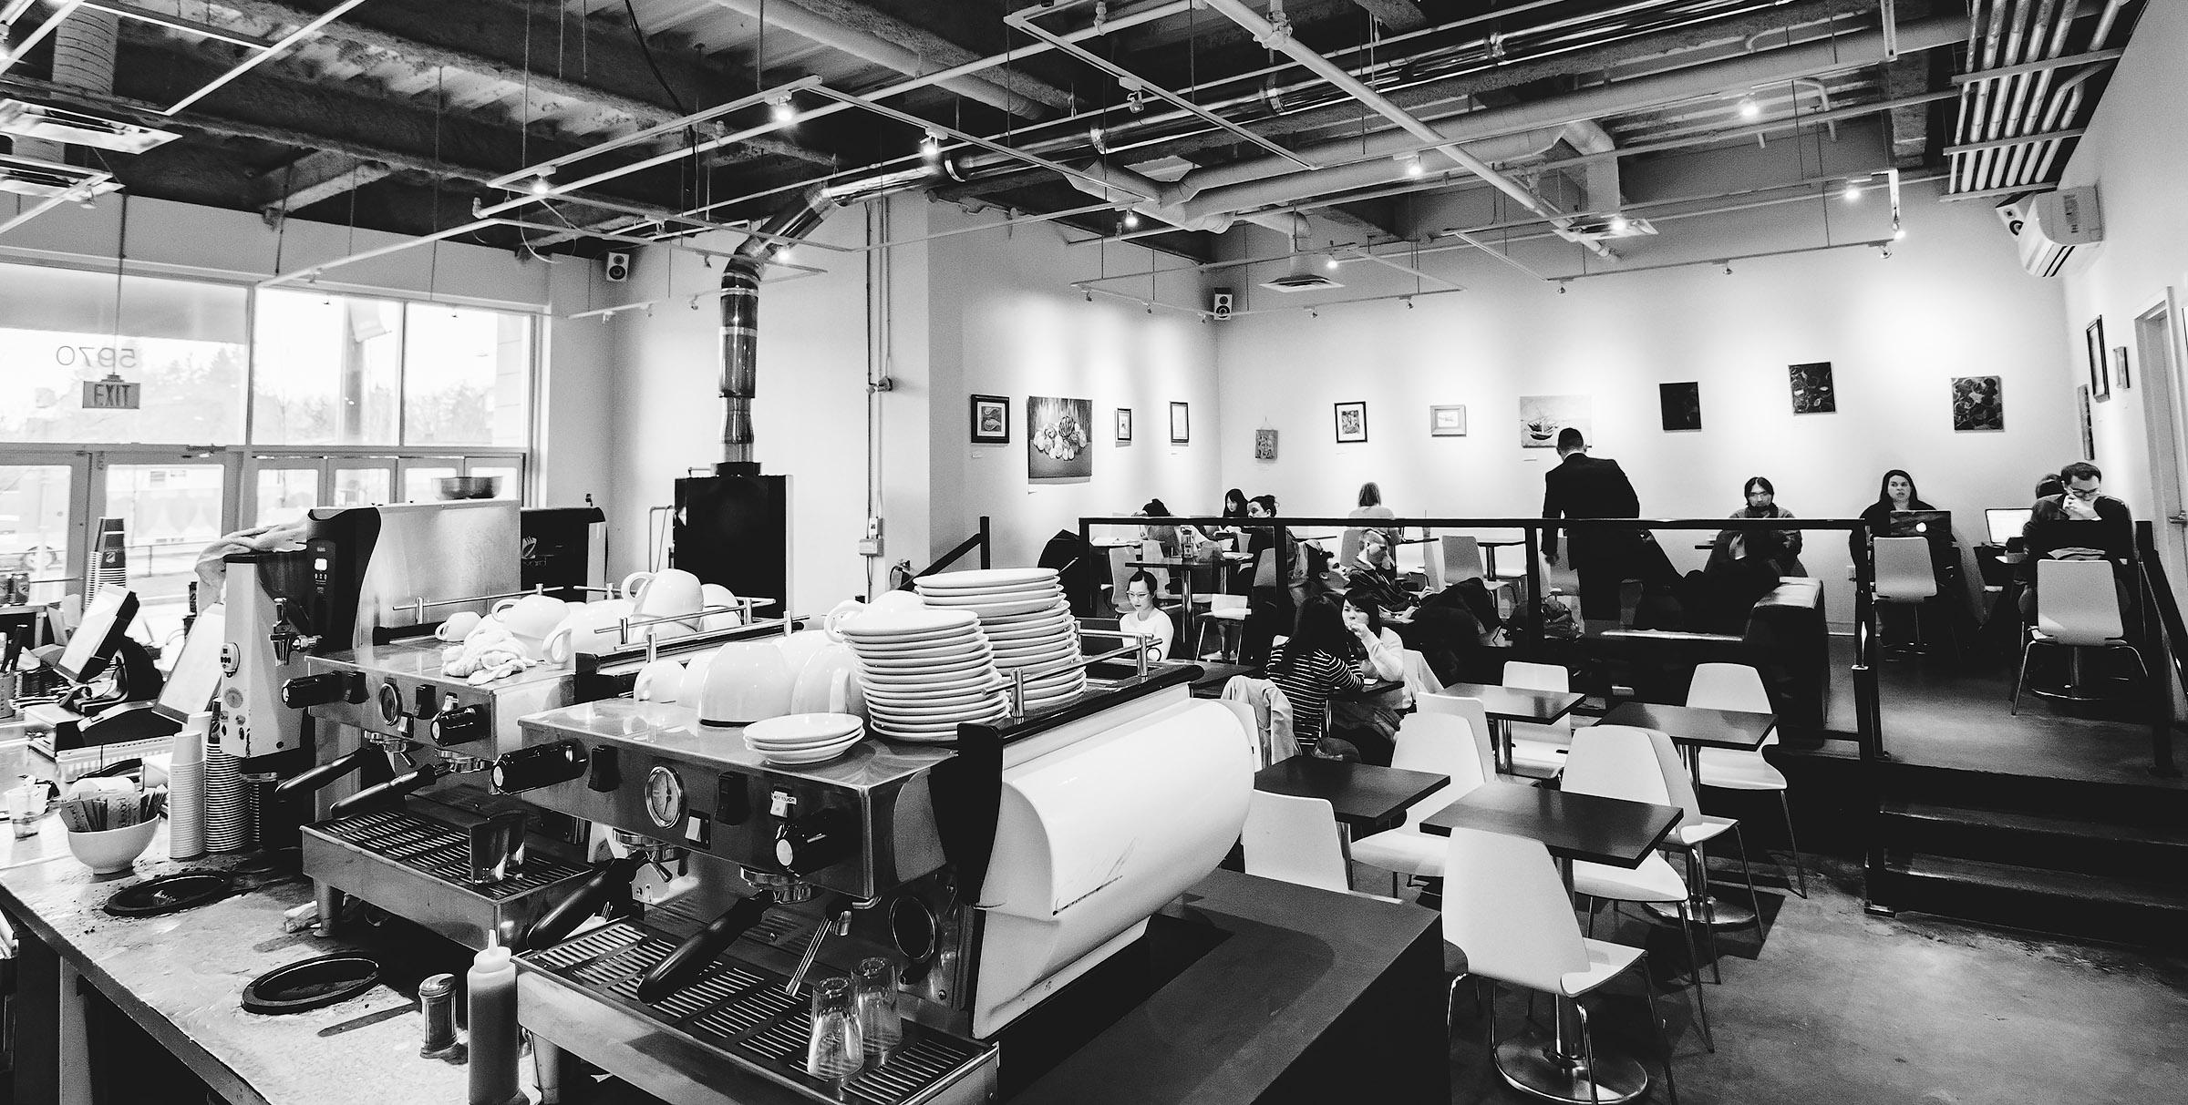
Make a site that better represents the company
Show off the work of local artists
Provide a better design than the current website
Create a more responsive and mobile friendly site

Slide 4
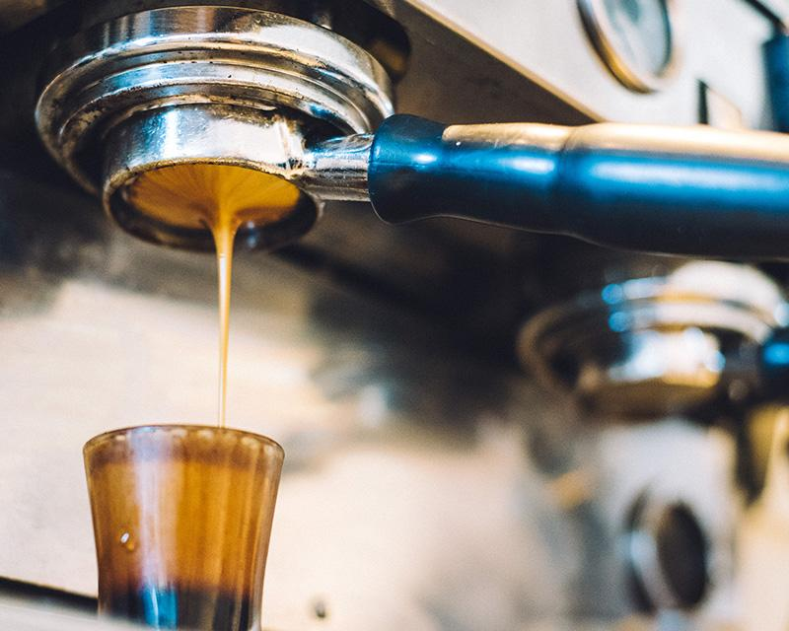
Improving the original design

Slide 5
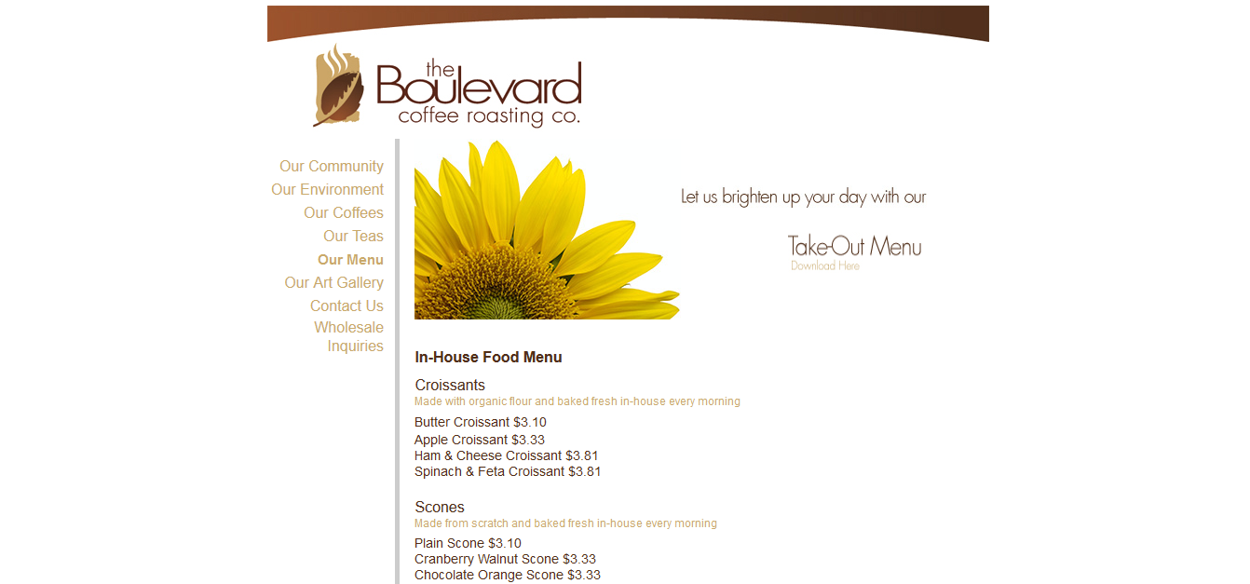

Slide 6
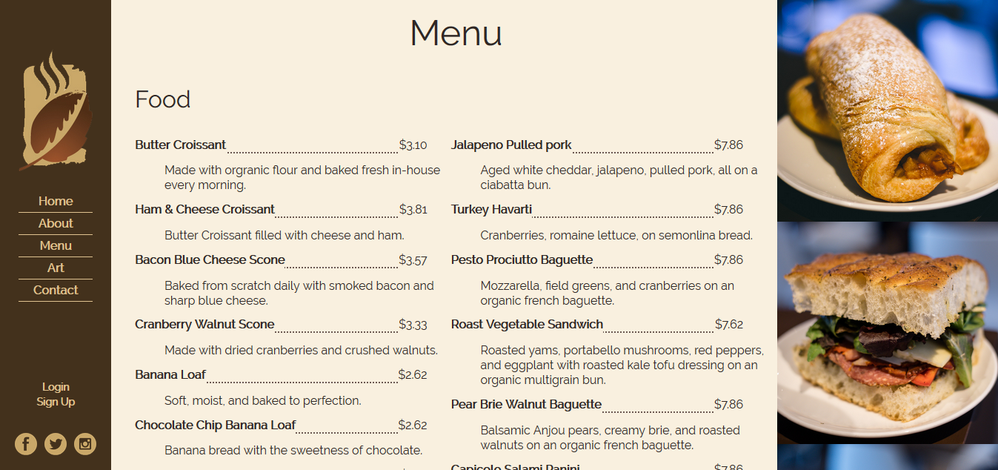

Slide 7
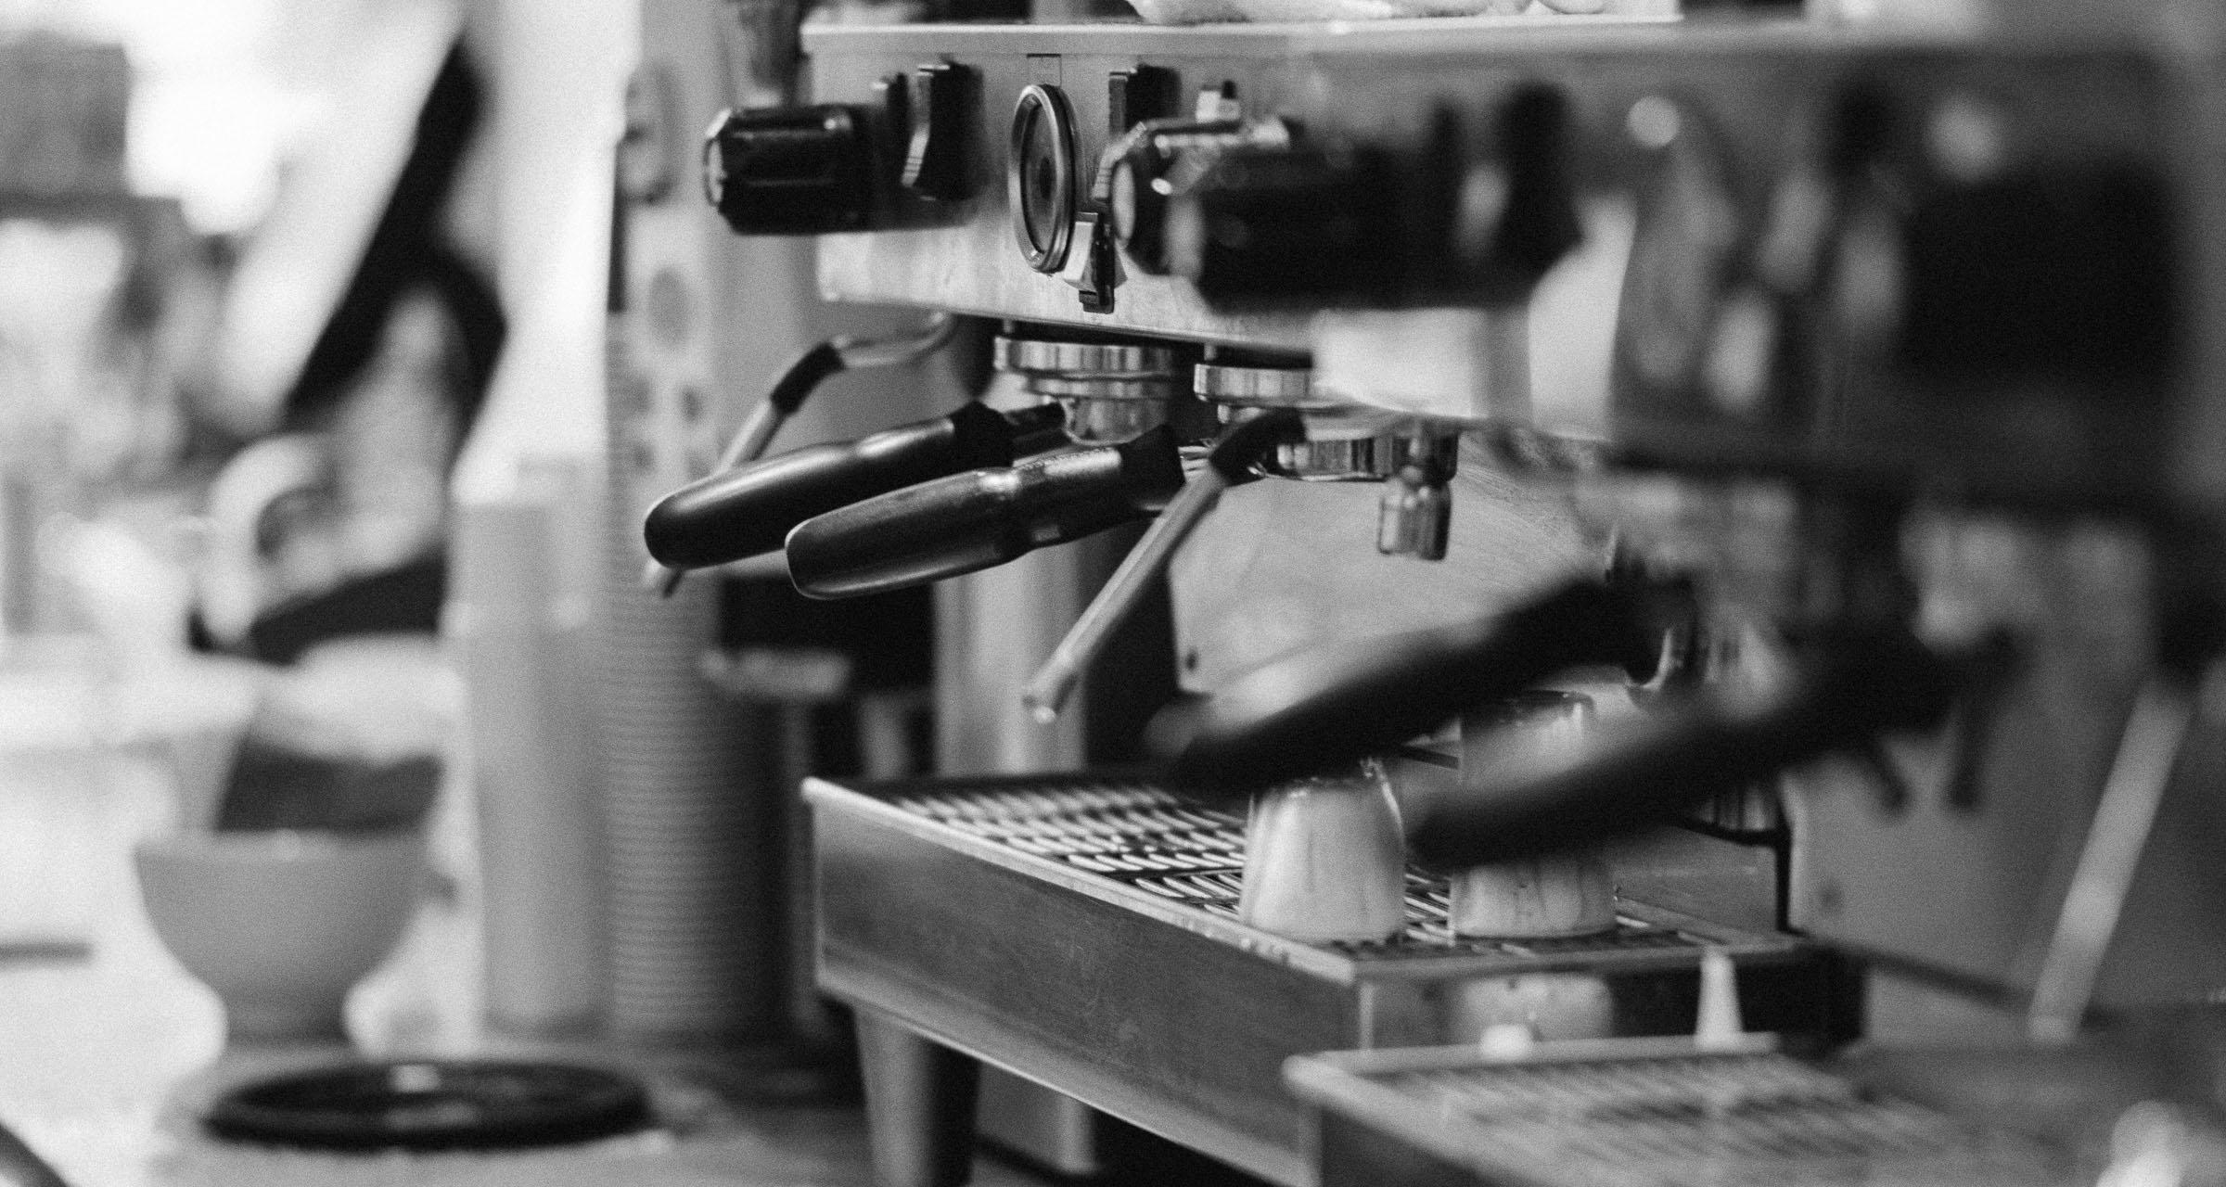
What we did
Used flexboxes in our navigation, headers and footers and some images
Added CSS to turn the site mobile at lower resolutions
Kept the website small and easy to navigate to improve accessibility

Slide 8
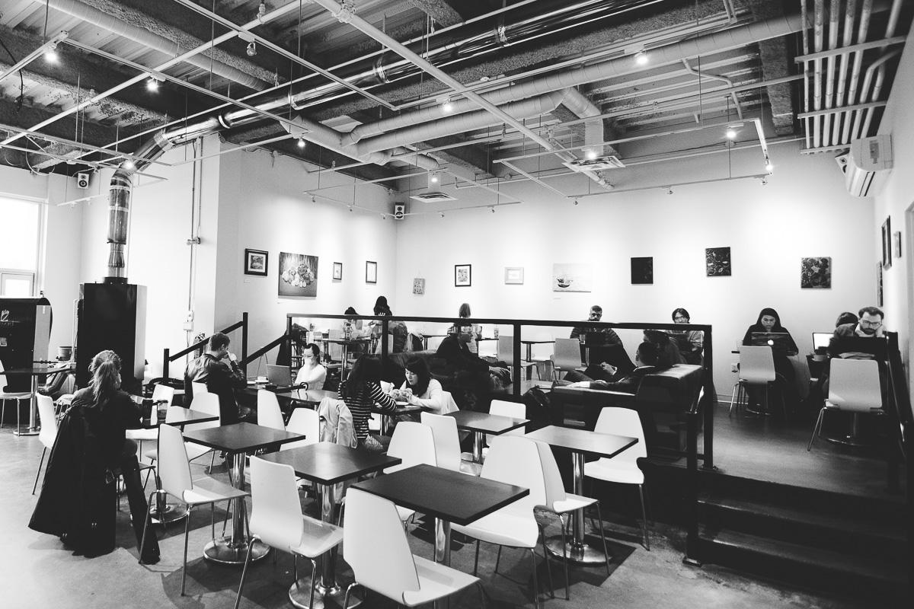
Lessons Learned
Flex box is amazing
How to pick a good colour scheme
How to make a fluid and responsive design
We should have finalized website structure before working on other pages

Slide 9
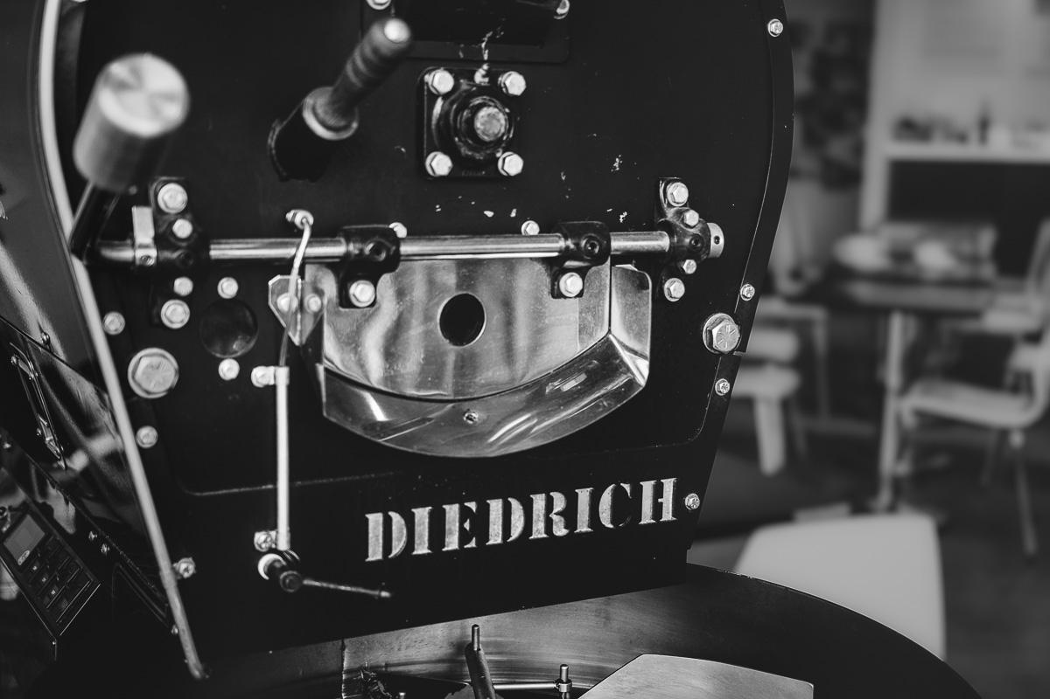
Demonstration of our site

