Slide 1
Algorithms on Parking Functions and Related Multigraphs
賴俊儒 Lai, Chun-Ju
國家理論科學研究中心
cjlai@ntu.edu.tw

Slide 2


Parking Functions: Model
n drivers try to park in n spots (1 to n) one by one.
i^{th} driver → spot a_{i}.
Vacant → park there
Occupied → park at next vacant spot.
If no spots left, then he’ll give up parking.
(a₁, a₂,..., a_{n}) is called a parking function if all cars are parked.
1
2
3
3
2
2
3
2
1

Slide 3
Parking Functions: Sequence
A sequence (a₁,...a_{n}) is a parking function if its nondecreasing rearrangement b₁ ≤ ... ≤ b_{n} satisfies b_{i} ≤ i for all i
[Example]
(1,3,1), (4,3,1,1), (5,3,1,1,2) are parking functions.
(2), (1,3,3), (3,5,1,2,3) are not

Slide 4
Parking Functions
n = 1, there are 1 parking functions:
1
n = 2, there are 3 parking functions:
11, 12, 21
n = 3, there are 16 parking functions:
111, 112, 113, 121, 122, 123, 131, 132
211, 212, 213, 221, 231, 311, 312, 321

Slide 5
Parking Functions: P_{n}
P_{n} := #{ Parking functions of length n }
P₁ = 1, P₂ = 3, P₃ = 16, P₄ = 125, ...
Theorem [Konheim & Weiss, 1966] P_{n} = (n+1)^{n-1}

Slide 6
Parking Functions :P_{n,k}
(a₁, ..., a_{n}) is called k-leading if a₁ = k.
P_{n,k} := #{ k-leading parking function of length n }
[Example]
P_{1,1} = 1
P_{2,1} = 2
P_{3,1} = 1

Slide 7
Parking Functions : P_{3,k}
All 16 parking functions of length 3.
 | 111 |  | 122 |  | 211 |  | 231
 | 112 |  | 123 |  | 212 |  | 311
 | 113 |  | 131 |  | 213 |  | 312
 | 121 |  | 132 |  | 221 |  | 321

Slide 8
Parking Functions : P_{3,1}
All 16 parking functions of length 3.
P_{3, 1} = 8
 | 111 |  | 122 |  | 211 |  | 231
 | 112 |  | 123 |  | 212 |  | 311
 | 113 |  | 131 |  | 213 |  | 312
 | 121 |  | 132 |  | 221 |  | 321

Slide 9
Parking Functions : P_{3,2}
All 16 parking functions of length 3.
P_{3, 1} = 8
P_{3, 2} = 5
 | 111 |  | 122 |  | 211 |  | 231
 | 112 |  | 123 |  | 212 |  | 311
 | 113 |  | 131 |  | 213 |  | 312
 | 121 |  | 132 |  | 221 |  | 321

Slide 10
Parking Functions : P_{3,3}
All 16 parking functions of length 3.
P_{3, 1} = 8
P_{3, 2} = 5
P_{3, 3} = 3
 | 111 |  | 122 |  | 211 |  | 231
 | 112 |  | 123 |  | 212 |  | 311
 | 113 |  | 131 |  | 213 |  | 312
 | 121 |  | 132 |  | 221 |  | 321

Slide 11
Parking Functions : P_{n,k}
P_{n,k} =?
We’ll give an answer by combinatorial argument, then move on to prove more.

Slide 12
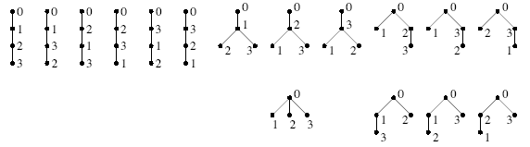
Rooted Labeled Tree
Fact: (n+1)^{n-1} = # { rooted labeled trees on { 0,1, ... , n } }
[Example] n = 3, we have 16 trees.
Some bijections between trees and parking functions are known, but none seems useful.

Slide 13
Triple-Label Algorithm: Idea
Given a labeled tree,
Label π_{a}(x) to each node x according to the Breadth First Search (BFS).
π_{a}(0) = 0
0
0
π_{a}(2) = 1
π_{a}(3) = 2
π_{a}(6) = 3
π_{a}(1) = 4
π_{a}(5) = 5
π_{a}(4) = 6
1
2
3
2
3
6
1
5
4
4
5
6

Slide 14
Triple-Label Algorithm: Idea
Given a labeled tree,
Label π_{a}(x) to each node x according to the Breadth First Search (BFS).
Assign 3rd label w by the formula w(x) = π_{a}(parent of x) + 1
π_{a}(0) = 0
w(2) = 1
w(3) = 1
w(6) = 1
w(1) = 3
w(5) = 3
w(4) = 4
0
0
π_{a}(2) = 1
π_{a}(3) = 2
π_{a}(6) = 3
π_{a}(1) = 4
π_{a}(5) = 5
π_{a}(4) = 6
1
1
1
1
2
3
2
3
6
3
1
5
4
4
3
4
5
6

Slide 15
Triple-Label Algorithm: Idea
We proved that: (w(1), ...,w(n)) is the desired parking function (a₁,...a_{n})
In this case, it is (3, 1, 1, 4, 3, 1).
π_{a}(0) = 0
w(2) = 1
w(3) = 1
w(6) = 1
w(1) = 3
w(5) = 3
w(4) = 4
0
0
π_{a}(2) = 1
π_{a}(3) = 2
π_{a}(6) = 3
π_{a}(1) = 4
π_{a}(5) = 5
π_{a}(4) = 6
1
1
1
1
2
3
2
3
6
3
1
5
4
4
3
4
5
6

Slide 16
Triple-Label Algorithm: Formal
Given a parking function (a₁,...a_{n}) , For i = 1 to n, define:
π_{α}(i) := #{ a_{j} : a_{j} < a_{i} } ∪ { a_{j} : a_{j} = a_{i} and j < i }
Triplet-labeled rooted tree T_{α} associated with
V(T_{α}) := { (0, 0, 0) } ∪ { (i, a_{i}, π_{α}(i)) }
rooted at (0, 0, 0)
For any 2 vertices u = (i, a_{i}; π_{α}(i)), v = (j, a_{j}; π_{α}(j)), u is a child of v if a_{i} = π_{α}(j) + 1.
Notes:
∈

Slide 17
Enumeration: Idea
Under the setting of our algorithm, we can enumerate parking functions by the leading term in a neat “autograft” method.
correspond
k-leading
Parking Functions
Autograft
Labeled Trees
Triple-Label Algorithm

Slide 18


Enumeration: Autograft
Establish a bijection so that #{ T_{n,k} \ T’_{n,k} } is easy to compute.
Notes:
T_{n,k}:= \{\text{Labeled trees}\leftrightarrow P_{n,k}\}
T_{n,k+1}~\tilde{\rightarrow}~ T'_{n,k}\subset T_{n,k}

Slide 19
Autograft Method
Remove the subtree S := { node 1 and all its descendants }
0
n = 5, k = 1
1
3
4
2
5

Slide 20
Autograft Method
Remove the subtree S := { node 1 and all its descendants }
Renew the labels according to the BFS
0
n = 5, k = 1
3
1
2
3
2
5

Slide 21
Autograft Method
Remove the subtree S := { node 1 and all its descendants }
Renew the labels according to the BFS
Locate the node y satisfies π_{a} (y) = k
0
n = 5, k = 1
3
1
2
3
2
5

Slide 22
Autograft Method
Remove the subtree S := { node 1 and all its descendants }
Renew the labels according to the BFS
Locate the node y satisfies π_{a} (y) = k
Re-attach S making node 1 a child of node y
0
n = 5, k = 1
1
3
1
4
2
3
2
5

Slide 23
Enumeration: Form
The trees in T_{n,k} \ T’_{n,k} are in the form:

Slide 24
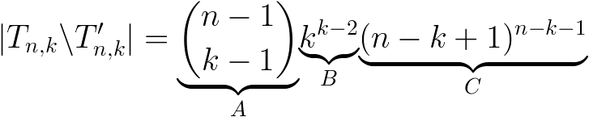
Enumeration: Formula
It is easy to observe that:
A: # ways to form S.
B: #{ P_{k} }
C: #{ P_{n-k+1} }
Notes:
|T_{n,k}\backslash T'_{n,k}| =\underset{A}{\underbrace{{n-1\choose k-1}}}\underset{B}{\underbrace{k^{k-2}}}\underset{C}{\underbrace{(n-k+1)^{n-k-1}}}

Slide 25

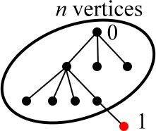
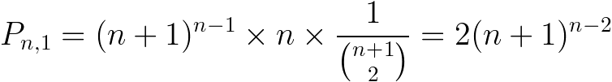
Enumeration: Results
Proposition
Corollary
Corollary
Notes:
P_{n,k}- P_{n,k+1} ={n-1\choose k-1}k^{k-2}(n-k+1)^{n-k-1}
P_{n,1}=(n+1)^{n-1}\times n \times \frac{1}{{n+1\choose 2}}=2(n+1)^{n-2}

Slide 26
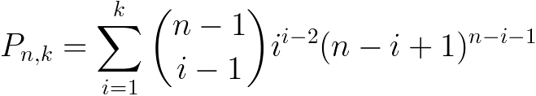
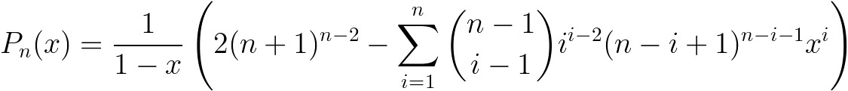
Enumeration: Results
Proposition
Theorem [Foata & Riordan, 1974]
The original proof combined 3 papers
Notes:
P_{n,k}=\sum_{i=1}^k{n-1\choose i-1}i^{i-2}(n-i+1)^{n-i-1}
P_{n}(x)=\frac{1}{1-x}\left(2(n+1)^{n-2}-\sum_{i=1}^n{n-1\choose i-1}i^{i-2}(n-i+1)^{n-i-1}x^i\right)
The original proof is by combining 3 papers.

Slide 27
X-Parking Functions
x := (x₁,...,x_{n}) is a sequence of positive integers.
A sequence (a₁,...,a_{n}) is a x-parking function if its nondecreasing rearrangement b₁≤ ... ≤ b_{n} satisfies b_{i} ≤ x₁ +...+ x_{i} for all i
The ordinary parking function is a special case: x = (1,1,...,1)

Slide 28
X-Parking Functions
An equivalent definition: λ = ( λ₁,..., λ_{n} ), λ₁ ≥ ... ≥ λ_{n}. A sequence (a₁,...,a_{n}) is a λ-parking function its nondecreasing rearrangement b₁ ≤ ... ≤ b_{n} satisfies b_{i} ≤ λ_{n-i+1} for all i
The ordinary parking function is a special case that λ= (n, n-1, ...,1)
Theorem [Steck 1968, Gessel 1996].

Slide 29
Explicit Formulae
However, nice explicit formulae are very few.
back to the x = ( x₁,...,x_{n} ) notataion.
[Pitman, Stanley, 1986] (a, b,...,b) and two other cases.
[Yan, 1999] Two other cases, algebraically.
[Yan, 2001] (a, b,..., b), combinatorially.
[Kung, Yan, 2001] Goncarov Polynomials.
Arguably, (a,b,...,b)-parking functions is the best so far.

Slide 30
Explicit Formulae
However, nice explicit formulae are very few.
back to the x = ( x₁,...,x_{n} ) notataion.
How about the Statistics k-leading?
[Foata, Riordan, 1974] (1,1,...,1), algebraically.
[Eu, Fu, Lai, 2005] (a, b,..., b), combinatorially.
No other results

Slide 31
K-leading (a,1,...1) Parking Functions
Consider a forest with a components:
Ex: a = 2, (2, 5, 9, 1, 5, 7, 2, 4, 1)
(ρ₀ , , )
(ρ₁, , )
0
1
(1, , )
4
(7, , )
5
(9, , )
3
(4, , )
2
(5, , )
(8, , )
8
6
7
(2, , )
(6, , )
9
(3, , )
10

Slide 32
K-leading (a,1,...1) Parking Functions
Consider a forest with a components:
Ex: a = 2, (2, 5, 9, 1, 5, 7, 2, 4, 1)
(ρ₀ , , )
(ρ₁, , )
0
1
(1, , )
2
4
(7, , )
2
5
(9, , )
3
1
(4, , )
2
1
(5, , )
(8, , )
8
6
4
5
7
(2, , )
5
(6, , )
9
7
(3, , )
9
10

Slide 33
K-leading (a,1,...1) Parking Functions

Slide 34
K-leading (a,b,...b) Parking Functions
When it comes to (a, b, ...,b)-parking functions.
Consider a forest with a components and edge-coloring.
We extract an (a, 1, ...,1)-parking function.
Remainder indicates the color used.

Slide 35
K-leading (a,1,...1) Parking Functions
Ex: a = 2, b=2, (2, 7, 15, 1, 8, 12, 2, 5, 1)
r = (-1, 1, 1, -1, 0, 0, -1, 1, -1)
(ρ₀ , , )
(ρ₁, , )
0
1
(1, , )
2
4
(7, , )
2
5
(9, , )
3
1
(4, , )
2
1
(5, , )
(8, , )
8
6
8
4
5
5
7
(2, , )
7
5
(6, , )
12
9
7
(3, , )
9
10
15

Slide 36
K-leading (a,1,...1) Parking Functions
Ex: a = 2, b=2, (2, 7, 15, 1, 8, 12, 2, 5, 1)
r = (-1, 1, 1, -1, 0, 0, -1, 1, -1)
(ρ₀ , , )
(ρ₁, , )
0
1
(1, , )
2
4
(7, , )
2
5
(9, , )
3
1
(4, , )
2
1
(5, , )
8
(8, , )
8
5
6
( , , )
6
7
6
(2, , )
7
( , , )
11
(3, , )
15
(6, , )
10
( , , )
9
12
10
9
16

Slide 37
K-leading (a,b,...b) Parking Functions

Slide 38
Inflating Parking Functions
Take x = (1,1,...,1,a,1, ...,1) of length n, a is at the k-th position. We call it an inflating parking function.
# { IPF with a at the k-th position }
= # { P_{n+a-1} with the first a-1 numbers are k’s }

Slide 39
Inflating Parking Functions
Ex: x = (1, 1, 1, 3, 1, 1, 1, 1, 1, 1)
From (5, 1, 4, 5, 1, 10, 3, 3, 7)
to (4, 4, 6, 1, 4, 6, 1, 11, 3, 3, 5)

Slide 40
Parking Function
The first few P_{n, k}’s are:
n | P_{n, 1} |  | P_{n, 2} |  | P_{n, 3} |  | P_{n, 4} |  | P_{n, 5} |  | P_{n, 6}
1
2
3
4
5
6 | 4802 |  | 3506 |  | 2881 |  | 2401 |  | 1921 |  | 1296
1
2
1
8
5
3
50
34
25
16
432
307
243
189
432

Slide 41
More Theorems
0
0
0
0
A
1
1
B
A
1
B
A
1
B
B
A

Slide 42
More Theorems
The first few P_{n, k}’s are::
n | P_{n, 1} |  | P_{n, 2} |  | P_{n, 3} |  | P_{n, 4} |  | P_{n, 5} |  | P_{n, 6}
1
2
3
4
5
6 | 4802 |  | 3506 |  | 2881 |  | 2401 |  | 1921 |  | 1296
1
1
0
2
1
1
1
0
8
3
5
2
3
3
0
50
16
34
9
25
9
16
16
0
432
125
307
64
243
54
189
64
432
125
0
1296 625 480 480 625 1296
0

Slide 43
More Theorems
The first few P_{n, k}’s are:
The table is symmetric!
n | P_{n, 1} |  | P_{n, 2} |  | P_{n, 3} |  | P_{n, 4} |  | P_{n, 5} |  | P_{n, 6}
1 |  |  |  |  |  |  | 1
2 |  |  |  |  |  | 1 |  | 1
3 |  |  |  |  | 3 |  | 2 |  | 3
4 |  |  |  | 16 |  | 9 |  | 9 |  | 16
5 |  |  | 125 |  | 64 |  | 54 |  | 64 |  | 125
6 |  | 1296 |  | 625 |  | 480 |  | 480 |  | 625 |  | 1296

Slide 44
More Theorems
Theorem [Eu, Fu & Lai, 2005]
P_{n,k} – P_{n,k+1} = P_{n,n-k+1} – P_{n,n-k+2}

Slide 45
More Theorems
n
P_{n,bk} – P_{n,bk+1}
Choose
forest
forest
something
scale
P_{n,n-bk+a} – P_{n,n-bk+a+1}
n
Choose
something
forest
forest

Slide 46
Algorithm
BFS
w(x) = πa(parent of x) + 1
DFS
Parking function
x-parking function
Tree(forest)
Some ordering
G-parking function
Graph

Slide 47
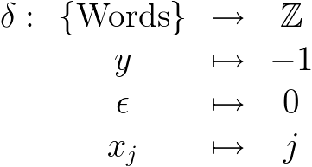
Words
Letters set X = { y, x₁, x₂, …, x_{j}, …}
A word is a sequence of letters
A factorization of word f is a pair of words (g,h) such that f = gh, g is not empty
Weight
Notes:
\begin{array}{cccc}
\delta:&\{\text{Words}\}&\rightarrow&\mathbb{Z}\\
&y&\mapsto&-1\\
&\epsilon&\mapsto&0\\
&x_j&\mapsto&j\\
\end{array}

Slide 48
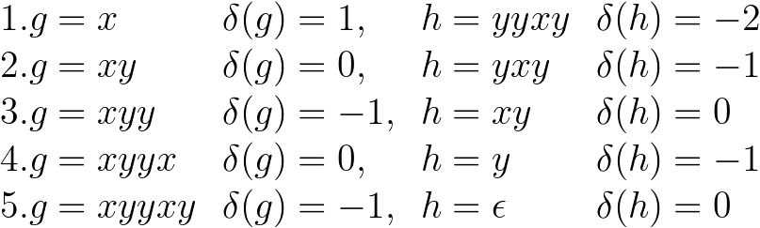
Words: Example
Letters Set X = { y, x }
A word f = xyyxy is of weight – 1 has factorizations:
Notes:
\begin{array}{llll}
1. g=x&\delta(g)=1,&h=yyxy&\delta(h)=-2\\
2. g=xy&\delta(g)=0,&h=yxy&\delta(h)=-1\\
3. g=xyy&\delta(g)=-1,&h=xy&\delta(h)=0\\
4. g=xyyx&\delta(g)=0,&h=y&\delta(h)=-1\\
5. g=xyyxy&\delta(g)=-1,&h=\epsilon&\delta(h)=0
\end{array}

Slide 49
Lukasiewicz Word
A word f is called a Lukasiewicz word if 1) δ( f ) < 0 2) For any nonempty factorization ( g, h ), δ( g ) > δ( f )

Slide 50
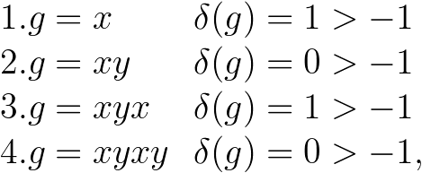
Lukasiewicz Word: Example
1. f = xyyxy is not a Lukasiewicz word since g = xyy has δ( g ) = – 1 δ( f ) = – 1
2. f = xyxyy is a Lukasiewicz word since 1) δ( f ) = – 1 < 0 2) All nonempty factorizations satisfy
Notes:
\begin{array}{llll}
1. g=x&\delta(g)=1>-1\\
2. g=xy&\delta(g)=0>-1\\
3. g=xyx&\delta(g)=1>-1\\
4. g=xyxy&\delta(g)=0>-1,
\end{array}

Slide 51
Cycle Lemma
Theorem 2.2 [Lothaire, 1997] If δ( f ) = – p < 0, Then f has exactly p factorizations ( g, h ) such that ( h, g ) is a Lukasiewicz word.
Notes:
\begin{array}{l}
\text{If } \delta(f)=-p<0,\\
\text{Then } f \text{ has exactly } p \text{ factorization}(g,h)\\
\text{ such that } (h,g) \text{ is a Lukasiewicz word.}
\end{array}

Slide 52
Cycle Lemma: Example
X = { y, x, x₂ } f = x₂yyyxy satisfies δ( f ) = –1 By cycle lemma, there is only 1 Lukasiewicz word ( h, g ) among all factorizations:
yyyxyx₂ : –1 → –2 → –3 → –2 → –3
yyxyx₂y : –1 → –2 → –1 → –2 → 0
yxyx₂yy : –1 → 0 → –1 → 1 → 0
xyx₂yyy : 1 → 0 → 2 → 1 → 0
yx₂yyyx : –1 → 1 → 0 → –1 → –2
x₂yyyxy : 2 → 1 → 0 → –1 → 0

Slide 53
Conjugates
Π_{n,m} := { 0, 1, …, m−1 }^{n}
Given f є Π_{n,m} , its conjugate is a sequence obtained from f by shifted each word by the same amount (mod m).
[Example] ( 0,3,7 ) є Π_{3,10} has 10 conjugates:
( 0,3,7 ), ( 1,4,8 ), ( 2,5,9 ), ( 3,6,0 ), ( 4,7,1 ), ( 5,8,2 ), ( 6,9,3 ), ( 7,0,4 ), ( 8,1,5 ), ( 9,2,6 ).

Slide 54
Conjugates v.s. Parking Functions
Theorem 2.7 [Eu, Fu & Lai, 2010] If m = a + bn, f = (u₁,…,u_{n}) є Π_{n,m} , g := y^{u1} x_{b} y^{u2} x_{b} … x_{b} y^{m−un}, then:
g is a Lukasiewicz word iff f є P_{n}^{(a,b)}
#{ g є P^{(a,b)} : g is a conjugate of f } = a

Slide 55
Conjugates v.s. Parking Functions
[Example] a = 4, b = 2, n = 3, m = 10 f = ( 0,3,7 ) є Π_{3,10} g = x₂yyyx₂yyyyx₂yyy, δ( g ) = −4
By cycle lemma, there are 4 Lucasiewicz words
There are 4 conjugates of f being parking functions.

Slide 56
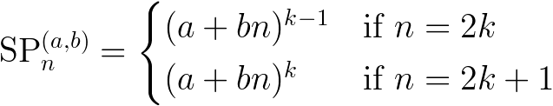
Corollary
Corollary 2.9 #P_{n}^{(a,b)} = a(a+nb)^{n-1}
Corollary 2.10 (Symmetric Restriction) #
Notes:
\text{SP}_n^{(a,b)}=\begin{cases}
(a+bn)^{k-1}&\text{if } n=2k\\
(a+bn)^{k}&\text{if } n=2k+1
\end{cases}

Slide 57
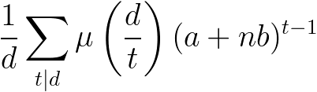
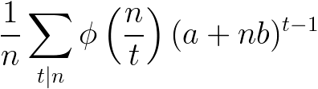
Corollary
Corollary 2.11 (Periodic Restriction) If d|n, let m := n/d, then # { f є P_{n}^{(a,b)} : ^{Cm}f = f } = a(a+nb)^{d-1}
Corollary 2.12 ( Orbits of C_{n} )
#{ Orbits of size d } =
#{ Orbits } =
Notes:
\frac{1}{d}\sum_{t|d}\mu\left( \frac{d}t{} \right)(a+nb)^{t-1}
\frac{1}{n}\sum_{t|n}\phi\left( \frac{n}t{} \right)(a+nb)^{t-1}

Slide 58
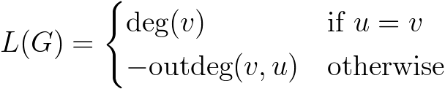
Laplacian Matrix
Given a graph G = ( V, E ), its Laplacian matrix
It’s an interested object in algebraic graph theory:
2nd smallest Laplacian eigenvalue (μ₂) is the bound of connectivity.
If |V| is even, μ_{|V|} ≤ 2μ₂, then G has a perfect matching.
Notes:
L(G)=\begin{cases}
\text{deg}(v)&\text{if }u=v\\
-\text{outdeg}(v,u)&\text{otherwise}
\end{cases}
L(G):\mathbb{Z}^{|V|}\rightarrow\mathbb{Z}^{|V|}

Slide 59


Critical Group
Regard as a linear map its cokernel
K(G) is called the critical group of graph G In general, it is not easy to compute.

Slide 60
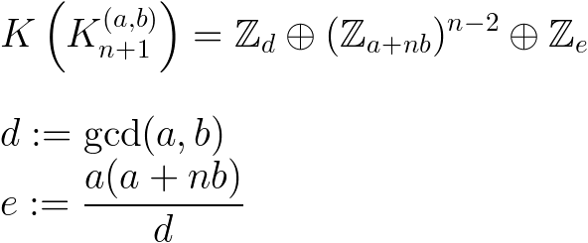
Critical Groups: Results
Theorem 5.1 [Eu, Fu & Lai, 2010]
Notes:
\\
K\left(K_{n+1}^{(a,b)}\right)=\mathbb{Z}_d\oplus(\mathbb{Z}_{a+nb})^{n-2}\oplus\mathbb{Z}_e\\\\
d:=\text{gcd}(a,b)\\
e:=\frac{a(a+nb)}{d}

Slide 61
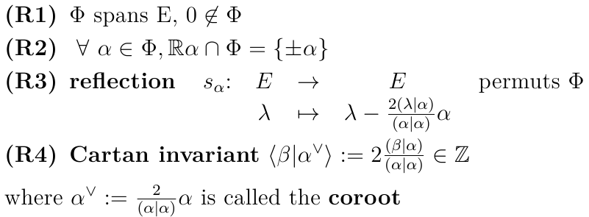
Root System
Given a finite dimensional real vector space E, A root system Φ is a finite subset of E satisfies:

Slide 62
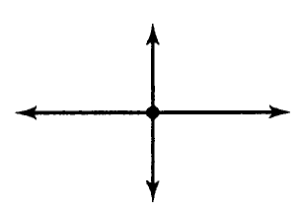
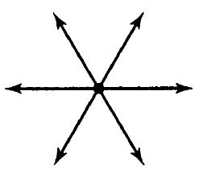
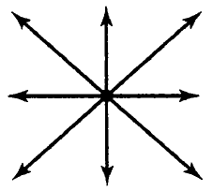

Root System: Example
Root System of some classical Lie algebras Type A1 x A1 Type A2
Type B2 Type G2

Slide 63


Root System: Example
Root System of some classical Lie algebras Type A3 Type B3

Slide 64
Coxeter Arrangement
H_{α,0} := { x є E: ( α, x ) = 0 }
Coxeter Arrangement := { H_{α,0} : α є Φ }
H_{α1,0}
H_{α2,0}
α₂
ρ
α₁
H_{ρ,0}

Slide 65
Affine Coxeter Arrangement
H_{α1,0}
H_{α1,1}
Affine Coxeter Arrangement := { H_{α,k} : α є Φ, k = 0,1,…}
Shi arrangment := { H_{α,k} : α є Φ, k = 0, 1 }
H_{α2,1}
H_{α2,0}
α₂
ρ
α₁
H_{ρ,1}
H_{ρ,0}
65

Slide 66
Shi Arrangement of Type A2

Slide 67
Bijection
123
132
122
113
131
112
231
121
111
213
221
211
212
321
311
312

Slide 68
Combinatorial Invariants
Shi arr. P. Fcns R. Lbl Trees #regions total # total # #dominant # increasing # unlabeled regions PFs Trees distant sum # inversions operator

Slide 69
Bijeciton: Generalization
Theorem [Shi] # regions in Shi arrangement = ( h + 1 )^{r}
h = Coxter number of the root system r = dimension of E
The total # of Shi Arr. Of type Bn, Dn, … correspond to what types of parking function?
Any reasonable bijection?

Slide 70
References
Athanasiadis, Generalized Catalan Numbers, Weyl Groups And Arrangements Of Hyperplanes, Bull. London Math. Soc. 36, 294–302 (2004)
Eu, Fu and Lai, On Enumeration of Parking Functions by Leading Numbers, Advances in Applied Mathematics 35, 392-406, (2005)
Eu, Fu and Lai, Cycle Lemma, Parking Functions and Related Multigraphs, Graphs and Combinatorics 26, 345-360, (2010)

Slide 71
Thank you
賴俊儒 Lai, Chun-Ju
國家理論科學研究中心
cjlai@ntu.edu.tw

