Slide 1

CS50 Web Project 0 Demo

Slide 2
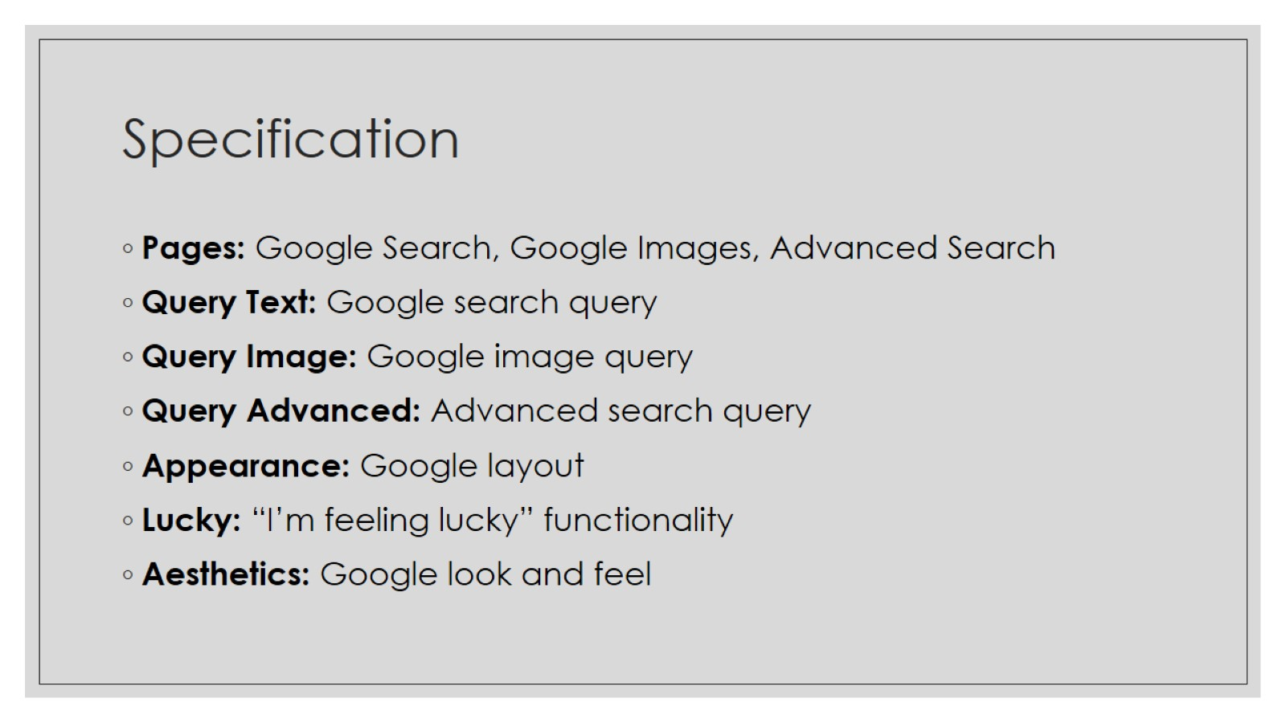
Specification

Slide 3

DEMO

