Slide 2

Inferring Region Types via an Abstract Notion of Environment Transformation
Chuangjie Xu (j.w.w. Ulrich Schöpp)
APLAS’22, 5 Dec 2022, Auckland, New Zealand

Slide 3
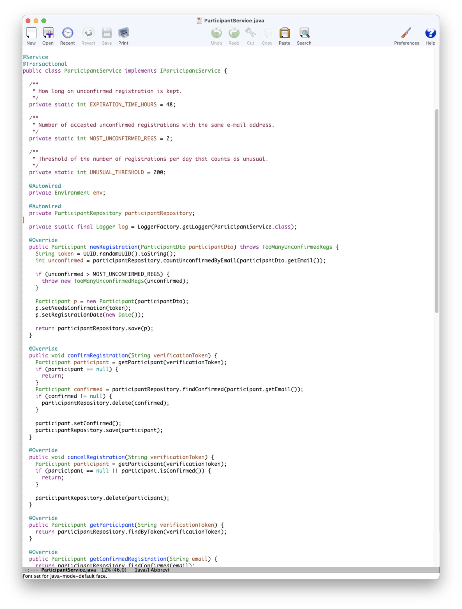
Enforcing Secure Programming Guidelines
  Does my Java program follow secure programming guidelines such as
  “All inputs must be sanitized.”
  “Any access to sensitive data must be authorized.”
  “Any access to sensitive data must be logged.”
  …
  Can guidelines be verified continuously and incrementally?
  A lightweight tool for this can help programmers to avoid making typical errors during the development.

Slide 4
GuideForce¹
GuideForce develops effect type systems for lightweight static analysis.
  Trace properties of programs
    Functions of interests emit events, e.g.:
    Server.login() emits a login event; Connection.close() emits a close event
    Each execution of a program generates a (finite or infinite) trace of events.
    A guideline = a set of allowed event traces
  The type system has effect annotations to give information about the possible traces.
  E.g., login() ? readData() : close(); : type & {login read, login close}
  Type inference $⇒$ effect computation
  If “effect $⊆$ guideline”, then ✅ the program adheres to the guideline.
¹ DFG project number 250888164

Slide 5
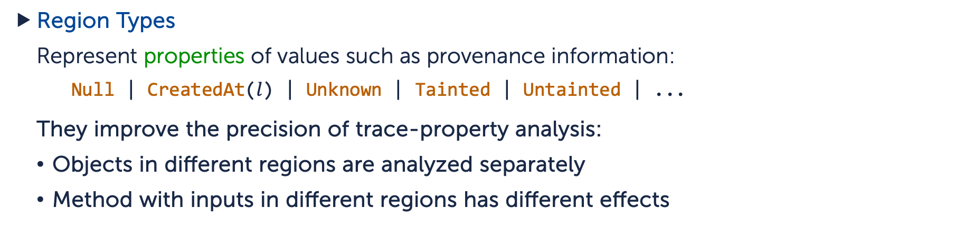
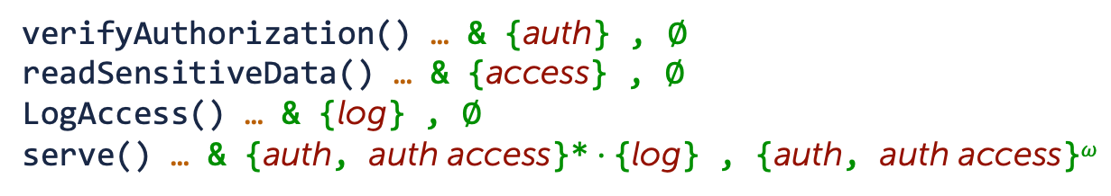
Key Concepts
Effect Annotations
  Capture information of terminating and nonterminating runs modularly in the type system.
verifyAuthorization() … & {auth} , ∅
readSensitiveData() … & {access} , ∅
LogAccess() … & {log} , ∅
serve() … & {auth, auth access}*$⋅${log} , {auth, auth access}^{𝜔}
Region Types
  Represent properties of values such as provenance information:
  Null | CreatedAt($l$) | Unknown | Tainted | Untainted | ...
  They improve the precision of trace-property analysis:
  Objects in different regions are analyzed separately
  Method with inputs in different regions has different effects

Slide 6
Type Inference in the Previous Work
Redundant analysis
...
object1.foo(input1);
...
object1.foo(input2);
...
object2.foo(input3);
...
void foo(C d) {
...
...
...
}
  In [GHL12, BGH13, EHZ17, ESX21], the code of the method foo is analyzed multiple times, one for each invocation if the objects and inputs are in different regions.
Goal: A type inference algorithm that analyzes the code only once.

Slide 7
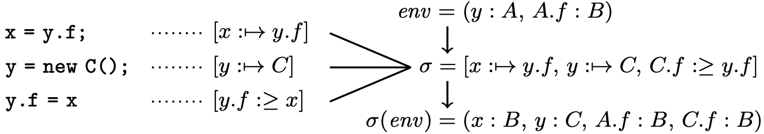
Idea of Our New Type Inference Algorithm
Generate a summary to each method – abstract environment transformation
  Equality constraint $x :↦y.f$ for variable assignment $x=y.f$
  Subtyping constraints $y.f :≥x$ for field assignment $y.f=x$ (weak update for fields)
  Composition and join – constraint generation
  Instantiation $env↦σ(env)$ – constraint solving
  Get the return type of the method from the updated environment $σ(env)$

Slide 8
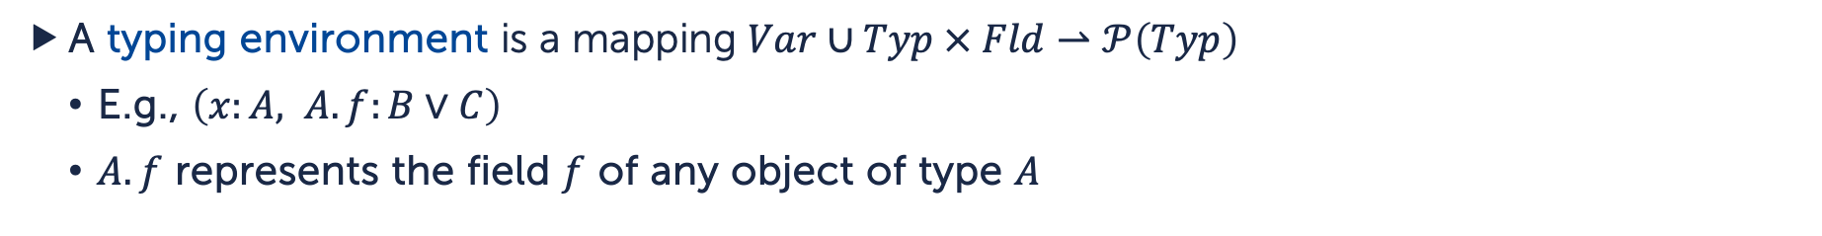
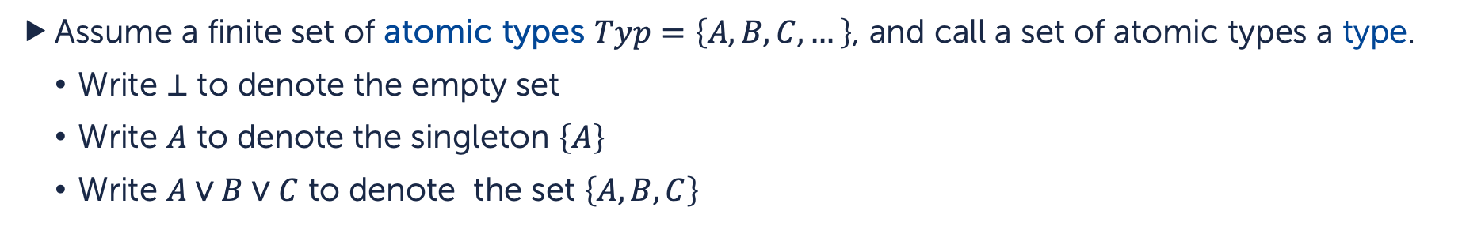
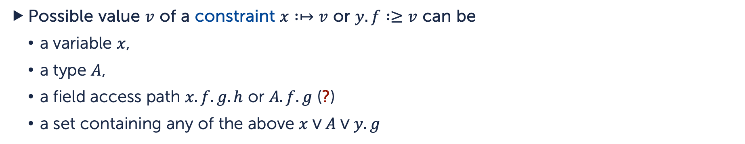
Types, Environments and Constraints
Assume a finite set of atomic types $Typ=\left\{A,B,C,…\right\}$, and call a set of atomic types a type.
  Write $⊥$ to denote the empty set
  Write $A$ to denote the singleton $\left\{A\right\}$
  Write $A∨B∨C$ to denote the set $\left\{A, B, C\right\}$
A typing environment is a mapping $Var∪Typ × Fld⇀𝒫\left(Typ\right)$
  E.g., $\left(x:A, A.f:B∨C\right)$
  $A.f$ represents the field $f$ of any object of type $A$
Possible value $v$ of a constraint $x :↦v$ or $y.f :≥v$ can be
  a variable $x$,
  a type $A$,
  a field access path $x.f.g.h$ or $A.f.g$ (?)
  a set containing any of the above $x∨A∨y.g$

Slide 9
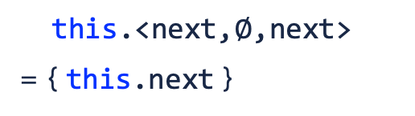
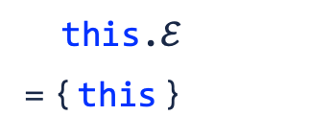
Access Graphs
The lengths of access paths may be unbounded. Consider
The return type can be the same of this, this.next, this.next.next, …
Node last() {
if (next == null) {return this;}
else {return next.last();}
}
Use finite representation of access paths, such as access graphs:
E.g.,
this
this
next
this
next
this.$ℰ$
= { this }
this.<next,$∅$,next>
= { this.next }
this.<next,{(next,next)},next>
= { this.next.next,
this.next.next.next,, … }

Slide 10
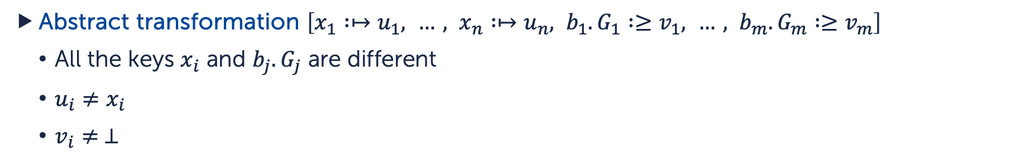
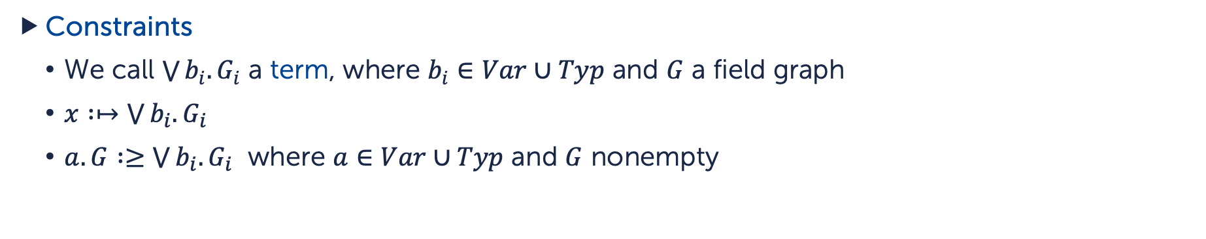
Abstract Environment Transformations
Constraints
  We call $\bigvee{b_{i}.G_{i}}$ a term, where $b_{i}∈Var∪Typ$ and $G$ a field graph
  $x :↦\bigvee{b_{i}.G_{i}}$
  $a.G :≥\bigvee{b_{i}.G_{i}}$ where $a∈Var∪Typ$ and $G$ nonempty
Abstract transformation $\left[x_{1} :↦u_{1}, …, x_{n} :↦u_{n}, b_{1}.G_{1} :≥v_{1}, …, b_{m}.G_{m} :≥v_{m}\right]$
  All the keys $x_{i}$ and $b_{j}.G_{j}$ are different
  $u_{i}≠x_{i}$
  $v_{i}≠ ⊥$
Example:
for the code

Slide 11
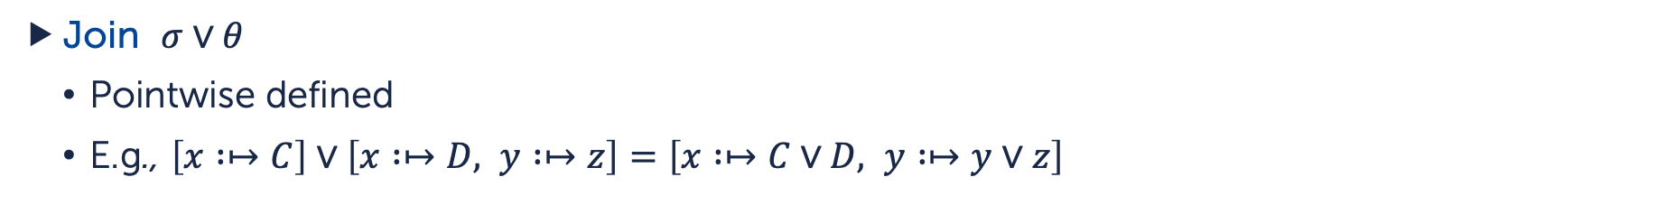
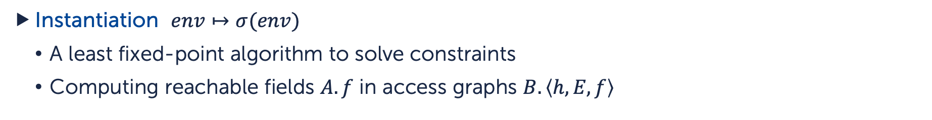
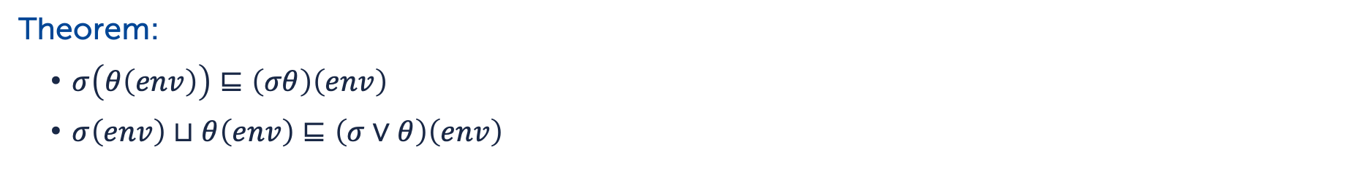
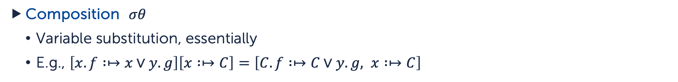
Operations on Abstract Transformations
Instantiation $env↦σ(env)$
  A least fixed-point algorithm to solve constraints
  Computing reachable fields $A.f$ in access graphs $B.\left\langle h,E,f\right\rangle$
Composition $σθ$
  Variable substitution, essentially
  E.g., $\left[x.f :↦x∨y.g\right]\left[x :↦C\right]=\left[C.f :↦C∨y.g, x :↦C\right]$
Join $σ∨θ$
  Pointwise defined
  E.g., $\left[x :↦C\right]∨\left[x :↦D, y :↦z\right]=\left[x :↦C∨D, y :↦y∨z\right]$
Theorem:
  $σ\left(θ\left(env\right)\right)⊑\left(σθ\right)\left(env\right)$
  $σ\left(env\right)⊔θ\left(env\right)⊑\left(σ∨θ\right)\left(env\right)$

Slide 12
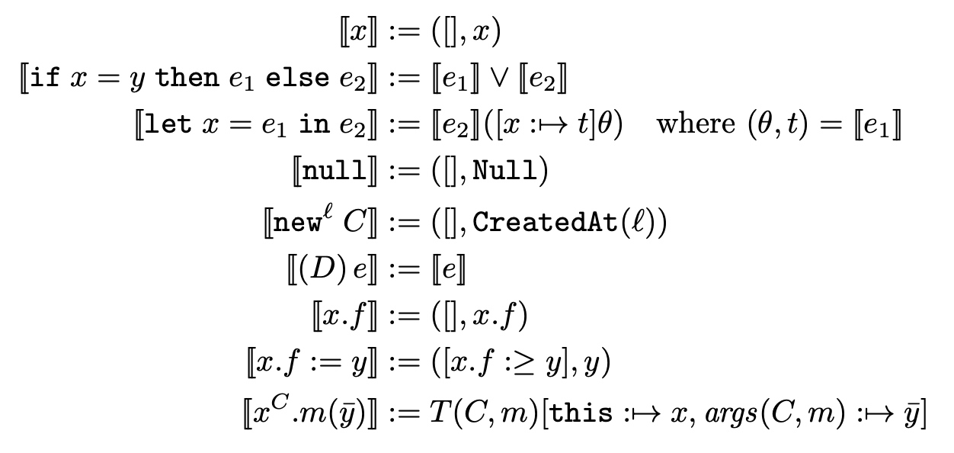
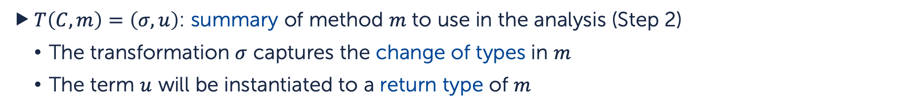
Type Inference via Abstract Transformations
We work with some region type system on Featherweight Java and
choose $Typ$ to be the set of regions.
Step 1: Compute an abstract method table $T:Cls × Mtd⇀ATrans × Tm$
$T\left(C,m\right)=\left(σ,u\right)$: summary of method $m$ to use in the analysis (Step 2)
  The transformation $σ$ captures the change of types in $m$
  The term $u$ will be instantiated to a return type of $m$
$T$ is compute via a fixed-point algorithm using $⟦e⟧:ATrans × Tm$
…

Slide 13
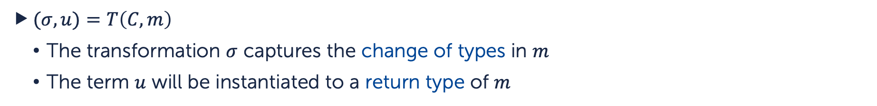
Type Inference via Abstract Transformations
Step 2: Use $T$ to compute the method and field typing of the program
For example, we compute the type of a method $m$ of class $C$ as follows:
Suppose the object where $m$ lives is in region $r$ and
the inputs of $m$ are in regions $s_{1},…,s_{n}$
$(σ,u)=T\left(C,m\right)$
  The transformation $σ$ captures the change of types in $m$
  The term $u$ will be instantiated to a return type of $m$
Update the environment $env=σ\left(this:r, x_{1}:s_{1}, …, x_{n}:s_{n}, …\right)$
where $x_{1},…,x_{n}$ are the arguments of m
Instantiate $u\left[env\right]$ to get the return type of $m$

Slide 14
Conclusion and Discussion
We introduce a theory of abstract environment transformations to summarize how types are changed in a program
We introduce an inference algorithm to compute region information of (Featherweight) Java programs which can avoid redundant code analysis.
The inference algorithm can be extended to a more efficient region-sensitive analysis of trace properties.
Thank you!

Slide 15


Example
Guideline 1: Any access to sensitive data occurs after authorization.
Server.java
16
17
18
19
20
21
22
23
24
25
26
void serve() {
while (hasQuery()) {
boolean authorized = verifyAuthorization();
if (authorized) {
readSensitiveData();
}
}
LogAccess();
}
// emits auth
// emits access
// emits log
(this:EntryPoint, authorized:Base) & ${\left\{auth, auth access\right\}}^{∗}⋅\left\{auth\right\}$
(this:EntryPoint, authorized:Base) & ${\left\{auth, auth access\right\}}^{∗}$
－ ✅ Analysis Results
This method adheres to the given guideline.
Terminating effect: ${\left\{auth, auth access\right\}}^{∗}⋅\left\{log\right\}$
Nonterminating effect: ${\left\{auth, auth access\right\}}^{ω}$
－ ✅ serve

Slide 16


Example
Guideline 2: Any access to sensitive data must be logged.
Server.java
16
17
18
19
20
21
22
23
24
25
26
void serve() {
while (hasQuery()) {
boolean authorized = verifyAuthorization();
if (authorized) {
readSensitiveData();
}
}
LogAccess();
}
// emits auth
// emits access
// emits log
Generated trace: ${\left(auth access\right)}^{ω}$
－ ❌ Analysis Results
This method may not satisfy the given guideline.
Terminating effect: ${\left\{auth, auth access\right\}}^{∗}⋅\left\{log\right\}$
Nonterminating effect: ${\left\{auth, auth access\right\}}^{ω}$
－ ❌ serve

