Slide 1
Introduction to Design Patterns & Adapter Pattern
Gergely Szilágyi

Slide 2
Agenda
Introduction to Design Patterns
Adapter Pattern
Real life example
Applicability
Intent
Class Diagram of the class and object Adapter
Code examples

Slide 3
What Design Patterns are?
General and reusable solutions to common problems in software design.
Defines how specific classes are relates to each other.
Each patterns has a name.
Template for solving certain problems.
Patterns are not complete.
Patterns deal with problems that have already been solved.
Patterns are not concerned with algorihms.

Slide 4
Why design patterns matter?
Gives our profession a shared language
Helps avoid re-inventing constantly
Provide a starting point for a solution
It can speed production in a team
Generally improves system and application design.
Better separation
Clear responsibility of each classes

Slide 5
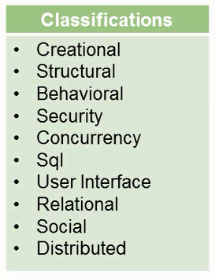
Classifications
Design Patterns: Elements of Reusable Object-Oriented Software (1994)
Initialy it contained only 3 types of patterns.
Growing library
There are patterns for
Object oriented design
Functional programming
Parallel programming.

Slide 6
Creational Patterns
How to instentiate object at runtime, the circumstances how to do that is differs, based on what kind of problems do we want to solve.
Creational Patterns:
Abstract Factory
Builder
Factory Method
Prototype
Singleton
Lazy Instantiation
Utility Pattern

Slide 7
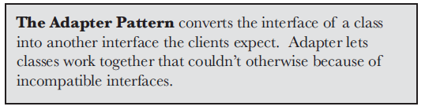
Adapter Pattern

Slide 8
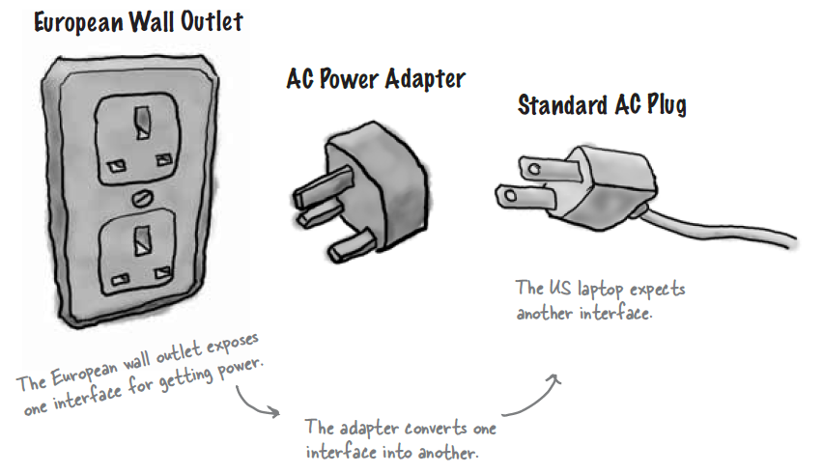
Adapter in real word

Slide 9
Adapter Pattern
Use the adapter pattern when:
A class that would be useful to your application does not implement the interface you require.
you want to create a reusable class that cooperates with unrelated or unforeseen classes, that is, classes that don't necessarily have compatible interfaces.
Adapters are also commonly known as Wrappers.
It is a Structural pattern - ease the design by identifying a simple way to realize relationships between entities.
There are two types of adapters
Object adapters
Class adapters (it requires multiple inheritance)

Slide 10
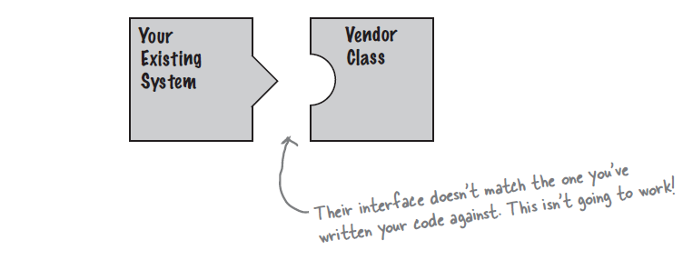
OO adapters

Slide 11
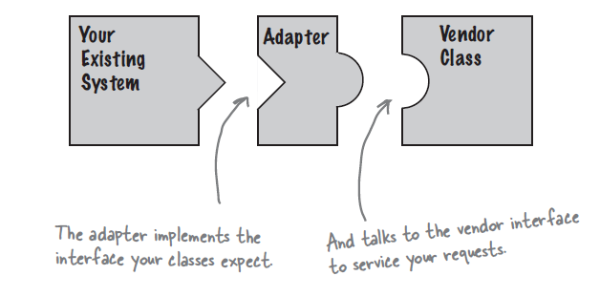
OO adapters
Adapter:
Provides the interface what the client expects
Implements the interface what the component requires

Slide 12
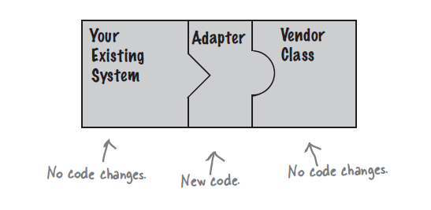
OO adapters

Slide 13
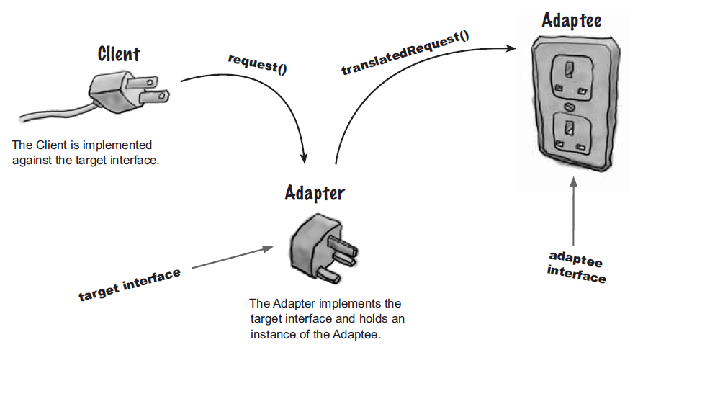

Slide 14
Adapter Example
https://github.com/esziger/design_patterns/tree/master/Adapter_Examples/Adapter_plug

Slide 15
Intent
Convert the interface of a class into another interface client expects.
Allow classes to work together that couldn’t otherwise due to incompatible interfaces.
Future-proof client implementations by having them depend on Adapter interface, rather than concrete classes directly.

Slide 16
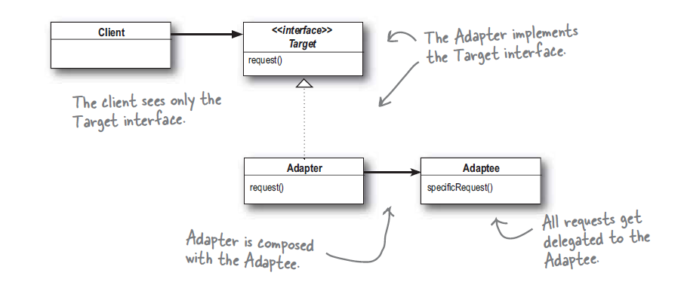
Object Adapter Class Diagram
Notes:
Client wants to use the Adaptee, since there is a specificRequest() which the Client wants to use.
Unfortunatelly the client has been written in such a way, that it can not directly call the specificRequest(), because its interface is not the one that client expects.
Client wants to use the Adaptee directly, but can’t due to incompatible interface.
Clints expects to use the request()
The Target interface defines the domain specific interface that the Client used, so the client collaborates with objects that implement the Target interface. On the other side of things, the Adaptee is the existing interface that needs adapting in order for our client to interact with it. The Adapter adapts the Adaptee to the Target interface - in other words, it translates the request from the client to the adaptee.

Slide 17
How it gets Used
Clients depend on the Adapter interface, rather than a particular implementation.
At least one concrete Adapter class is created to allow the client to work with a particular class that it requires.
Future client needs for alternate implementations can be satisfied through the creation of additional concrete Adapter classes.
Effective way to achive Open/Closed Principle

Slide 18
Example II.
Drawing editor application
The interface for graphical objects is defined as an abstract class Shape.
Subclass of shapes: LineShape, PolygonShape etc...
LineShape and PolygonShape implementation is easy, but TextShape subclass that can display and edit text is little bit more difficult.
We would like to use an off-the-shelf user interface toolkit(called Textview).
Ideally we would like to reuse TextView to implement TextShape, but the toolkit interface is different. So we cant use TextView and Shape objects interchangeably.
TextView source code is not available, so we can not change its interface.

Slide 19
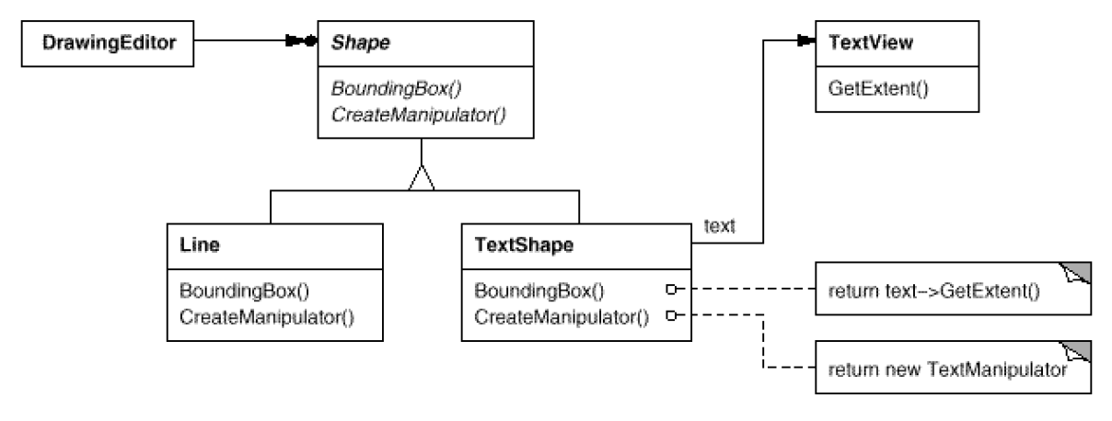
Example II.
Notes:
Solution: is to define TextShape so that it adapts the TextView interface to Shapes interface.
Composing a TextView instance within a TextShape and implementing TextShape in terms of TextViews interface.
Often the adapter is responsible for functionality the adapted class doesn't
provide.
The diagram shows how an adapter can fulfill such responsibilities.
The user should be able to "drag" every Shape object to a new location interactively,
but TextView isn't designed to do that. TextShape can add this missing
functionality by implementing Shape's CreateManipulator operation, which returns
an instance of the appropriate Manipulator subclass.
Manipulator is an abstract class for objects that know how to animate a Shape
in response to user input, like dragging the shape to a new location.

Slide 20
Example II
https://github.com/esziger/design_patterns/tree/master/Adapter_Examples/Adapter_shape/src

Slide 21
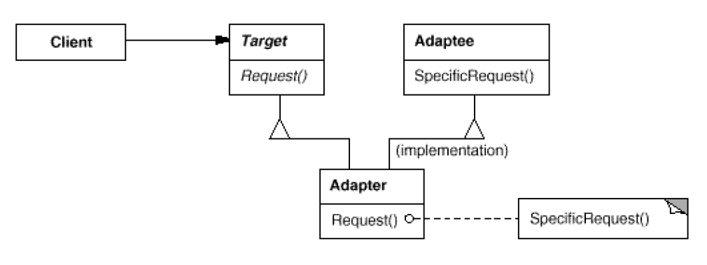
Class Adapter Class Diagram
Notes:
Implementing class adapters in C++. In a C++ implementation of a class
adapter, Adapter would inherit publicly from Target and privately from
Adaptee. Thus Adapter would be a subtype of Target but not of Adaptee.

Slide 22
Object Adapter vs. Class Adapter
Class Adapter:
adapts Adaptee to Target by committing to a concrete Adapter class. As a consequence, a class adapter won't work when we want to adapt a class and all its subclasses.
lets Adapter override some of Adaptee's behavior, since Adapter is a subclass of Adaptee.
introduces only one object, and no additional pointer indirection is needed to get to the adaptee.
Object Adapter:
lets a single Adapter work with many Adaptees—that is, the Adaptee itself and all of its subclasses (if any). The Adapter can also add functionality to all Adaptees at once.
makes it harder to override Adaptee behavior. It will require subclassing Adaptee and making Adapter refer to the subclass rather than the Adaptee itself.

Slide 23
Related Pattern
Bridge - has a structure similar to an object adapter, but Bridge has a different intent: It is meant to separate an interface from its implementation so that they can be varied easily and independently. An adapter is meant to change the interface of an existing object.
Notes:
Facade - Provide a unified interface to a set of interfaces in a subsystem. Facade defines a higher-level interface that makes the subsystem easier to use.

Slide 24
Adapter in our Application
HW: Check our application, are we using the Adapter pattern?

Slide 25
References
Design Patterns: Elements of Reusable Object-Oriented Software (1994)
Head First Design Patterns
https://dzone.com/articles/design-patterns-uncovered-0

Slide 26
Q&A

