Slide 1
Storyboards – C5 Group
Bargain Hunt
Anas Sabbah

Slide 2
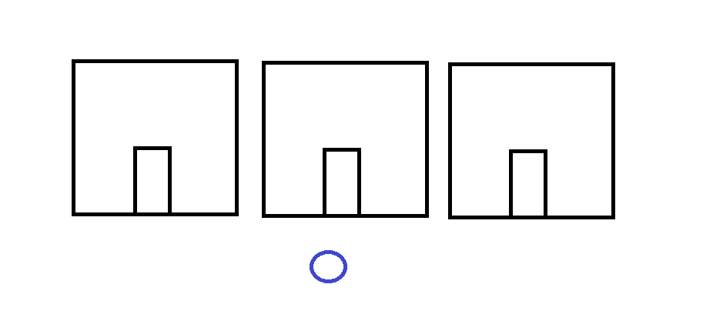
The first screen presented is the main screen of our program
This screen contains the user controlled character and 3 separate houses which the character can enter

Slide 3
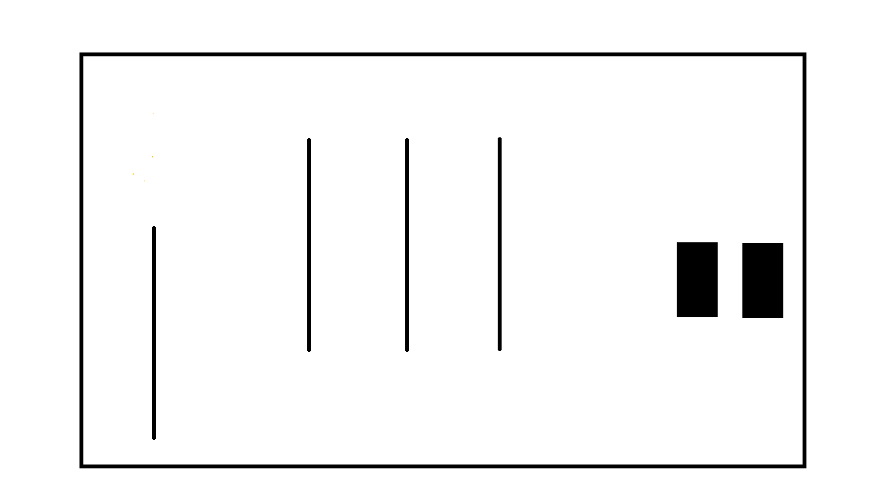
Each time a house is entered it leads to a different screen which portrays the inside of the house

Slide 4

Each house contains a Shopkeeper
Each house also contains different products which are shown in a list during shopkeeper dialogue
Shopkeepers have pre-set responses to different user-inputted commands
Shopkeepers are able to categorize bargain products based on price

Slide 5
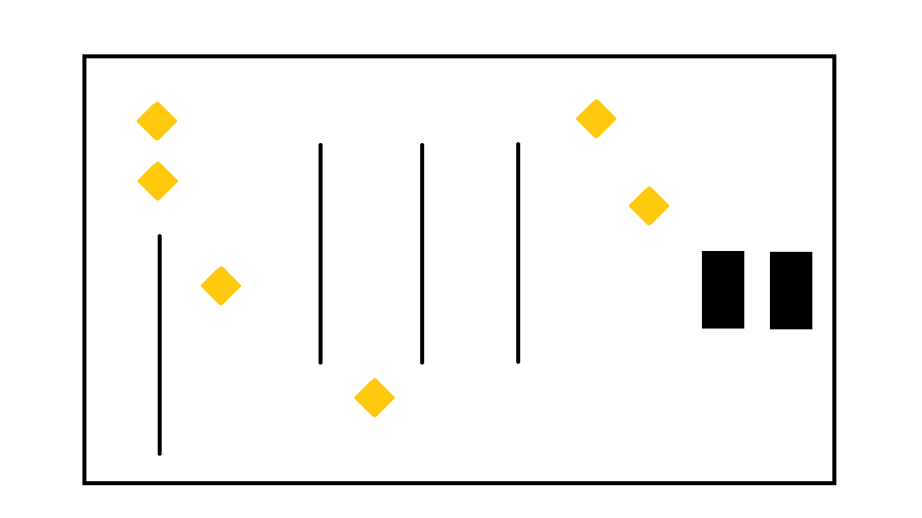
Depending on user-inputted commands, the items will be physically presented and the shopkeeper will then be able to pickup their specified items depending on time searched
*I will add the search function to the shopkeeper, so depending on which option is selected he will pick up a certain amount of items without user input (AI controlled)

Slide 6
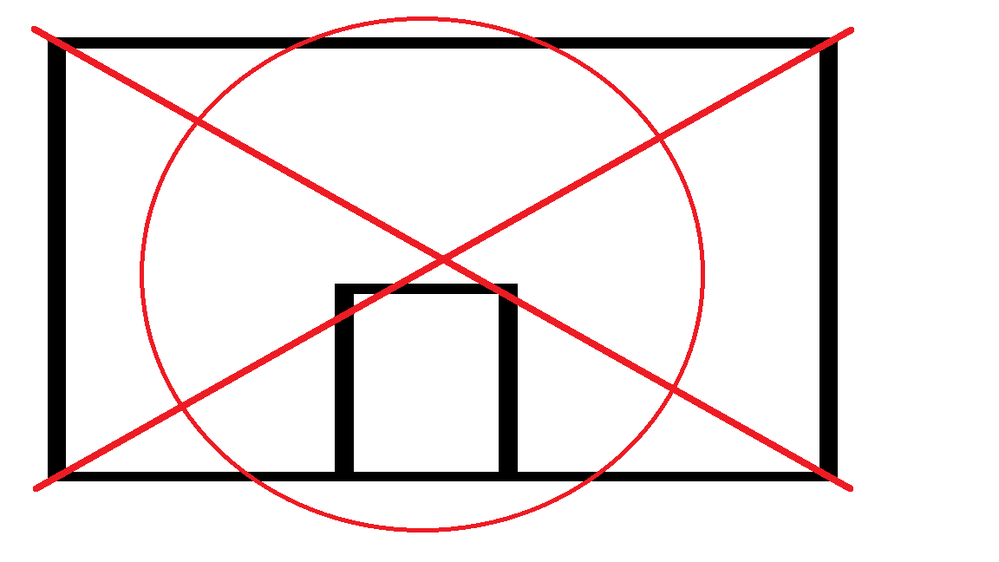
Once the shopkeeper has collected their item(s), the shopkeeper then despawns and the shop is then closed (each shopkeeper is 1-time only use)
Items collected are stored in a hidden inventory
This can be repeated for each house until all the items are collected

Slide 7
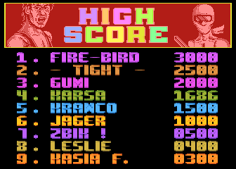
Once the player has collected items from each shop, a final score is generated at the end and displayed on the screen signalling the end of the game

