Slide 1
NERVOUS SYSTEM
APII
CJJ Sakala

Slide 2
“The right half of the brain controls the left half of the body. This means that only left handed people are in their right mind.”

Slide 3
Introduction
The nervous system is the body’s “command centre.” It controls everything you do - from thinking and feeling to breathing, moving, and digesting. It helps the body respond to changes inside and outside — keeping you safe, balanced, and alive! (Ross & Wilson, 2014; Waugh & Grant, 2018).

Slide 4
Learning Objectives:
By the end of this section, you will be able to:
Identify the main structures of the central and peripheral nervous systems.
Describe the functions of the autonomic nervous system (sympathetic and parasympathetic).
Explain how a nerve impulse is transmitted and how a synapse works.
Describe the components and purpose of a reflex arc.

Slide 5
Structure and function of the Central Nervous System (CNS)
The Central Nervous System is the body's ultimate control centre. It integrates and processes all information sent from around the body. It has two main parts:
The Brain
The Spinal Cord

Slide 6
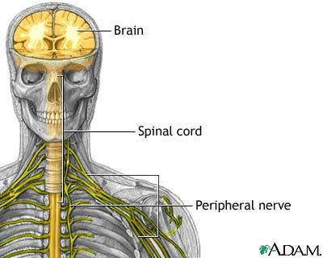

Slide 7
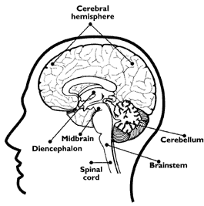
1. The Brain

Slide 8
1. The Brain
i. Cerebrum: The largest part. It's divided into two hemispheres and 4 lobes and is responsible for higher functions like thought, memory, reasoning, sensation, and voluntary movement. Its surface is the cerebral cortex, made of grey matter (Waugh & Grant, 2018).

Slide 9
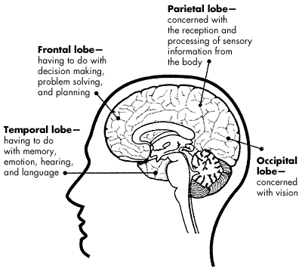
Cerebrum

Slide 10
The Brain
ii. Cerebellum: Located at the back, below the cerebrum. It's crucial for coordinating movement, balance, posture, and muscle tone (ensuring movements are smooth and precise) (Ross & Wilson, 2014).

Slide 11
The Brain
ii. Cerebellum
Muscle coordination is developed here as well as the memory of physical skills.
If the cerebellum is injured, your movements become jerky.
When you see an amazing athlete perform, you are watching a well-trained cerebellum at work.

Slide 12
The Brain
iii. Brainstem (Midbrain, Pons, Medulla Oblongata): Connects the brain to the spinal cord. It controls automatic, vital functions essential for life, such as:
Medulla: Heart rate, blood pressure, and breathing.
Pons: Assists with breathing control and sleep cycles.
Midbrain: Involved in vision, hearing, and motor control (Drake, Vogl, & Mitchell, 2019).

Slide 13
2. The Spinal Cord
A long, tubular bundle of nerve tissue that runs from the medulla oblongata down the vertebral column (spine).
Its two primary jobs are:
Conduction: It acts as a superhighway, carrying sensory (afferent) nerve impulses toward the brain and motor (efferent) impulses away from the brain to the body.
Reflex Integration: It is a minor processing centre for reflex actions

Slide 14
Protection of the CNS
The brain and spinal cord are very delicate and are protected by:
Bone: The skull and vertebral column.
Meninges: Three protective membranes (dura mater, arachnoid mater, pia mater) that surround the CNS.
Cerebrospinal Fluid (CSF): A clear, cushioning fluid that circulates around the brain and spinal cord, providing shock absorption and nutrients (Waugh & Grant, 2018).

Slide 15
Peripheral Nervous System (PNS)
The PNS consists of all the nerves that lie outside the CNS. It connects the CNS to the limbs, organs, and skin. Its job is to carry information to and from the CNS. The PNS is divided based on function:
Sensory (Afferent) Division: Carries signals toward the CNS from sensory receptors in the skin, muscles, and organs (e.g., "This surface is hot!" or "My stomach hurts.").

Slide 16
Peripheral Nervous System (PNS)
Motor (Efferent) Division: Carries signals away from the CNS to muscles and glands, telling them what to do (e.g., "Contract this muscle!" or "Secrete this hormone!").

Slide 17
Peripheral Nervous System (PNS)
The motor division is further split into:
Somatic Nervous System: Controls voluntary movements of skeletal muscles.
Autonomic Nervous System(ANS):
Controls involuntary actions of glands, cardiac muscle, and smooth muscle (e.g., in the gut).

Slide 18
Autonomic Nervous System (ANS)
The ANS is the part of the nervous system that works automatically to maintain internal stability (homeostasis). It primarily controls visceral functions.
It has two main subdivisions that typically have opposite effects on the same organs:

Slide 19
Feature | Sympathetic Nervous System ("Fight-or-Flight") | Parasympathetic Nervous System ("Rest-and-Digest")
Function | Prepares the body for stress, excitement, or emergency. Uses energy. | Conserves and restores energy during relaxed states.
Heart | Increases heart rate and force | Decreases heart rate
Lungs | Dilates airways (bronchodilation) | Constricts airways
Digestion | Decreases digestive activity | Increases digestive activity
Pupils | Dilates pupils | Constricts pupils
Overall Goal | Maximize blood flow to muscles and brain for quick action. | Promote digestion, elimination, and energy storage.
Notes:
Think of it like a car: the sympathetic system is the accelerator, and the parasympathetic is the brake. Both are essential for smooth driving (Waugh & Grant, 2018; Ross & Wilson, 2014).

Slide 20
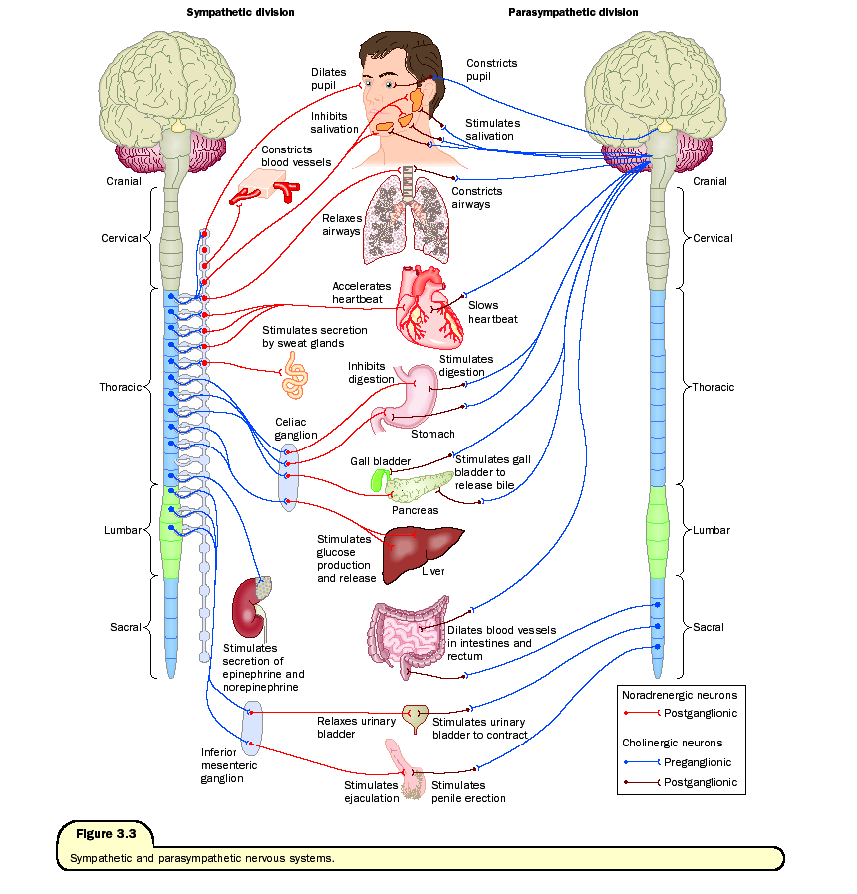

Slide 21
Reception and Transmission of Stimuli
This process involves neurons (nerve cells) sending electrical signals called nerve impulses.

Slide 22
Key Parts of a Neuron
Dendrites: Receive signals from other cells.
Cell Body: Processes the signals.
Axon: Sends the signal along to the next cell.
Myelin Sheath: A fatty covering that insulates the axon and speeds up signal transmission (Marieb & Hoehn, 2012).

Slide 23
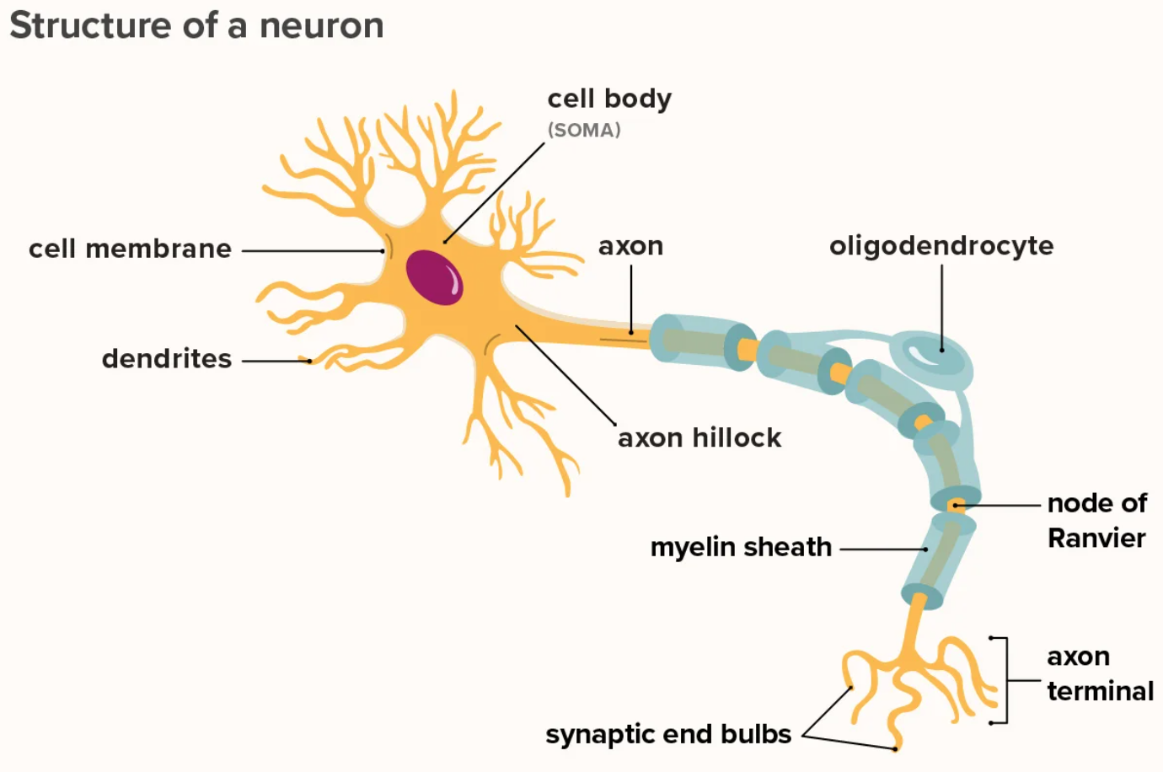

Slide 24
Structure of a Neuron

Slide 25
Transmission across a synapse
A synapse is the tiny gap between the end of one neuron (presynaptic neuron) and the next cell (postsynaptic neuron).

Slide 26
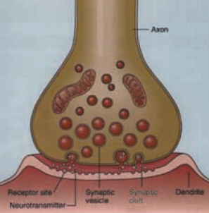

Slide 27
Transmission across a synapse
The electrical impulse (action potential) travels down the axon to the synaptic knob.
This triggers the release of chemical messengers called neurotransmitters (e.g., acetylcholine, dopamine) into the synaptic cleft.

Slide 28
Transmission across a synapse
The neurotransmitters diffuse across the gap and bind to receptors on the next neuron.
This binding can either excite the next neuron (making it more likely to fire) or inhibit it (making it less likely to fire) (Ross & Wilson, 2014).
The neurotransmitters are then broken down or reabsorbed to end the signal.

Slide 29
Transmission across a synapse
Clinical Connection: Many medications work by affecting synapses. For example, SSRIs (a type of antidepressant) work by preventing the reabsorption of serotonin, leaving more of it in the synapse to improve mood.

Slide 30
Reflex Action
A reflex is a rapid, automatic, involuntary response to a stimulus. It is designed to protect the body from harm. It does not require conscious thought from the brain (though the brain is often informed after the action happens).

Slide 31
Reflex Arc
The pathway a reflex follows is called a Reflex Arc. A simple somatic reflex arc (e.g., knee-jerk reflex) has 5 essential components:
Receptor: (e.g., in the tendon) detects the stretch.
Sensory Neuron: Carries the signal to the spinal cord.
Integration Centre: In the spinal cord (may involve an interneuron).
Motor Neuron: Carries the command away from the spinal cord.
Effector: The muscle that carries out the response (e.g., quadriceps muscle contracts, kicking the leg forward).

Slide 32
Why is this important for nurses?
Testing reflexes (like the patellar reflex) is a key part of a neurological assessment. It helps check the integrity of the nervous system at specific spinal levels. Absent or exaggerated reflexes can indicate neurological damage (Drake, Vogl, & Mitchell, 2019; Waugh & Grant, 2018).

Slide 33
Summary & Key Takeaways
The CNS (brain & spinal cord) is the command centre.
The PNS (nerves) is the communication network linking the body to the CNS.
The Autonomic NS runs automatic body functions and has two balancing parts: Sympathetic (action) and Parasympathetic (rest).

Slide 34
Summary & Key Takeaways
Neurons talk to each other using electrical impulses and chemical neurotransmitters across synapses.
Reflexes are fast, protective automatic responses that involve a reflex arc, often bypassing the brain for speed.

Slide 35
Study Tip:
Draw the reflex arc and label the 5 components. Create a table to compare the Sympathetic and Parasympathetic systems.
This active recall will help solidify your understanding!

Slide 36
References
Drake, R., Vogl, A.W., & Mitchell, A.W.M. (2019). Gray’s Anatomy for Students.
Marieb, E.N. & Hoehn, K. (2012). Human Anatomy and Physiology.
Ross & Wilson (2014). Anatomy and Physiology in Health and Illness.
Waugh, A. and Grant, A. (2018). Ross & Wilson Anatomy & Physiology in Health and Illness.

