Slide 1

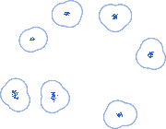
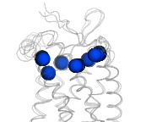
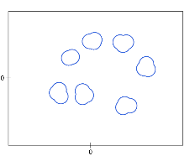
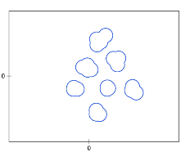


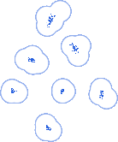
Upper region
6
5
y position
7
4
Helix ends
1
2
3
x position
Projection
5
Plane of membrane
6
3
ATOLL
y position
7
4
Lower region
1
2
Transmembrane protein structure
x position

