Slide 1

Notes:
PantaScope video storyboard

Slide 2
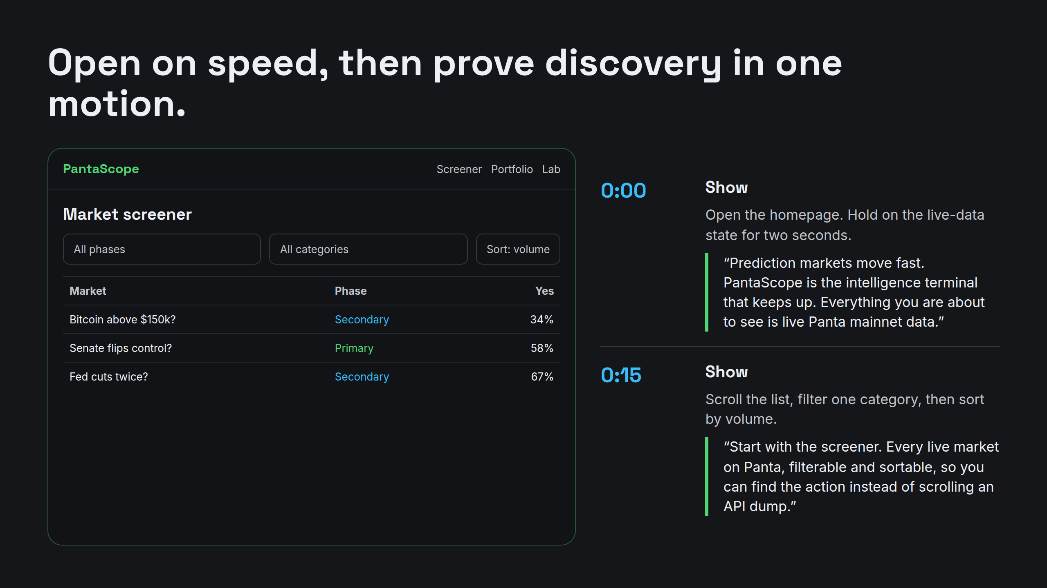
Notes:
Open on speed, then prove discovery in one motion.

Slide 3
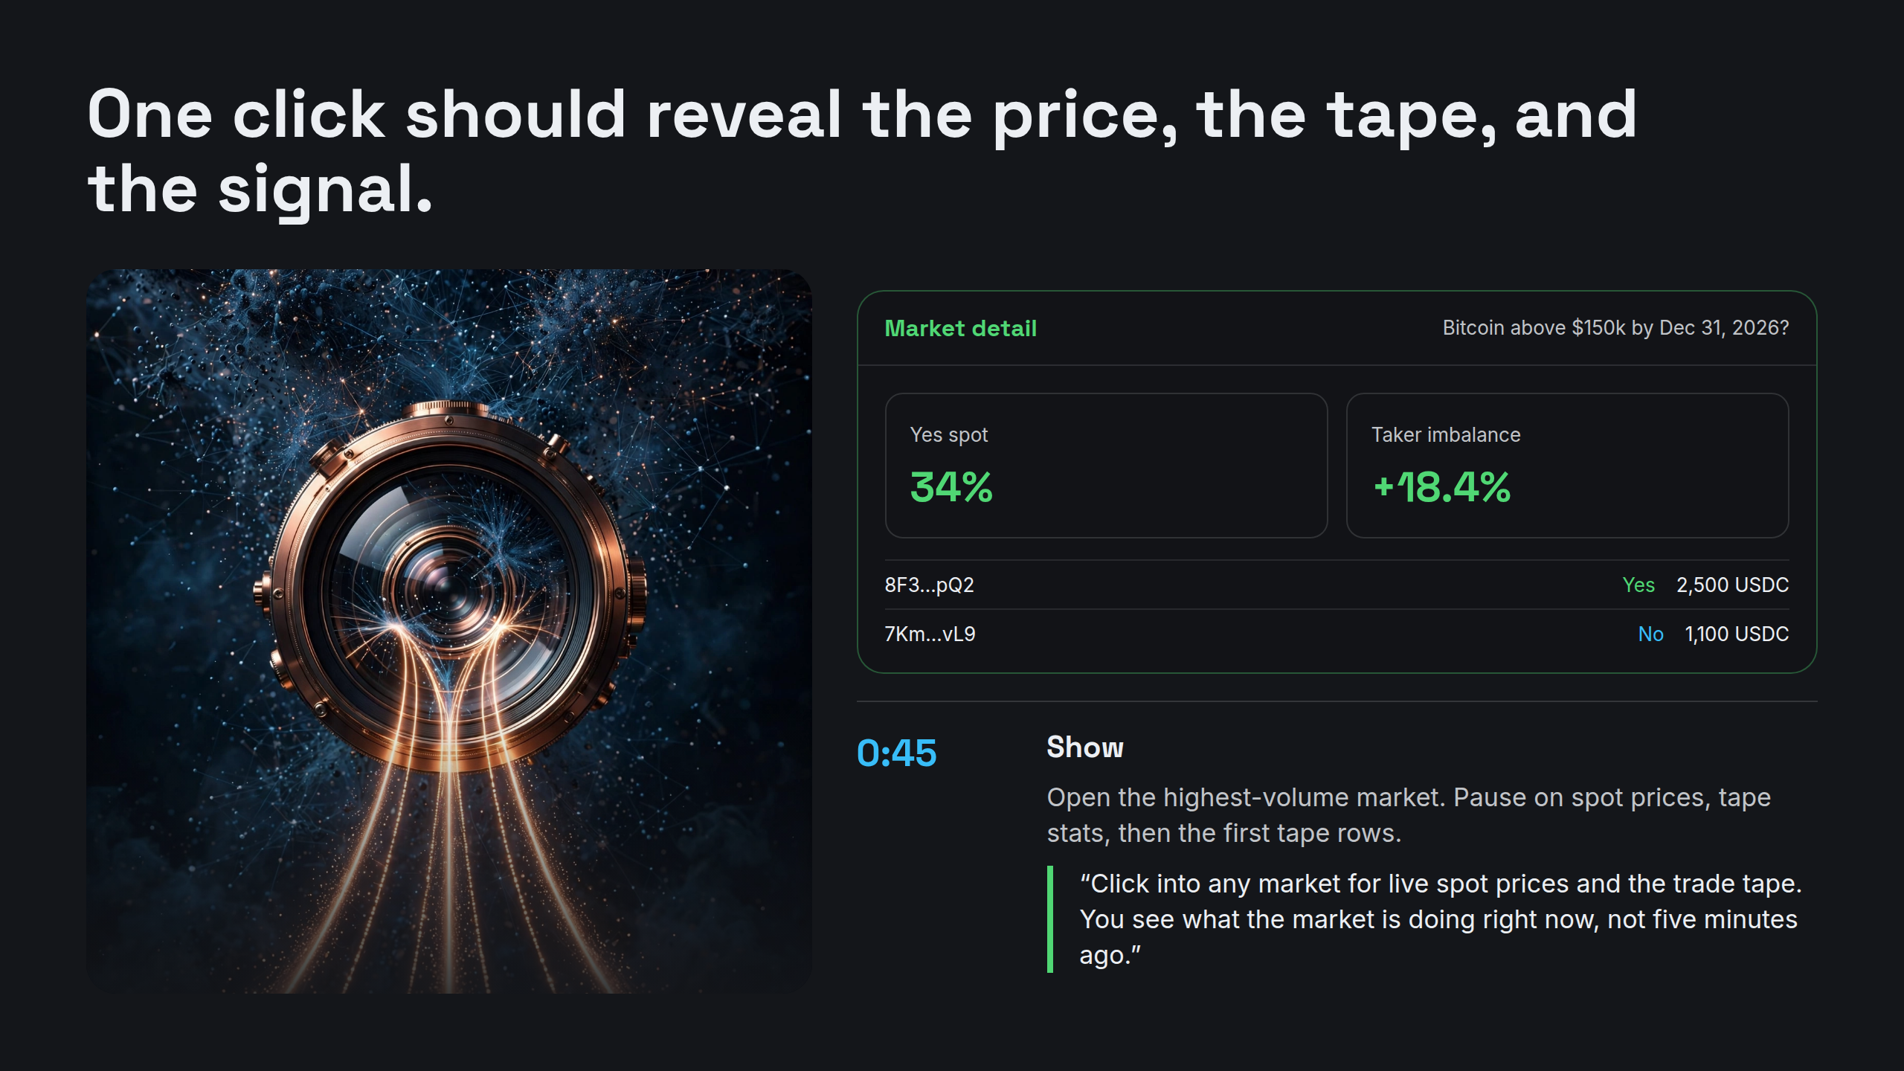
Notes:
One click should reveal the price, the tape, and the signal.

Slide 4
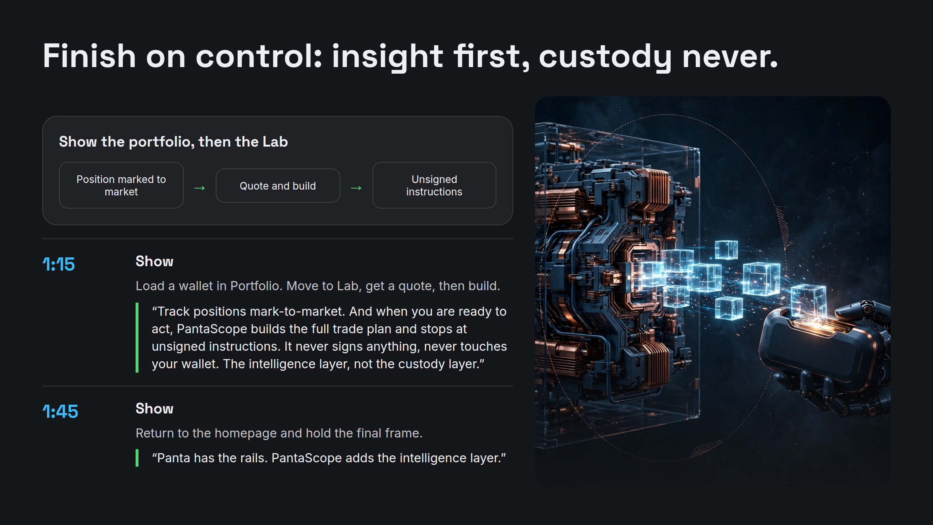
Notes:
Finish on control: insight first, custody never.

Slide 5
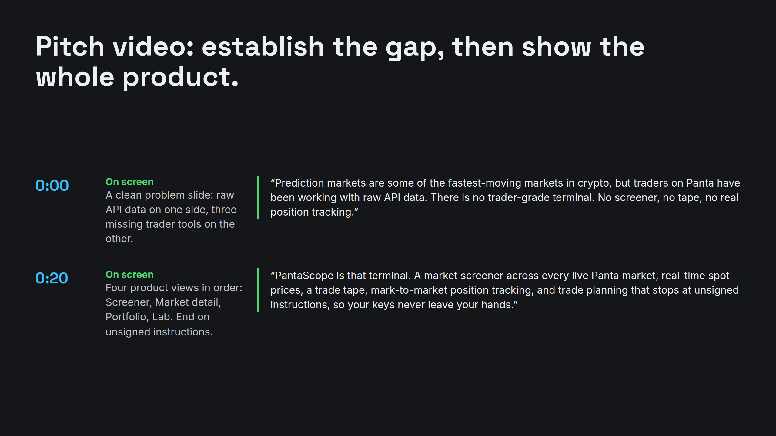
Notes:
Pitch video: establish the gap, then show the whole product.

Slide 6
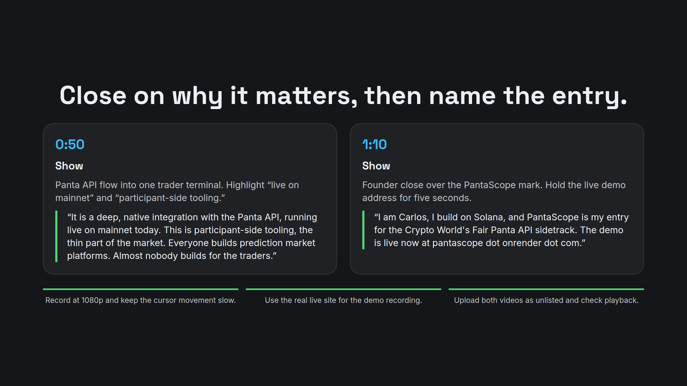
Notes:
Close on why it matters, then name the entry.

