Slide 1

Notes:
PantaScope

Slide 2
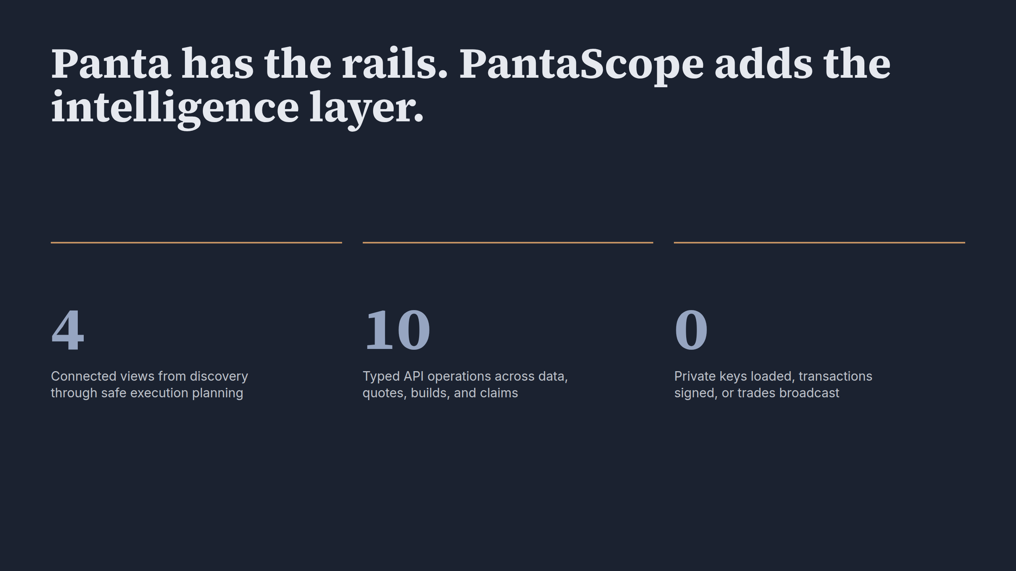
Notes:
Panta has the rails. PantaScope adds the intelligence layer.

Slide 3
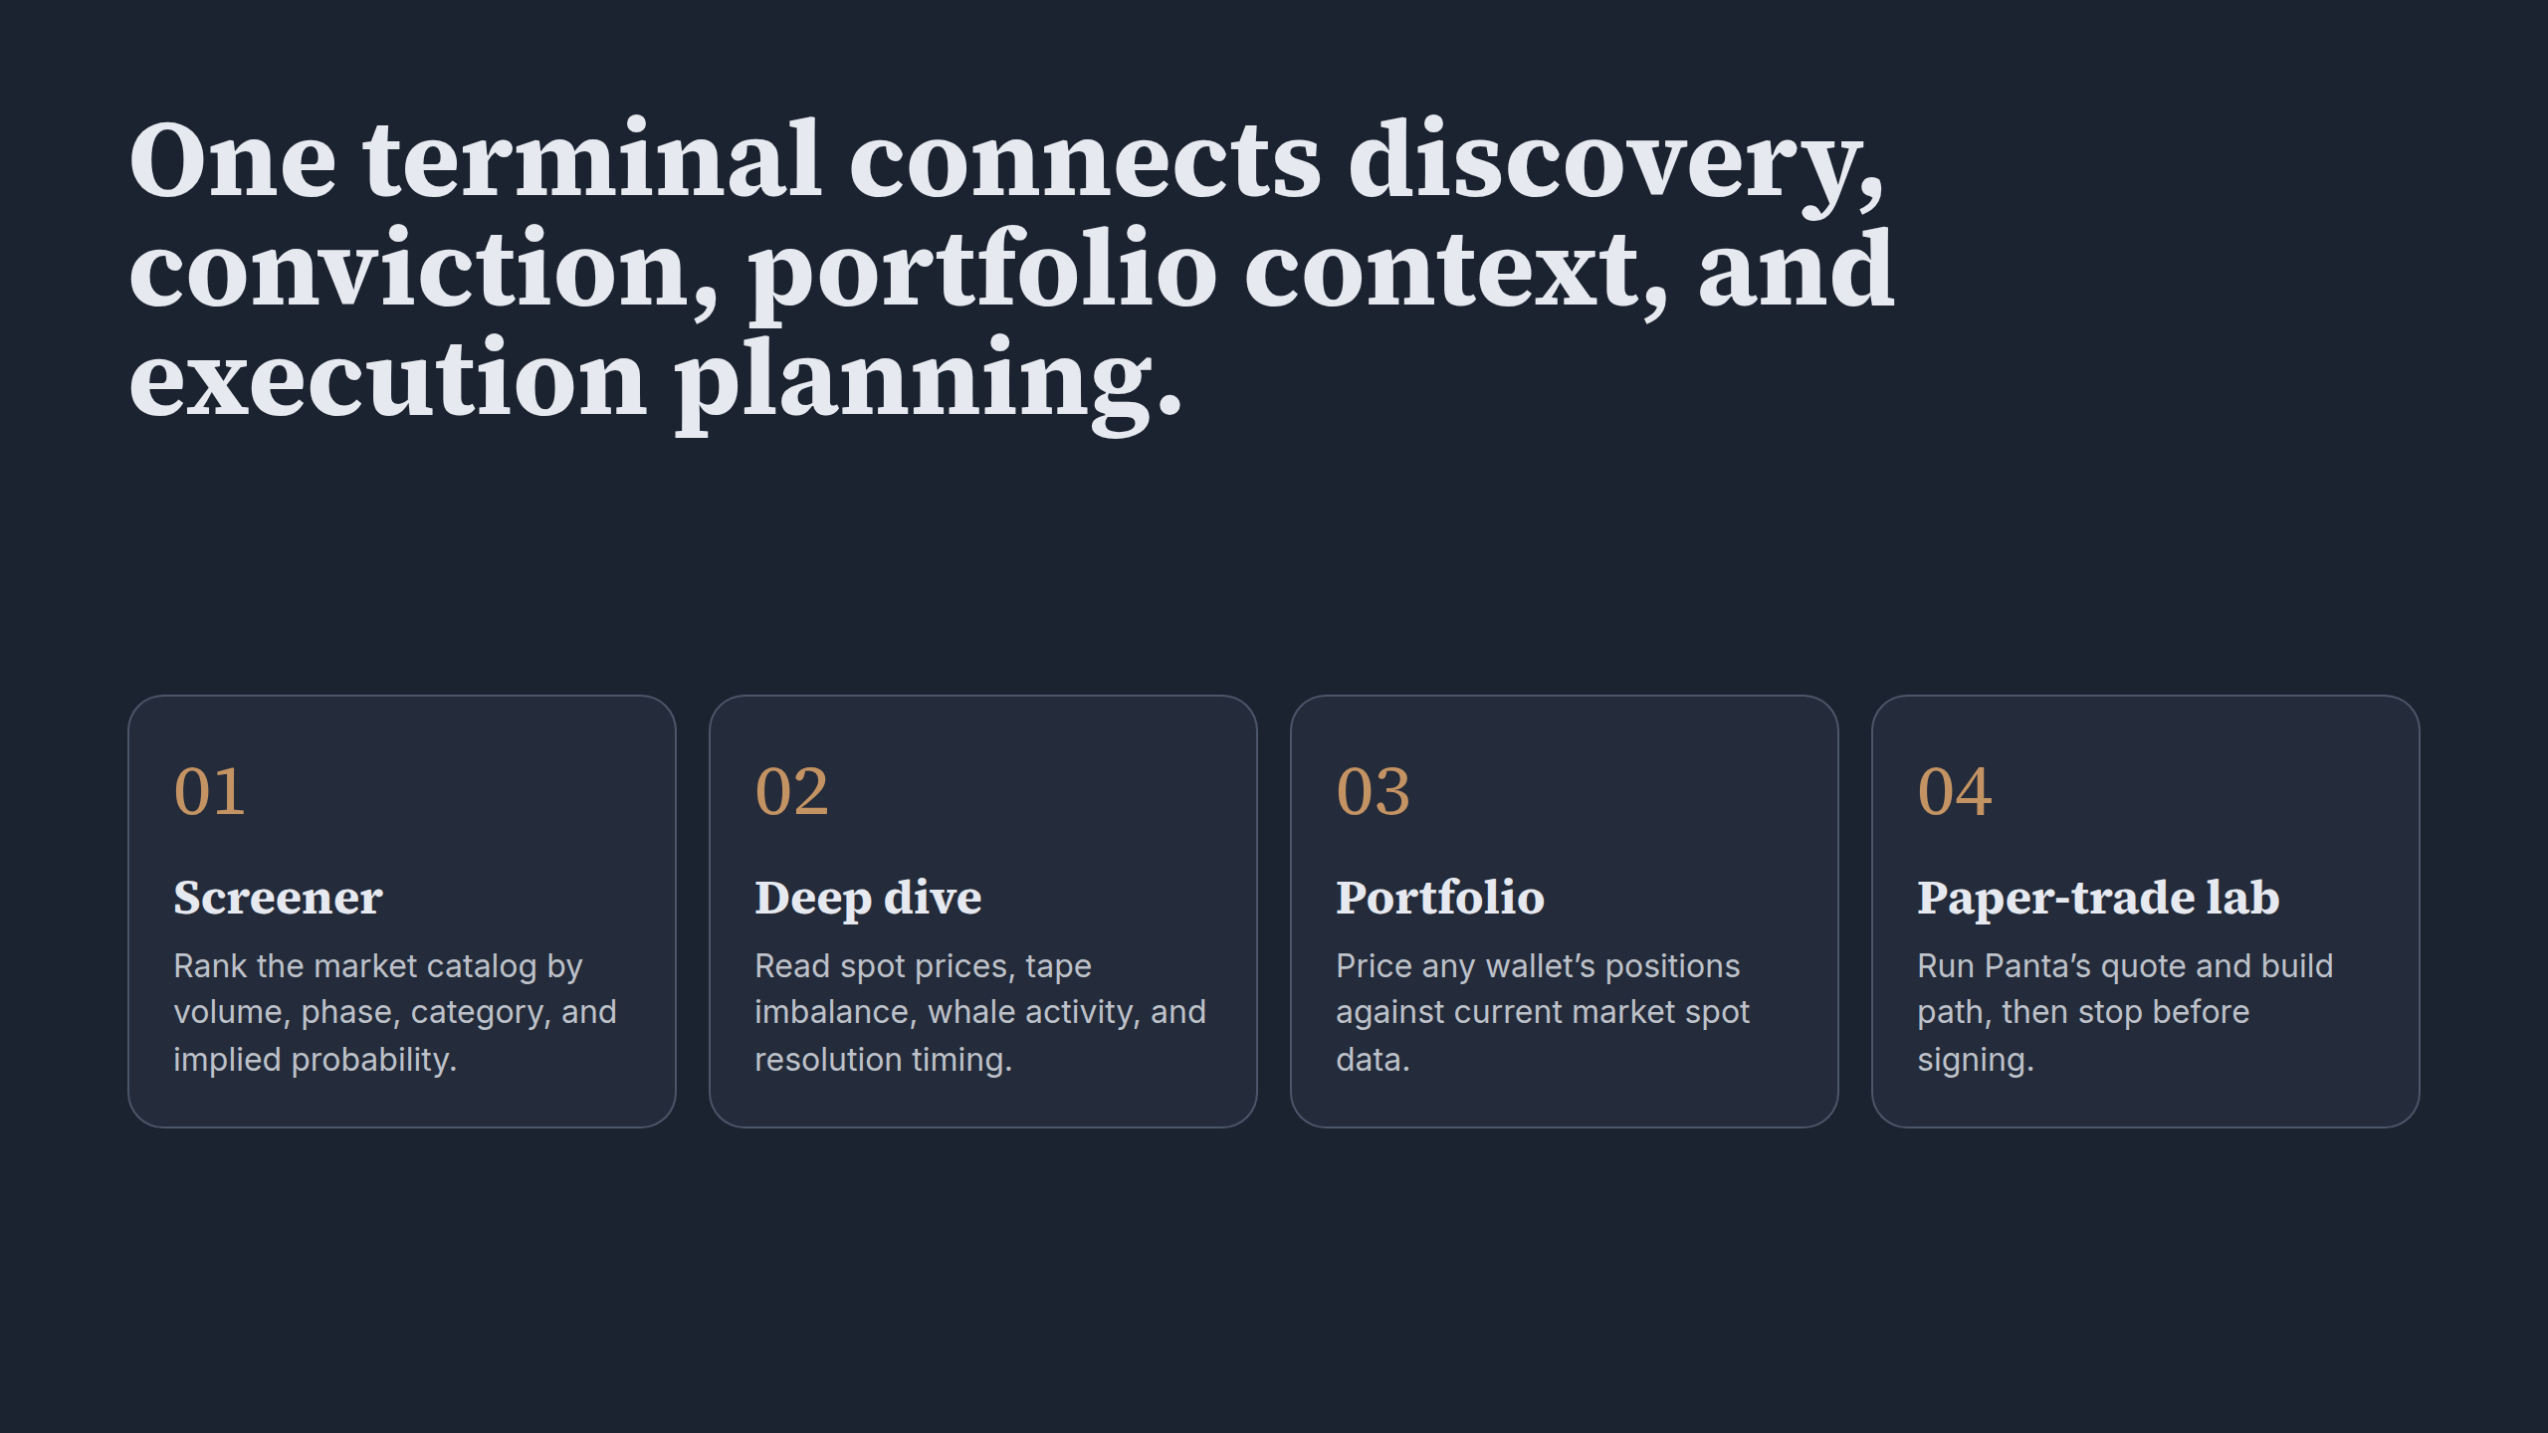
Notes:
One terminal connects discovery, conviction, portfolio context, and execution planning.

Slide 4
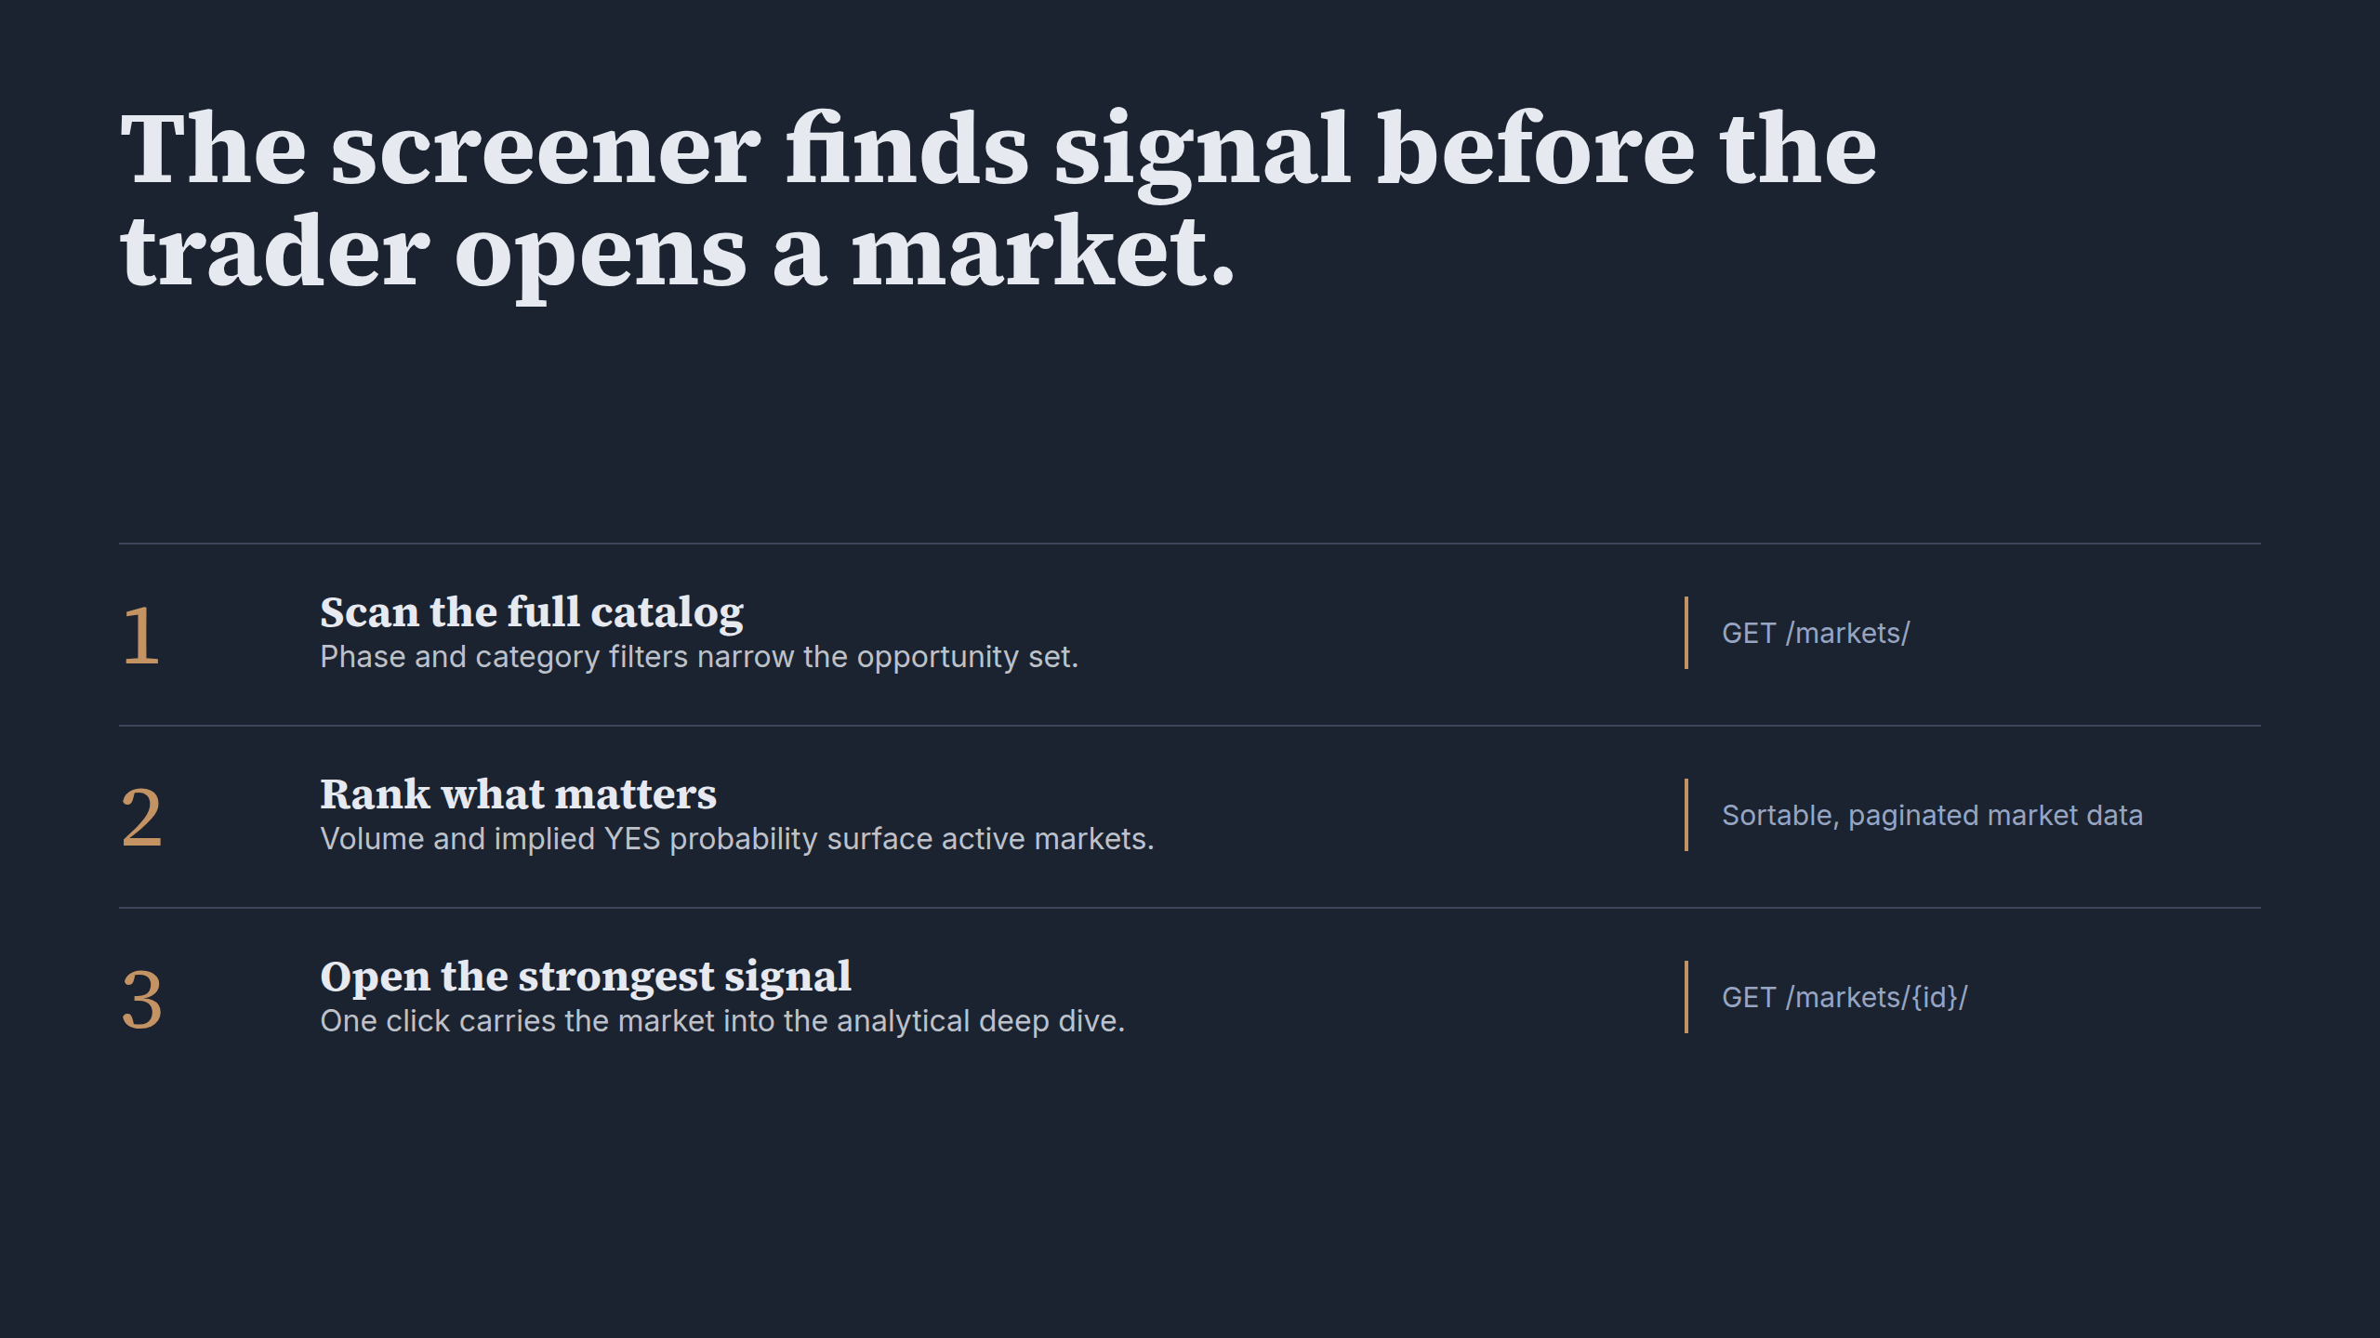
Notes:
The screener finds signal before the trader opens a market.

Slide 5
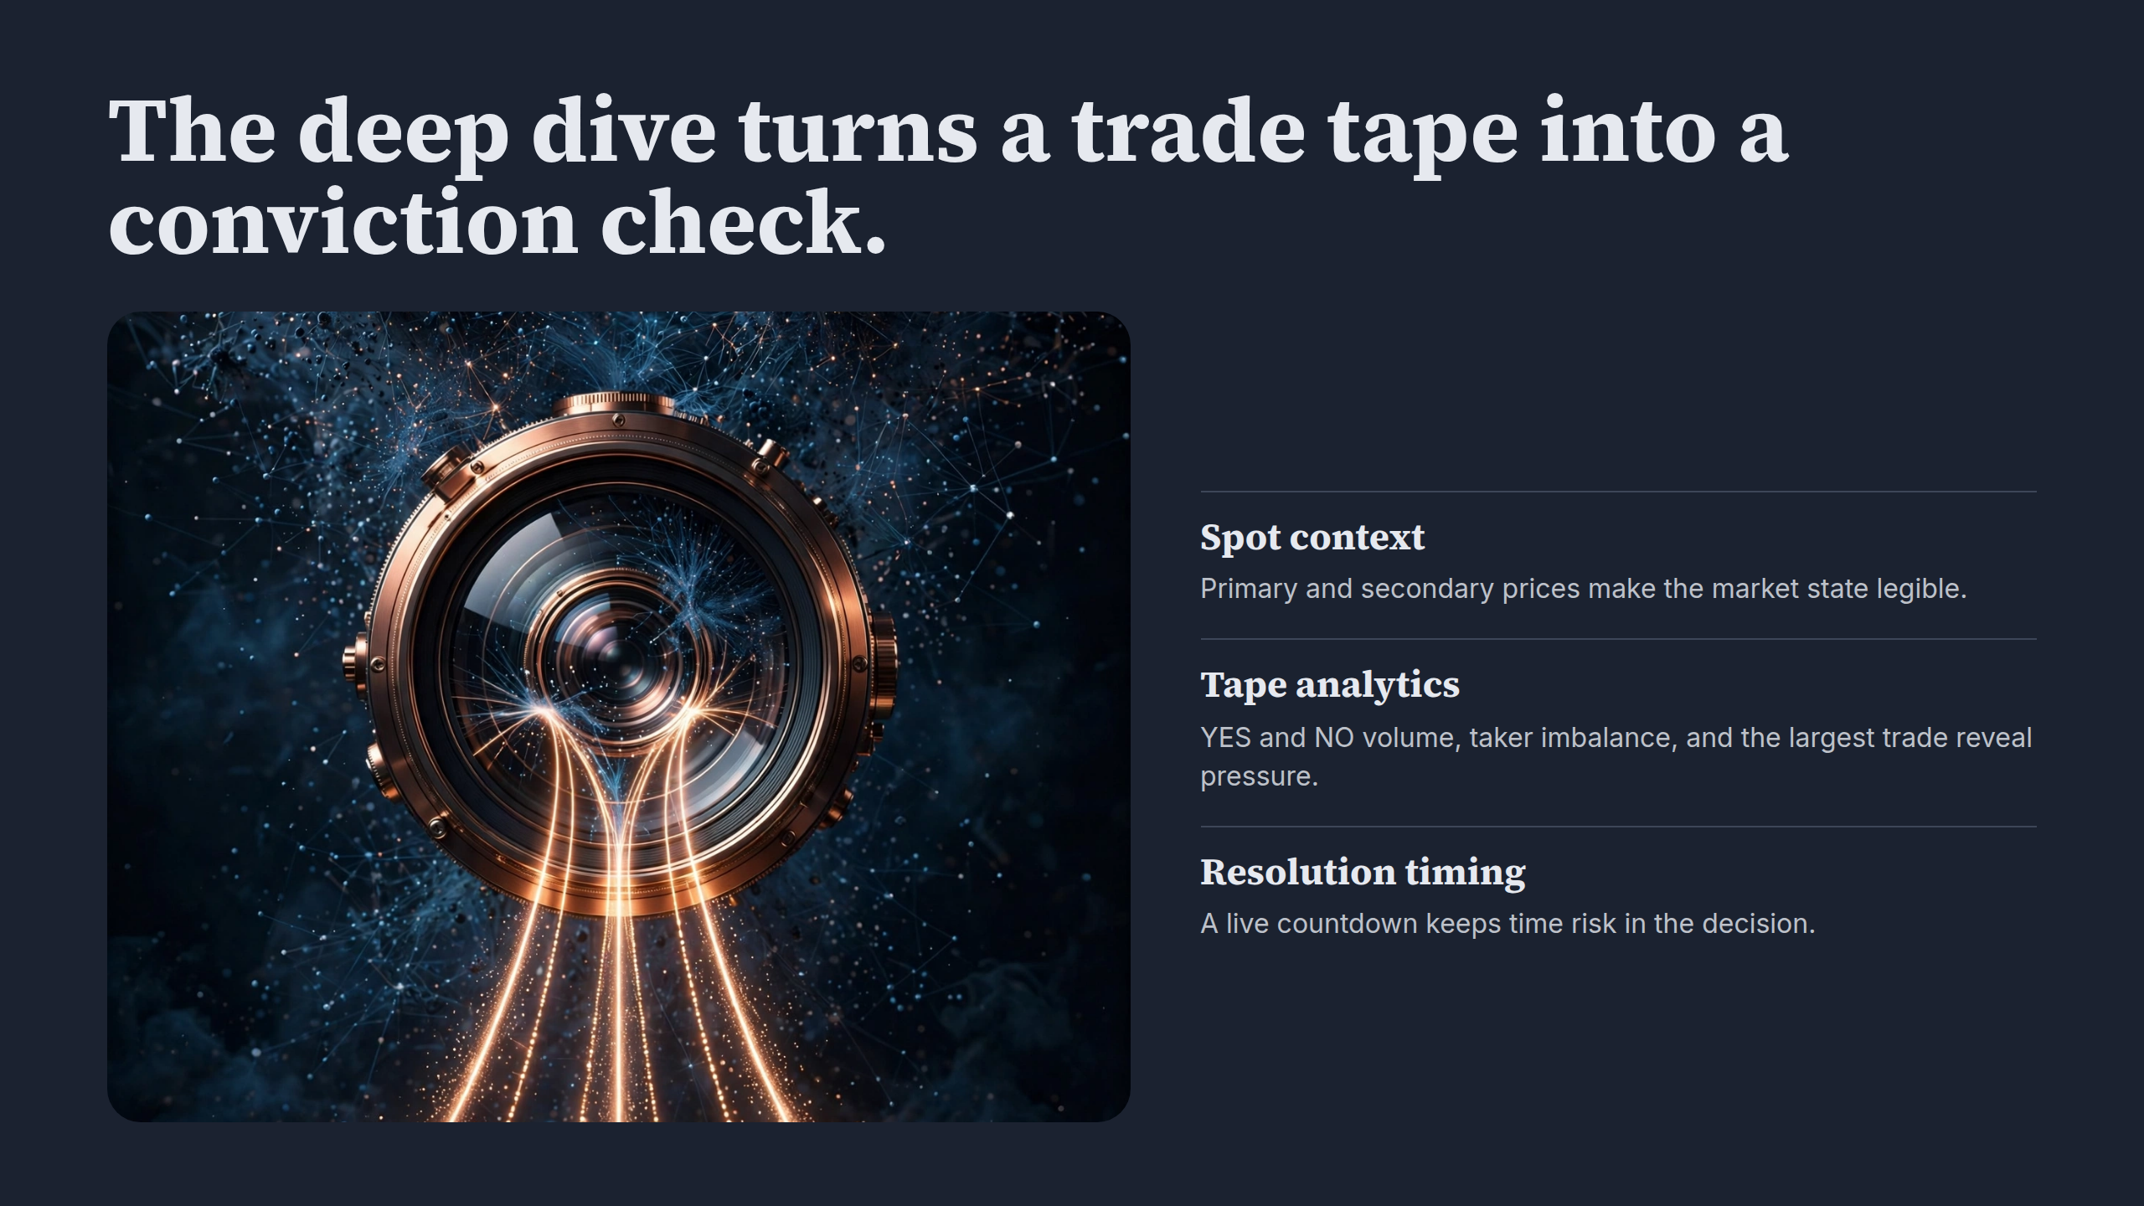
Notes:
The deep dive turns a trade tape into a conviction check.

Slide 6
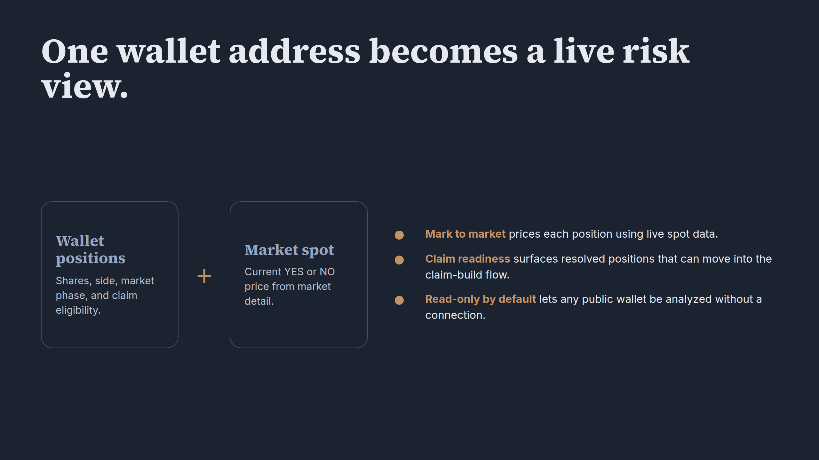
Notes:
One wallet address becomes a live risk view.

Slide 7
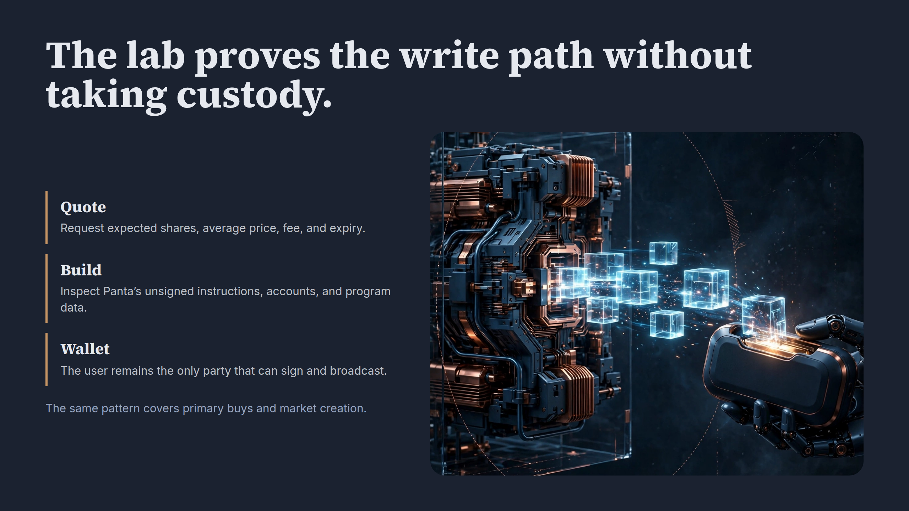
Notes:
The lab proves the write path without taking custody.

Slide 8
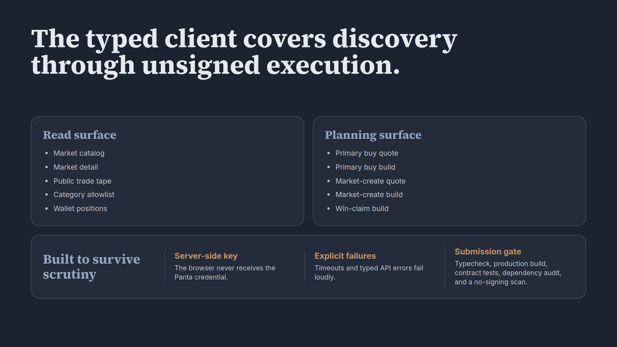
Notes:
The typed client covers discovery through unsigned execution.

Slide 9
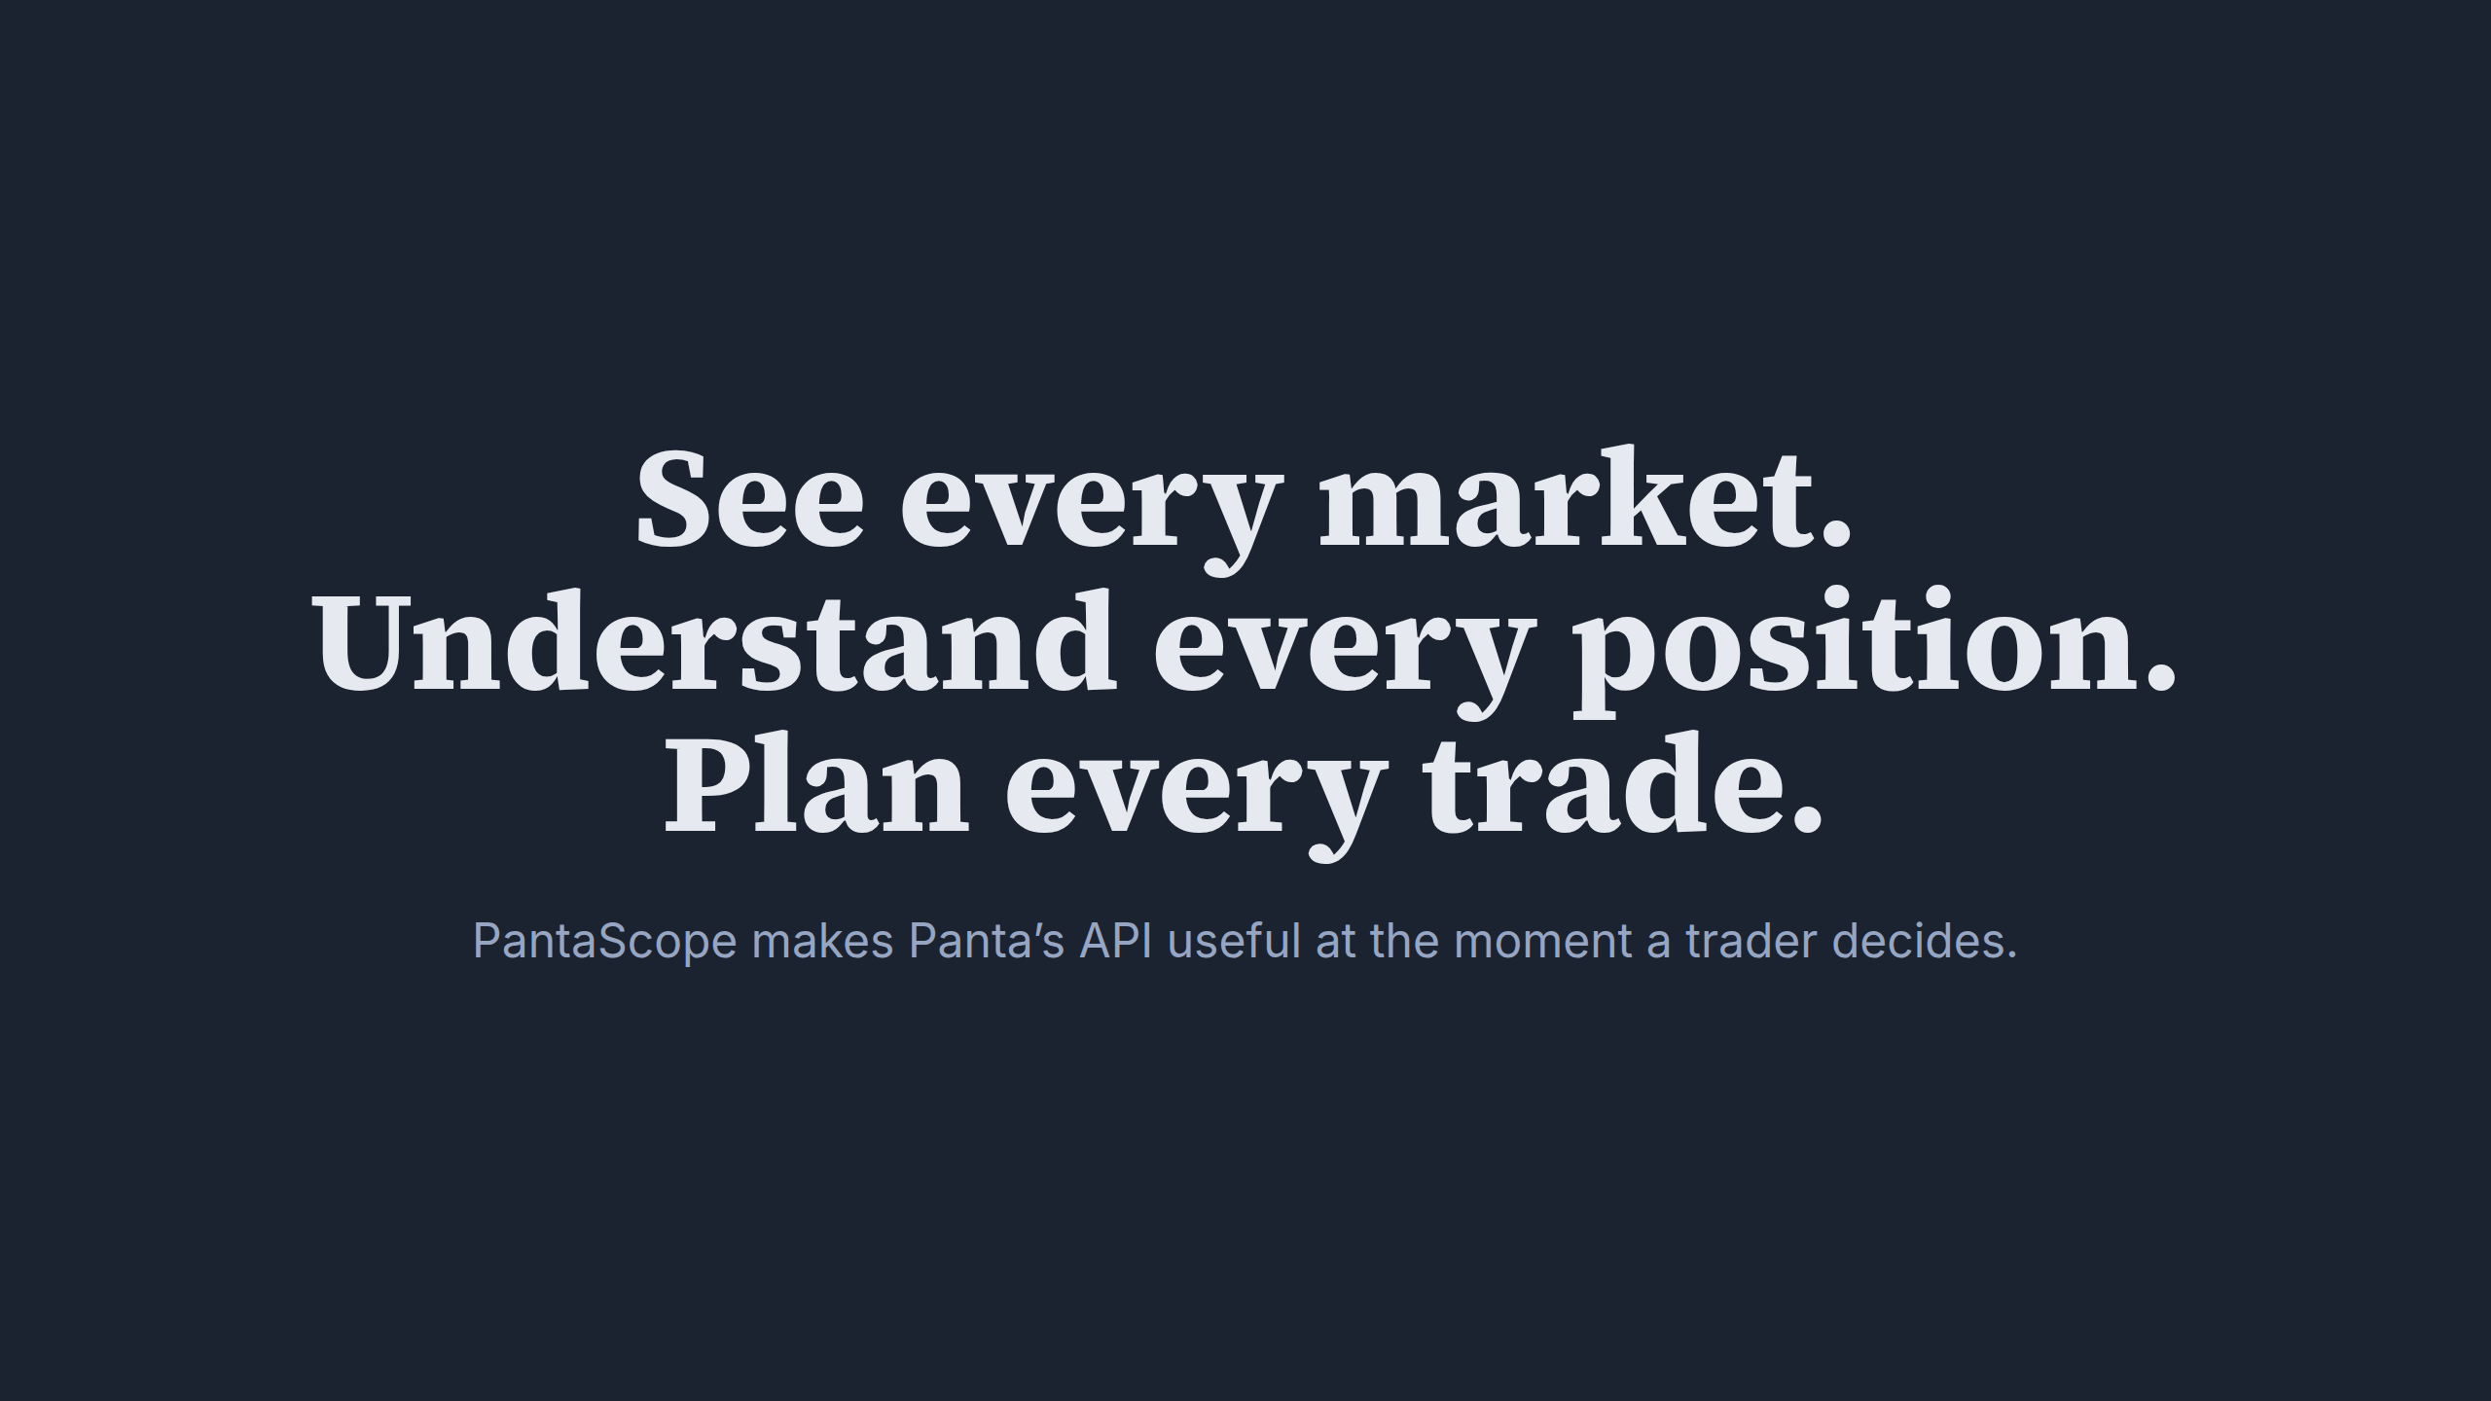
Notes:
See every market. Understand every position. Plan every trade.

