Slide 1
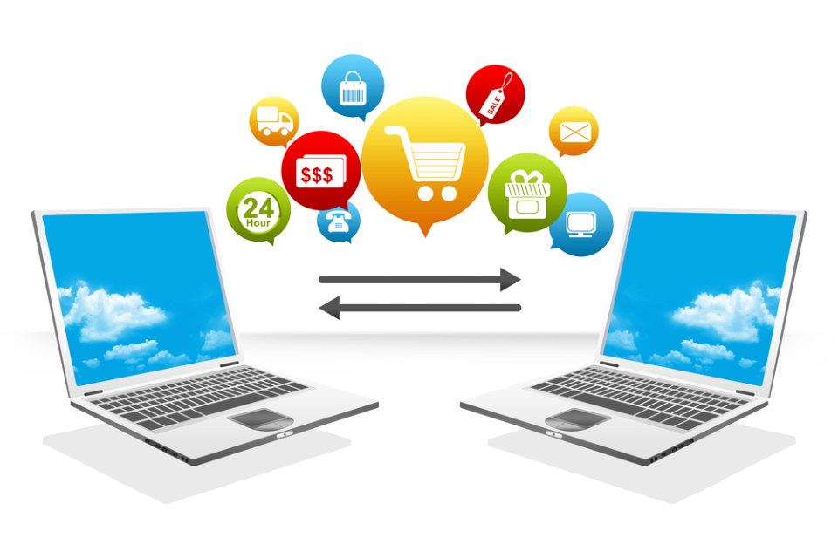
Virtual private networks
Presentation BY Christian Janeczek
12.03.2015

Slide 2
Table of contents
Introduction – What and why?
How does a VPN work?
Tunneling Protocols
Advantages and Disadvantages
Comparison of VPN providers

Slide 3
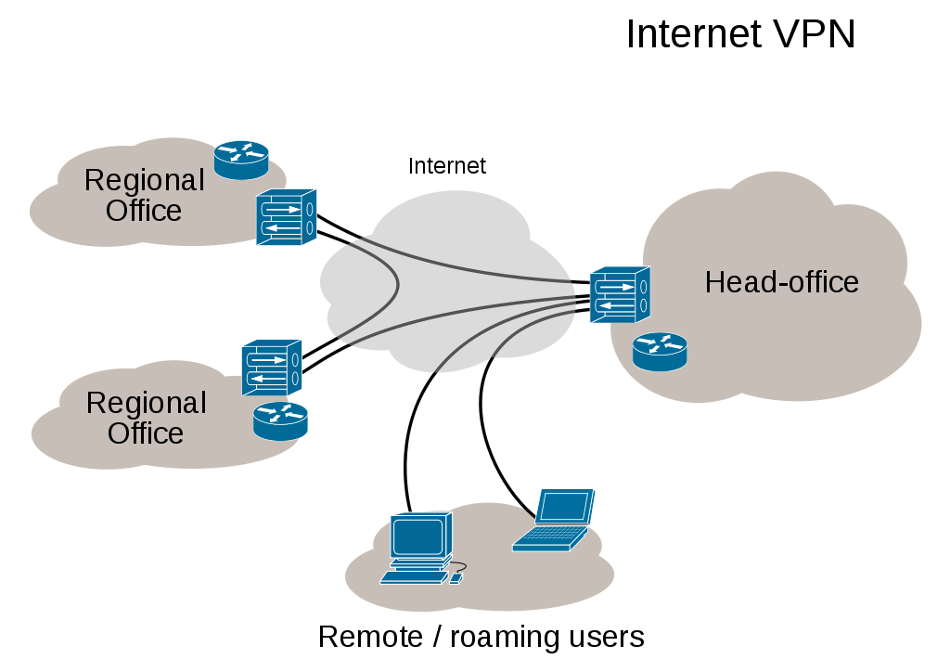
What is a VPN?
Source: http://en.wikipedia.org/wiki/Virtual_private_network#/media/File:Virtual_Private_Network_overview.svg
Notes:
Ein elektronischer Markplatz ist eine elektronische Einkaufsplattform, die es verschiedensten Herstellern, Dienstleistern und Vertriebsunternehmen erleichtert, deren Produkte anzubieten.

Slide 4
WHY SHOULD YOU USE A VPN?
Availability – remote access (employees -> files, applications, printers)
Security – Connecting networks securely, Tunneling Protocols
Privacy – Wi-Fi hotspots, Encryption of Data Traffic
Authorization – „Geo-Blocking“

Slide 5
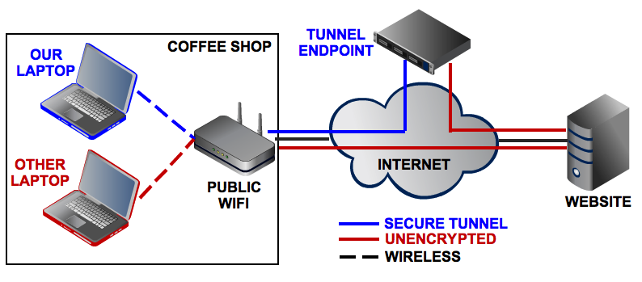
WHY SHOULD YOU USE A VPN?
Source: http://images.techhive.com/images/article/2013/01/vpn-graphic-100022486-large.png
Availability – remote access (employees -> files, applications, printers)
Security – Connecting networks securely, Tunneling Protocols
Privacy – Wi-Fi hotspots, Encryption of Data Traffic
Authorization – „Geo-Blocking“

Slide 6
HOW DOES A VPN WORK?
Creation of the Internet
Nuclear Attacks -> Routers
Security Issues?
Tunnel via Tunneling Protocol
Client-Server Architecture

Slide 7
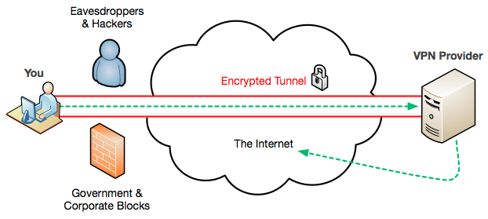
Source: http://4.bp.blogspot.com/-4ezmca5E6JM/Uazjlu_9YKI/AAAAAAAAAo4/6k5oyYdMfDw/s1600/vpn-diagram.png

Slide 8
AS A LITTLE SUMMARY:
Tunneling Protocol responsible for data‘s safety
Penetration Detection
Recreation of the connection
New set of routers

Slide 9
Tunneling Protocols
Point-to-Point Tunneling Protocol (PPTP)
Layer 2 Tunneling Protocol (L2TP)
Internet Protocol Security (IPSec)
Secure Sockets Layer (SSL)

Slide 10
Point-to-Point Protocol
Least secure
Great starting point – OS support
Native plaintext
Adv: Easiest to use
Disadv: Most insecure TP
Notes:
Zentral:
Lokal positioniert in einem zentralen Rechensystem
Dezentral:
Die Datenbank des Markplatzes wird auf viele verschiedene Systeme aufgeteilt.

Slide 11
Layer 2 Tunneling Protocol
More secure than PPTP
More complicated to set up
Privacy via encryption protocol via Tunnel
Adv: More secure than PPTP
Disadv: More complicated to set up
Notes:
Zentral:
Lokal positioniert in einem zentralen Rechensystem
Dezentral:
Die Datenbank des Markplatzes wird auf viele verschiedene Systeme aufgeteilt.

Slide 12
Internet Protocol security
More secure than PPTP
More complicated to set up
Authenticating and encrypting each IP packet
Adv: More secure than the PPTP
Disadv: More complicated to set up
Notes:
Zentral:
Lokal positioniert in einem zentralen Rechensystem
Dezentral:
Die Datenbank des Markplatzes wird auf viele verschiedene Systeme aufgeteilt.

Slide 13
Secure sockets layer
Most secure way of Tunneling
Sensitive domains, e.g.: banking sites
Highest level of security
Connection via Web Browser -> „Clientless“
Adv: Web browser -> Easier and more reliable
Disadv: Most complex TP
Notes:
Zentral:
Lokal positioniert in einem zentralen Rechensystem
Dezentral:
Die Datenbank des Markplatzes wird auf viele verschiedene Systeme aufgeteilt.

Slide 14
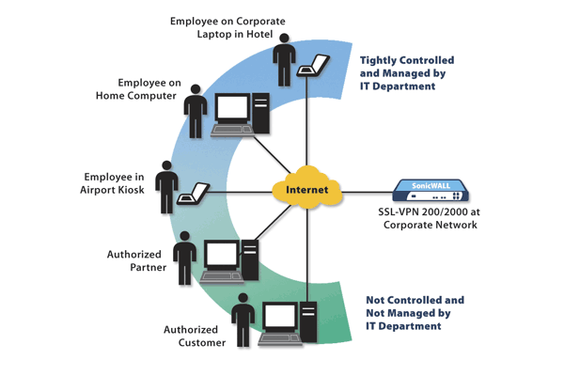
Source: http://4.bp.blogspot.com/-4ezmca5E6JM/Uazjlu_9YKI/AAAAAAAAAo4/6k5oyYdMfDw/s1600/vpn-diagram.png
Notes:
An SSL VPN server is designed to be accessed via Web browser and creates encrypted channels so that you can safely access the server from anywhere.

Slide 15
ADVANTAGES AND DISADVANTAGES
Security and Design
P: High level of security (compared to other methods of communication)
C: Complex -> professional staff
Cost
P: Significantly lower costs (compared to other types of configurations)
C: Reliability to Provider
Notes:
Zentral:
Lokal positioniert in einem zentralen Rechensystem
Dezentral:
Die Datenbank des Markplatzes wird auf viele verschiedene Systeme aufgeteilt.

Slide 16
ADVANTAGES AND DISADVANTAGES
Scalability
P: Flexible in terms of growing
C: Expanding may cause technical issues (Incompatibility)
Mobile
P: More flexible (Smartphone)
C: Eventually tighten up security
Conclusion: Viable solution, but competent staff required
Notes:
Zentral:
Lokal positioniert in einem zentralen Rechensystem
Dezentral:
Die Datenbank des Markplatzes wird auf viele verschiedene Systeme aufgeteilt.

Slide 17
Comparison of VPN providers
Private Internet Access
TorGuard
IPVanish
VikingVPN
CyberGhost

Slide 18
Comparison of VPN providers
Aspects:
Logging?
Jurisdictions/Information Sharing?
Monitoring Tools?
DMCA Takedown?
Court Order Identification
File Sharing Traffic?
Payment Methods?
Securest Encryption Algorithm
Price ($ per month)

Slide 19
Comparison of VPN providers
Complications with Table -> PDF

Slide 20
THANK YOU FOR YOUR ATTENTION!
?

