Slide 1
CS 412/512
Computer graphics
- final project
Team Members:
Adrian Ruiz Vasquez
Christopher Jarek

Slide 2
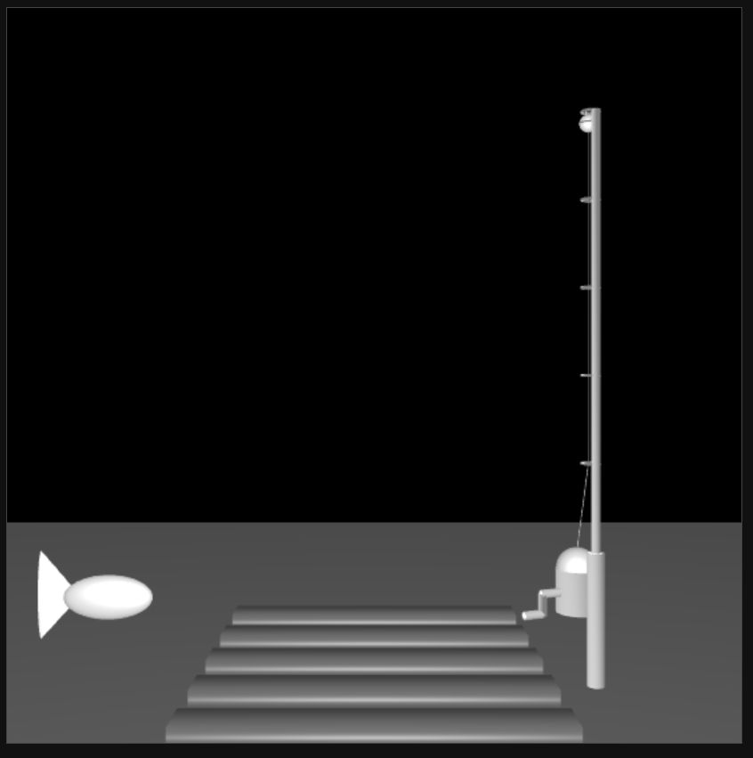
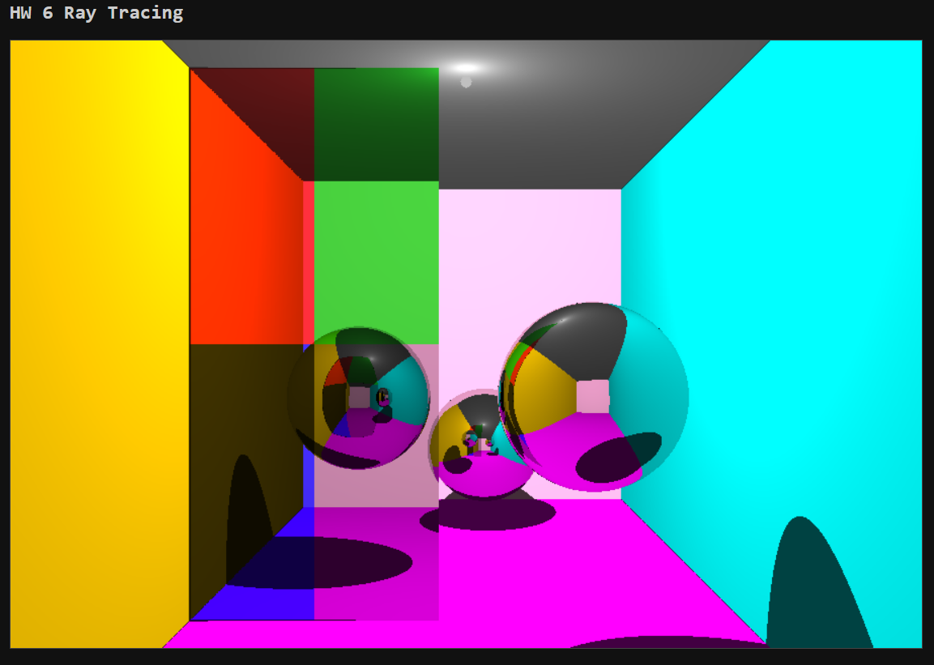
Project Ideation
Game State Machine
Hierarchical Models
Ray Tracing

Slide 3
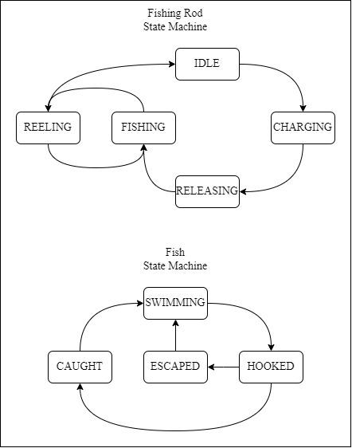
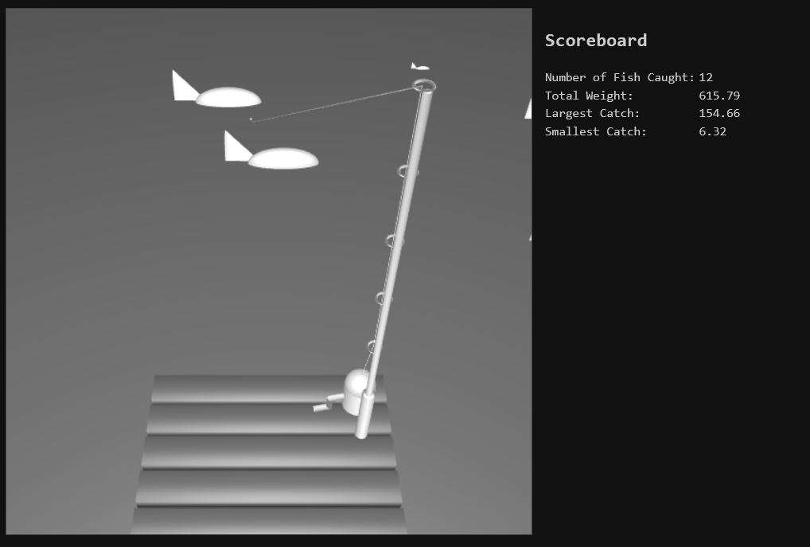
Development Process
Added Game State

Slide 4


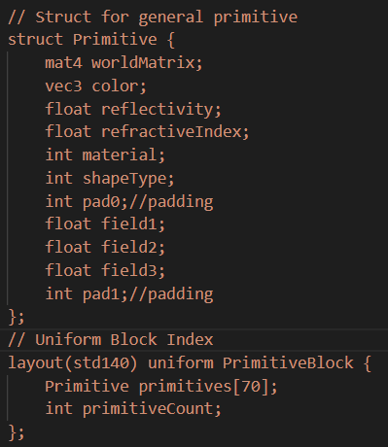
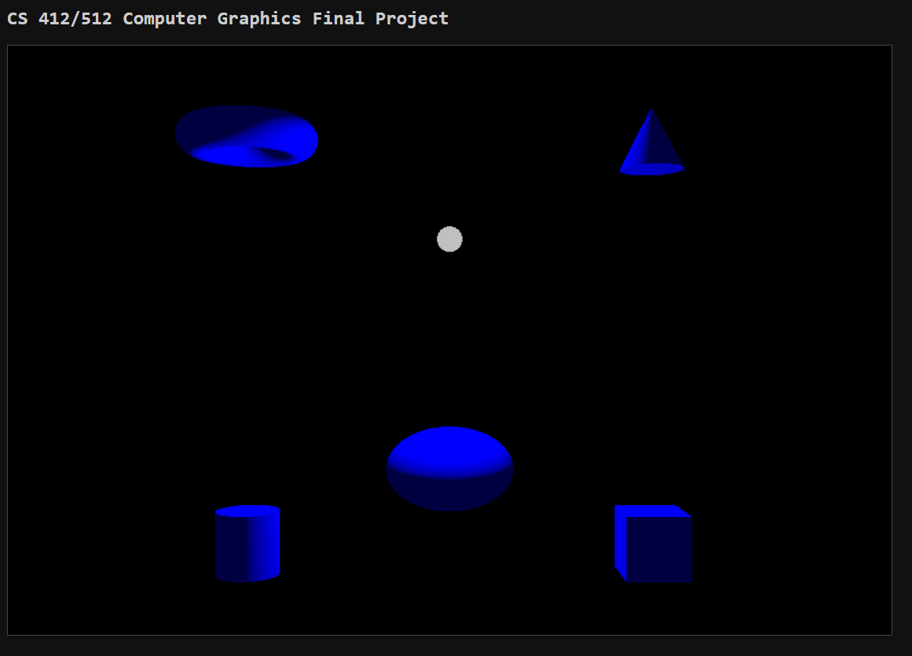
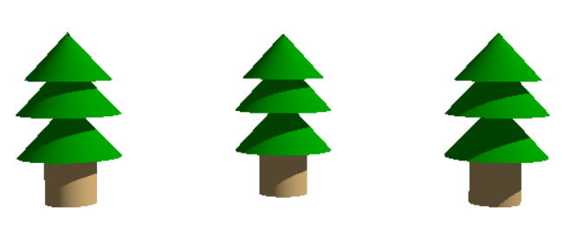



Development Process
Improved Ray Tracing Shaders, Primitive Buffering, and Entities

Slide 5
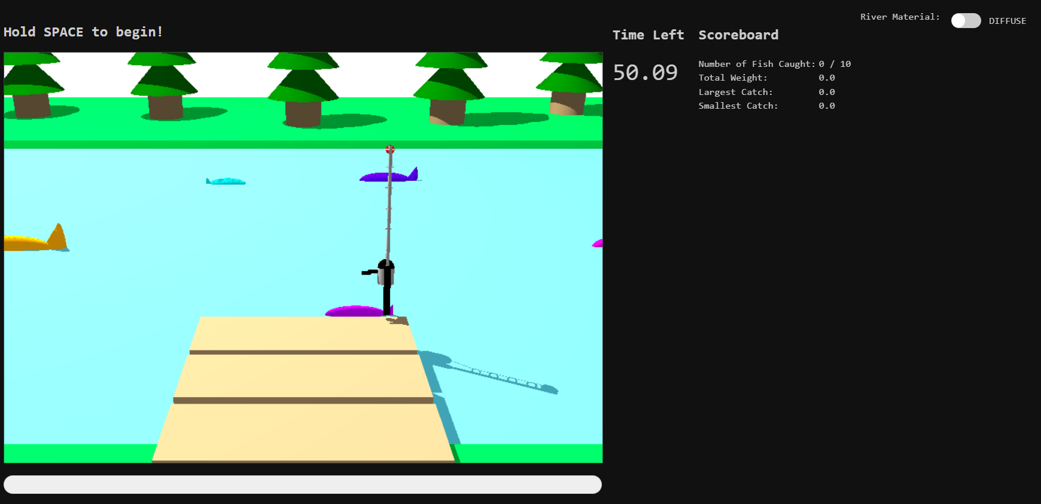
Final Design

