Slide 1

AVIFUANA
PLAY GAME

Slide 2




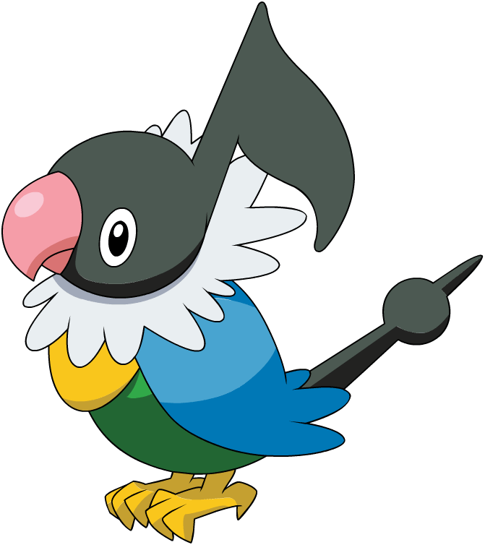
Classic Mode
FLY

Slide 3
Multiplayer Mode
Story Mode

Slide 4





