Slide 1


NASSCOM HACKATHON
KNOWLEDGE INSTITUTE OF TECHNOLOGY
Topic : Explore on Travel App Development
Team Name : IDFC
Team Members :
1. BHARATH VISHNU C J(Head)
2. ARUN R G
3. DILIP S
4. AAKASH R
5. CHERAN J

Slide 2
PROBLEM
Now a days , Lots of people facing time issues while travelling from one point to another point .
As the cities grow, it is common for people to use multiple modes of transportation like bus , metro and other transportation for last mile connectivity. What can be an effective solution to allow commuters to have a seamless experience as they travel from one point to another.
So that , by analyzing the problem we come up with a start up idea by understanding the viability (the customer needs ) ,desirability ( the long lasting growth ) and also the feasibility ……

Slide 3
Solution
Here We got a solution to overcome this problem by developing an app named Explore on Travel(EOT).
In this app , the users can locate where is the Transport(Bus , train , etc..) .
The users can also see at what time the Bus or train will reach the Bus stop or Metro Station .
The users can See the route Map of current traveling Bus or Metro Train.
And also If the Transport is delayed to reach the Stop or Station , it will be also Displayed on the App .
The users can see at What time The Transport will reach the Destination .

Slide 4
Marketing Strategy
App’s landing page and blog
App Store Optimization
Social media marketing
Influencer marketing
Paid user acquisition campaigns
Email marketing

Slide 5
TARGET CUSTOMER
Often users travelling from one point to another .
People who go for the Tour .
Totally , the people who are all wants to travel with the guidance of our app, for the coolest stress free travel . They are all our target customers.

Slide 6
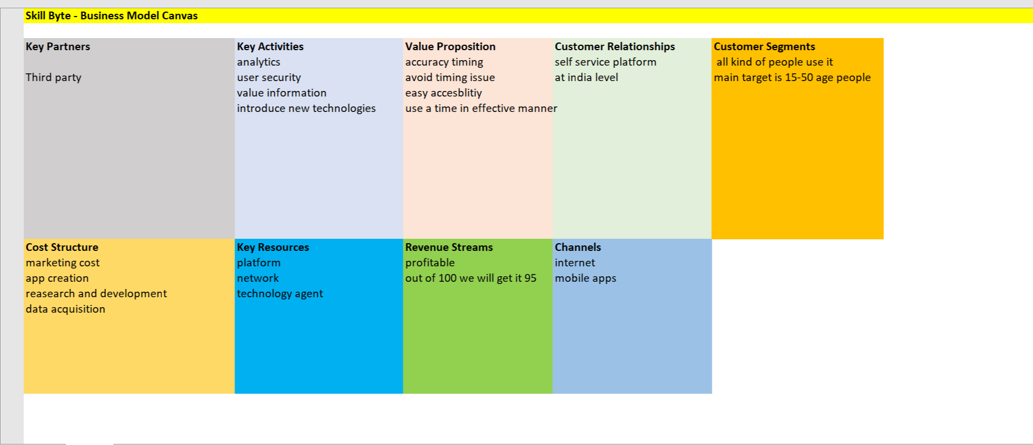
BUSINESS MODEL CANVAS

Slide 7
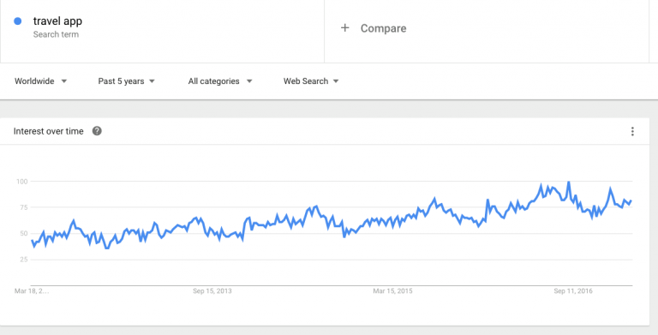
Competitive Analysis
Defining the Competition - Any app that is providing a similar service to our App. This was carried out by a search engine queries and App store search, using keywords specific to our app and the word ‘app’ in the search terms.
Value - There are generally certain value offerings that are
an expectation of customers within an industry such as being
‘bug-free’, therefore we are only interested in the unique
value offered.
SWOT ANALYSIS :
Strength – Saving user data to provide the best service in the future
Weakness – Mobile app version is not available yet
Opportunities – Current services are not personalized enough
Threat - Not enough funds for strong marketing campaigns
App Rating : This data tells us whether or not our competitors have a good track record with our users. It allows us to identify opportunities for development and features based on users requests and complaints and generates a target audience ‘needs’ analysis and allows us to offer the audience what they want.

Slide 8
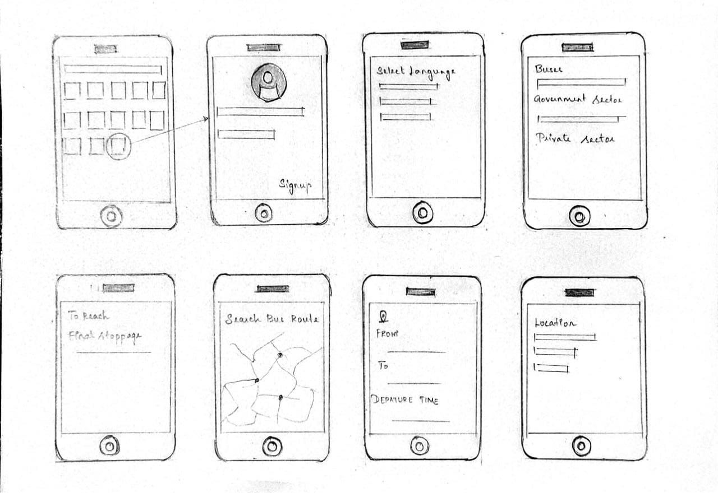
PROTOTYPE

Slide 9
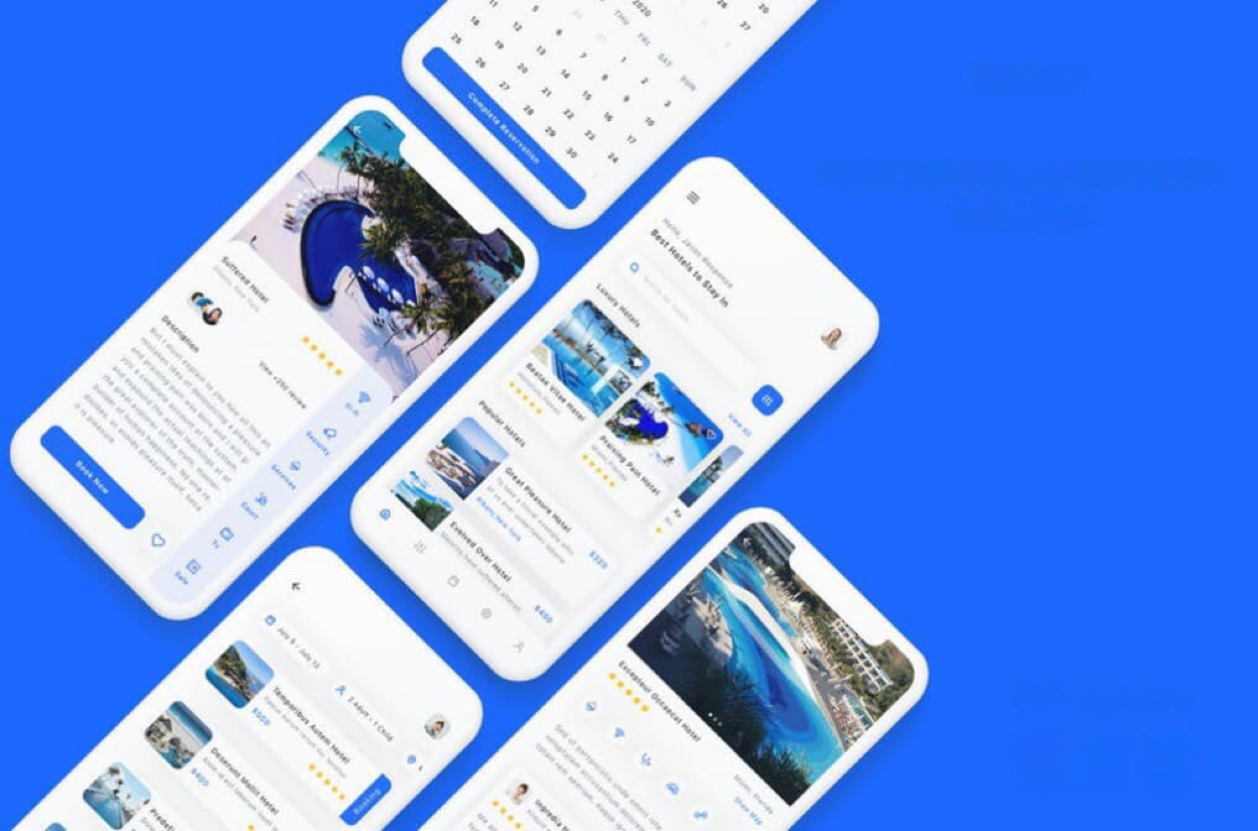
Thank You

