Slide 1
Advanced/Scalable Databases
How can I store my data?

Slide 2
Today in perspective
Week 1 – Cloud Native Computing
Week 2 – Web Communications
Week 3 - Data
Notes:
Pretend we are building an application, weeks 1 and 2 are things we can use to get our application setup on a cloud server somewhere and have it communicating.
Another thing we might need is data. How do we store our data? What’s the best way to store the data? Most people are familiar with SQL databases and might jump towards a SQL solution right away.
But consider,

Slide 3
SQLn’t Solutions
Benefits depend on which NoSQL database you use
Generally have more high availability with less down time
Generally can have performance improvements because of eventual consistency promises
Each NoSQL database is different even within a category
Notes:
High availability: a characteristic of a system which aims to ensure a level of operational performance for a higher than normal period – basically, the system tends to have a higher uptime than its SQL counterparts
Eventual consistency: the database will eventually return the newest records in the system. A SQL system is strongly consistent, that is, if you write data everyone who reads it after will receive the same data you wrote. NoSQL databases may not offer that same guarantee
NoSQL solutions are generally designed with scalability in mind and tend to optimize a particular set of operations

Slide 4
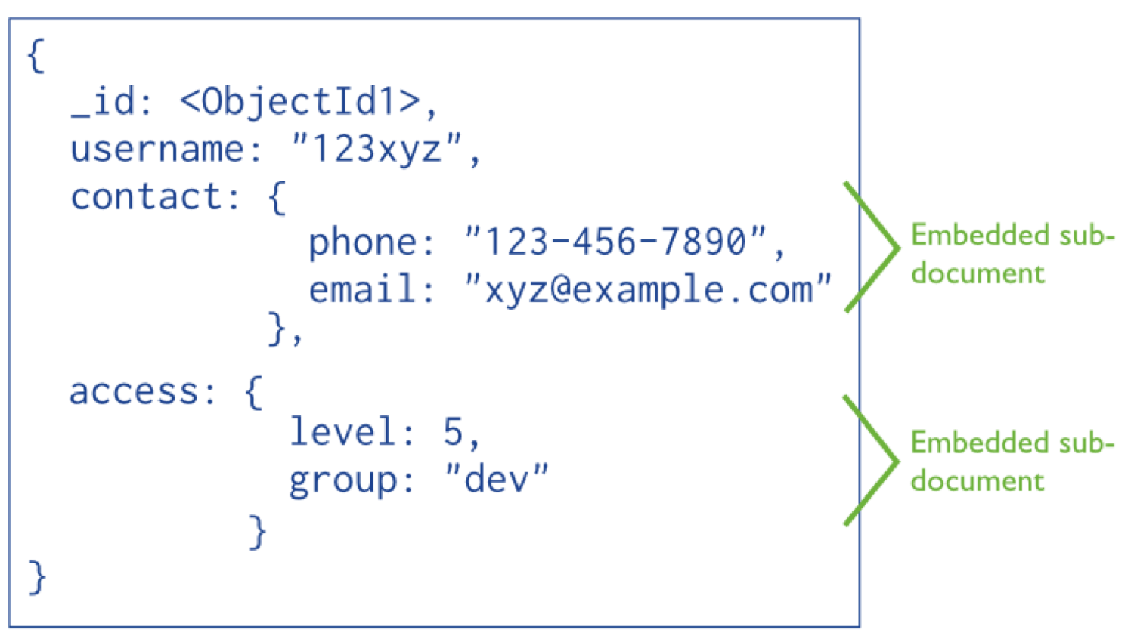
Document
Can store structured or semi-structured data
Benefits
The semi-structured nature allows missing fields
Can restructure the documents easily
Sub documents
Problems
Unstructured data can be misleading
No verification of what gets put in a document field
Good use cases?
Good for general storage
Can store binary blobs (arbitrary files)
You want to work with something like json or xml

Slide 5

MongoDB
Probably the most well known document store
Easily configured scalability
Mongo Shell & other drivers
Supports sorting
Find one / find all
Lets you use JavaScript in queries
https://www.mongodb.com/

Slide 6
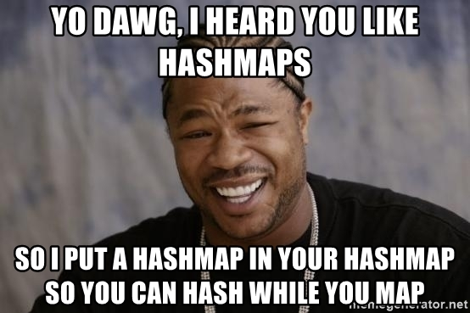
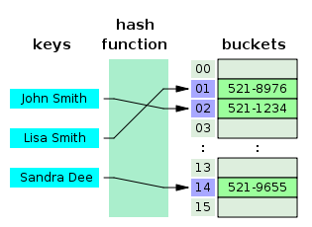
Key - Value
Essentially a giant hash map
Benefits
Generally fast (again, it’s a hash map)
Low complexity implementations
Support basic datatypes usually
Problems
Major pain for storing complex data
Consistency can be difficult (each client tries to access the same key)
Good use cases?
Simple data storage
Need high throughput (very fast)
Data caching

Slide 7

Redis
Main memory store with minimal persistent options
Fast. Faster than that.
High-End machines can do ~700k operations per second
Some people report higher numbers than that
Commonly used for
Caching
Queuing
Pub/Sub
https://www.mongodb.com/

Slide 8
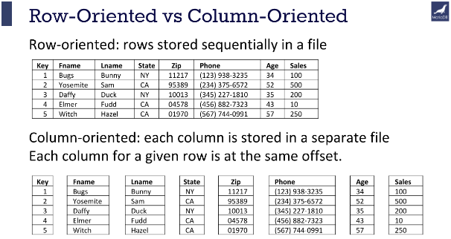
Columnar Store
Columns instead of Rows
Benefits
Some highly optimized queries
Aggregation for example
Problems
Writes might be slower since each column is written to
Have to design columns to the queries run on it
Good use cases?
Good for optimizing certain types of queries
Data warehouses (big data analysis)
Sequential data storage (e.g. by time)

Slide 9
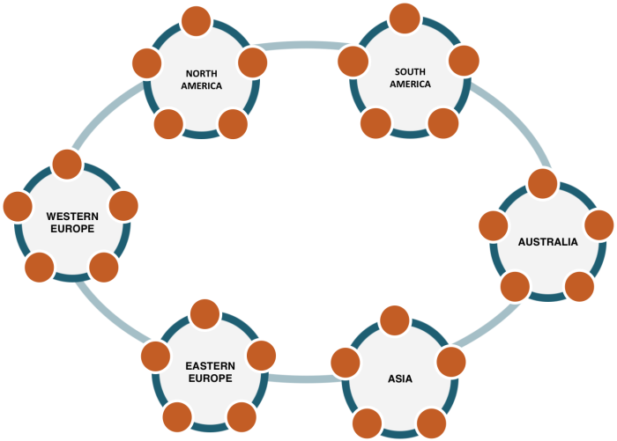
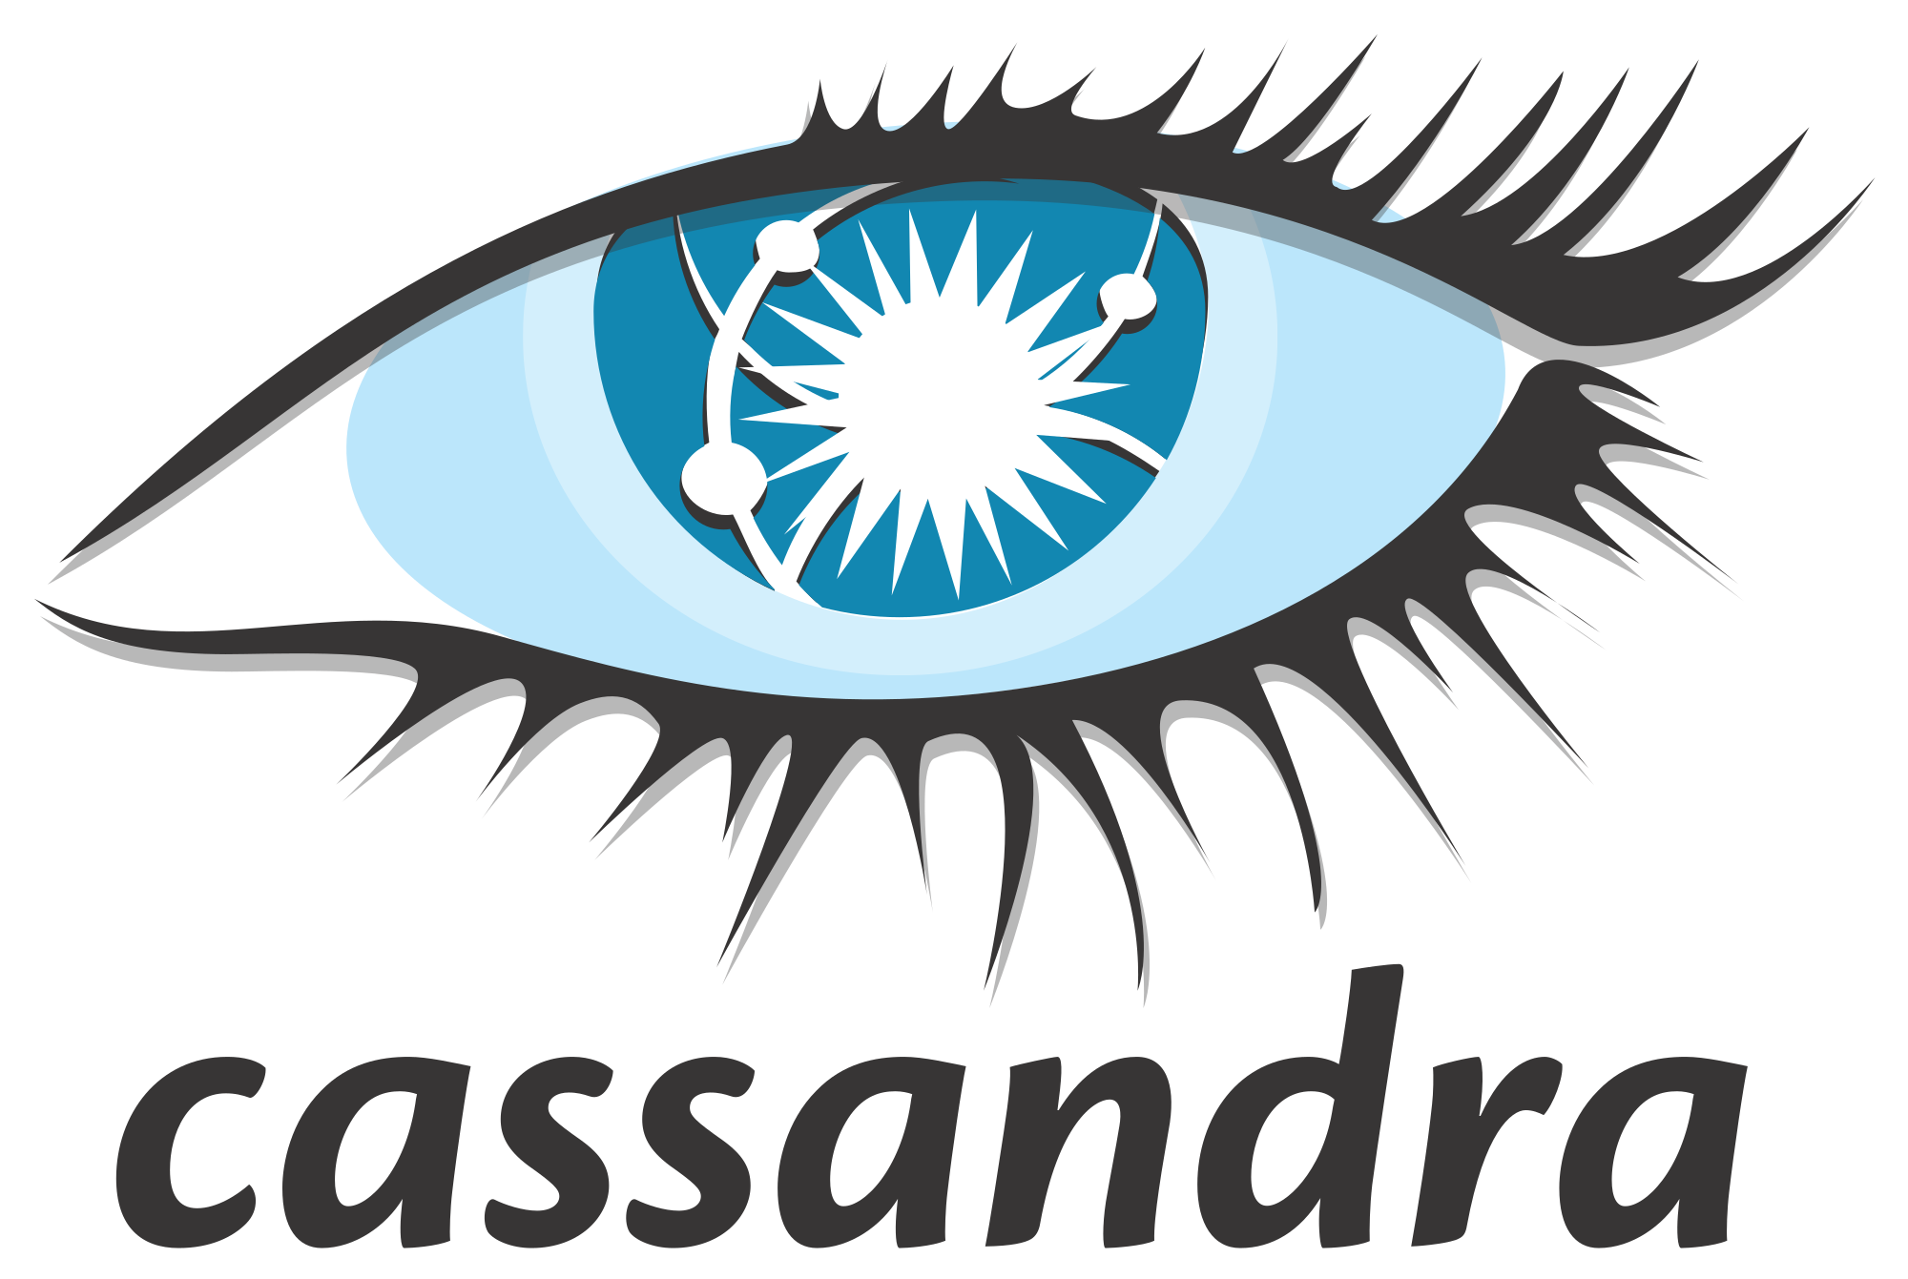
Cassandra
Easy scalability
offers horizontal and vertical scaling types
Incredible High Availability
CQL (Cassandra Query Language)
Pretty similar to SQL
http://cassandra.apache.org/
Notes:
Column Families

Slide 10
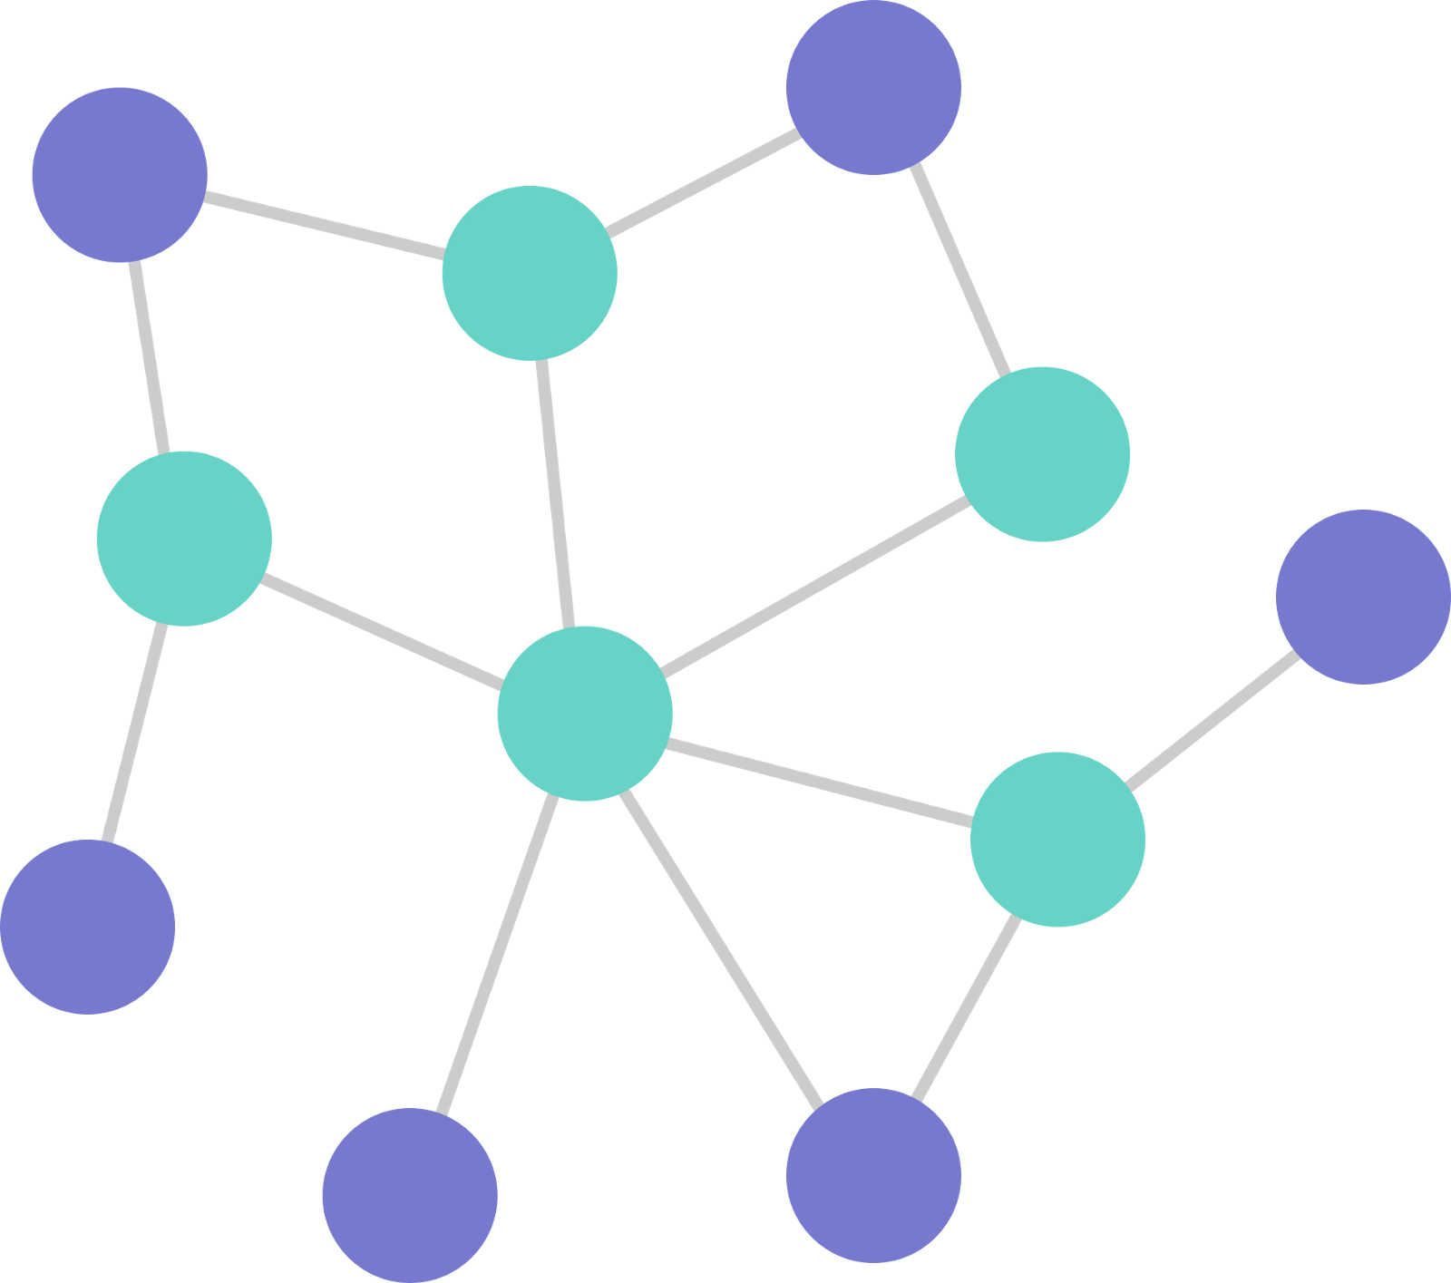
Graphs
Nodes represent entities
Edges are relationships
Benefits
Graph algorithms already implemented
Usually handle directed relationships
Problems
Some standard queries are harder
Performance can be bad when the paths no limits are placed on the size
Good use cases?
Recommendation engines
Networks (Friends on a social network)
Any time your data looks graphical
Notes:
- People often try to shove their data into a SQL database and then pull it out and build a graph before querying it. Why bother when you can store your data in its natural state, a graph.

Slide 11
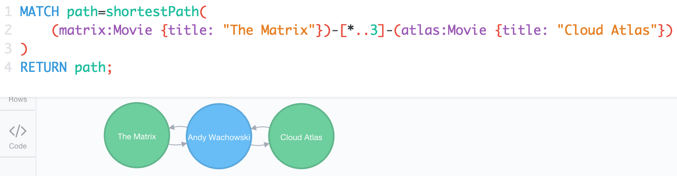
Neo4J
Probably the most well known graph database
Only scalable with the Enterprise version not the free version
Query Language – Cypher
Pattern Matching Language
https://neo4j.com/
Notes:
With Cypher you can specify a path in the graph to match and return things about it.

Slide 12
Concluding Notes
The type of information should drive which database solution you pick
Each database within a category will offer different benefits
There are 4 main types
Graph
Key-Value
Document
Columnar
There are so few good database memes

Slide 13
Questions?

