Slide 1


Calibrating the infrared camera Clio Or how I needed 4 months to generate 1 graph
By Chris Bohlman
Mentor: Dr. Katie Morzinski
Steward observatory, UA

Slide 2
Adaptive Optics 101
Adaptive optics correct for disturbances of the atmosphere in astronomical image taking
Although it serves as an improvement to raw data, it’s still not precise enough alone
Using Python, I got to calibrate the images taken by Clio

Slide 3
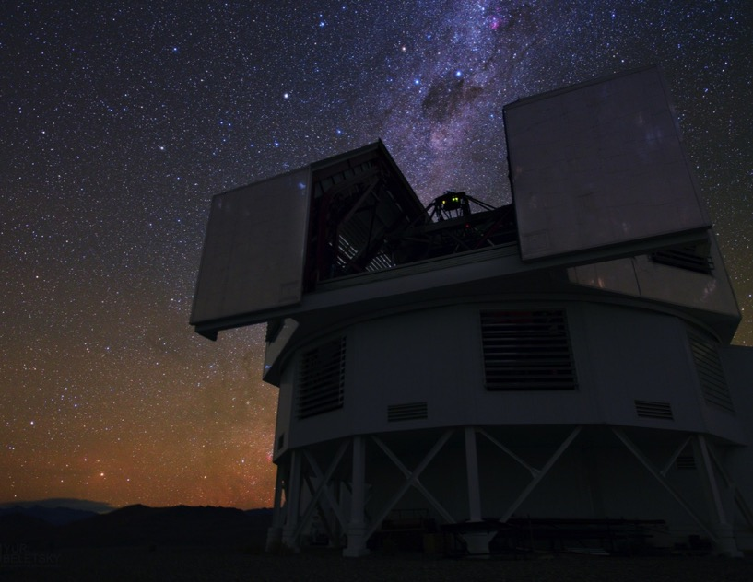
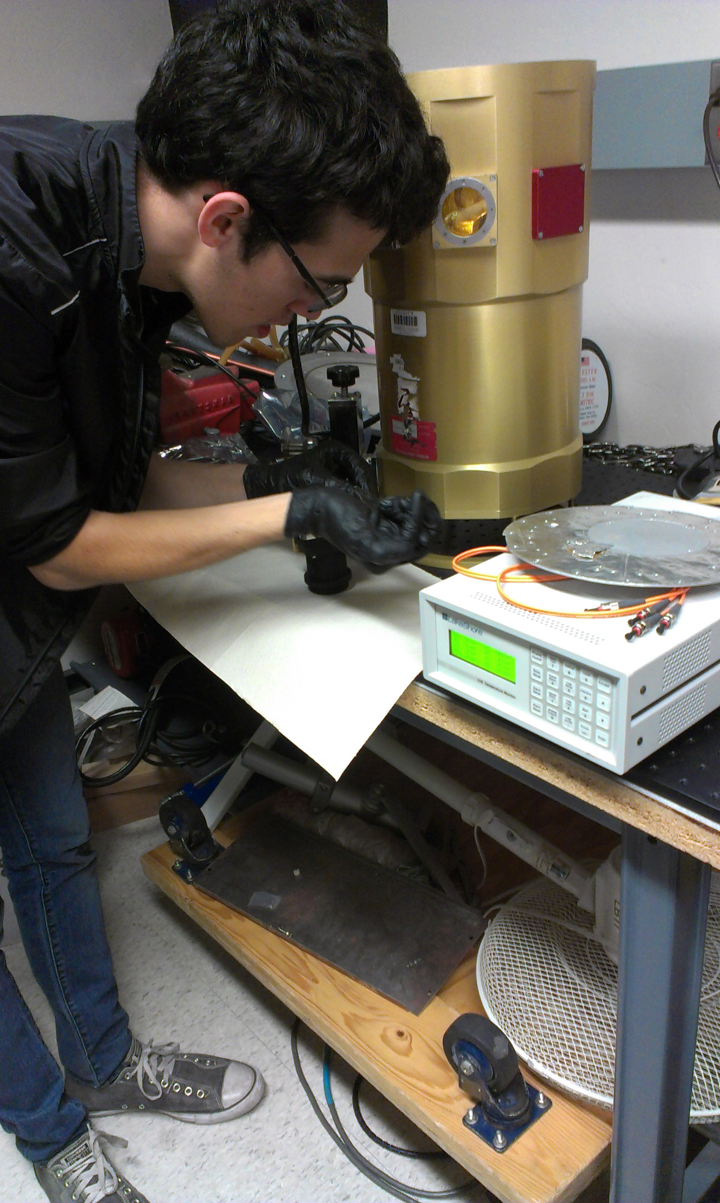
Magellan AO System
Photo by Yuri Beletsky, Las Campanas Observatory

Slide 4
Overview of Internship
Corrected images taken by the Clio instrument
Calibrated one data set, took coefficients from those, applied them to another data set.
Hands on applications of my work

Slide 5
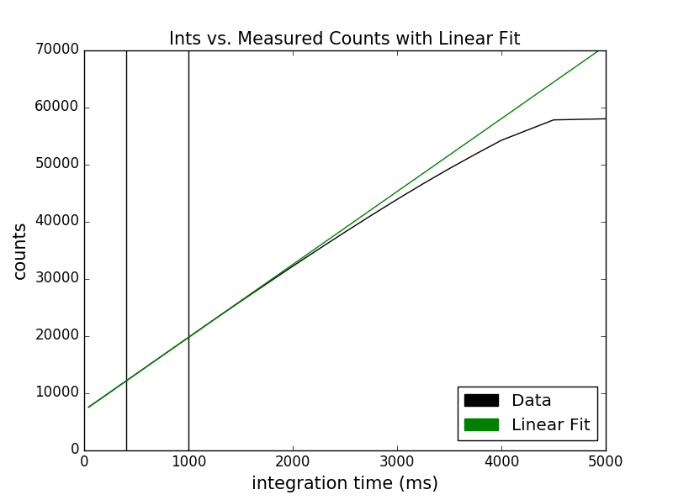
Relevant Terms and Information
Ints & Counts?
Linearity?
Python: Coding language of choice

Slide 6
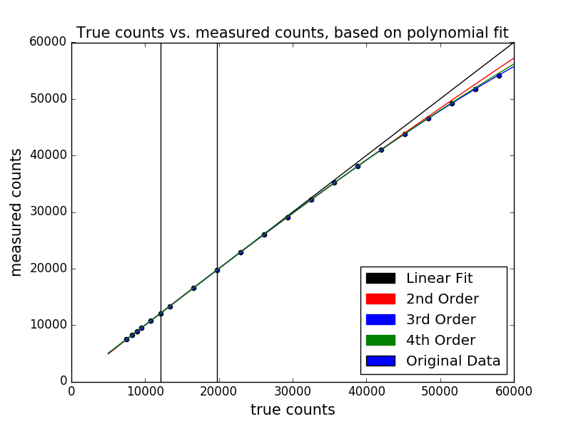
Explanation of Code (All 400 lines!)
Had to read in every image’s exposure and brightness count, and devised a way to linearize the images and correct them through an equation.
Tested second, third, and fourth order equations to see which fit the data the best

Slide 7
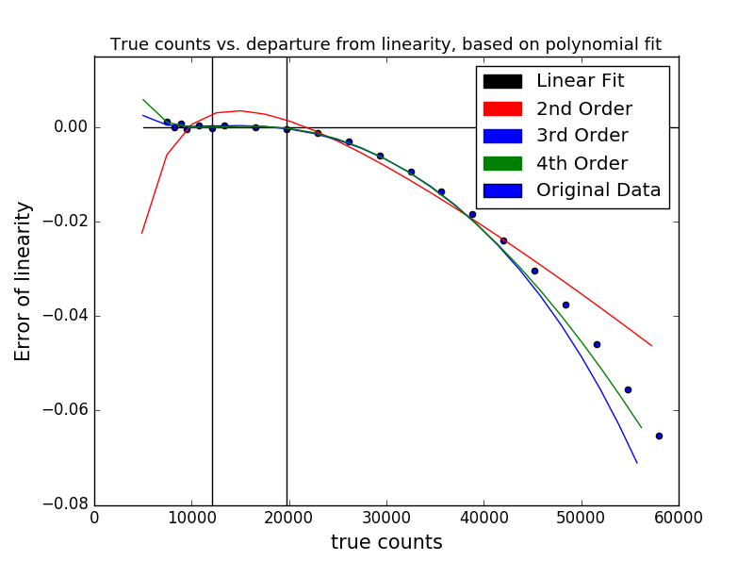
Explanation of Code Part 2
Devised error plots as well to view where fits diverged
Combination of plots demonstrated which fit turned out to be the best

Slide 8
Results of Correction
Calibrated the counts to the fourth order
Took coefficients from that and applied them to another data set
Therefore, multiple data sets can be calibrated through this method.

Slide 9
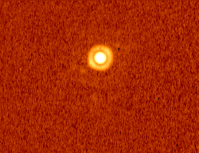
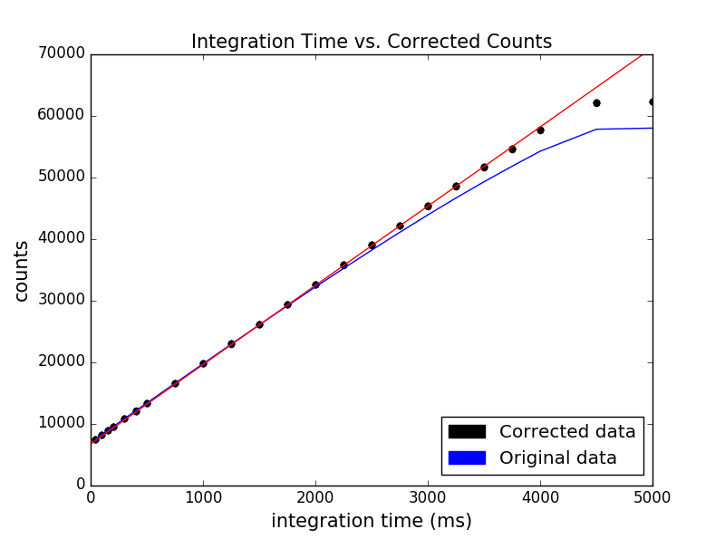
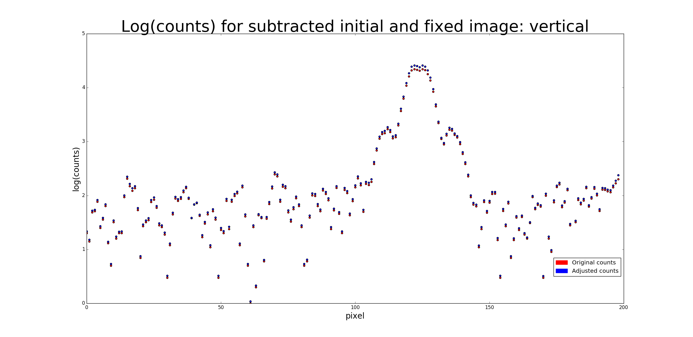
Corrected Data Visualization
Corrected picture:
Graph of a Vertical Slice:

Slide 10
Impact on Modern Astronomy
Exoplanet luminosity has to be measured with the linearity correction applied, due to low counts
Can accurately measure the brightness of planets and stars with calibrated data
Leads to energy measurements through luminosity, distance, habitable planets.

Slide 11
Acknowledgements and Questions
Katie Morzinski, my mentor
The Entire MagAO staff
Susan Brew and the Arizona Space Grant Consortium

