Slide 1
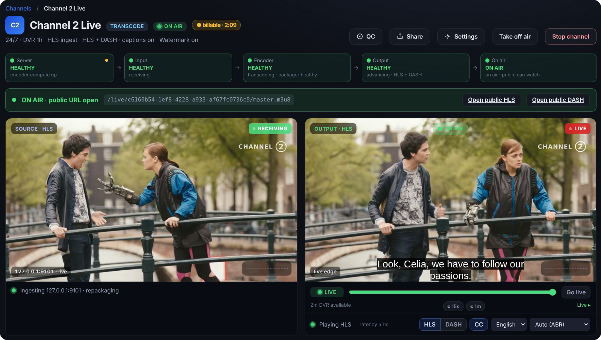
One bright current.
BRAND GUIDE · 2026
How the name, logo, colour, type, icons and diagrams of Volt Streaming work together.
Version 1 · October 2026

Slide 2







A live-first streaming platform
THE PRODUCT
Volt Streaming runs live channels, live events, radio, FAST and loops.
Recordings turn into a media library, and the library turns back into a channel.
The brand comes from the control room: dark, calm and precise, with one bright current running through it.
Live Channels
Live Events
Radio
FAST
Loops
SIGNATURE WORKFLOW
SIGNATURE WORKFLOW
Live → VOD
VOD → Live
Record every channel as it airs. Clip and publish while it is still live.
Turn a media library into a scheduled channel.

Slide 3
Volt Streaming, then Volt
NAME
WRITE
NEVER WRITE
Volt Streaming
VOLT
First mention in any document, page or ad
All caps is only for eyebrows and status pills
Volt
volt
Every mention after that
The name is always title case
Live streaming platform
VOLT Stream
The descriptor, when one is needed
Earlier working names are retired
Live → VOD · VOD → Live
Volt streaming
The workflows, with an arrow. Plain text: Live to VOD
Streaming is part of the name
PRODUCT AREAS KEEP THEIR UI NAMES
Live Channels
Live Events
Radio
FAST
Loops
Recordings
Media Library
EPG
Multiview
Watchfolders
Analytics

Slide 4
A senior broadcast engineer
VOICE
01
Plain and specific
Recording starts when the channel goes on air.
Say what happens.
WRITE
02
The operator's words
NOT
Seamlessly capture your content.
On air, ingest, failover, rendition, as-run, slate.
Active voice, present tense
WRITE
No signal on the primary input. Volt switched to the backup at 14:02:11.
03
Buttons state the action. Confirmations repeat it.
NOT
Oops, something went wrong.
04
Errors explain and fix
What failed, what Volt did, and when.
Go on air · On air
WRITE
05
Calm about failure
The product exists for the bad night.
NOT
Let's get you streaming!
UK spelling · sentence case · no emoji · em dashes and semicolons rare

Slide 5





The split bolt
LOGO
Full lockup on Control room. The default.
volt-lockup-on-dark
Tile: app icon, favicon, avatar
Short lockup: footers, app headers
Mark: once the name is on the page
On Paper: documents and print

Slide 6
Clear space and minimum sizes
LOGO
Full lockup
120px · 30mm
V
Short lockup
64px · 16mm
Mark alone
16px
Below 24px
Clear space on every side equals the height of the capital V. Nothing enters it.
use the tile

Slide 7



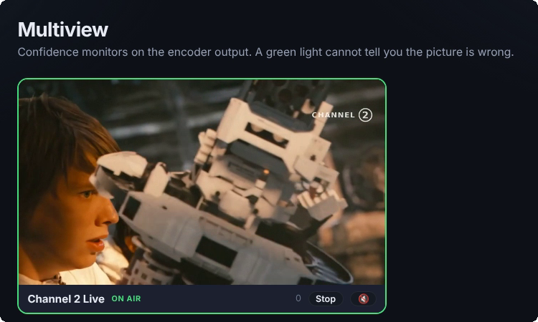
Colourways and misuse
LOGO
On Control room
On Paper
Solid, no gradient
One colour, ink
One colour, white
DO NOT
Volt Streaming
Stretch or squash
Rotate
Put it in a circle
Retype the name
Colour lockup on a busy image
Also never outline it, add a glow or shadow, recolour Streaming or split the halves apart in still artwork.

Slide 8





The tile
LOGO
Corners
10/34 of the tile width.
Light from above
A soft white highlight that fades out by the middle, a slight indigo shade at the base.
Edge and mark
A 1px light inner edge and a soft shadow under the white mark.
Shadow
Under the tile use shadow-tile, a neutral shadow. Never a coloured glow.
Print
volt-tile-flat drops the lighting for print and EPS.
volt-tile@512.png
1024
512
192
64
32
16
flat

Slide 9
The Volt blend is the primary colour
COLOUR
volt
Icons, single-colour marks, focus ring, first chart series
#5569F2
volt-strong
Buttons and filled tags, with white text
#4F46E5
volt-text
Eyebrows and links
#8B9CFF · Paper #4F46E5
current
Streaming in the wordmark, second series
#9A9DFF · Paper #4F46E5
Volt blend
PROPORTION
volt-start #5B8CFF → volt-end #4F46E5 · 140°
On the mark, the app tile and one hero block per layout. Never behind body text, never a page background.
60% ground
25% panels and ink
10%
5%
60% ground, 25% panels and ink, 10% Volt, 5% current and status. More Volt than that and it stops meaning anything.

Slide 10
Two themes, one set of names
COLOUR
CONTROL ROOM · DARK
ground
panel
panel-2
panel-3
line
line-strong
ink
ink-muted
ink-faint
#0F1218
#171B24
#1C2130
#212736
#22262E
#2A2E37
#E9ECF4
#98A1B6
#6A7387
ON AIR
#4ADE80
SCHEDULED
#38BDF8
DEGRADED
#FBBF24
ERROR
#F87171
STOPPED
#66708A
State only, always with a word.
PAPER · LIGHT
ground
panel
panel-2
panel-3
line
line-strong
ink
ink-muted
ink-faint
#F6F8FC
#FFFFFF
#EEF2F8
#E4E9F2
#DFE4EE
#C6CEDC
#0F1218
#4B5468
#626B80
ON AIR
#15803D
SCHEDULED
#0369A1
DEGRADED
#B45309
ERROR
#B91C1C
STOPPED
#5B6478
State only, always with a word.

Slide 11
Three families, one job each
TYPOGRAPHY
DISPLAY
TEXT
DATA
Archivo
Inter
JetBrains Mono
Every live hour becomes a library.
Recording starts when the channel goes on air. Clip and publish while it is still live.
00:59:58:12
6 Mb/s · 1920×1080 · 50p
SRT · RTMP · HLS · DASH
Titles: 800, width 112, -2%
The product UI and body copy
Timecode HH:MM:SS:FF
Headings: 700, width 100
Tables and captions
Stream URLs, keys, code
Eyebrows: 600, width 112, caps +14%
Tabular figures for numbers
Protocol tags

Slide 12
Styles in Word and PowerPoint
TYPOGRAPHY
STYLE | FONT | SIZE | COLOUR
Title | Archivo Bold | 26pt | ink
Heading 1 | Archivo Bold | 18pt | ink
Heading 2 | Archivo SemiBold | 13.5pt | ink
Heading 3 | Inter SemiBold | 11pt | ink
Normal / body | Inter, 1.5 spacing | 10.5pt | ink
Caption, table text | Inter | 9pt | ink-muted
Code, URLs, timecode | JetBrains Mono | 9pt | ink
Slide title | Archivo Expanded ExtraBold | 32 to 40pt | ink
Slide eyebrow | Archivo Expanded SemiBold, caps, +14% | 10pt | volt-text
Slide body | Inter | 16 to 20pt | ink-muted
Install first
Archivo, Archivo Expanded, Inter and JetBrains Mono from fonts/desktop.
Embed fonts
When a file goes to someone who will edit it, choose Embed fonts in Office.
Fallback
Arial replaces Archivo and Inter. Consolas replaces JetBrains Mono.
Arrows
The desktop fonts are Latin subsets without →, so templates set the arrow in Arial.

Slide 13


One line family, 51 icons
ICONS
Grid
24 × 24 with a 2-unit margin. Nothing touches the edge.
Stroke
2 units, round caps and joins, no fills.
Perspective
Flat and front-on. No shading, no second colour.
volt on panel
ink on Paper
white on volt-strong
Colour
volt on a panel node, ink when the page is one colour, white on volt-strong.
SIZES, SHOWN AT 1.5×
Label
Always set the word beside or below the icon.
Not icons
Protocols are mono tags. Third-party services use their own marks.
15px
18px
24px
32px
48px
Buttons
Navigation
UI, documents
Slides
Marketing

Slide 14












































The set, by group
ICONS
BROADCAST · 12
live
channel
event
radio
fast
loop
epg
schedule
failover
overlay
multiview
monitoring
MEDIA · 10
live-to-vod
vod-to-live
recording
clip
media
image
captions
translate
audio
review
PIPELINE · 15
source
ingest
upload
encoder
packager
server
cdn
cloud
storage
watchfolder
player
drm
rights
geo
globe
AUDIENCE · 5
tv
desktop
mobile
viewers
analytics
PLATFORM · 9
dashboard
tenant
users
key
api
webhook
bell
alert
settings

Slide 15
A picture of signal flow
DIAGRAMS
Signal flows left to right. Control above, storage below, audiences on the right.
Nodes are 56px panel tiles with a volt icon, a short label and one mono detail line.
Live path: 2px volt. Secondary: 1.5px ink-faint. Backup: dashed.
Groups are dashed boundaries. Tint only the Volt group.
Show what Volt does, never how it is built.
VOLT PLATFORM
TV
Camera
Ingest
Packager
CDN
SRT
HLS · DASH
Mobile
Backup
SRT
Recording

Slide 16
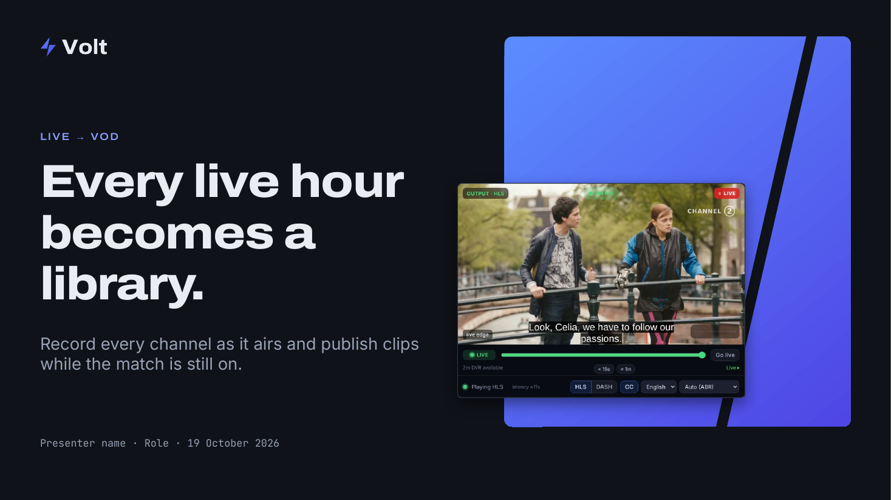
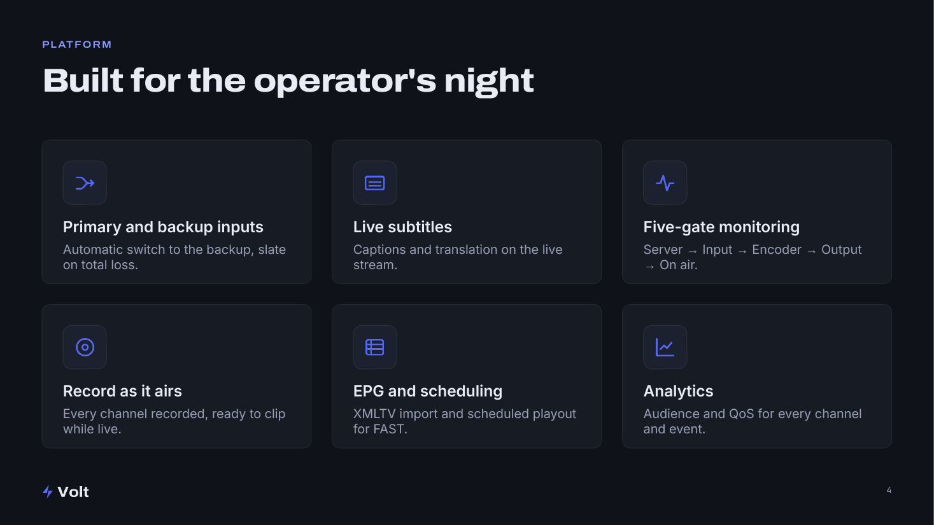
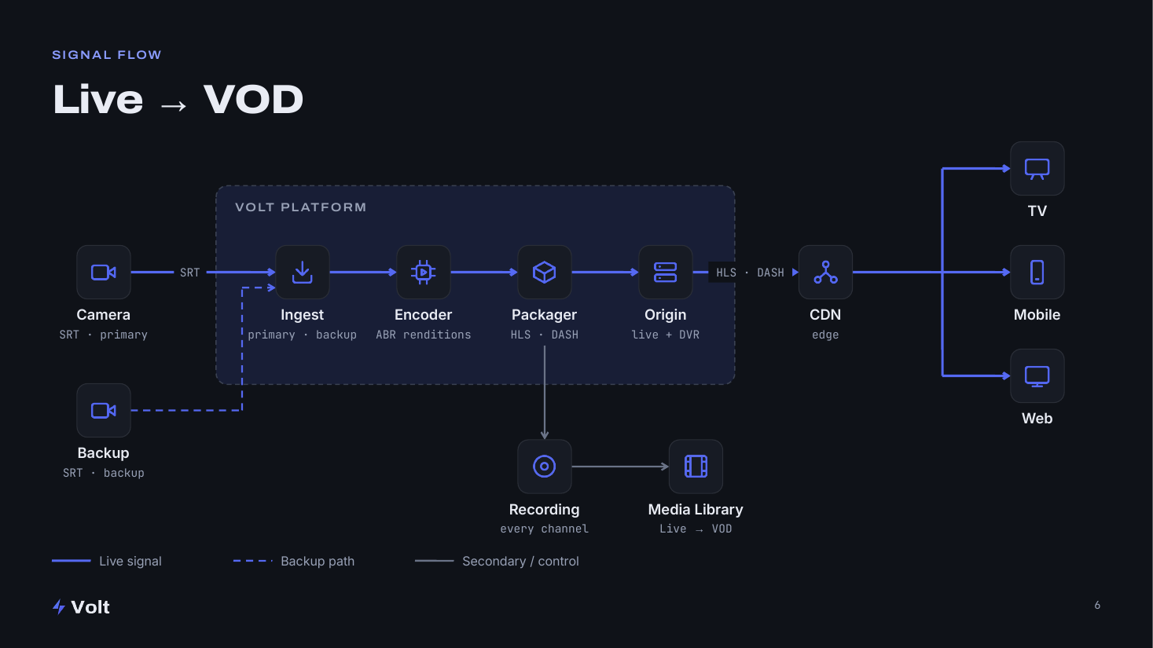
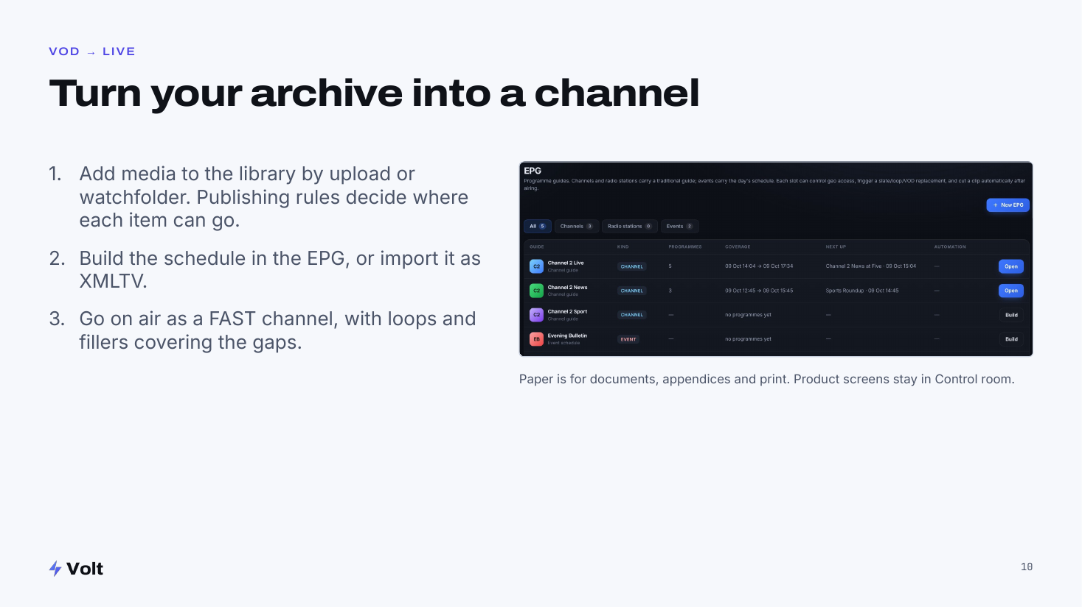
Decks start from the template
SLIDES
Title
Content: one idea
Diagram
Paper appendix
Canvas
16:9 on ground. Paper for dense appendices.
Margins
64px at 1920 wide. Content aligns to the left margin.
Content slide
Eyebrow, title, then one idea: a screen, a diagram, three facts or a quote.
Bullets
Never a wall. Five is the ceiling.
Footer
Short lockup bottom-left, page number bottom-right, nothing else.
Charts
volt first series, current second, ink-muted for comparison.

Slide 17
One message per piece
ADVERTISING AND SOCIAL
PROVEN HEADLINES
LIVE → VOD
Go live. Stay live.
Every live hour becomes a library.
Every live hour becomes a library.
Turn your archive into a channel.
Live → VOD in one take.
Record every channel as it airs.
Book a demo
FORMATS
Ground field, one blend block, type on the ground, lockup always present, space-12 safe area for crops.
16:9
1:1
4:5
Link
MPU
Leader
1920×1080
1080×1080
1080×1350
1200×628
300×250
728×90

Slide 18
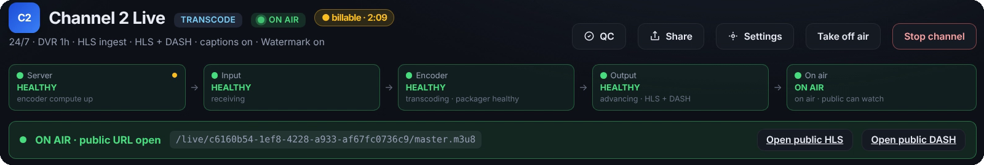
Real screens, real broadcast work
IMAGERY
Photography
Control rooms, OB trucks, commentary booths, stadiums at night, radio studios.
Cool and low-key, lit by screens.
No stock people pointing at laptops, glowing globes or data swooshes.
Product screens are the hero
The slit
Control room UI, cropped to the part that tells the story. Demo tenants and channels only.
The only graphic device: the mark's 6:26 diagonal, about 77°. It may cut a colour block, crop a photo edge or split a before and after. Once per layout.

Slide 19
Templates and where files live
FILES
TEMPLATES
brand/
logos/svg/
lockups, short lockups, mark, tile
Volt_Slide_Template.potx
PowerPoint template: every layout, Control room and Paper
logos/png/
1200w lockups, 512 marks
logos/eps/ logos/pdf/
print
Volt_Slide_Template.pptx
logos/app-icon/
tile 16 to 1024, favicon
Sample deck with each layout filled
icons/svg/
currentColor, volt, ink, white
icons/png/
96px volt, ink, white
Volt_Brand_Style_Guide.pptx
icons/eps/
print
This guide
fonts/desktop/
static TTFs for Office
fonts/web/
variable WOFF2
New slide: Home › New Slide and pick a Volt layout. Build colours from the theme and tokens, never typed hex values.
tokens/
volt-tokens.css, .json
templates/
Office templates

Slide 20
Calm, precise, live.
When in doubt, start from the template and the tokens, and keep Volt to a tenth of the page.
Open the brand folder
Volt Streaming brand guide · Version 1 · October 2026

